Slide 1

Machine Learning with scikit-learn: Model Evaluation
Intro to Data Science using Jupyter
PART 2:
A
2018 training by

Slide 2
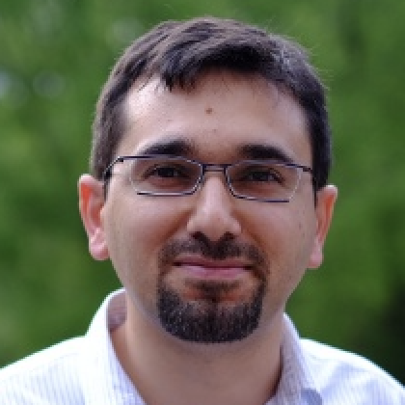



Presented by
Ozgur Ozturk, PhD
Data Scientist
at
twitter.com/@DrOzTurk
linkedin.com/in/DrOzTurk

Slide 3

To hear about our future trainings, Signup at:
meetup.com/DataSciencePros

