Slide 1
EXPERIENCE
SUMMARY
PIC
CONTACT INFO
EDUCATION
SKILLS
ABOUT ME
CERTIFICATIONS
PROJECTS

Slide 2





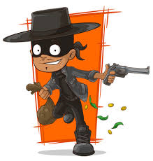






EXPERIENCE
PIC
SUMMARY
ZORRO
+001 874 682 573
EDUCATION
SKILLS
wikipedia.org/wiki/Zorro
zorro@california.com
SCHOOL OF
ZORRO-ISM
ABOUT ME
Zorro is a fictional character created in 1919 by American pulp writer Johnston McCulley, appearing in works set in the Pueblo of Los Angeles in Alta California. He is typically portrayed as a dashing masked vigilante that defends the commoners and Indigenous peoples of California against corrupt and tyrannical officials and other villains. His signature all-black costume includes a cape, a hat known as a sombrero cordobés, and a mask covering the upper half of his face.
CERTIFICATIONS
PROJECTS (Microsoft Fabric / Power BI portfolio, NOT related to Zorro)

Slide 3



