Slide 1
Four Harms COVID-19 Dashboard
https://data.gov.scot/coronavirus-covid-19/

Slide 2


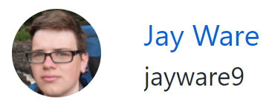

A lot of people contributed
Michael Davidson
Amy Watson
Thomas Williamson
Kim Davie
Robyn Bailey
Jackie Hall
Felix Palin
Barry Miller
… and more!

Slide 3

Purpose of the dashboard
Purpose: something like the National Performance Framework but for the 4 harms of COVID-19
Audience: everyone

Slide 4
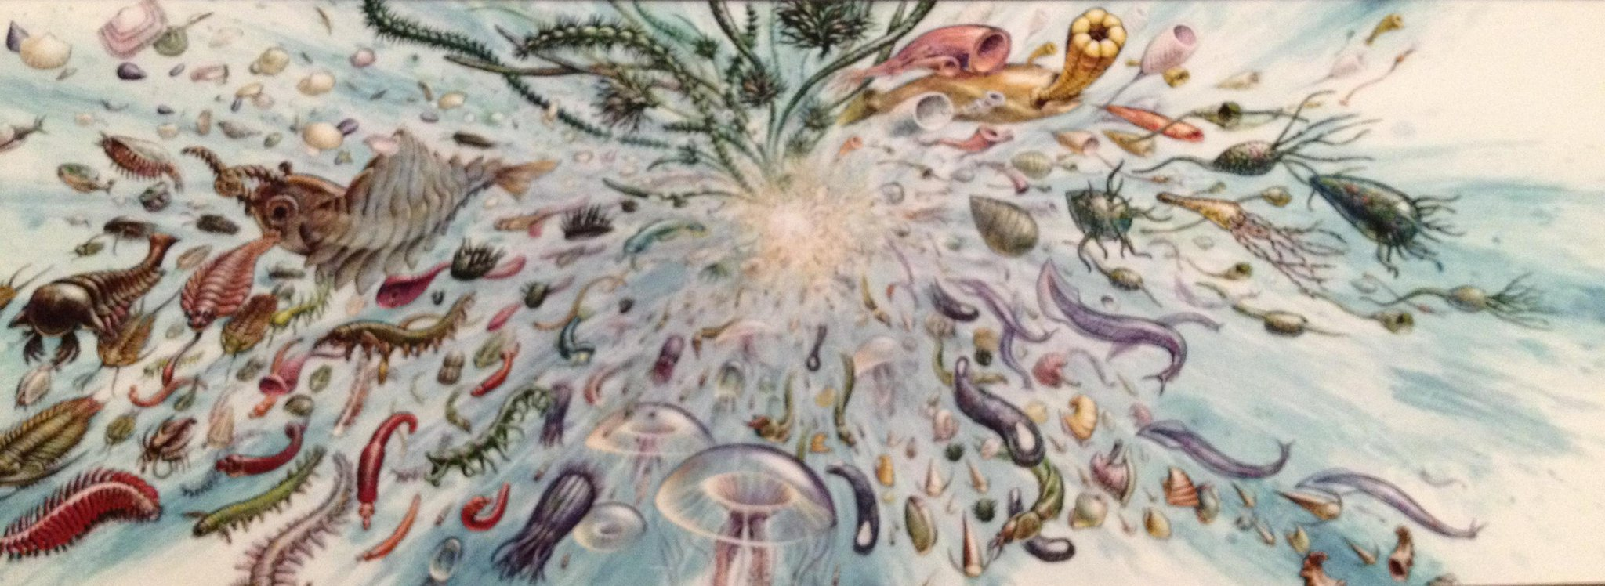
Research
Notes:
Cambrian explosion of charts
Charts appearing in government briefings prime time
Private individuals making charts because it was the latest hot topic
Public organisations and media trying to get a handle on things
People writing articles to track all the charts
People writing articles explaining why they weren’t making charts

Slide 5








Research
Notes:
Presentation (log scales, colour, language)
Technologies (shiny, markdown, scripts)

Slide 6


Tools
Pros
Cons
No timeout
Simpler to maintain
Limited interactivity
Cannot access APIs
- Interactive web charts
- Popular with colleagues
- Grammar of graphics
- Translate ggplot2 charts
- Unfamiliar package
- Scrolling on touch screens
- Poor support for interactive small multiples
Notes:
Ggraph, rbokeh, highcharter

Slide 7



Accessibility
Start early!
Look for internal guidance
Don’t delay writing an accessibility statement
Get it reviewed by an internal expert
Colour contrast analyser

Slide 8
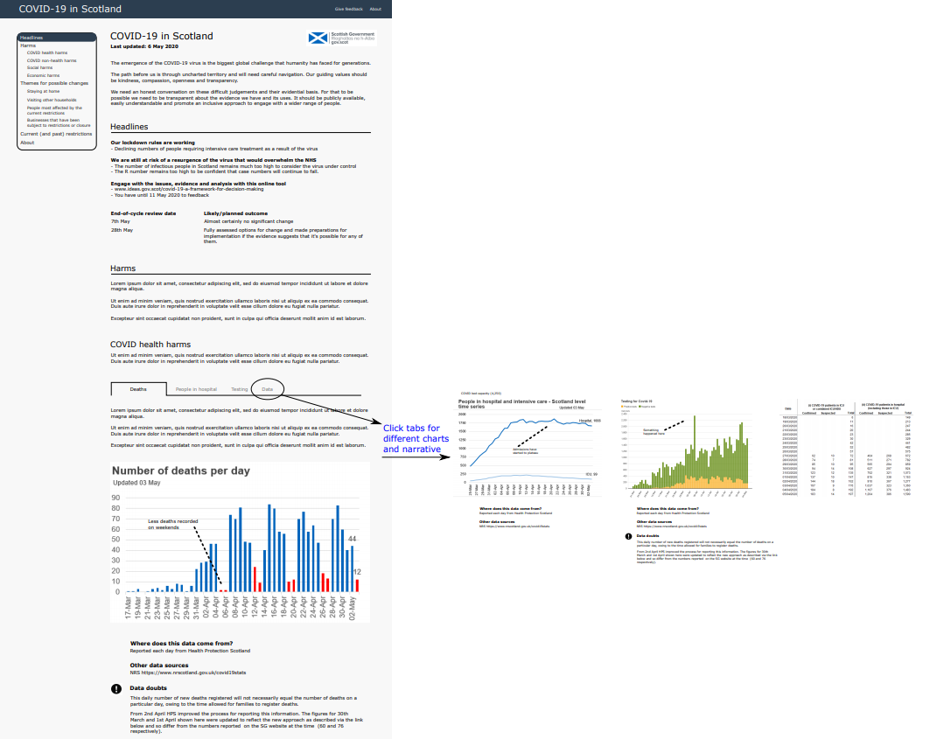
6 May 2020 - mockup

Slide 9
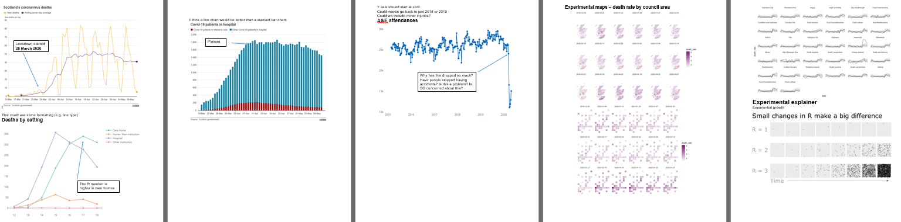
12 May – experiment with charts

Slide 10
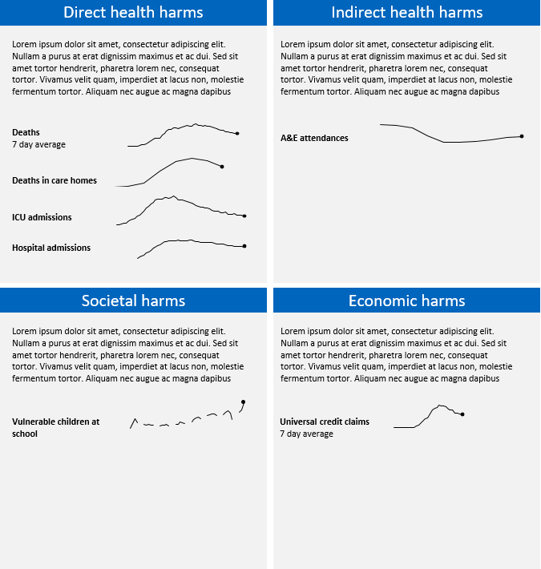
15 May – new direction
“A opening webpage with four quadrants for the four harms with a description of each.
Next web page four quadrants with indicators.
Next Joe’s material with detailed graphics behind each quadrant.
Can the design accommodate text boxes at the sides of the graphs to enable some additional qualitative material to be added?“
12 May

Slide 11
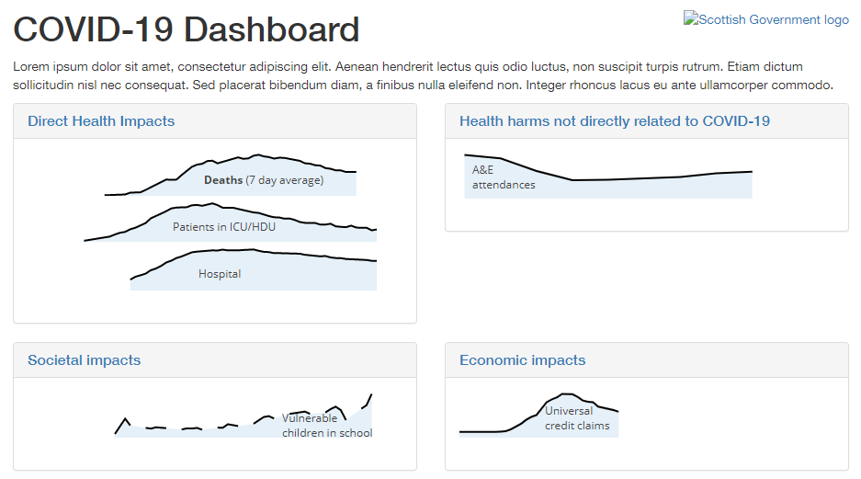
19 May – start using RMarkdown
12 May
Notes:
Single index.html
Zip file
Locally hosted web pages
bootstrap

Slide 12
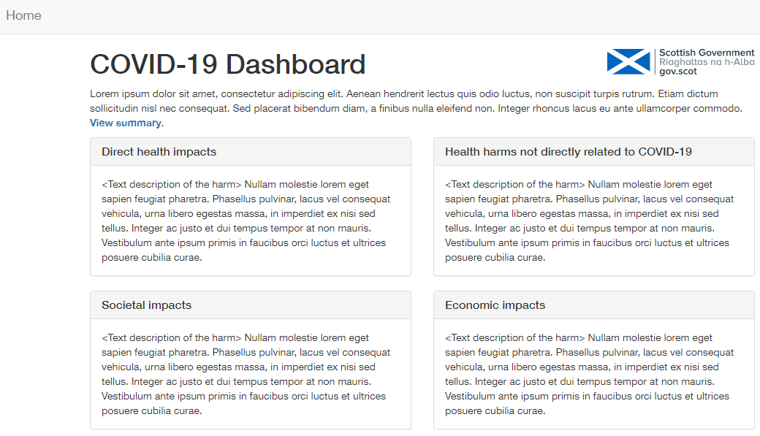
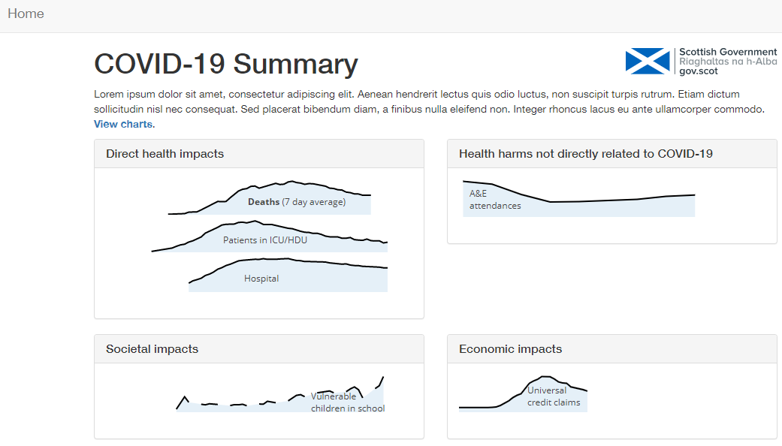
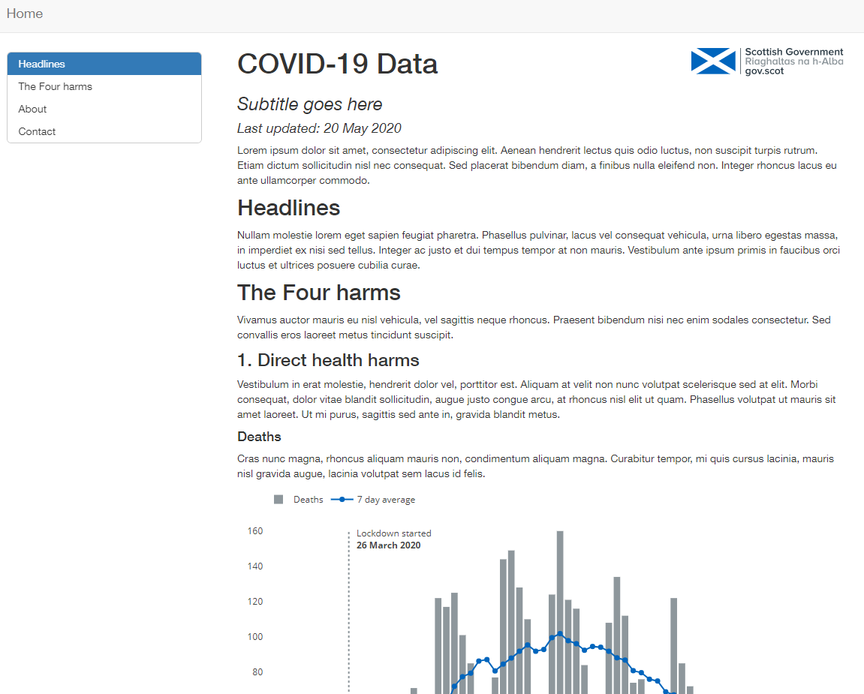
20 May – multiple page layout
Original mockup
12 May

Slide 13
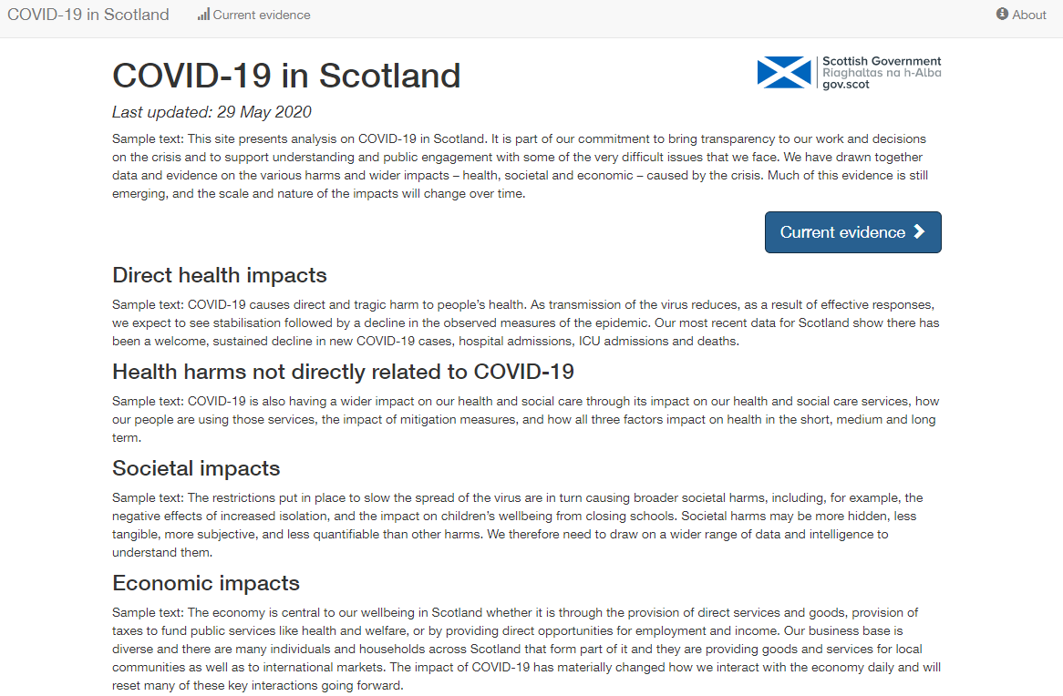
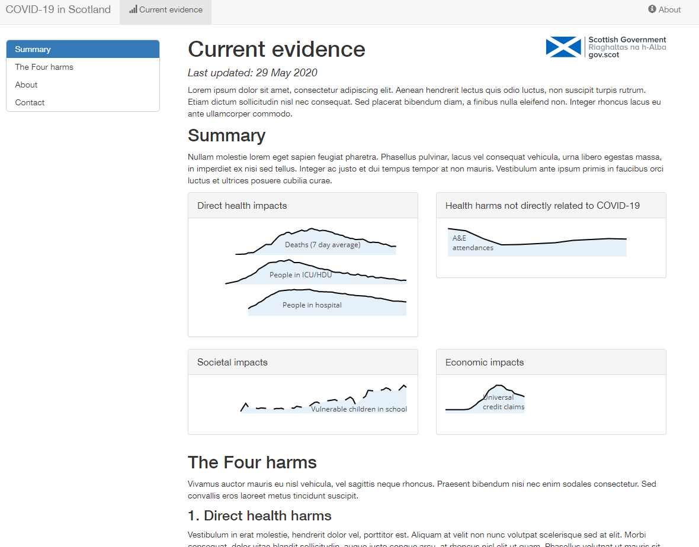
29 May – down to 2 pages
12 May

Slide 14
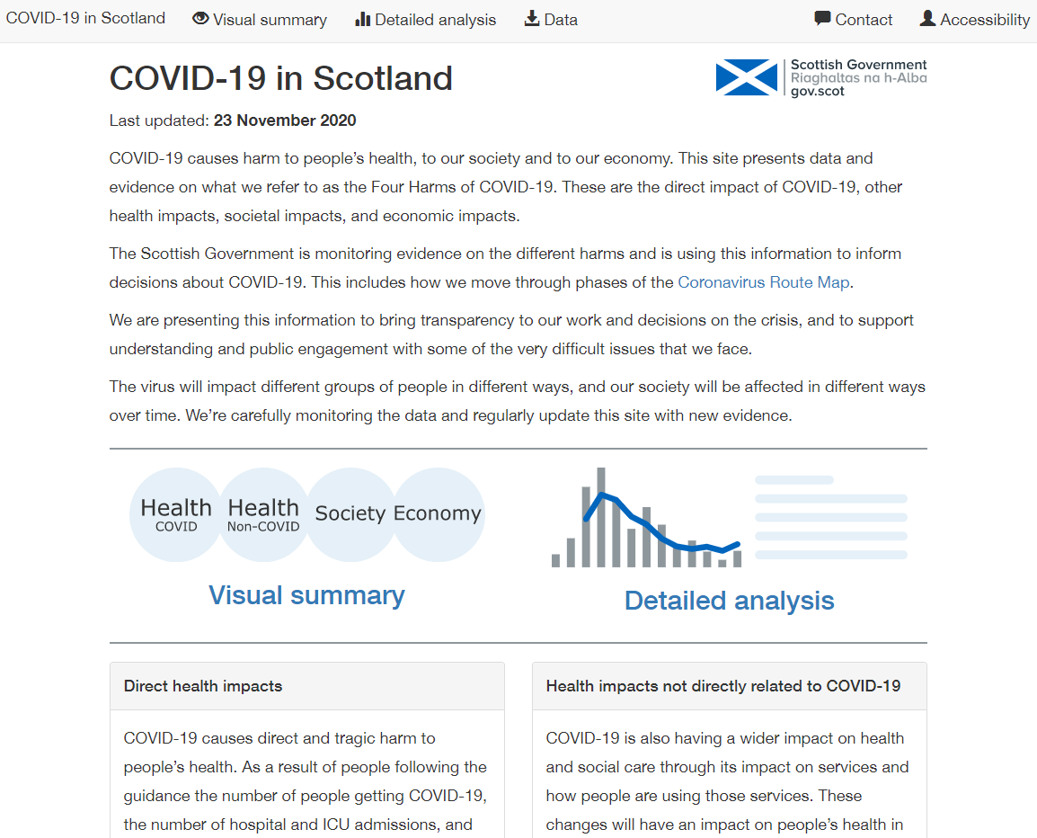
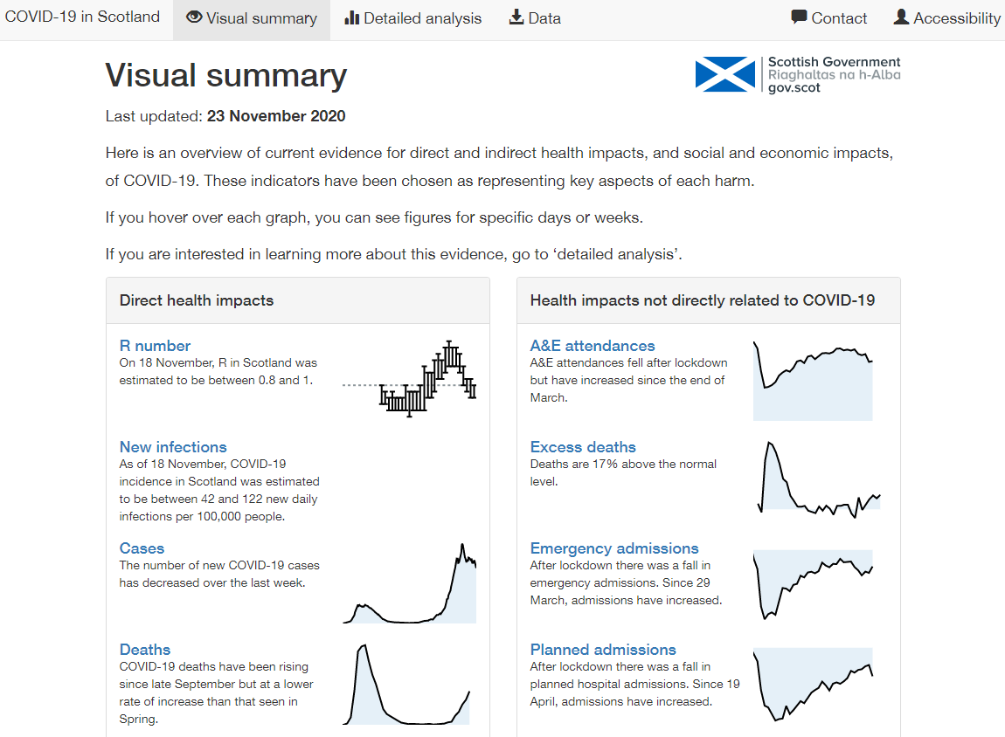
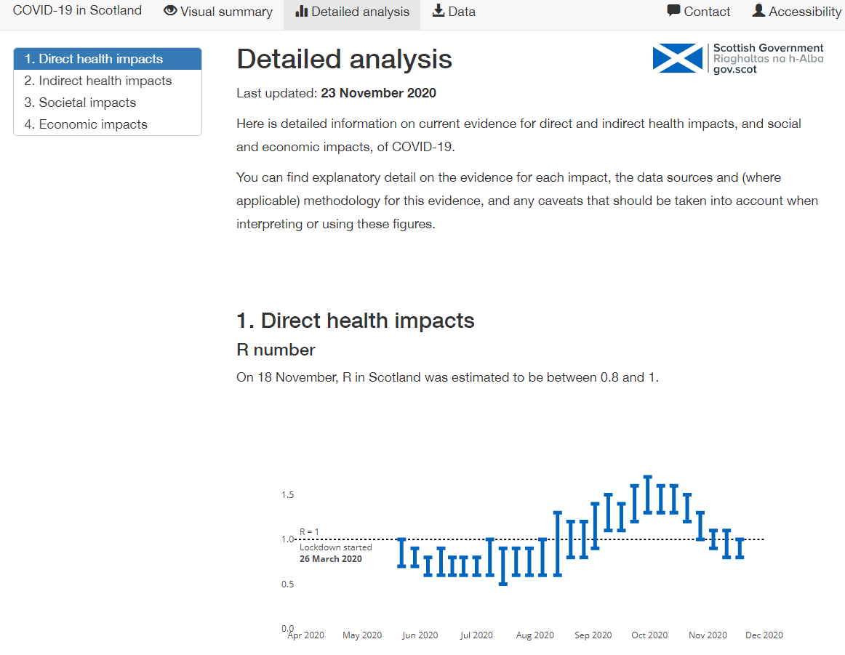
24 November - public

Slide 15





Hosting and updating
data.gov.scot

Slide 16
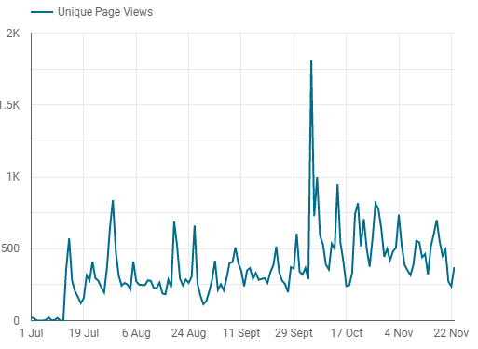
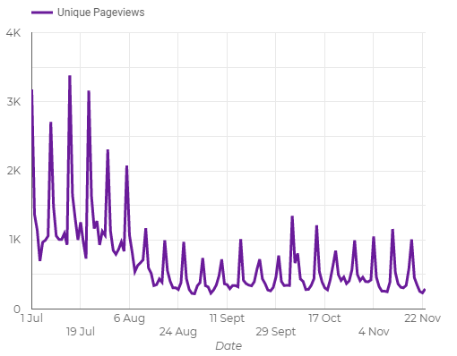
Web analytics
Four Harms COVID-19 dashboard
NRS webpage on COVID-19 statistics
FM announces updates to PHS dashboard
Notes:
https://www.gov.scot/publications/coronavirus-covid-19-update-first-ministers-speech-5-october-2020/

Slide 17
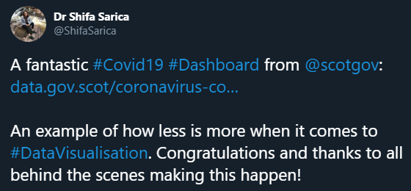
Social media

Slide 18
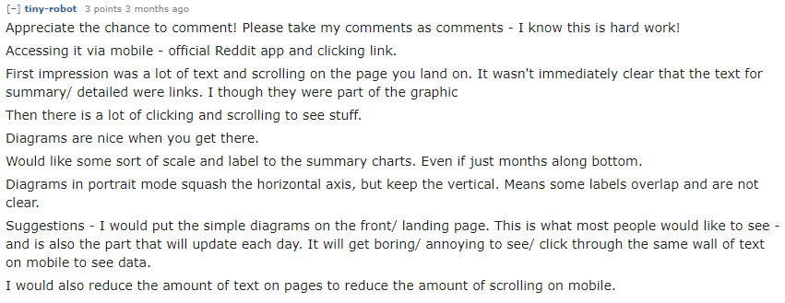
Social media

Slide 19
Lessons learnt
Start accessibility early
Start coding late (research, mock ups)
Choose tools carefully
People can write Markdown (with a little help)
Seek feedback from outside your bubble
Start accessibility early

