Slide 1
Official Statistics in R Markdown Maike Waldmann
To do before we start:
If you don’t know R Markdown, this 1-min read shows what it does - 27.2 R Markdown basics:
r4ds.had.co.nz/r-markdown.html#r-markdown-basics
2. Find latest wealth statistics on www.gov.scot
3. Go to report
4. Go to first chart

Slide 2
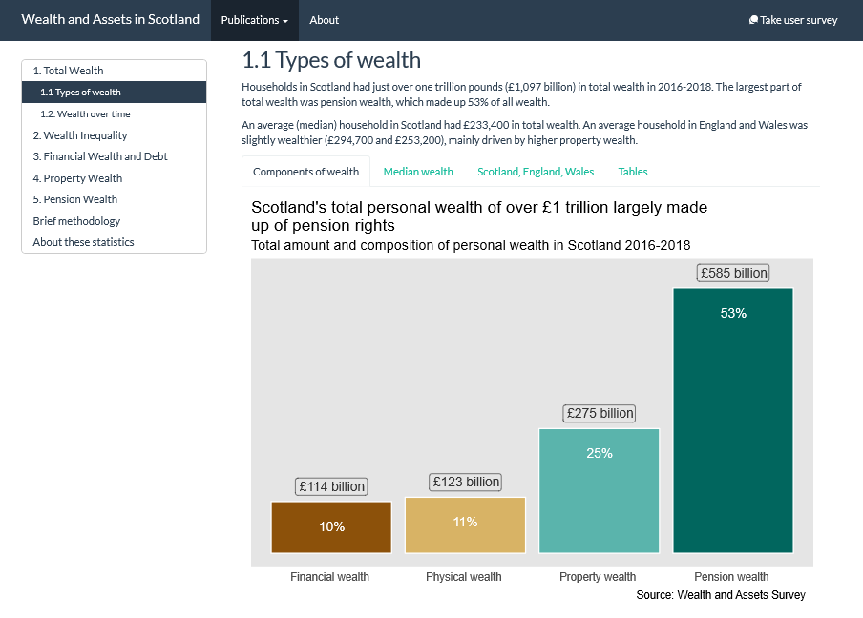
data.gov.scot/wealth

Slide 3
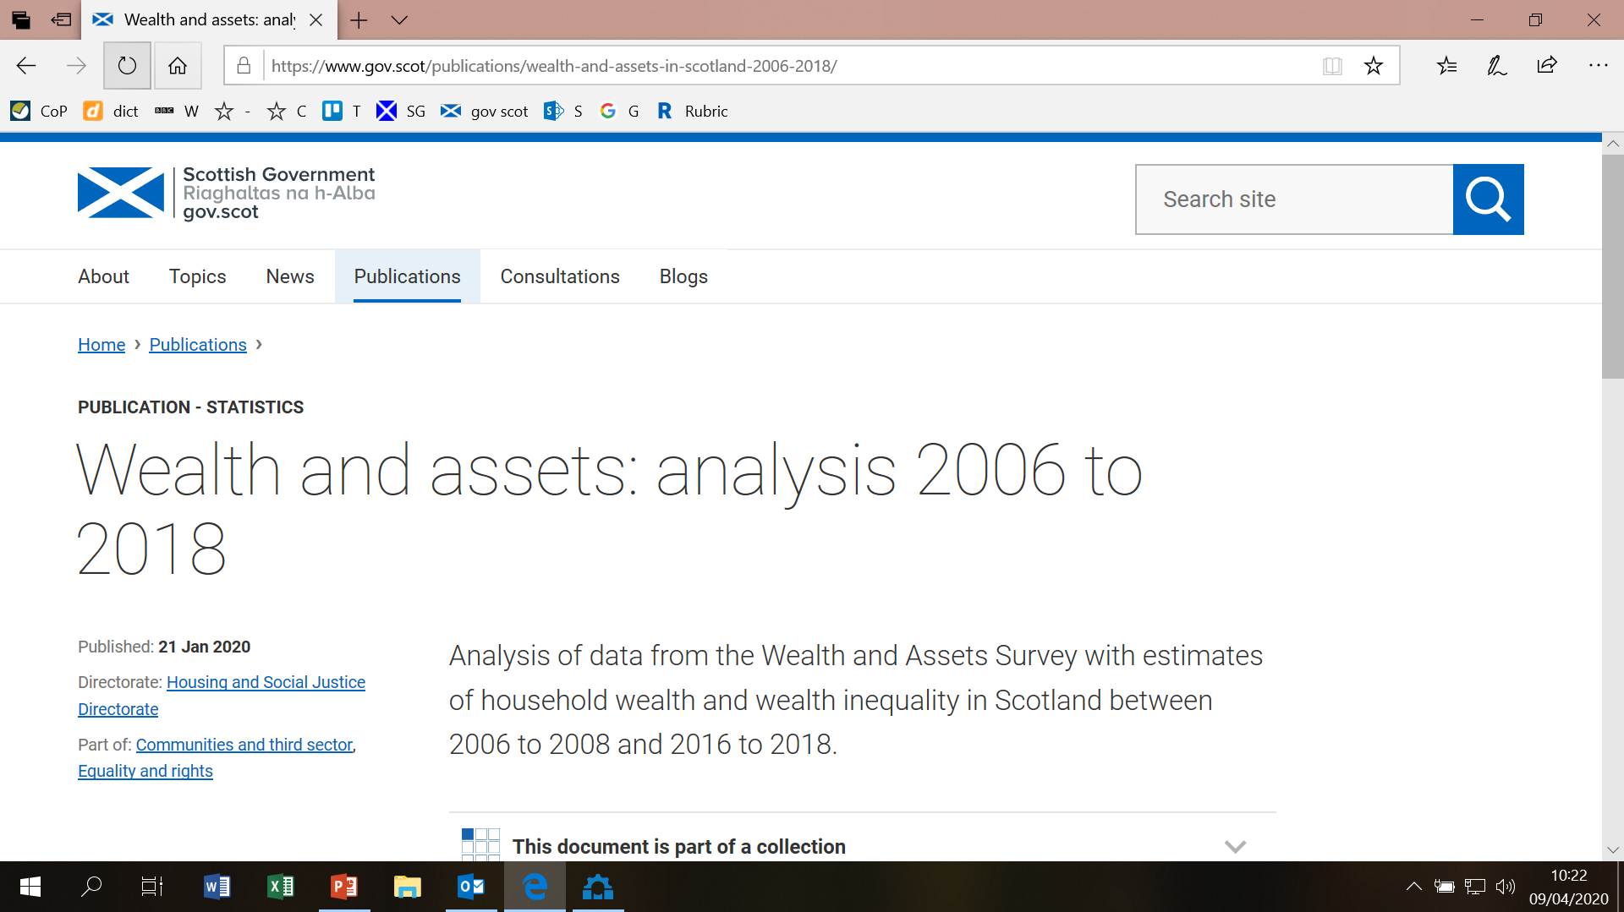
If you see this instead, please scroll down and click on the link:

Slide 4
data.gov.scot/wealth

Slide 5
Html features
R code
Publishing process
Open issues

Slide 6
1. Html features
(R code shown later)
No page breaks
Floating table of contents for easy navigation
Overall look: bootstrap theme
Multiple tabs
Interactive charts: tooltips and highlighting
Interactive tables: highlighting

Slide 7
2. R code - bootstrap themes
Themes determine overall look
List of themes with examples: bootswatch.com
I used the flatly theme
Requires javascript (but we needn’t worry about that too much)
But: see this recent article on Bootstrap dropping IE support

Slide 8
2. R code - bootstrap themes & toc
R Markdown YAML:
---
title: "Wealth in Scotland 2006-2018"
output:
html_document: # bookdown::html_document2
theme: flatly
toc: yes
toc_float:
collapsed: yes
---
Brief documentation of bootstrap themes and table of contents

Slide 9
2. R code - multiple tabs
## 1.1 Types of wealth {.tabset}
[text]
### Components of wealth
[R chunk to make chart]
### Median wealth
[R chunk to make chart]
### Scotland, England, Wales
[R chunk to make chart]
### Tables
[R chunks to make tables]
Brief documentation

Slide 10
data.gov.scot/wealth

Slide 11
2. R code - Interactive tables
kableExtra package applies bootstrap theme to otherwise very plain table (brief documentation)
library(knitr)
library(kableExtra)
kable(data,
col.names = c("Type", "Share", "Amount"),
align = c('l', 'r', 'r'),
caption = title) %>%
kable_styling(bootstrap_options = c("striped", "hover", "responsive", "condensed"),
full_width = F, position = "left") %>%
footnote(alphabet = “Source: Wealth an Assets Survey”)

Slide 12
2. R code - Interactive charts
ggiraph package adds tooltips and highlighting to ggplot2 charts (brief documentation) but other packages available
look of the charts doesn’t change!
I used an old version (ggiraph_0.6.1), slightly different syntax
library(ggplot2)
library(ggiraph)
plot <- ggplot(data, aes(x = wealthtype,
tooltip = tooltiptext,
data_id = tooltiptext)) +
geom_col_interactive()
ggiraph({print(plot)})

Slide 13
2. R code - SG logo
Html code nicked from Jamie R.
Save logo image file in your R project folder
Add this to R Markdown code just below the YAML:
<script>
$(document).ready(function(){
$head = $('#header');
$head.prepend('<a href=\"https://www.gov.scot\"><img src=\"sglogo.svg\" style=\"float: right; height: 38px;\" alt=\"Scottish Government logo\"/></a>')
});
</script>

Slide 14
3. Publishing process - workflow
Microdata is in a SAS library
SAS: produce summary stats in a tidy(-ish) SAS dataset and save to R project folder
Import SAS dataset to R (haven package)
R Markdown magic -> html

Slide 15
3. Publishing process
Html is a natural output from R Markdown (RAP!)
So, let’s use html features: multi-tabs, interactivity, …
But SG website can’t host this
And what about APS?

Slide 16
3. Publishing process SG website team 1
“[The CMS] can accommodate very basic tables on an html page but [not] multiple tabs.”
“We don’t include interactive charts and tables on gov.scot due to issues with accessibility and security. “
“[Multiple tabs] are not really accessible because you are purposely obscuring some information in favour of other information even if you are presenting options for users. You’re also creating barriers/confusion for other users.”

Slide 17
3. Publishing process
Domain www.wealthandassets.scot: £20/year
Server space: £42/year
APS (SG publishers) costs: £0 (cause I didn’t use them)

Slide 18
3. Publishing process SG website team 2
Very helpfully created a stats publication page on the SG website to link to my new website
This way, the publication appears on the SG website
www.gov.scot/publications/wealth-and-assets-in-scotland-2006-2018/

Slide 19
3. Publishing process
No printable document
How to cooperate on the draft with non-R users?
How to quality assure?
How to brief ministers in pre-release period?
Data security

Slide 20
4. Open issues
Website loading time
Website maintenance
wrangling a large R Markdown file

Slide 21
4. Resources
Data manipulation in R:
R for Data Science (Grolemund & Wickham) Data transformation chapter (and read the rest of the book too)
The grammar of graphics:
R for Data Science Data visualisation chapter
Or ggplot2 webinar on Youtube
R Markdown and publishing in html:
R Markdown: The Definitive Guide (Yihui Xie et al.)
My code for wealth report (first 2 chapters only) on github

