Slide 1
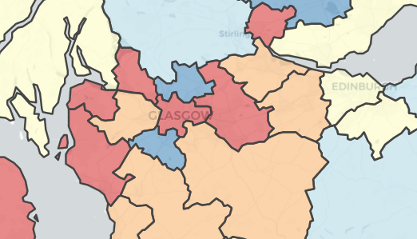
Maps in R and Shiny
Jaime Villacampa
Senior Information Analyst - ISD/ScotPHO
Jaime.villacampa@nhs.net

Slide 2
To start
You need good computer memory
Recent R version
Many new packages and developments
Integration with Shiny as other visuals

Slide 3
Types of objects and reading shp
sp type: Spatial: polygons, polygondataframes (rgdal/sp/shapefiles packages)
Accessing properties of an spatial object, slots
sf type (sf package)
Save them as RDS

Slide 4
Manipulation
rmapshaper, rgeos and maptools
Check and change your projections
Simplifying shapefiles -rmapshaper more powerful and respects type, needs more memory.
Spatialdataframes and sf – almost like normal dataframes

Slide 5


Visualization
Static
base plots
ggmap, tmap
lattice
sp
Interactive
Plotly – ggplotly
Ggiraph (based on ggplot)
leaflet, mapview
Notes:
Base plots are very simple, very quick to do and better than many alternatives.

Slide 6
Leaflet
similar style syntax to ggplot, plotly, etc, layer after layer.
Lots of possibilities
Javascript library

Slide 7
Saving maps as images
Webshot for leaflet
Non-interactive versions

Slide 8
Things I don’t know
So many:
Raster (packages raster and rastervis)
Selecting a map area and that updates charts
Optimize performance
Spatial analysis
Geo-JSON

Slide 9
Some useful links
https://cran.r-project.org/doc/contrib/intro-spatial-rl.pdf
https://cran.r-project.org/web/views/Spatial.html
http://www.rspatial.org/
http://geog.uoregon.edu/bartlein/courses/geog495/lec07.html
https://cengel.github.io/rspatial/
https://rstudio.github.io/leaflet/

