Slide 1

(Reproducible) Energy and Climate Change modelling

Slide 2
An imaginary country
£
Sectoral Input commodity
Emissions
How does an economy
Distribute shared commodities?
Utilise processes to meet demands…
at minimum cost
Sector 1
Process 1.1
Process 1.2
Sector 1 outputs
Sector 1 demands
£
£
Sectoral Input commodity
Emissions
Sector 2
Process 2.1
Process 2.2
Sector 2 outputs
Sector 2 demands
£
£
Shared Input commodity
Sectoral Input commodity
Emissions
£
Sector 3
Process 3.1
Process 3.2
Sector 3 outputs
Sector 3 demands
£
£
Emissions
Sectoral Input commodity
Sector 4
Process 4.1
Process 4.2
Sector 4 demands
£
Sector 4 outputs

Slide 3
An imaginary country
Constrain
Constrain
Sectoral Input commodity
Emissions
How does an economy
Distribute shared commodities?
Utilise processes to meet demands…
at minimum cost
under constraints
Sector 1
Process 1.1
Process 1.2
Sector 1 outputs
Sector 1 demands
Constrain
Constrain
Constrain
Sectoral Input commodity
Emissions
Sector 2
Process 2.1
Process 2.2
Sector 2 outputs
Sector 2 demands
Constrain
Constrain
Constrain
Constrain
Shared Input commodity
Sectoral Input commodity
Emissions
£
Sector 3
Process 3.1
Process 3.2
Sector 3 outputs
Sector 3 demands
Constrain
Constrain
Emissions
Sectoral Input commodity
Constrain
Sector 4
Process 4.1
Process 4.2
Sector 4 demands
Sector 4 outputs
Constrain

Slide 4
An imaginary country
Constrain
Emissions
How does an economy
Distribute shared commodities?
Utilise processes to meet demands…
at minimum cost
under constraints
over a time horizon
Sectoral Input commodity
Constrain
Sector 1
Process 1.1
Process 1.2
Sector 1 outputs
Sector 1 demands
Constrain
Constrain
Constrain
Sectoral Input commodity
Emissions
Sector 2
Process 2.1
Process 2.2
Sector 2 outputs
Sector 2 demands
Constrain
Emissions
Constrain
Constrain
Sectoral Input commodity
Constrain
Constrain
Emissions
Sector 1
Process 1.1
Process 1.2
Shared Input commodity
Constrain
£
Sectoral Input commodity
Sector 1 outputs
Sector 1 demands
Sector 3
Process 3.1
Process 3.2
Sector 3 outputs
Sector 3 demands
Constrain
Constrain
Constrain
Sectoral Input commodity
Emissions
Constrain
Constrain
Emissions
Sector 2
Process 2.1
Process 2.2
Sectoral Input commodity
Constrain
Sector 2 outputs
Sector 2 demands
Sector 4
Process 4.1
Process 4.2
Sector 4 outputs
Sector 4 demands
Constrain
Constrain
Constrain
Emissions
£
Constrain
Constrain
Shared Input commodity
Sectoral Input commodity
Sector 3
Process 3.1
Process 3.2
Sector 3 outputs
Sector 3 demands
2020
Constrain
Constrain
Emissions
Constrain
Emissions
Sectoral Input commodity
Constrain
Sectoral Input commodity
Constrain
Sector 1
Process 1.1
Process 1.2
Sector 1 outputs
Sector 1 demands
Sector 4
Process 4.1
Process 4.2
Sector 4 outputs
Sector 4 demands
Constrain
Constrain
Constrain
Constrain
Sectoral Input commodity
Emissions
2030
Sector 2
Process 2.1
Process 2.2
Sector 2 outputs
Sector 2 demands
Constrain
Constrain
Constrain
Emissions
Shared Input commodity
Constrain
£
Sectoral Input commodity
Sector 3
Process 3.1
Process 3.2
Sector 3 outputs
Sector 3 demands
Constrain
Constrain
Emissions
Sectoral Input commodity
Constrain
Sector 4
Process 4.1
Process 4.2
Sector 4 outputs
Sector 4 demands
Constrain
2050

Slide 5
What is TIMES?
TIMES: The Integrated Markal EFOM System (Integrated Market Allocation Energy Flow Optimization Model System)
Aims to find least (global) cost solution for energy system under constraints
Used internationally
Model of whole energy system over time - Tens of thousands of variables

Slide 6
What is TIMES?
Inputs
Technology information:
Current and future capacities
Efficiencies of converting inputs to outputs (including GHG)
Costs (Installation, maintenance, running…)
Commodities
Current and future availabilities
Costs per unit
Which technologies use
Constraints
GHG targets
Any other targets/additional constraints
Outputs
Technology mixes
Future costs
Breakdown of commodities used (including energy)
Emissions – carbon envelopes

Slide 7
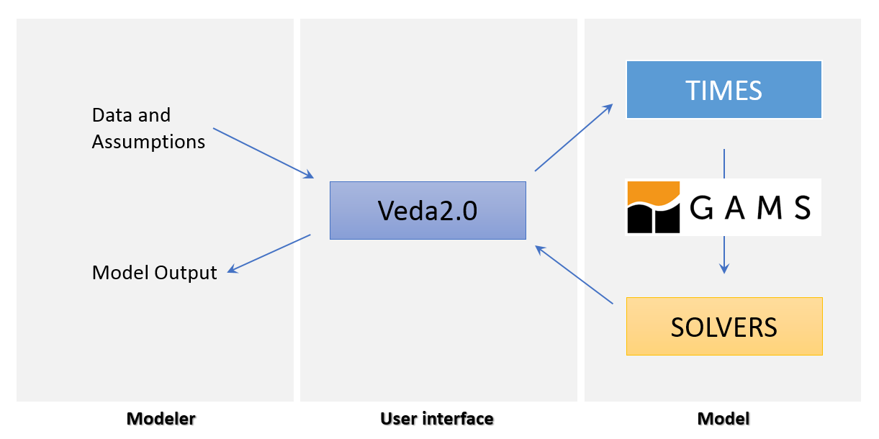

Using TIMES
TIMES Workflow
Input data pre-processing
GUI
Output post-processing
Not-reproducible
Reproducible

Slide 8
Using TIMES
Veda demo

Slide 9
Using TIMES
RAP-ifying the TIMES Workflow
Input data pre-processing
GUI
Output post-processing
Not-reproducible
Reproducible

Slide 10

Using TIMES
RAP-ifying the TIMES Workflow
Input data pre-processing
GUI
Output post-processing

Slide 11
Using TIMES
RAP-ifying the TIMES Workflow
Input data pre-processing
GUI
VedaR
Output post-processing

Slide 12
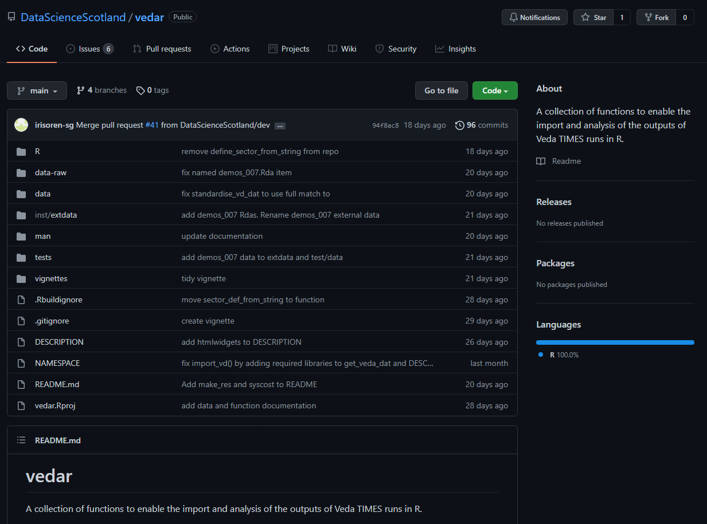
VedaR

Slide 13
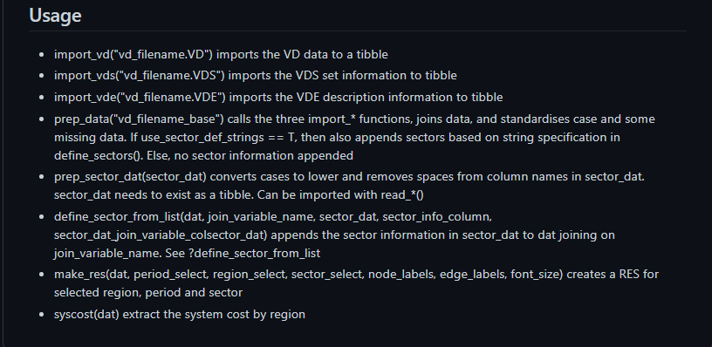
VedaR

Slide 14
Writing R packages
Package: bundle of code, data, documentation + tests to provide collection of useful functions
Advantages
Easily share code
Makes you pay attention to package versions
Makes you think about the functionality of your code – what will users need/what can go under the hood
Enforces good practice: paths, file organisation, documentation
Makes you understand how R treats data/files
Disadvantages
Learning curve
Getting packages from Github to SCOTS requires extra steps
User centred design can slow development
Tips
Read Hadley’s: Welcome! | R Packages (r-pkgs.org)
Use GitHub: issue tracking for features

Slide 15
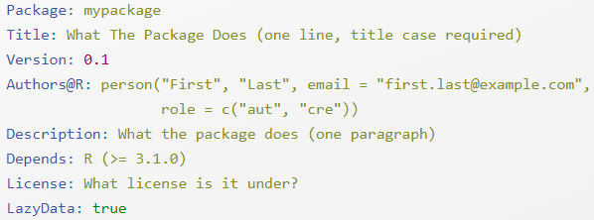
Writing R packages
Process
System setup
install.packages(c("devtools", "roxygen2", "testthat", "knitr", "usethis"))
Write functions:
Name all packages explicitly e.g. dplyr::mutate()
Decide how to organise functions into separate files
No source()/library()/require()
Consider system side effects
3. Package metadata
4. Licencing

Slide 16
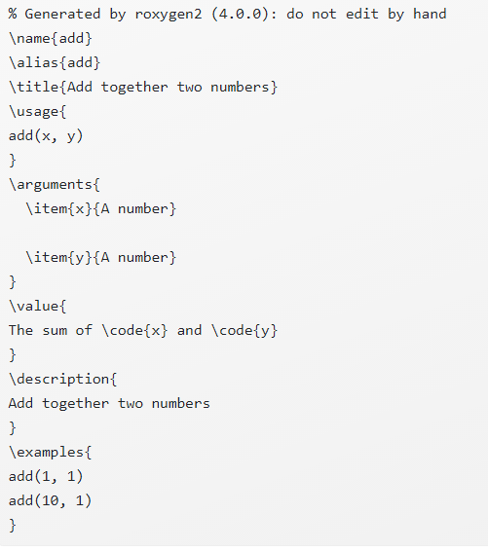
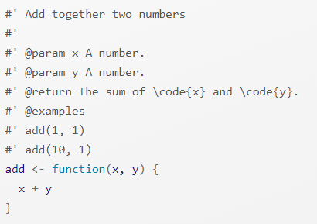
Writing R packages
Process
5. Object documentation
- object = package, functions, data
- Roxygen2
devtools::document()

Slide 17
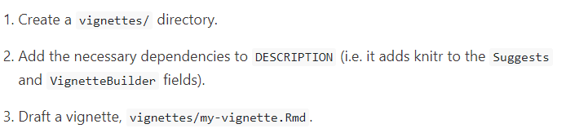

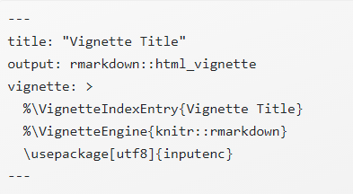
Writing R packages
Process
6. Write vignettes: Markdown files to walk users through how to use the package

Slide 18
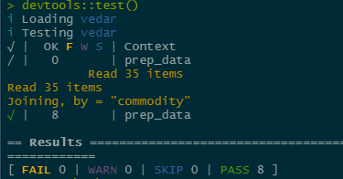
Writing R packages
Process
6. External data:
Where it is saved depends on:
Where is it used:
Internally or available to package users
Tests?
Vignettes?
Rda or raw data?
Document data using Roxygen2
7. Testing:
- Write unit tests and save in tests/testthat
- Run devtools::test()

Slide 19
VedaR
VedaR demo

Slide 20
Closing thoughts
Writing packages made simple by devtools
Use GitHub for effective workflow
A little extra effort but a lot of fun!

