Slide 1
Scotland’s Population 2020 The Registrar General's Annual Review of Demographic Trends
https://www.nrscotland.gov.uk/files//statistics/rgar/2020/scotlands-population-2020.html
Notes:
Background
The ‘Registrar General’s Annual Review of Demographic Trends’ which is an annual report that has been created every tear since 1855. I might refer to as RGAR is an annual review that brings together a range of NRS data to provide new insights and highlight key demographic trends.

Slide 2
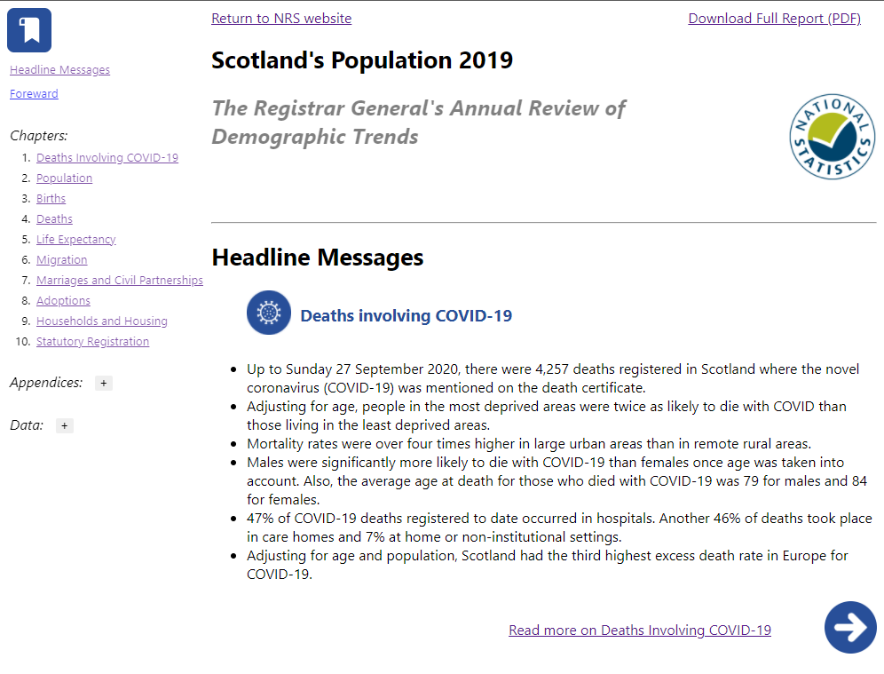
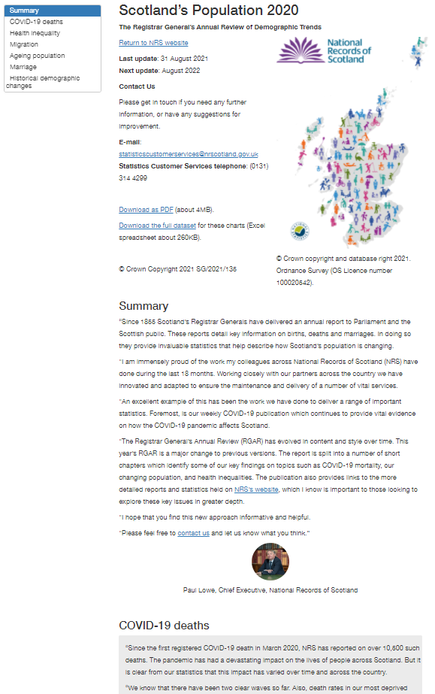

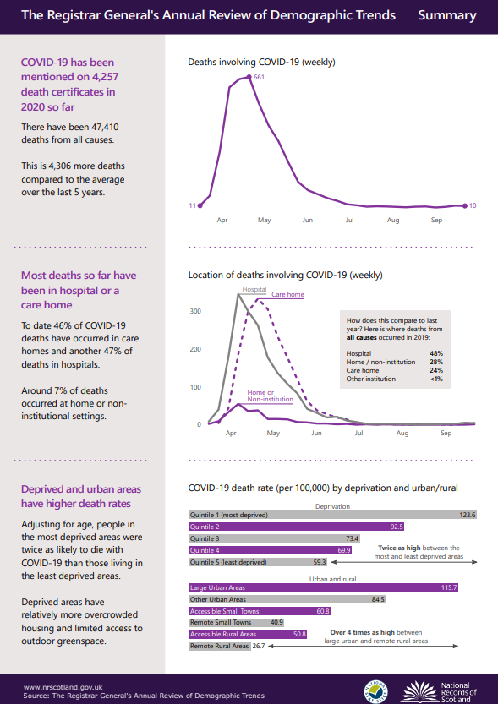
2019
2020

Slide 3
We proposed:
Significantly smaller than previous years
A single output combining the best features of the 3 outputs published in previous years
PDF, HTML, infographic booklet
We achieved:
A ~75% reduction in word/page count
A single HTML file as our primary output (with a PDF file as a secondary output)
Notes:
We made some significant changes this year

Slide 4
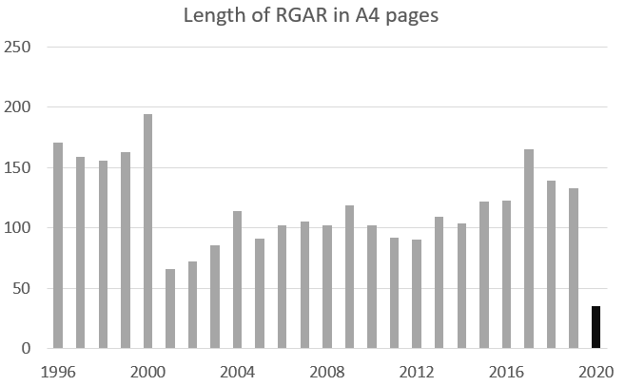
Result
Significantly smaller than previous years
A single output combining the best features of the 3 outputs published in previous years
PDF, HTML, infographic booklet
We achieved:
A 75% reduction in word count
A single HTML file as our primary output (with a PDF file as a secondary output)
Notes:
Crept up each year with more content being added

Slide 5
Change in content & style
Before
A comprehensive ‘almanac’ organised by dataset
After
A cross-cutting summary focussing on what RGAR can uniquely do
Organised by broad societal themes
Plain English reduced reading age from 16 to 8
Selectively chosen datasets reduced from 65 to 17
Notes:
A cross cutting summary so that the RGAR could provide something unique
Societal themes allows the different demographic trends to overlap

Slide 6
Change in process
Before
Branches write and central team collates
Duplicate a lot of existing material
After
Central team selects main themes in advance
Central team writes and branches check
Signpost existing content praised in user feedback
Notes:
Agreeing themes in advance will improve understanding of our statistics as a whole and create added-value
Signposting existing materials removes need for teams to create new content summarising their existing publications – less work, more cohesive end product

Slide 7
Expected benefits
Improved reputation for NRS, showcasing:
the breadth and depth of our statistics
our relevance to more current issues in Scotland
Increased interest in our other outputs
Increased value for our users: quality over quantity
Reduce risk of mistakes from duplicating existing publications
Free up significant time for staff
Introducing a RAP so for time saved next year
Notes:
Easily ingestible
Points to other outputs for further reading
Incorporating a RAP
Actual benefits:
The media mainly focussed on the impact of COVID-19 on health inequalities
Web analytics suggests wider interest is about the same

Slide 8
Workflow
Inspiration from the COVID-19 Dashboard
Text and data in a spreadsheet
Separate scripts for data reading, wrangling & plotting
One R Markdown to bring it all together and knit to HTML/PDF

Slide 9




eRDM
Storage / Backups
Allow access for the whole team in the absence of git
Maintaining the data and text files
Analytical Workbench
Internal network
Knit to PDF
Created the RAP
Knit to HTML

Slide 10
Analytical Workbench (AWB)
Pros
R is more flexible on AWB
Great user support
Can use external services
EPCC Serv-U data transfers
Cons
Bit of set up required
Inconsistencies in code for Windows vs Linux
Not the smoothest user experience
Notes:
Virtual machine
Pros
Can install what every packages needed via CRAN or github etc.
The user support from Miles was great.
For example using the statistics.gov.scot API, or Highcharts maps come from their database.
Easy to transfer data between SCOTS and the AWB
There are more restricted and secure versions of the AWB which I haven’t used.
Cons
Bit of set up required in my specific use case. Setting up an R environment with conda – But I got a lot of help from Miles in the AWB team for that.
For example R crashes every time I knit to PDF and sometimes is can be a little slow.

Slide 11



Tools

Slide 12

Pros
Accessibility
included by default
Sonification module
Intuitive charts
Familiar code
Cons
The documentation
Small multiples
Requires license
Annotations
It’s pretty smart
Notes:
Accessibility:
Keyboard navigation
Screen readers
Low vision features
Sonification module but I haven’t worked out how to use this in R yet. Still a lot more to learn with this package
Familiar code
The Highcharter documentation is good but it’s not complete. As far as I can tell it is one person working on it. The highcharts JS documentation is extensive.
So it takes a bit of work translating that documentation into R.
Its pretty smart which is great – the charts do a lot of the heavy lifting. But sometimes the automated features getr in the way – eg. Defining chart width in small multiples
Annotations
I’ll give a bit of a demo at the end and share a link to the publication

Slide 13



Accessibility
Notes:
Using Sally on the HTML output helped flag some of the more automated checks.
Highcharts has some built in accessibility features
Colour contrast analyser for checking colours/background for WCAG AA & AAA standards
Hemmingway editor for Plain English checks

Slide 14
Attributed quotes
Outlet | 2020 | 2021 | Links to articles
The Scotsman | 0% | 25% (41% excluding the section on other SG news) | 2020 article 2021 article
BBC News | 0.8% | 26% | 2020 article 2021 article
The Herald | 16% | 50% | 2020 article 2021 article
The National | NA | 44% | 2021 article Couldn't find a 2020 article
The Times | 14% | 44% | 2020 article 2021 article
Notes:
I did a bit of analysis on the articles by some of the top media outlets to look at what percentage of the article was direct quotes lifted from the report compared to the previous year.
Helps to disseminate the message as we wanted it to be said

Slide 15
Feedback from policy
What do you use the RGAR for?
“Find the latest stats to supplement our policies and update FMQs”
“Core briefs, FMQs, knowing where these points come from to dig deeper”
“Updating core briefs”

Slide 16
Feedback from policy
What worked well?
Navigation and links to more information
“easy to navigate, presented well, I like the text boxes”
“Bullets are good for me to create a brief”
“It was easy to follow and pull out the charts”
“The report appears to be well presented and set out so it is easy to find relevant information and sections. It provides links to a good range of wider reports and evidence”
“People are busy – keeping it tight and focussed – links to more info for a deeper dive”
“A visual summary, links to detailed information”
“New HTML format. I like the searchability and it's really clean. PDF is handy to highlight. The graphs are really easy to use. Have liked how NRS does good charts. I like the pictures - makes it personal”
Themes
“arranging it in themes (incl. health inequality) was helpful for us”
“definitely better by theme, you can see a thread/story, this makes sense, helps if you’re busy”
“I like thematic”

Slide 17
Feedback from policy
What could be improved?
More data
“Reports like this often talk about the impact of being from deprived areas, but there is no further breakdown or analysis of this. These deprived areas will be made up of a range of different populations, individuals, minority ethnic groups, etc”
“more detail on local authority and health board areas”
Bring the infographic booklet back
“The infographic supplement is a loss. Useful to have all the charts in 1 document for briefing ministers.”

Slide 18
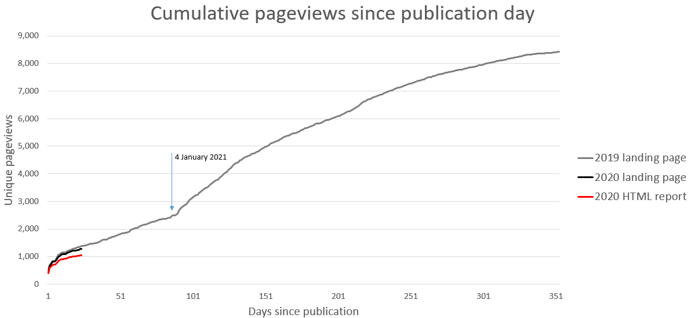
Web analytics
 | Average time on page | Estimated reading time | Max read | Bounce rate
2019 landing page | 90 seconds | 69 seconds | 100% | 45%
2020 landing page | 100 seconds | 60 seconds | 100% | 41%
2020 HTML report | 6 mins | 26 mins | 23% | 78%
Notes:
Estimated reading times calculated as the median of 3 scores from:
Read-o-Meter | Estimate the reading time. (niram.org)
ReadTime | Calculate how long it takes to read out loud
Read Time & Word Counter (thereadtime.com)

Slide 19
Measurable benefits
The media mainly focussed on the impact of COVID-19 on health inequalities
Web analytics suggests wider interest is about the same

Slide 20
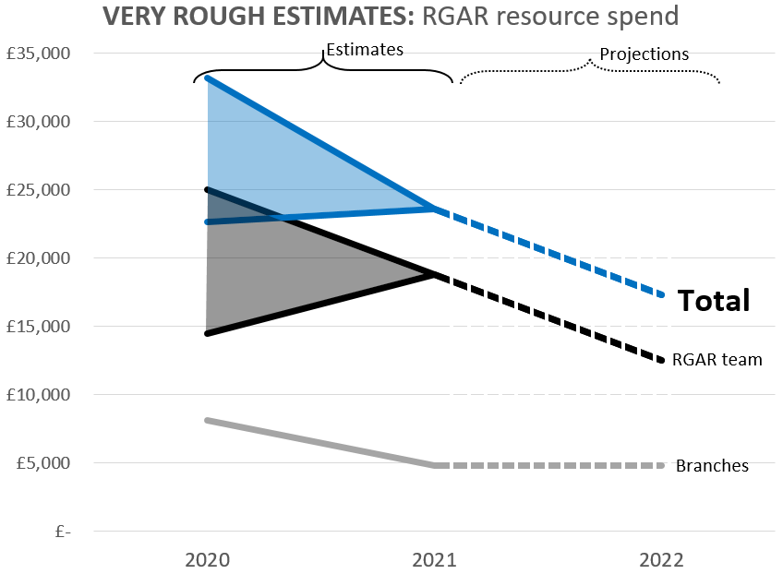

Slide 21
Plain English
mygov.scot content standards
“A lot of what the Scottish and UK governments publish, either online or in print, is too complex for at least half of our readers.
We know this by applying reading tests to what’s published, and comparing it to data from studies such as the Scottish Government Survey of Adult Literacy.”
examples
“Remember, all literacy tools are only indicators. They require interpretation and context. However, they are the only real indicators when it comes to judging the readability or complexity of a text against actual adult literacy, so their use is recommended.”
Notes:
Readability – mygov.scot | resources
Style guides: NRS writing style guide, Saltire style guide
Ewan Ferguson | Senior Content Designer | Scotland’s Census 2021 and StormID: aim for a reading age of between 6 and 9

Slide 22
Actions to increase value
Get input from communications and users early on
Create a significantly smaller output
Focus on what the RGAR can uniquely do. For example:
Structure content in societal themes instead of datasets

Slide 23
Actions to reduce effort
Create one output instead of three
previously: PDF, HTML, infographic
Point to datasets instead of duplicating them
Meet our minimum legal obligation using the Vital Events Reference tables

Slide 24
Summary
Proposal
Streamline the RGAR and focus on user value
Publication date
August 2021
Next steps
User engagement
Plan with communications staff
Decide on themes and key messages

