Slide 1

Debugging in R and Shiny
Jaime Villacampa (Jaime.villacampa@nhs.net)
Senior Information Analyst - NHS/ScotPHO

Slide 2
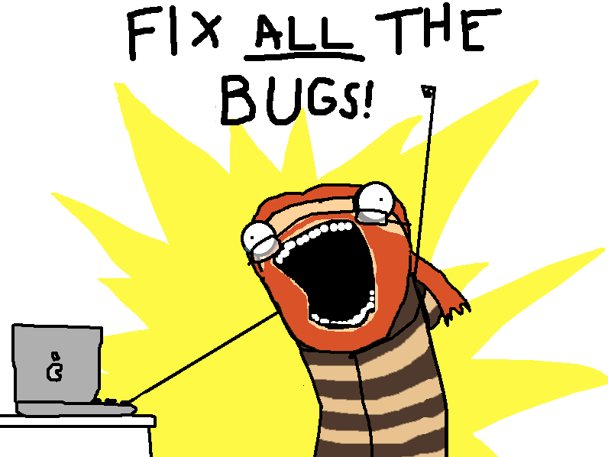
BIG Caveat
I am not very good at this…

Slide 3
Shiny vs R
Similar, but a bit more difficult than in normal R
Reactive environment
Trace() doesn’t work

Slide 4
Console error
Check for the errors the console prints
Error messages when app is big are too long
What do they mean??!!

Slide 5
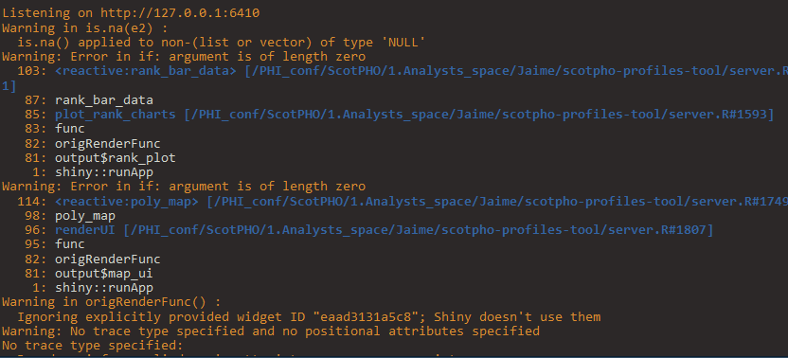
Console error

Slide 6
Primitive
Create things outside reactive environment, check they work and then add reactivity
Time consuming + needs transformation to reactive.

Slide 7
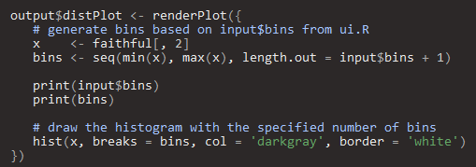
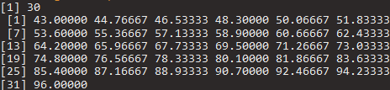
Printing results
Good for small things

Slide 8
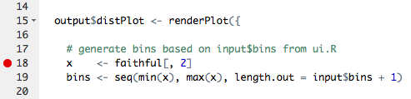
Break points
Good for inside functions
Step by step
In shiny, only works in the server side

Slide 9
Browser magic
Stops the app at the moment you chose to
You can have a button in the app!
options(shiny.error = browser) – just before the error

Slide 10
Browser magic
Server
UI

Slide 11
In Shinyapps.io
Logs of app
Very long
Can be accessed with:

Slide 12
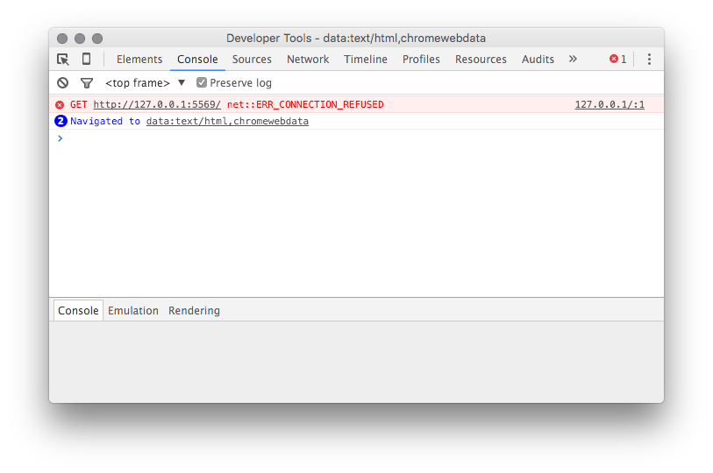
Things that I haven’t tried
JavaScript console

Slide 13
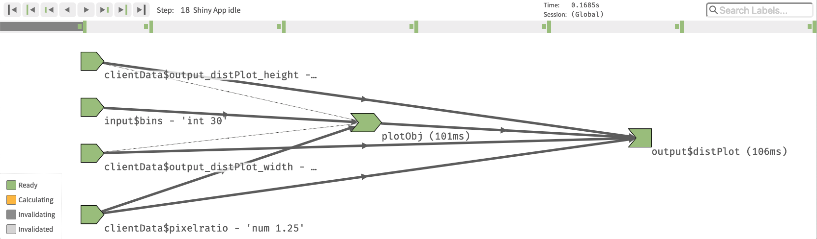
Things that I haven’t tried
Reactive log

Slide 14
Things that I haven’t tried
Showcase mode

Slide 15
Shinytest package
Creates tests that can be automated
To test changes in packages, changes in code

Slide 16
Last resorts
Reproducible example to stack overflow
Time consuming, sometimes the reproducible example works!
Look through issues in GitHub (or file one yourself)

Slide 17


Slide 18
Some useful links
https://support.rstudio.com/hc/en-us/articles/205612627-Debugging-with-RStudio
https://shiny.rstudio.com/articles/debugging.html
https://whattheyforgot.org/debugging-r-code.html
https://rtask.thinkr.fr/blog/a-little-trick-for-debugging-shiny/
https://rstudio.github.io/shinytest/articles/shinytest.html

