Slide 1

Convictions in Scotland
for data explorers and new readers

Slide 2
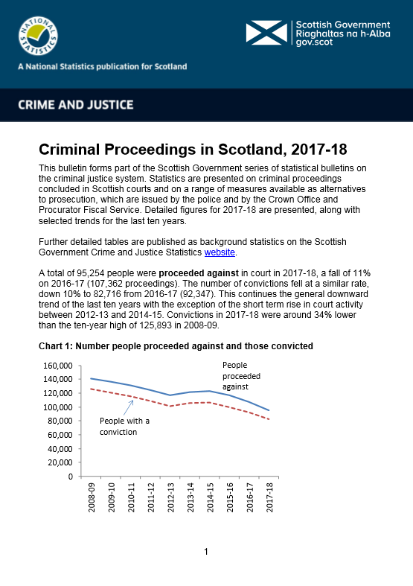
The data
Annual reports and data back to 1989
Consistent and comprehensive throughout the time series
Data is far richer than what can be presented …

Slide 3

Let’s make it…
Built for data explorers
Consistent, clean display
Engaging interface
Users might have a specific query, or just be interested parties
https://scotland.shinyapps.io/sg-convictions/

Slide 4

Analysis and commentary
Broad access is great, but understanding needs analysis
These data highlight important trends in society
Jenny Leishman used the app to write a paper about these changes
https://scotland.shinyapps.io/sg-age-crime/

Slide 5

What next?
Different data sets
Further publications
Securing the publication pipeline to gov.scot
Open data and open code

