Slide 1
Dynamic Help Pages

Slide 2
Problem
Provide help on how to use each tab
We didn't want to include this all on a home page as we wanted users to be able to get help on the page they were currently using
Wanted to make it obvious that help was available. Most of the tabs are very full so it would have been difficult to put a help button on each tab in a consistent way

Slide 3
Solution
Created a help button that sits on the dashboard header
When clicked, users are presented with a modal dialog box with help information
Set this up dynamically so that the modal displayed is dependent on the tab users are currently on

Slide 4
Demonstration
https://scotland.shinyapps.io/is-community-planning-outcomes-profile/

Slide 5
How to do this

Slide 6
1. Create action button on dashboard header
Dashboard header will only accept dropdown menus, e.g. won't allow you to put an action button straight there
You can get round this using css to tag the action button as a drop-down menu
https://stackoverflow.com/questions/47569992/home-button-in-header-in-r-shiny-dashboard?rq=1

Slide 7
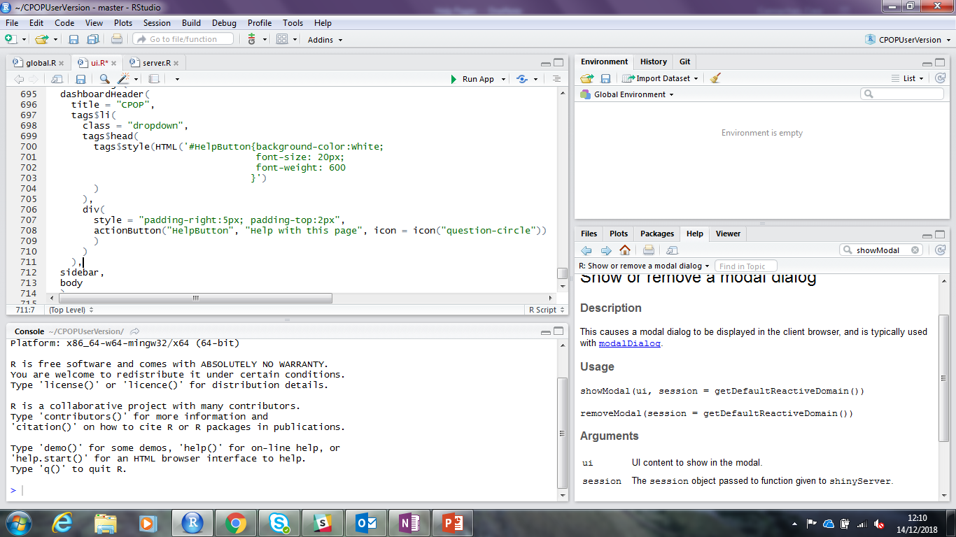

Slide 8
2. Have a modal dialog box appear once the help button is selected
This was done using the observeEvent() function. This observes whenever the help button is selected and performs an action when this is the case.
The event uses showModal(modalDialog()) which displays a modal dialog box. The Modal Dialog uses a jpg created externally with help information.

Slide 9
3. The dialog box which appears is dependent on which tab the user is currently on when selecting the help button
Each tab has an individual observeEvent() function. Within the handler expression (the event) an if statement tests first whether the tab selected is the correct tab and performs the event if so, otherwise the event is not performed.
This is tested using input$tabs.
In the sidebarMenu is id=tabs, this allows you to refer to tab names using input$tabs which retrieves the tab name of the tab currently selected

Slide 10
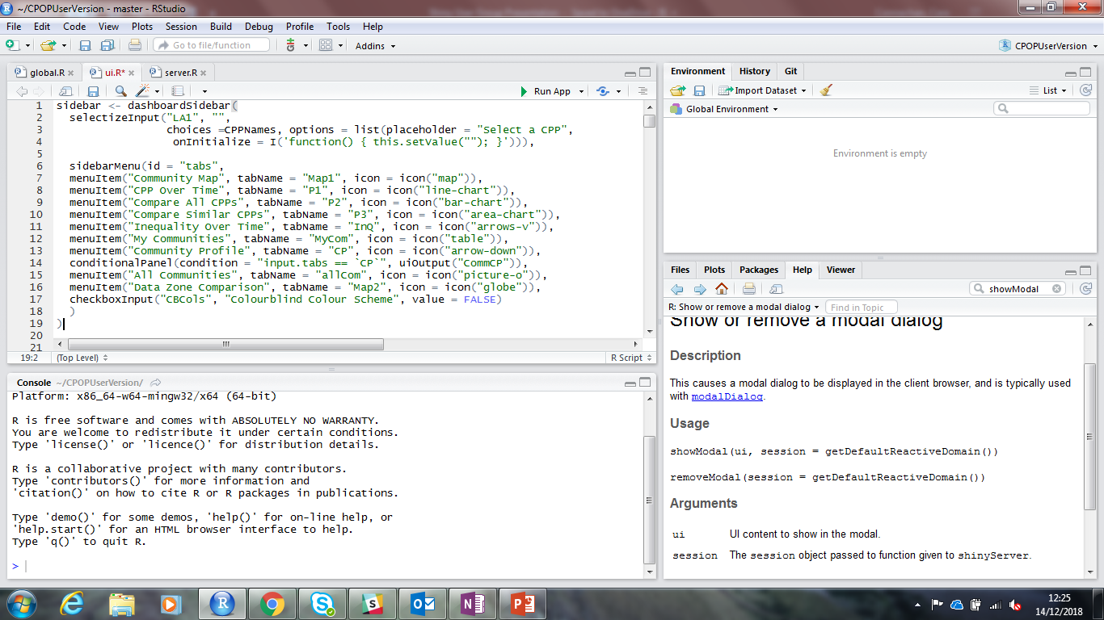
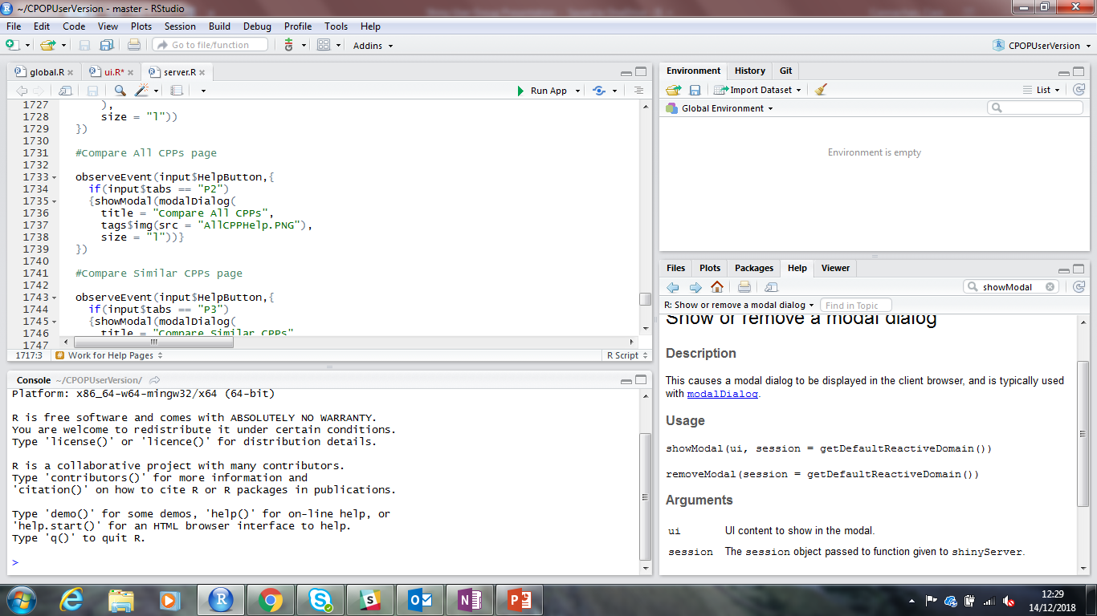
UI
Server

Slide 11
4. For some of the help pages, the information can't all fit on the screen in one dialog box, therefore additional "pages" were needed
This was done by creating action buttons within the first modal dialog box stating "next page". An observe event then observes whether this button has been selected. And if so a new dialog box is displayed.

Slide 12
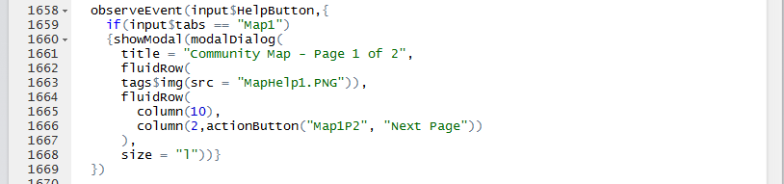
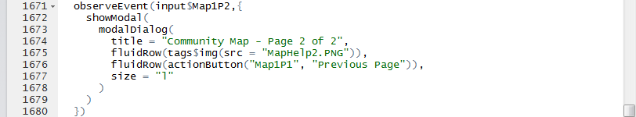
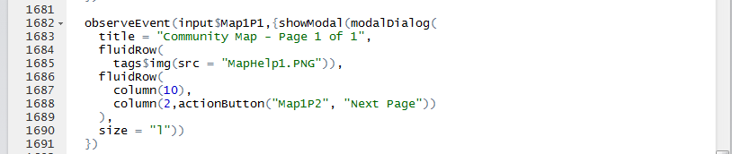

Slide 13
This way of creating Help Pages has allowed us to solve our particular problem but it does mean creating numerous observeEvent() functions(19!) which might not be the most efficient.
Alternative suggestions are welcome!

