Slide 1
The Triple I Shiny app
Liz Richardson
Email: elizabeth.richardson1@nhs.net
Webpage: http://www.healthscotland.scot/triplei

Slide 2
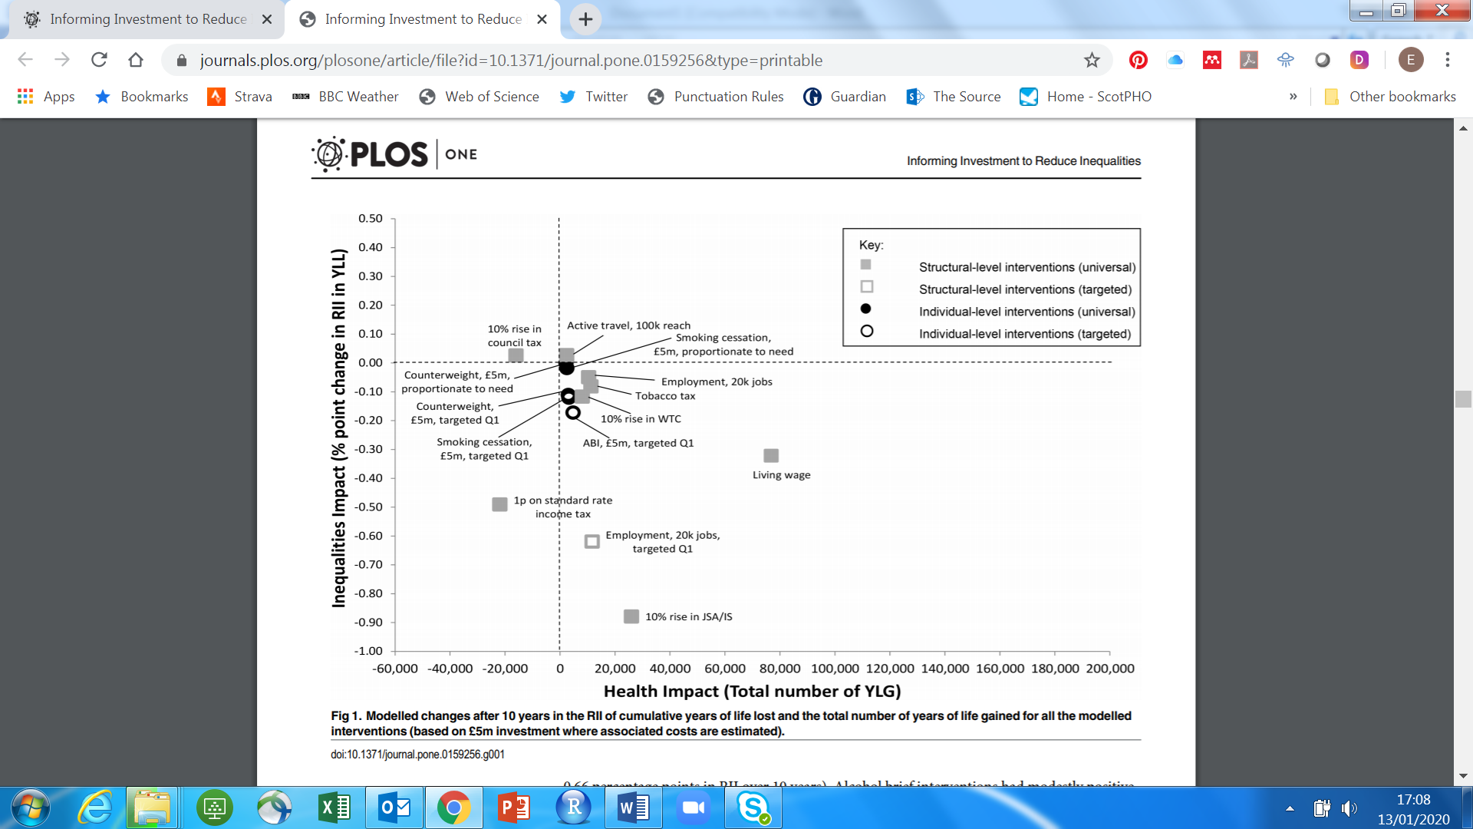

“Triple I”
“Informing Interventions to reduce health Inequalities”
For national and local decision makers
Modelling study
First phase: 2014
Excel-based; bespoke functions in VBA
Interactivity: 7 spreadsheets
Comparisons: 4 national-level static graphs
Many variables
Differing scales of effect
No local-level comparisons
Notes:
Triple I = Informing Interventions to reduce health Inequalities
Compares a range of ‘interventions’ on the basis of their predicted effect on health outcomes and social inequalities in those health outcomes.
Originated in 2014. Excel based model with bespoke functions written in VBA. Outputs then were spreadsheets that users could interact with, and a few graphs in reports.
Issues: complicated, too much information, wide range of effect sizes, lots of factors could be changed in the spreadsheets (e.g., n treated, how targeted, all/part of Scotland?) but the graphs presented a very limited view, all at national level.

Slide 3

Second phase: maintain relevance and increase usage
Update evidence
Improve modelling
Improve presentation
Improve dissemination
Requirements
Interactive
User-friendly
Cheap!
Easy to learn!
Notes:
2017: Second phase
Update evidence
Improve modelling
Improve presentation
Improve dissemination -> increase usage
All work to be done within Health Scotland this time: we don’t have the modelling expertise that was tapped into before, so the model was largely unchanged, and we didn’t have expertise in R at the time, so the model remained in Excel, using VBA functions. (next time: it’ll all be in R!)

Slide 4
Learning R Shiny
PHI staff development meeting, June 2017
Vicky’s baby names app
Jaime’s ScotPHO profiles app
Stack Overflow
Trial and error
Notes:
How I learned R Shiny
Gatecrashed a PHI staff development meeting in June 2017 – heard more about Jaime’s profile tool, and Vicky’s baby names app. The apparent simplicity of the baby names app looked most applicable to the simple charts I wanted to produce, so Vicky kindly shared her code with me and answered numerous questions that must have been very trying. She and Jaime were extremely patient and helpful as I learnt Shiny from scratch (I didn’t know R much better either). I used the ScotPHO profiles app code from Jaime a lot too.

Slide 5
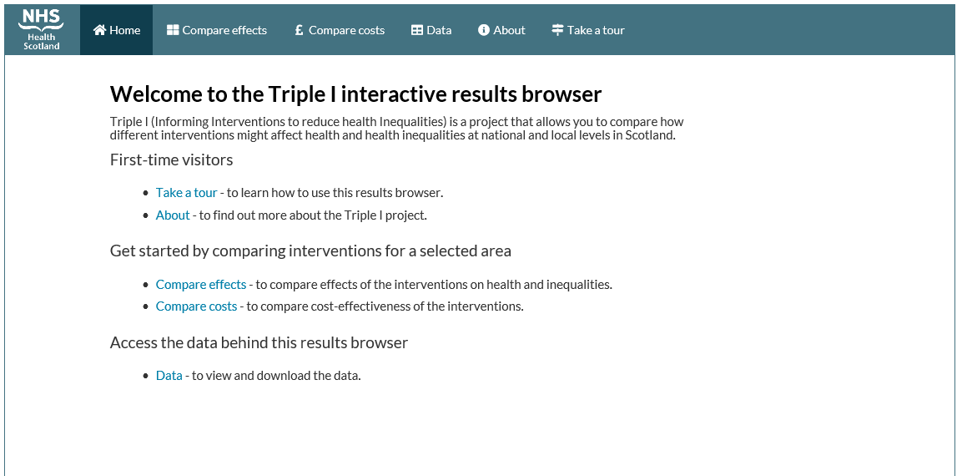
End product: Triple I Results Browser
Notes:
Hosted on SG’s Shiny server

Slide 6
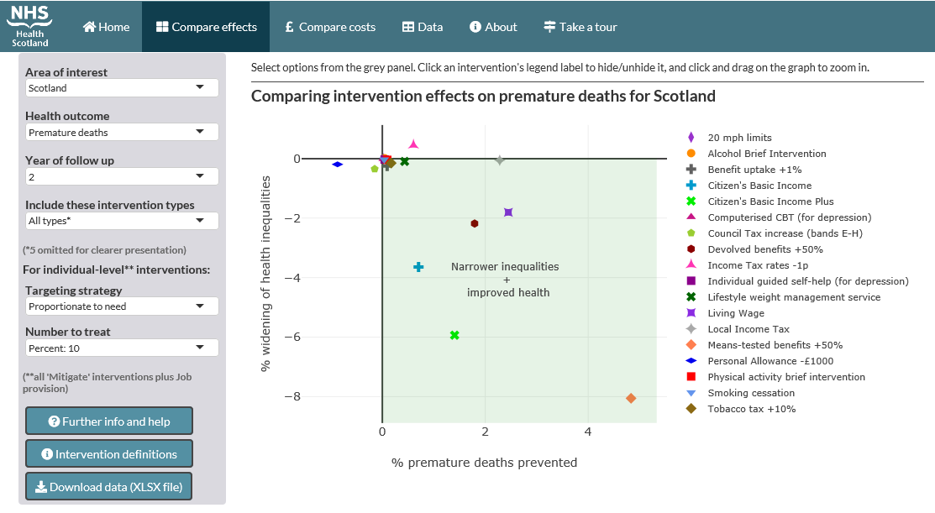
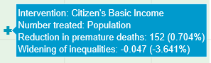
Second phase
Notes:
The ‘compare effects’ tab compares how each intervention performs in terms of improved health (x-axis) and narrowed health inequalities (y-axis).
Users can easily change the geographical area of interest, health outcome, year of follow up, intervention types, targeting strategy, number to treat.
Explanation about these = click on definitions or further info -> pop-up boxes (modals) produced using shinyBS
N.B. The data points are extracted from a file of ~1 million pre-generated results, rather than being generated on-the-fly.
Interacting with the plot: Plotly.
Zoom in
Mouseover details
Turn interventions on or off
Download an excel file of the selected data and graph: openxlsx
Bespoke: generated on-the-fly
Plotly plot (static), data tables, background info, definitions, links to further info

Slide 7
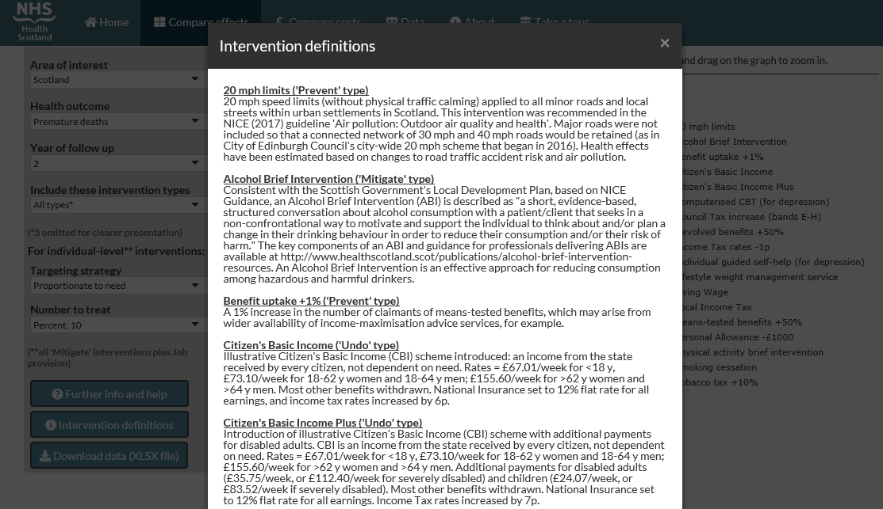
Notes:
Example of pop-up (modal)

Slide 8
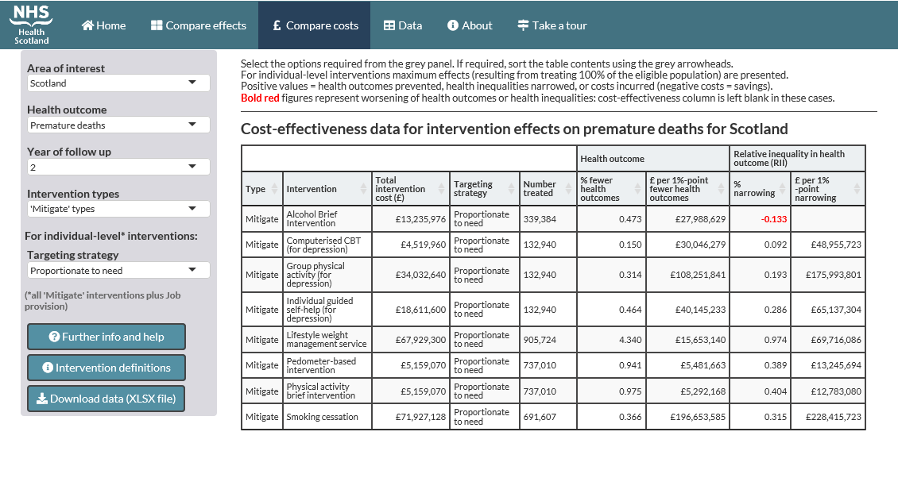
Second phase
Notes:
Basic cost-effectiveness comparisons possible for the interventions on the next tab.
R’s DT data table package used.
Sorting possible.

Slide 9
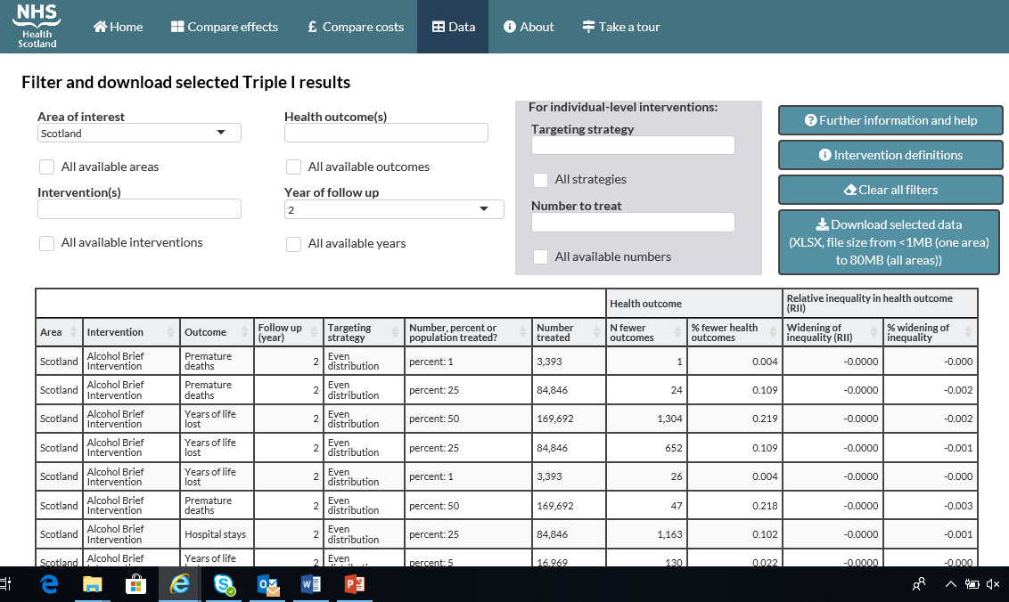
Second phase
Notes:
Finally, users can select as much or as little of the underlying data file as they wish, using the drop down menus.
Again, an Excel file is produced using openxlsx.

Slide 10
Some issues
Embedding on healthscotland.scot website
Firewall issue
Accessibility restrictions were quite limiting

Slide 11
R packages used
shiny
shinyBS
shinyWidgets
DT
plotly
openxlsx

Slide 12
Lessons learned
If I can do it anyone can
Help, advice and code from more experienced users is invaluable
Stack Overflow is your friend
Get IT and web team on board early

