Slide 1
Coding in the open

Slide 2
Definition
Writing code that is:
Open
Reusable
Published under an appropriate licence
Other organisations are already doing this
NHS National Services Scotland
Marine Scotland
Improvement Service
More?

Slide 3
Why code in the open?
Our code has been written with public money. So it should be available for people to use and build on.
UK Government Service Standard 12
Make things open; it makes things better
UK Government Design Principle 10
Where appropriate, statistics producers should take opportunities to share resources and collaborate to achieve common goals and produce coherent statistics.
Code of Practice for Statistics T4.4

Slide 4

Why code in the open?

Slide 5
Why code in the open?
It encourages good practice
It makes collaboration easier
External users can help make it better
Others can learn from your work
It makes it easier to share standards
It improves transparency on government’s work
It clarifies ownership
It helps make government technology seamless
It’s easier to code in the open than to open a closed repository
Full post on GDS blog

Slide 6
Being responsible
Reflect on your obligations as a public servant
Data protection legislation
Code of Practice for Statistics
Don’t share things you shouldn’t share
Usernames
Passwords
API keys
Adopt good practices
Write good READMEs

Slide 7
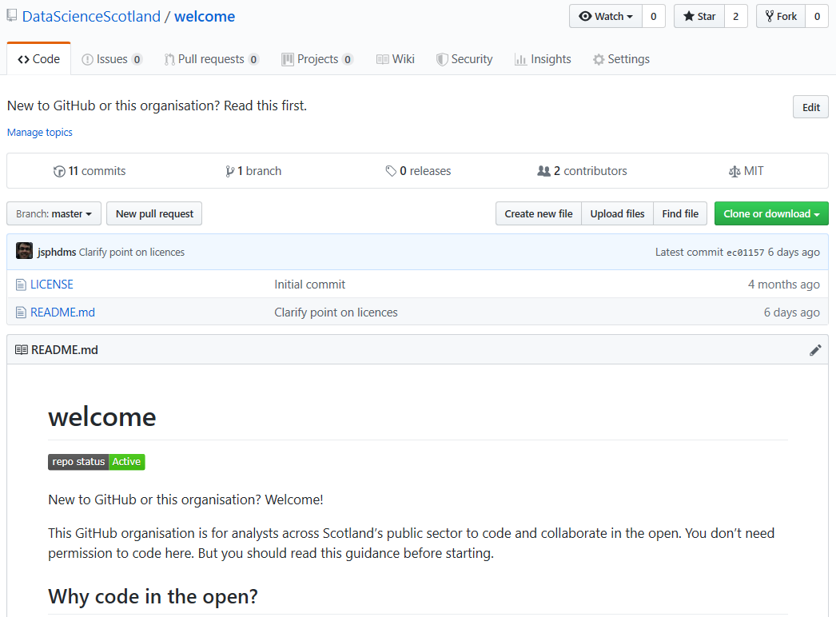
Community
Notes:
This GitHub organisation is for analysts across Scotland’s public sector to code and collaborate in the open.

Slide 8

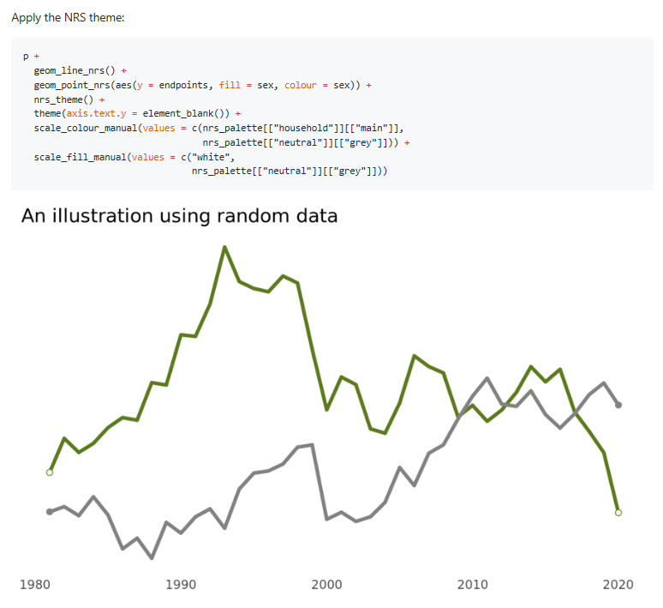
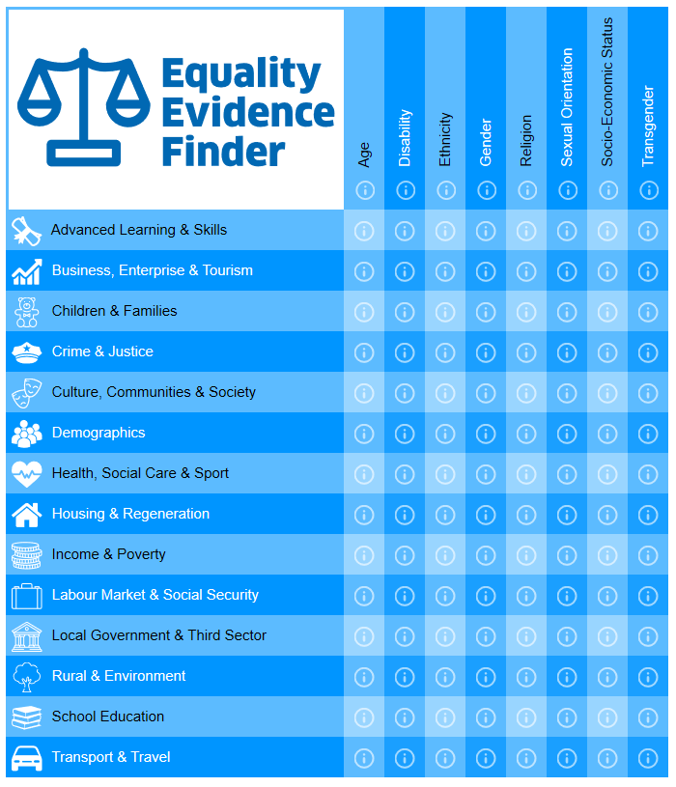
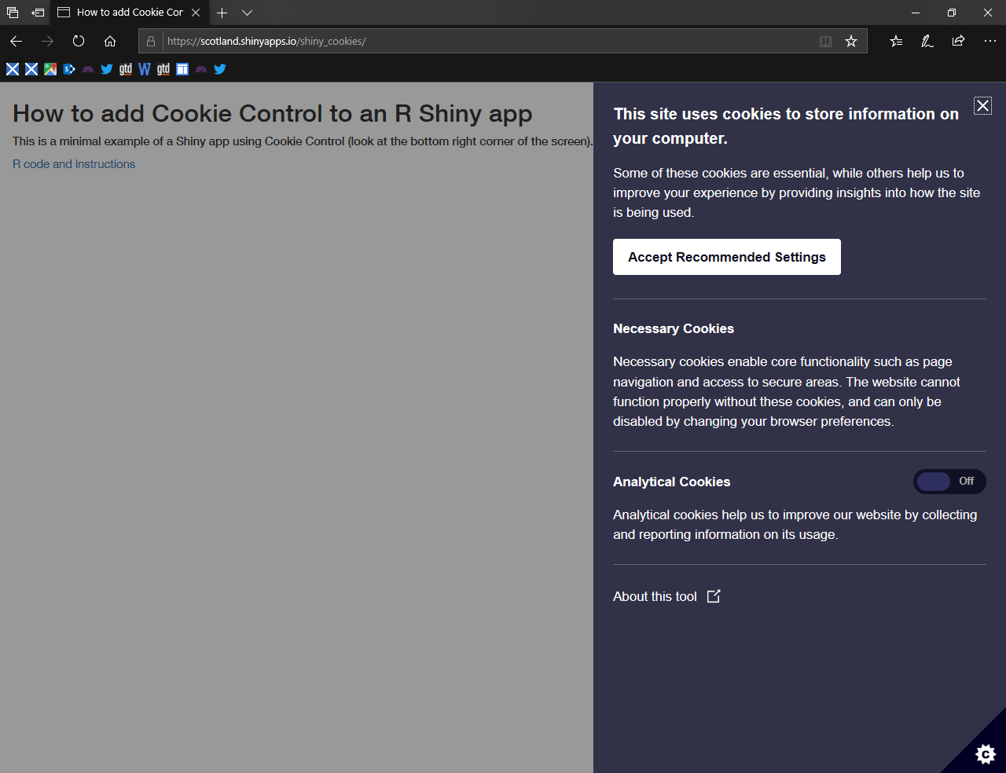
Examples of what’s on DataScienceScotland

Slide 9
Where to start
Create a GitHub account
Enable 2 factor authentication
Add your details
Ask joseph.adams@nrscotland.gov.uk for an invite to DataScienceScotland
You don’t need permission
But do read the welcome repo before you start

Slide 10
A (modest) proposal for the R/shiny group
Broadening the scope of our meetings

Slide 11
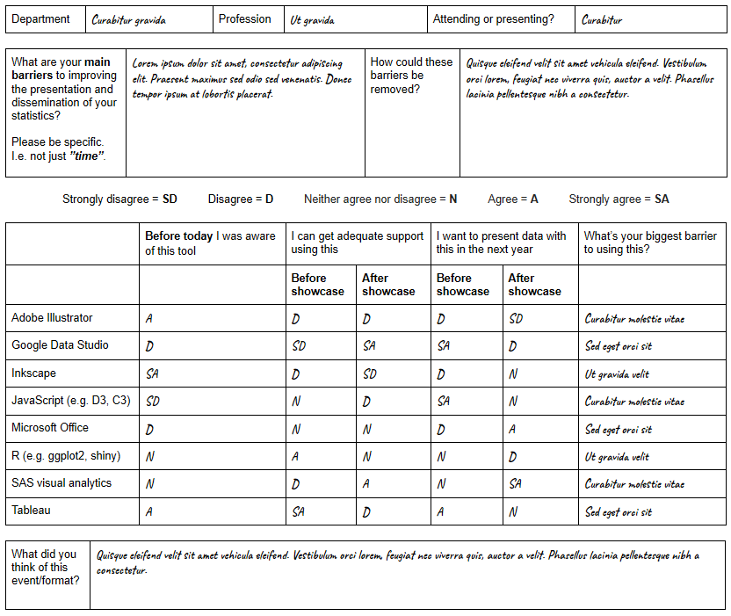
Data visualisation showcase
Slides
Write up
Common barriers
Time to learn new tools
Access to software and cost of licences
Lack of a support network

Slide 12
Options for the R/shiny group
Do nothing
Broaden to include RMarkdown
Broaden to R for communicating analysis
Broaden to R in the Scottish public sector
Any other options?

Slide 13
Things to consider
A broader scope may lose
Time for presentations, feedback, and discussion
Focus on design, accessibility, and visualisation
More attendees could make logistics tricky
Your organisation may already have support for things like RMarkdown

Slide 14
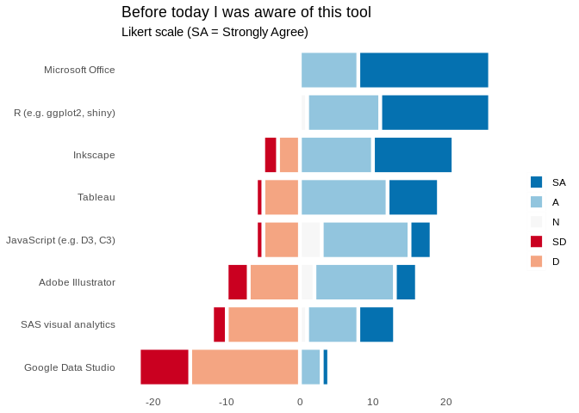
Data visualisation showcase

Slide 15
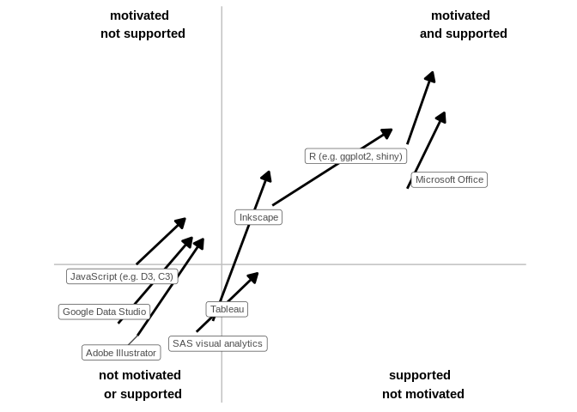
Data visualisation showcase

