Slide 1

Sparklines for Tables – Local Government Benchmarking Framework
Nick Cassidy
The ‘come to’ organisation for local government improvement in Scotland

Slide 2
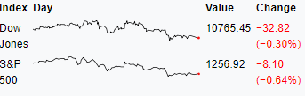

What are Sparklines?
A small chart e.g.
Available in R and Shiny via htmlwidgets
Can be used within tables to make them look a bit more interesting/ easy to understand at a glance
Interactive
We broker additional resources for local government to support improvement

Slide 3
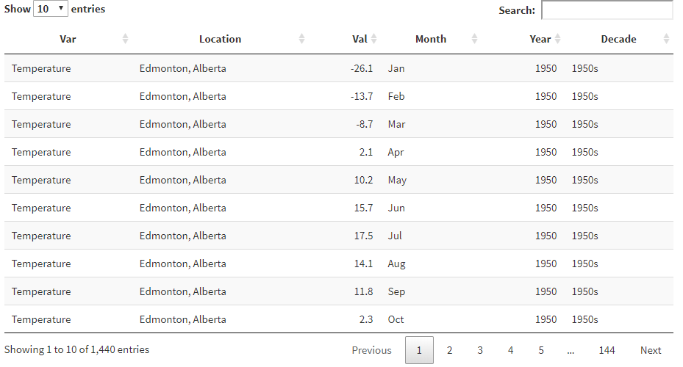

From this..
We provide a wide range of practical improvement support

Slide 4
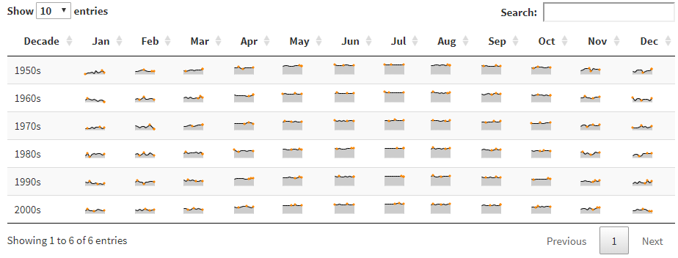

To this!
We work closely with local government partners to better align policy, improvement and delivery

Slide 5
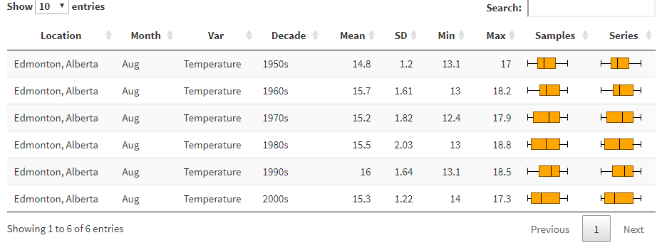

Or more likely this!
We help support and develop effective and informed local political leaders

Slide 6

LGBF App
https://scotland.shinyapps.io/is-local-government-benchmarking-framework-analysis/
Github - https://github.com/Improvement-Service/LGBF_Analysis
We make innovative use of data and intelligence to support decision making

Slide 7

How to implement in R
Sparkline package
Really simple function-
sparkline(vector of values, type of graph,…)
Examples:
sparkline(c(1,2,3,4,5), type = “line”)
sparkline(c(4,3,5,9,33), type = “bar”)
sparkline(runif(30, min = -20, max = 20), type = “discrete”)
Full list of graph types (and how to customise them) available here
We are innovators for local government and help councils to identify and share good practice

Slide 8

Creating dynamic tables in Shiny
In the LGBF tool I needed to create a dynamic formattable (or KableExtra or datatable) table depending on selections
Need to create additional column with html describing the sparkline to pass to format_table
We can do this with the spk_chr function
And the summarise function from dplyr
We facilitate the sharing of skills, capacity, knowledge and expertise

Slide 9
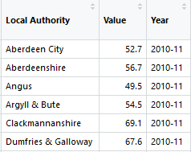
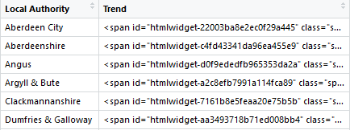
dplyr::group_by(`Local Authority`) %>% summarise(Trend = spk_chr(Value, type = "line"))
The ‘come to’ organisation for local government improvement in Scotland
Notes:
Group_by whichever column we would like to create individual sparklines for
That passes a vector of values for each LA to spk_chr

Slide 10
Finally
Pass this data frame to your table function and add:
Format_table:
htmltools::HTML() %>%
shiny::div() %>%
sparkline::spk_add_deps()
Datatable:
In options - fnDrawCallback = htmlwidgets::JS( "function(){HTMLWidgets.staticRender();}")
After the datatable function - %>% spk_add_deps()
We facilitate the sharing of skills, capacity, knowledge and expertise

