Slide 1

Shiny Modules
Jaye Ware

Slide 2
What are shiny modules?
A Modular approach splits an app into smaller parts (called modules)
Modules have there own UI and server functions
The app UI calls the module UI functions
The app server function calls the module server functions

Slide 3
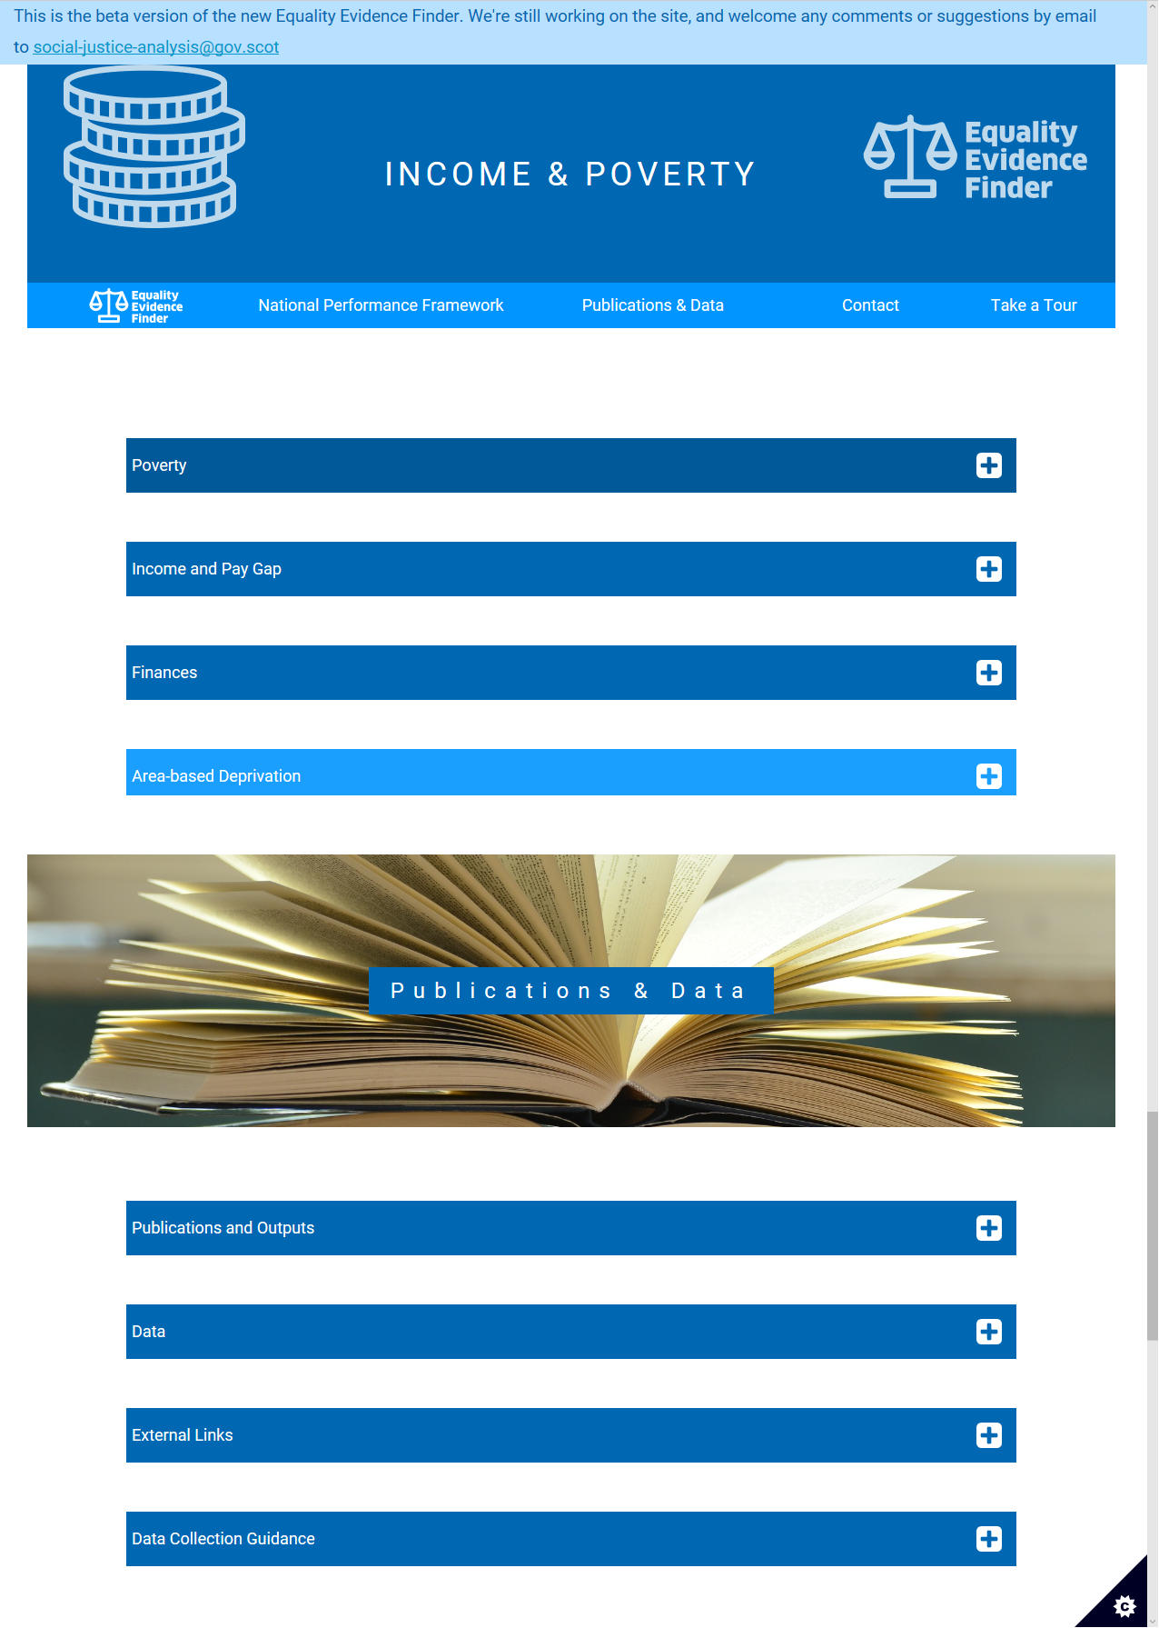
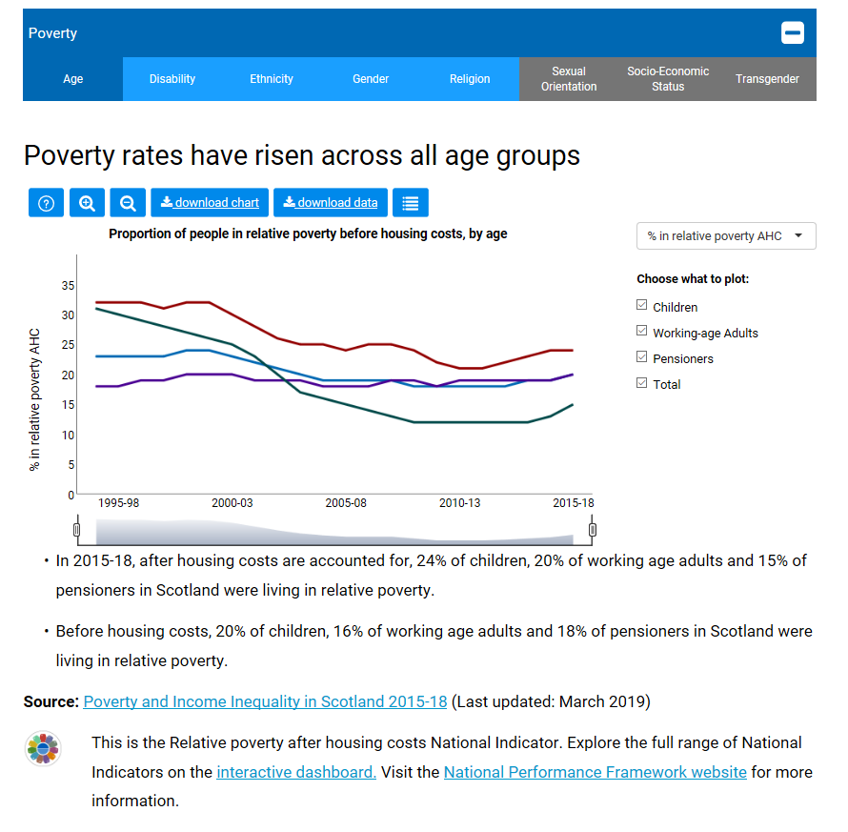
Dividing an app into modules

Slide 4

Why use modules?
Organise the code into more manageable blocks
Make it easier to reuse code in other apps
Reuse code in the same app
Save time
Avoid copy/paste errors!

Slide 5
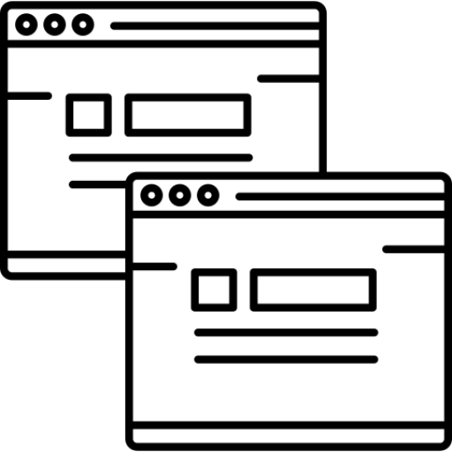
Reusing code within an app
Shiny requires all elements to have unique IDs
Unique IDs needed for Shiny to track connections between reactive elements
UI elements are converted to HTML which also requires unique IDs
Reusing code directly within a shiny app may duplicate IDs as well

Slide 6
Namespaces
Modules use namespaces to avoid duplicate element IDs
All elements inside the module functions are prefixed with the namespace
App calls the module function and gives it a namespace to use
Use a different namespace each time you call a module
name_spaceA
module_variable
name_spaceB
module_variable
name_spaceC
module_variable

Slide 7
Module UI function
Step 1: start with the module UI function template
Step 2: insert your UI code
Step 3: wrap any id’s in your UI code with the ns() function
Shiny UI inputs
Shiny UI outputs
Step 4: add module function to app UI
Include the namespace as a parameter
Module UI function template
#module UI
myModuleUI <- function(id) {
ns <- NS(id)
#insert your code here
}
#app UI
ui <- fluidPage(
myModuleUI("my_namespace"),
#more app UI elements/modules...
)
Notes:
Step 1: start with the module UI function template
id parameter will tell Shiny what namespace you’re using
ns is a function that adds the namespace prefix
Step 2: insert your UI code
Step 3: wrap any id’s in your UI code with the ns() function
Shiny UI inputs, Shiny UI outputs. For more complicated apps you may also need to wrap anything that is used as an HTML id attribute
Step 4: add module function to app UI
include

Slide 8
Module Server function
Module Server function template
Step 1: start with the module Server function template
Remember session is needed here!
Step 2: insert your server code
Shiny will automatically add the namespace prefixes
Step 3: add callModule to your server
Include the server function and namespace as first two parameters
#module server
myModuleServer <- function(input,output,session) {
ns <- session$ns
#insert your code here
}
#app server
server <- function(input,output) {
callModule(myModuleServer, "my_namespace")
#more app server elements/modules...
}
Notes:
Step 1: start with the module Server function template
Similar to the app server function except session must be included (session is optional in the app server function)
Step 2: insert your server code
You don’t need to make any changes to server code.
However if you are generating UI elements in the server then the IDs for these need wrapping in the ns() function
Step 4: add module function to app UI
callModule requires entering the server function without being inside quote marks – but the namespace should be in quote marks (or a character variable that contains the quoted namespace)

Slide 9

Tips
Module namespaces must match in the app UI and server
Always create the ns() function at the start of a module UI and server
ns <- NS(id) #ui
ns <- session$ns #server
Use similar names for the module UI and Server functions
Avoid creating relationships between inputs/outputs in different namespaces

Slide 10
Adding module parameters
You can pass your own parameters into the Module UI and Server functions
Specify UI parameters after id
Specify Server parameters after session
Only non-reactive objects can be passed to a module server
But non-reactive objects can contain reactive objects
#module UI
myModuleUI <- function(id,...) {
ns <- NS(id)
}
#module server
myModuleServer <- function(input,output,session,...) {
ns <- session$ns
#insert your code here
}

Slide 11
Returning values from modules
You can pass values from a module back to the app
End the module Server function with a return statement
Assign the output of callModule to a variable in the app
Only non-reactive values can be passed from a module server
#module server
myModuleServer <- function(input,output,session,...) {
ns <- session$ns
#insert your code here
return(my_module_variable)
}
#app server
server <- function(input,output) {
my_app_variable <- callModule(myModuleServer, "my_namespace",...)
#more app server elements/modules...
}

Slide 12
Non-reactive containers
Only non-reactive objects can be passed into or returned from modules
Reactive objects can be wrapped in non-reactive container
Shiny object | Reactive | Non-Reactive
my_variable <- reactive({...}) | my_variable() | my_variable
my_variable <- reactiveVal(...) | my_variable() | my_variable
my_variable <- reactiveValues(...) | my_variable$var1 | my_variable
input | input$var1 | reactive({input$var1})
output | output$var1 | reactive({output$var1})

Slide 13
Example - Module UI function
Non-modular
Modular
ui <- fluidPage(
navbarPage("Modules Demo",
tabPanel("Old Faithful Geyser Data",
titlePanel("Old Faithful Geyser Data"),
sidebarLayout(
sidebarPanel(
sliderInput("bins",
"Number of bins:",
min=1, max=50,
value=30
)
),
mainPanel(
plotOutput("distPlot")
)
)
)
)
)
panelUI <- function(id,startValue) {
ns <- NS(id)
moduleUI <- sidebarLayout(
sidebarPanel(
sliderInput(ns("bins"),
"Number of bins:",
min=1, max=50,
value=startValue
)
),
mainPanel(
plotOutput(ns("distPlot"))
)
)
return(moduleUI)
}
ui <- fluidPage(
navbarPage("Modules Demo",
tabPanel("Old Faithful Geyser Data",
panelUI("panel1",startValue=30)
)
)
)
Notes:
Step 1: start with the module UI function template
id parameter will tell Shiny what namespace you’re using
ns is a function that adds the namespace prefix
Step 2: insert your UI code
Step 3: wrap any id’s in your UI code with the ns() function
Shiny UI inputs, Shiny UI outputs. For more complicated apps you may also need to wrap anything that is used as an HTML id attribute
Step 4: add module function to app UI
include

Slide 14
Example - Module Server function
Non-modular
Modular
server <- function(input, output) {
output$distPlot <- renderPlot({
# generate bins based on input$bins
x <- faithful[, 2]
bins <- seq(min(x), max(x),
length.out = input$bins + 1)
# draw the histogram
hist(x, breaks = bins, col = 'darkgray',
border = 'white')
})
}
panelServer <- function(input, output, session) {
ns <- session$ns
output$distPlot <- renderPlot({
# generate bins based on input$bins
x <- faithful[, 2]
bins <- seq(min(x), max(x),
length.out = input$bins + 1)
# draw the histogram
hist(x, breaks = bins, col = 'darkgray',
border = 'white')
})
}
server <- function(input, output) {
callModule(panelServer, "panel1")
}
Notes:
Step 1: start with the module UI function template
id parameter will tell Shiny what namespace you’re using
ns is a function that adds the namespace prefix
Step 2: insert your UI code
Step 3: wrap any id’s in your UI code with the ns() function
Shiny UI inputs, Shiny UI outputs. For more complicated apps you may also need to wrap anything that is used as an HTML id attribute
Step 4: add module function to app UI
include

Slide 15
Further resources
https://shiny.rstudio.com/articles/modules.html
https://www.rstudio.com/resources/webinars/understanding-shiny-modules/

