Slide 1
Population Dashboard
https://scotland.shinyapps.io/population_dashboard/

Slide 2
Contributors
Joseph Adams
Beth Watson
Liam Kearney
Ben Jones
Gordon Bryden
Maike Waldmann
Kevin White
Many others
Notes:
Lots of people were involved in the creation of this dashboard, via hands on assistance, guidance and feedback.

Slide 3
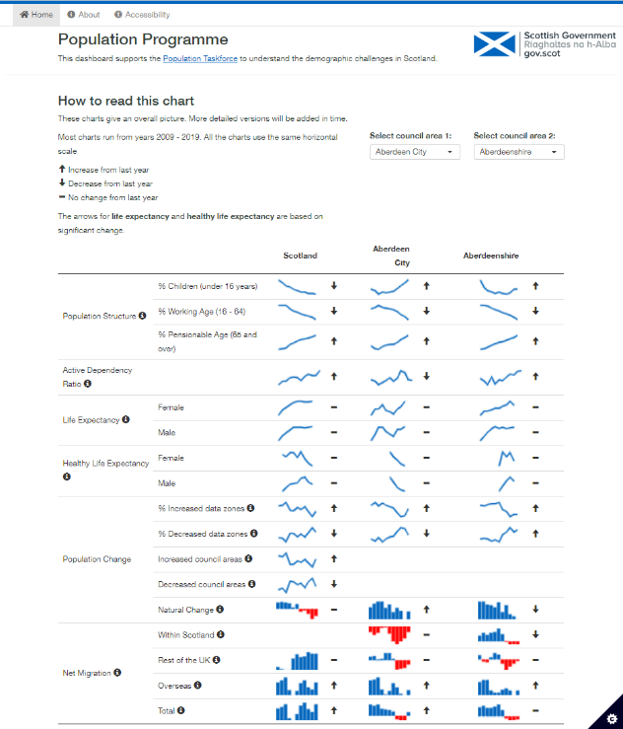
Notes:
Quick look at the final app but I’ll demo and share the link after

Slide 4
Population Taskforce
Purpose: Support the Population Taskforce
Audience: Ministerial taskforce, Councils, policy & public
Task: Build an interactive dashboard with the ability to compare council areas.
Notes:
Support the Population Taskforce to monitor progress, and understand the demographic challenges in Scotland.
Build an interactive dashboard with the ability to compare council areas which automatically updated.
The goal was to improve upon the static pdf dashboard

Slide 5
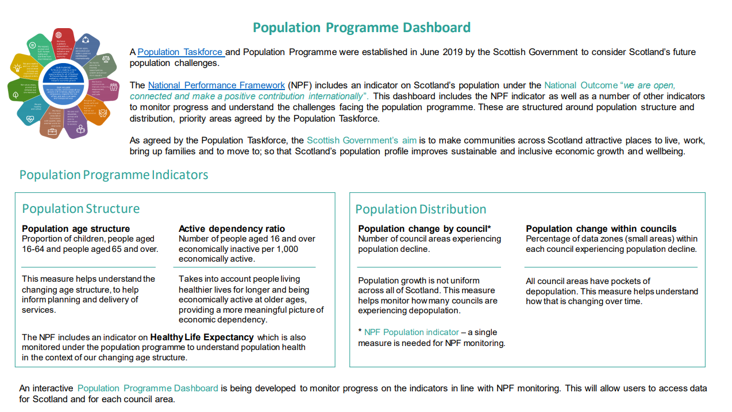
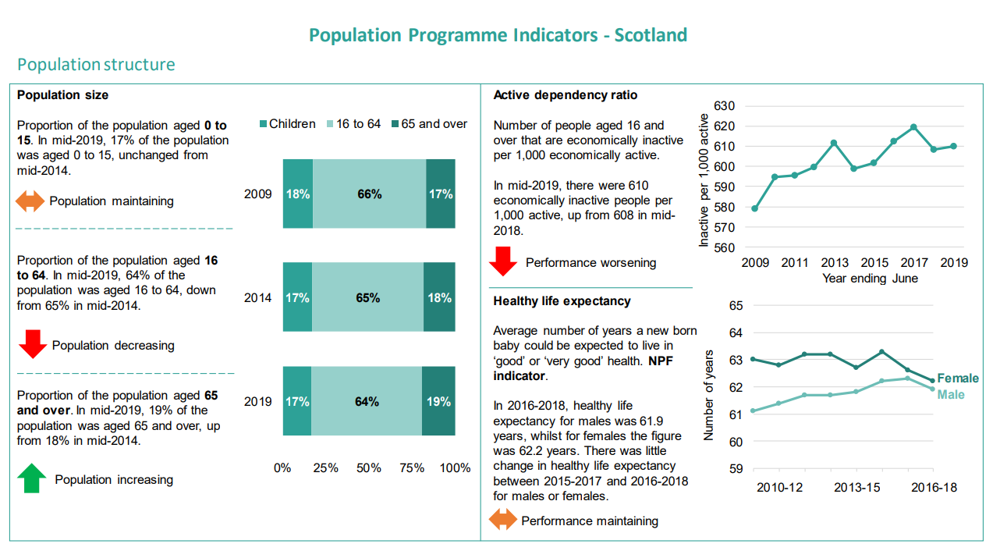

Slide 6
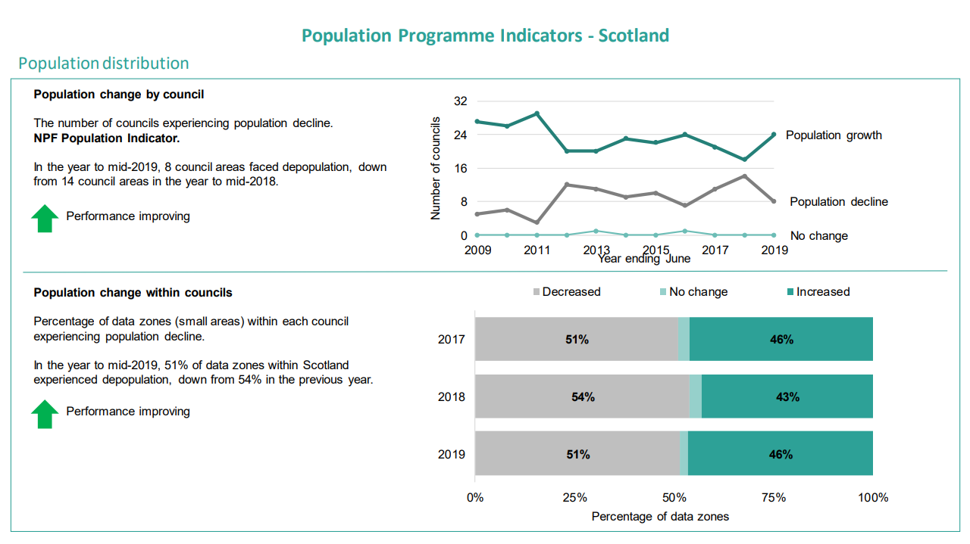
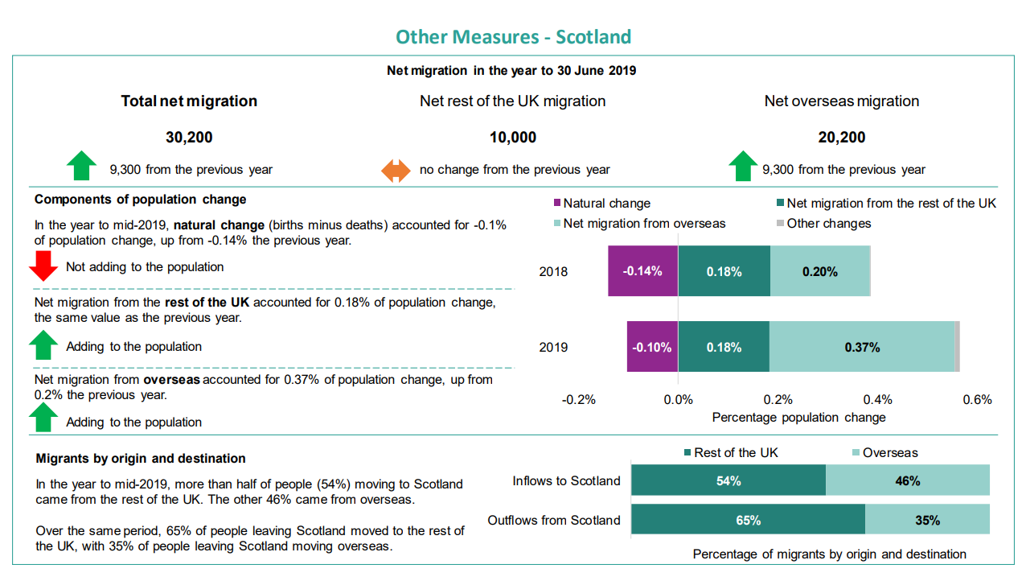
Notes:
There’s lots of detail here but we decided we wanted to compile all this information into a more simplistic overview to capture these trends

Slide 7


Data Sources
Notes:
statistic.gov.scot Access scottish government datasets and explore them by theme, organisation, or geography.
Or access programmatically using their API.
NRS for static datasets not yet on stats.gov.scot
And Office for national statistics to fill in any gaps

Slide 8
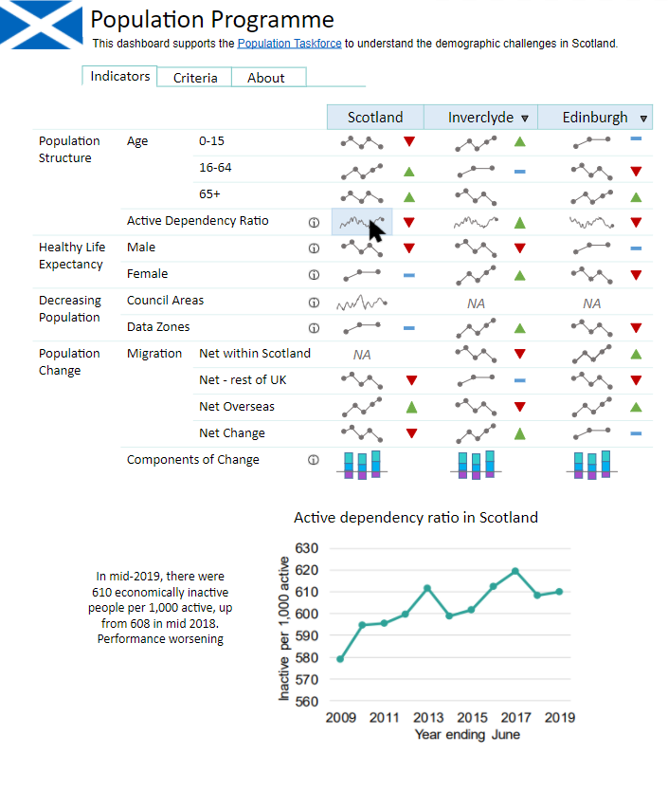
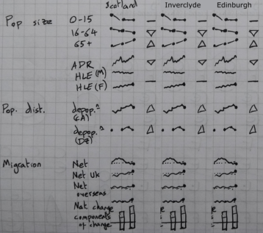
Mock-ups
Notes:
Detailed planning (lead by Joe)
Before any technical coding started we created mockups and back and forth with policy
the data is all time series
Small multiples and using sparklines
Briefly mention interactivity

Slide 9


Tools
Notes:
When we started we were considering both rmarkdown and shiny because these are both being used in SG to produce great dashboards. As we are planning to use the statistics.gov.scot API this was the deciding factor to use shiny as I am not aware of a way to use this with markdown

Slide 10
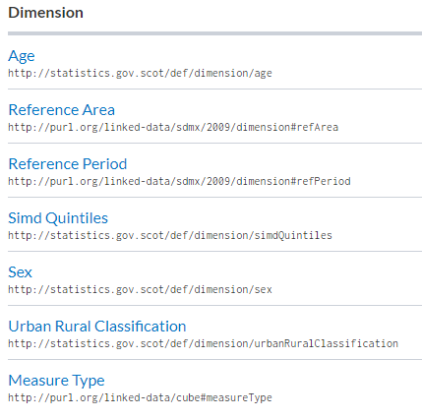
API
SPARQL
Documentation:
Querying data with SPARQL
Using the API with R
Notes:
API: Statistics.gov.scot provides highly flexible programmatic access to its data, through the SPARQL endpoint.
Using a URI: Uniform resource identifier it’s just a unique name for the specific resource you can pull the specific dataset you need with whichever dimensions
Sparql: Can be complicated and lengthy to write
Documentation

Slide 11

OpenDataScot
Creators:
Gordon Brydon Thomas Crines
Joseph Adams
Documentation:
Using the API with OpenDataScot
GitHub
Notes:
Use ODS to download data from statistics.gov.scot with a single line of R code. opendatascot removes the need to write SPARQL code; you only need the URI of a dataset. And to know what dimensions you need.
opendatascot can be used interactively, or as part of a reproducible analytical pipeline.
As you can see I have a year_quarters vector which changes based on the actual date so every time this line of code is run it searches for the specific time frame that’s required.
Use to print the sparql query
And combine location data
Slow to load (large datasets)

Slide 12
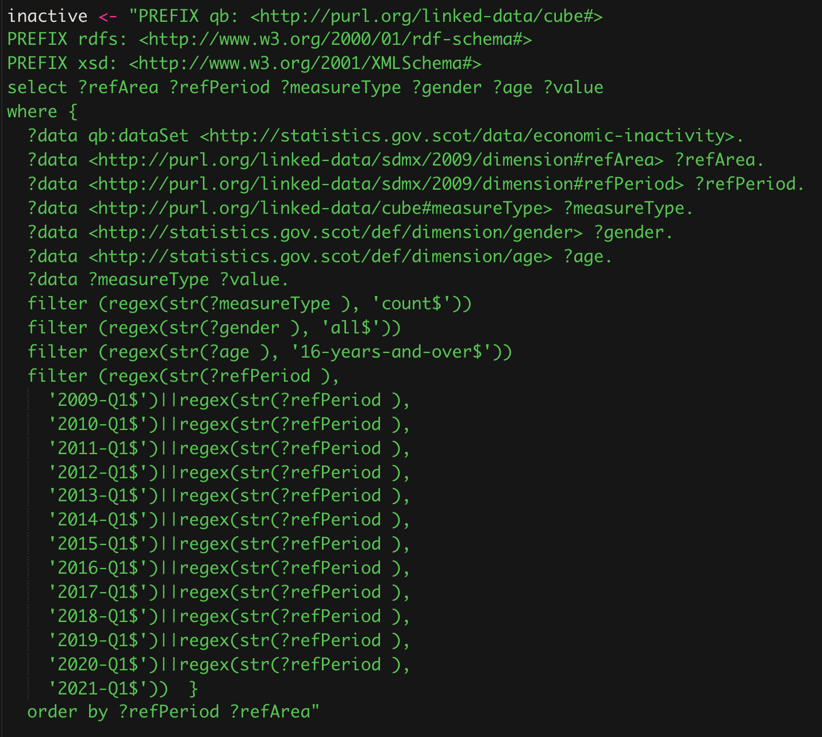
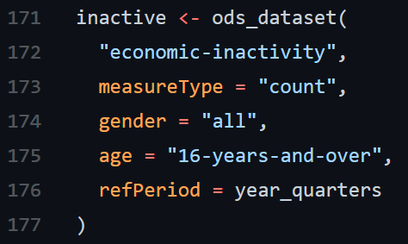
Notes:
Just to demonstrate the difference between sparql query and the same ODS query

Slide 13



Sparklines
Customise with jQuery
Minimalistic by design
Y-axis bar charts
Offset data
Tooltips
Notes:
For showing trends minimal design for quick impression of a trend or pattern without the usual peripherals of a traditional graph
limited customisation
No axis information except in the tooltip by design
Ask about jquery skills
Issues:
Offset where leading data is missing
Cannot put data in bar chart tooltip as it only takes values and displays in the order given.
Y axis is variable for bar charts so where it looks like zero is sometimes isn’t. This is so that it can adjust for negative values.

Slide 14
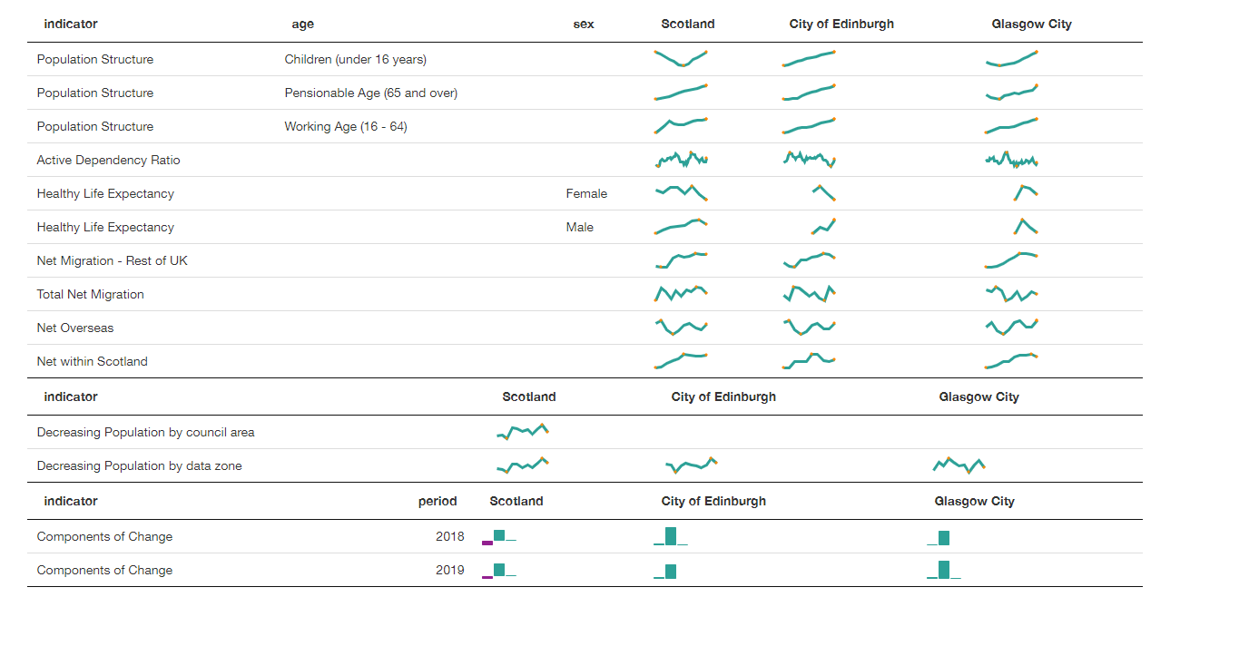
Formattable vs DataTable
Notes:
Started with formattable as it makes tidy tables but changed to data table because it allowed for merging of rows sharing the same name and specifying column width

Slide 15
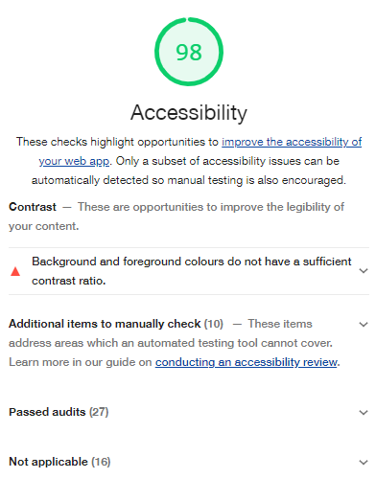


Accessibility
Sa11y
Lighthouse
Expert Advice
Notes:
Sa11y and Lighthouse assess the page and highlights issues and suggests improvements
These aren’t perfect but a good start
Kevin white and Maike – Saltire guidance Head of Digital Accessibility got in touch and provided feedback on what can be improved – More on that in a later slide

Slide 16
Feedback
Yammer
Population team
Colleagues
“Brilliant – that’s a really effective use of open data, and a nice presentation too”
“Looks great – I wondered if I could be a pain and suggest some accessibility improvements...”
Notes:
Feedback throughout the process from social media such as yammer, the population team and other colleagues.
Gave us a good insight on how to improve in a variety of areas especially for accessibility and actual use.

Slide 17
Challenges
General
Screen size adjustments
Same area selection
Y-Axis
Line charts
Bar charts
Accessibility
Low contrast selectors
Alt text
Small tooltips
Columns
Hidden headers
Row names
Split columns
Notes:
Challenges in condensing a lot of data

Slide 18
Lessons
Think about accessibility from the start
Keep a detailed plan
QA data
Code Reviews
Notes:
Think about accessibility from the start
Keep a detailed plan
QA data - A few time mistakes were spotted i.e data should have been proportion but was actual count. Data was slightly off – realised that Scotland was being included as a council area.
Code reviews
Go to app

