Slide 1
Proxifier on scots for secure api access
A brief guide on the use of new software to enable analysts to securely access external analytics and apis over the scots network

Slide 2
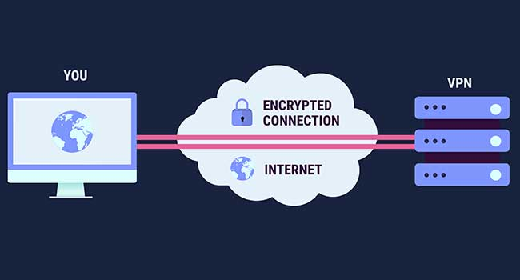
What is Proxifier?
Through the SCOTS VPN, you may make a connection to pre-approved internet URLs. Because you are making a connection through the VPN, the iTECS can limit what you can and cannot access. In this way, SG security teams can control traffic and access to malicious website which may compromise the security of the network.
Unfortunately this means most analytical tools, including version control through GitHub, are not allowed on SCOTS as it would also allow files which can contain malicious instructions.

Slide 3
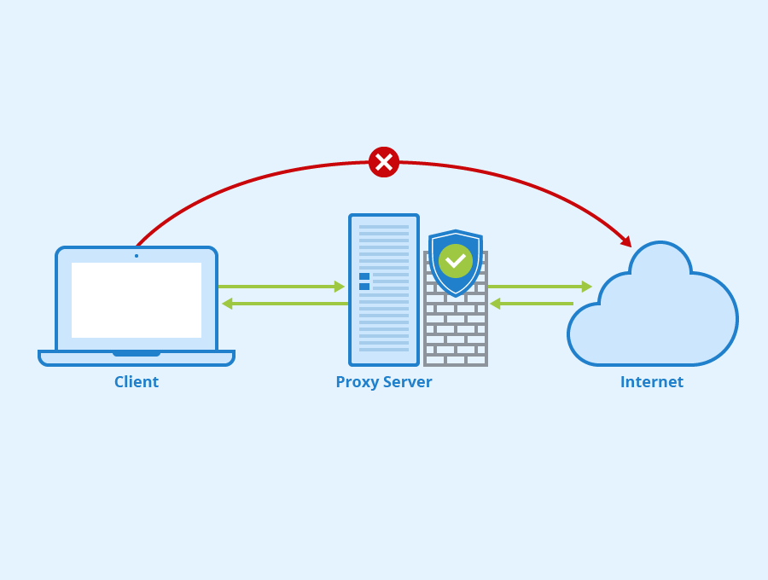
How it works
Proxifier allows a specific list of traffic types to directly connect to a proxy web server and bypass the limitations of the SCOTS VPN. To help avoid compromising security, this is only allowed through RStudio.
What this means is that, providing you are programmatically accessing the API via R, you are able to use them from within a SCOTS environment without compromising the network.

Slide 4
demonstration

Slide 5
How to request
A limited number of Proxifier keys are currently available
Contact Richard Haigh via Richard.haigh@gov.scot
Explain your reason for requesting and the intended use case along with the benefits it would bring to your team

