Slide 1
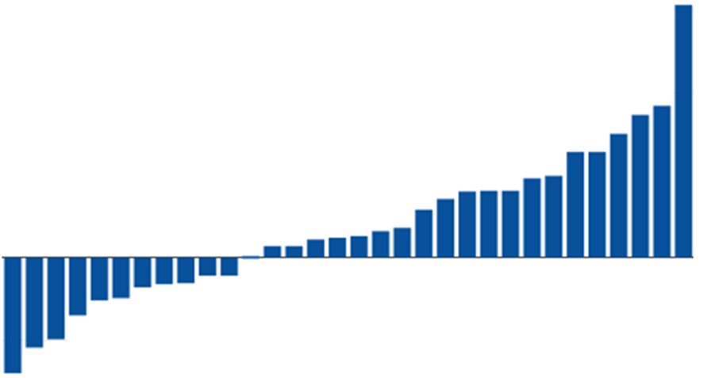
Plotly
Jaime Villacampa
Senior Information Analyst - NHS/ScotPHO
Jaime.villacampa@nhs.net

Slide 2
What is it?
Javascript library
Python, R and web
Integration with Shiny as other visuals

Slide 3
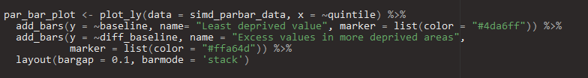
How does it work
Style of coding - layers

Slide 4
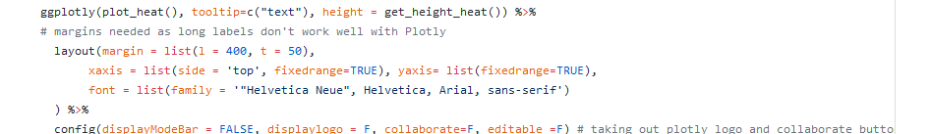
How does it work
Ggplotly vs plotly
Notes:
some ggplots things don’t work, performance, complex charts

Slide 5
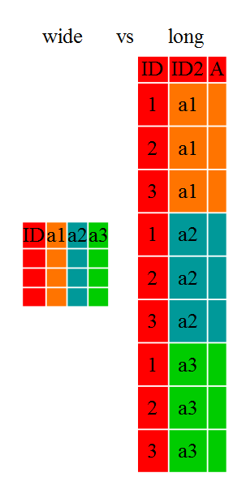
How does it work
Style of data: it prefers wide vs long
Notes:
it prefers wide over long format, but I prefer long vs wide, there are ways, colors

Slide 6
Ways of hosting the charts
Within Shiny
Plotly account
HTML code

Slide 7
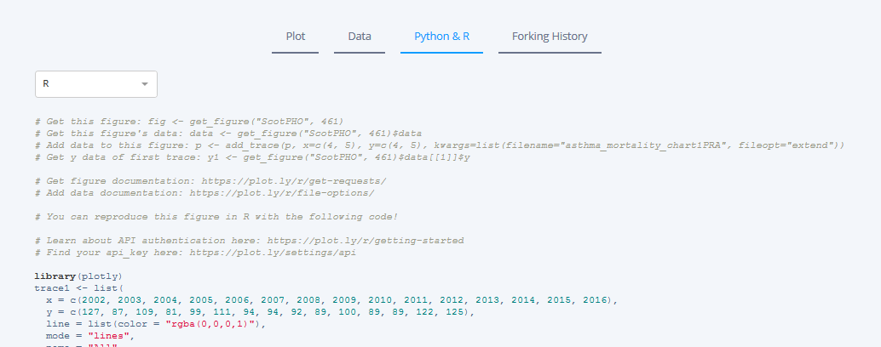
Some tricks and advice
Web plots - discover R code

Slide 8
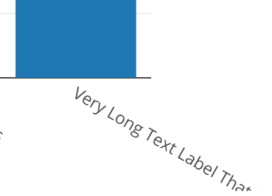
Some tricks and advice
Issue with long labels

Slide 9
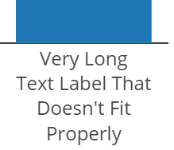
Some tricks and advice
Issue with long labels
<br> solution

Slide 10
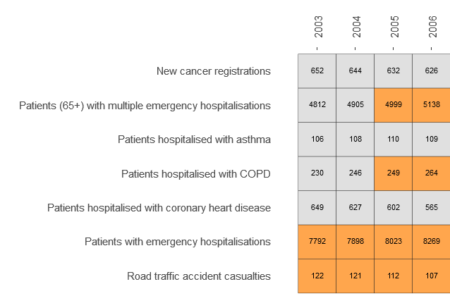
Some tricks and advice
Issue with long labels
Margin solution
<br> solution

Slide 11
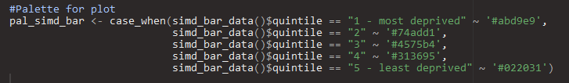
Some tricks and advice
How to setup palettes to factors

Slide 12


Some tricks and advice
The evil toolbar

Slide 13
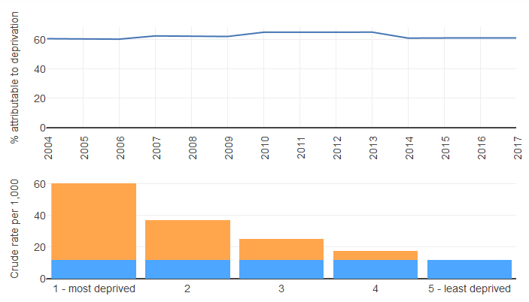
A bit of advanced stuff
Subplots

Slide 14
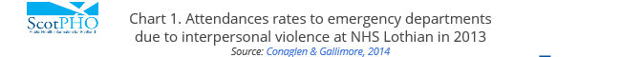

A bit of advanced stuff
HTML titles and elements

Slide 15
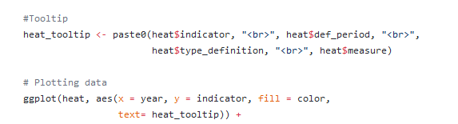
A bit of advanced stuff
Tooltips

Slide 16
A bit of advanced stuff
Linked charts

Slide 17

Things Plotly is not that great for
It can be buggy
Overly complex charts
Maps

Slide 18
Some useful links
https://plot.ly/r/
https://community.plot.ly/
https://github.com/Health-SocialCare-Scotland/ScotPHO-website-charts
https://github.com/Health-SocialCare-Scotland/ScotPHO-profile-tool
http://chriddyp.github.io/interactive-heatmaps/

