Slide 1
Joseph Adams
Google Analytics,
Cookies, and the law

Slide 2

Some caveats
I’m not an expert
The law is changing
We’re waiting for official guidance
Notes:
The law is changing – ICO: https://ico.org.uk/for-organisations/guide-to-pecr/what-are-pecr/
“PECR have been amended five times. The more recent changes were made in 2016, to require anyone making a marketing call to display their number; and in 2018, to ban cold-calling of claims management services. This guide covers the latest version of PECR, which came into effect on 8 September 2018, with some updates to cover changes made by the GDPR from 25 May 2018.
The EU is in the process of replacing the e-privacy Directive with a new e-privacy Regulation to sit alongside the GDPR. However, the new Regulation is not yet agreed. For now, PECR continues to apply alongside the GDPR.”

Slide 3

Definition
Cookies
A cookie is a small file, typically of letters and numbers, downloaded on to a device when the user accesses certain websites… to recognise a user’s device.

Slide 4
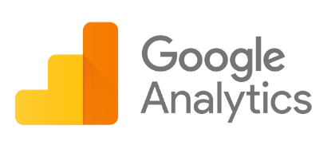
Definition
Google Analytics
Google Analytics uses cookies to "remember" what a user has done on previous pages / interactions with the website.

Slide 5

Definition
Personal data
Personal data is information about people who can be identified or who are identifiable; possibly in combination with other information.

Slide 6
Legislation
The GDPR and
Data Protection Act 2018
PECR
Includes personal data
Cookies (and other things)
Notes:
If you are processing personal data, you must comply with the GDPR and the Data Protection Act 2018.
ICO Guide to the Privacy and Electronic Communications Regulations: https://ico.org.uk/media/for-organisations/guide-to-pecr-2-4.pdf
“The GDPR does not replace PECR, although it changes the underlying definition of consent. Existing PECR rules continue to apply, but using the new GDPR standard of consent.
In particular, it’s important to realise that PECR apply even if you are not processing personal data. For example, many of the rules protect companies as well as individuals, and the marketing rules apply even if you cannot identify the person you are contacting.”

Slide 7
The PECR requires that we…
tell people the cookies are there
explain what the cookies are doing and why
get the person’s consent to store a cookie on their device
Notes:
https://ico.org.uk/for-organisations/guide-to-pecr/cookies-and-similar-technologies/

Slide 8

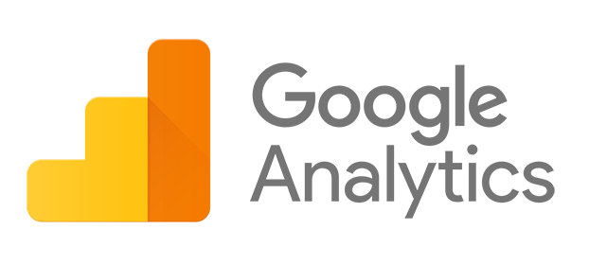
Recommended actions
Adopt best practices to avoid sending personally identifiable information to Google

Slide 9

Recommended actions
Configure Google Analytics to anonymise IP addresses

Slide 10

Recommended actions
Review any current privacy and security settings for Google Analytics

Slide 11

Recommended actions
Explain your use of cookies and how users can change their cookie preferences

Slide 12

Guidance from the ICO
“… consent must be given by a clear positive action... This must be more than simply continuing to use the website.” ICO
Notes:
ICO Guide to the Privacy and Electronic Communications Regulations: https://ico.org.uk/for-organisations/guide-to-pecr/cookies-and-similar-technologies/
“To be valid, consent must be freely given, specific and informed. It must involve some form of unambiguous positive action – for example, ticking a box or clicking a link – and the person must fully understand that they are giving you consent. You cannot show consent if you only provide information about cookies as part of a privacy policy that is hard to find, difficult to understand, or rarely read.
Consent does not necessarily have to be explicit consent. However, consent must be given by a clear positive action. You need to be confident that your users fully understand that their actions will result in specific cookies being set, and have taken a clear and deliberate action to give consent. This must be more than simply continuing to use the website. To ensure that consent is freely given, users should be able to disable cookies, and you should make this easy to do.
You should take particular care to ensure clear and specific consent for more privacy-intrusive cookies, such as those collecting sensitive personal data such as health details, or used for behavioural tracking. The ICO will take a risk-based approach to enforcement in this area, in line with our regulatory action policy.
For more advice on obtaining consent, including the rules on browser settings, see our cookies guidance and our consent guidance.”

Slide 13
Recommended actions
Use a cookie tool such as Cookie Control

Slide 14
(More!) recommended actions
From Google Analytics training course providers (SG)
Anonymise IP Addresses (using Tag Manager)
Turn off Demographic reporting on gender and interests (in Google Analytics Admin)
Do not use Google Analytics to collect information entered into editable fields on a web page i.e forms, feedback. For this to be anonymous it should be entered into a separate database.
Do not use Google Analytics to pull information from other databases which contain identifiable information. To do this would not only breach GDPR but also Google Analytics terms of use.
Utilise data retention and deletion features as needed

