Slide 1
Plotting with ggplot2
Exploratory Data Analysis
Roger D. Peng, Associate Professor of Biostatistics
Johns Hopkins Bloomberg School of Public Health

Slide 2
What is ggplot2?
An implementation of the Grammar of Graphics by Leland Wilkinson
Written by Hadley Wickham (while he was a graduate student at Iowa State)
A “third” graphics system for R (along with base and lattice)
Available from CRAN via install.packages()
Web site: http://ggplot2.org (better documentation)

Slide 3
What is ggplot2?
Grammar of graphics represents and abstraction of graphics ideas/objects
Think “verb”, “noun”, “adjective” for graphics
Allows for a “theory” of graphics on which to build new graphics and graphics objects
“Shorten the distance from mind to page”

Slide 4
Grammar of Graphics
“In brief, the grammar tells us that a statistical graphic is a mapping from data to aesthetic attributes (colour, shape, size) of geometric objects (points, lines, bars). The plot may also contain statistical transformations of the data and is drawn on a specific coordinate system”
from ggplot2 book

Slide 5
The Basics: qplot()
Works much like the plot function in base graphics system
Looks for data in a data frame, similar to lattice, or in the parent environment
Plots are made up of aesthetics (size, shape, color) and geoms (points, lines)

Slide 6
The Basics: qplot()
Factors are important for indicating subsets of the data (if they are to have different properties); they should be labeled
The qplot() hides what goes on underneath, which is okay for most operations
ggplot() is the core function and very flexible for doing things qplot() cannot do

Slide 7
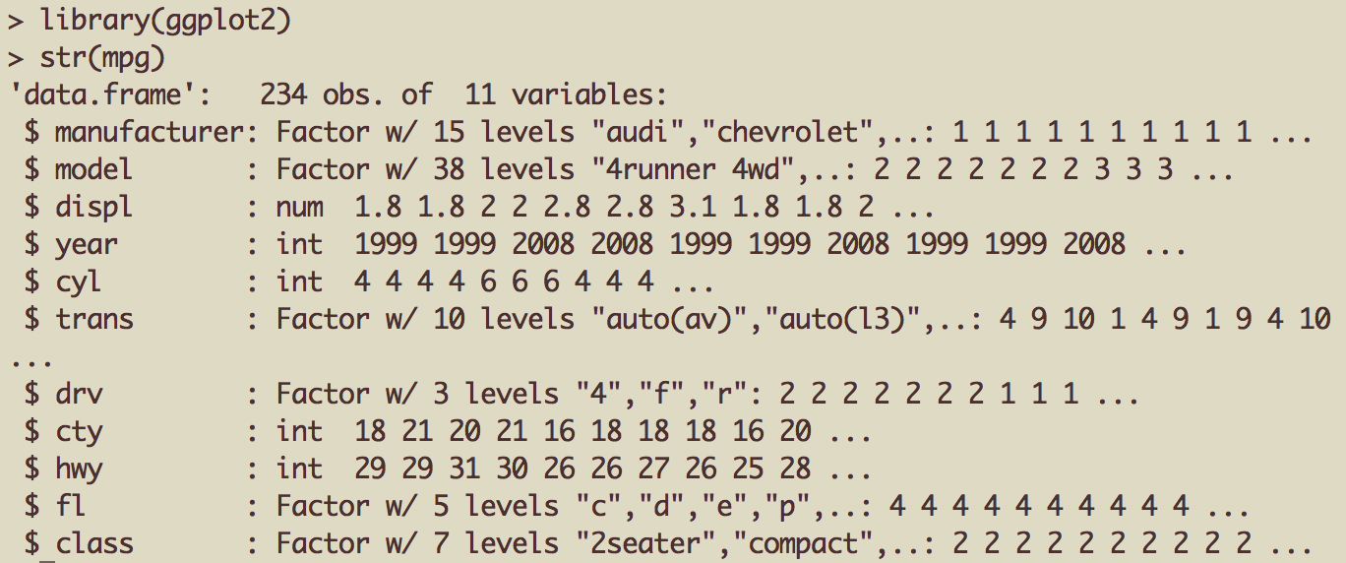
Example Dataset
Factor label information important for annotation

Slide 8

ggplot2 “Hello, world!”
x coord
y coord
data frame

Slide 9
Modifying aesthetics
auto legend placement
color aesthetic
qplot(displ, hwy, data = mpg, color = drv)

Slide 10
Adding a geom
qplot(displ, hwy, data = mpg, geom = c("point", "smooth"))

Slide 11
Histograms
qplot(hwy, data = mpg, fill = drv)

Slide 12
Facets
qplot(displ, hwy, data = mpg, facets = . ~ drv)
qplot(hwy, data = mpg, facets = drv ~ ., binwidth = 2)

Slide 13
MAACS Cohort
Mouse Allergen and Asthma Cohort Study
Baltimore children (aged 5—17)
Persistent asthma, exacerbation in past year
Study indoor environment and its relationship with asthma morbidity
Recent publication: http://goo.gl/WqE9j8

Slide 14
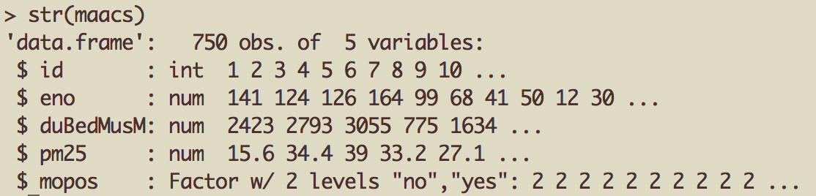
Example: MAACS
Exhaled nitric oxide
Fine particulate matter
Sensitized to mouse allergen

Slide 15
Histogram of eNO
qplot(log(eno), data = maacs)

Slide 16
Histogram by Group
qplot(log(eno), data = maacs, fill = mopos)

Slide 17
Density Smooth
qplot(log(eno), data = maacs, geom = "density")
qplot(log(eno), data = maacs, geom = "density", color = mopos)

Slide 18
Scatterplots: eNO vs. PM_{2.5}
qplot(log(pm25), log(eno), data = maacs)
qplot(log(pm25), log(eno), data = maacs, shape = mopos)
qplot(log(pm25), log(eno), data = maacs, color = mopos)

Slide 19
Scatterplots: eNO vs. PM_{2.5}
qplot(log(pm25), log(eno), data = maacs, color = mopos, geom = c("point", "smooth"), method = "lm")

Slide 20
Scatterplots: eNO vs. PM_{2.5}
qplot(log(pm25), log(eno), data = maacs, geom = c("point", "smooth"), method = "lm", facets = . ~ mopos)

Slide 21
Summary of qplot()
The qplot() function is the analog to plot() but with many built-in features
Syntax somewhere in between base/lattice
Produces very nice graphics, essentially publication ready (if you like the design)
Difficult to go against the grain/customize (don’t bother; use full ggplot2 power in that case)

Slide 22
Resources
The ggplot2 book by Hadley Wickham
The R Graphics Cookbook by Winston Chang (examples in base plots and in ggplot2)
ggplot2 web site (http://ggplot2.org)
ggplot2 mailing list (http://goo.gl/OdW3uB), primarily for developers

Slide 23
What is ggplot2?
An implementation of the Grammar of Graphics by Leland Wilkinson
Grammar of graphics represents and abstraction of graphics ideas/objects
Think “verb”, “noun”, “adjective” for graphics
Allows for a “theory” of graphics on which to build new graphics and graphics objects

Slide 24
Basic Components of a ggplot2 Plot
A data frame
aesthetic mappings: how data are mapped to color, size
geoms: geometric objects like points, lines, shapes.
facets: for conditional plots.
stats: statistical transformations like binning, quantiles, smoothing.
scales: what scale an aesthetic map uses (example: male = red, female = blue).
coordinate system

Slide 25
Building Plots with ggplot2
When building plots in ggplot2 (rather than using qplot) the “artist’s palette” model may be the closest analogy
Plots are built up in layers
Plot the data
Overlay a summary
Metadata and annotation

Slide 26
Example: BMI, PM_{2.5}, Asthma
Mouse Allergen and Asthma Cohort Study
Baltimore children (age 5-17)
Persistent asthma, exacerbation in past year
Does BMI (normal vs. overweight) modify the relationship between PM_{2.5} and asthma symptoms?

Slide 27
Basic Plot
qplot(logpm25, NocturnalSympt, data = maacs, facets = . ~ bmicat, geom = c("point", "smooth"), method = "lm”)

Slide 28
Building Up in Layers
> head(maacs)
logpm25 bmicat NocturnalSympt
2 1.5361795 normal weight 1
3 1.5905409 normal weight 0
4 1.5217786 normal weight 0
5 1.4323277 normal weight 0
6 1.2762320 overweight 8
8 0.7139103 overweight 0
> g <- ggplot(maacs, aes(logpm25, NocturnalSympt))
> summary(g)
data: logpm25, bmicat, NocturnalSympt [554x3]
mapping: x = logpm25, y = NocturnalSympt
faceting: facet_null()
Data Frame
Aesthetics
Initial call to ggplot
Summary of ggplot object

Slide 29
No Plot Yet!
> g <- ggplot(maacs, aes(logpm25, NocturnalSympt))
> print(g)
Error: No layers in plot
> p <- g + geom_point()
> print(p)
> g + geom_point()
Explicitly save and print ggplot object
Auto-print plot object without saving

Slide 30
First Plot with Point Layer
g <- ggplot(maacs, aes(logpm25, NocturnalSympt))
g + geom_point()

Slide 31
Adding More Layers: Smooth
g + geom_point() + geom_smooth()
g + geom_point() + geom_smooth(method = "lm”)

Slide 32
Adding More Layers: Facets
Labels from facet variable
Add facets
Faceting (factor) variable
g + geom_point() + facet_grid(. ~ bmicat) + geom_smooth(method = "lm")

Slide 33
Annotation
Labels: xlab(), ylab(), labs(), ggtitle()
Each of the “geom” functions has options to modify
For things that only make sense globally, use theme()
Example: theme(legend.position = "none")
Two standard appearance themes are included
theme_gray(): The default theme (gray background)
theme_bw(): More stark/plain

Slide 34
Modifying Aesthetics
g + geom_point(color = "steelblue”, size = 4, alpha = 1/2)
g + geom_point(aes(color = bmicat), size = 4, alpha = 1/2)
Constant values
Data variable

Slide 35
Modifying Labels
labs() function for modifying titles and x-, y-axis labels
g + geom_point(aes(color = bmicat)) + labs(title = "MAACS Cohort") + labs(x = expression("log " * PM[2.5]), y = "Nocturnal Symptoms")

Slide 36
Customizing the Smooth
Modified smoother
g + geom_point(aes(color = bmicat), size = 2, alpha = 1/2) + geom_smooth(size = 4, linetype = 3, method = "lm", se = FALSE)

Slide 37
Changing the Theme
g + geom_point(aes(color = bmicat)) + theme_bw(base_family = "Times”)

Slide 38
A Notes about Axis Limits
testdat <- data.frame(x = 1:100, y = rnorm(100))
testdat[50,2] <- 100 ## Outlier!
plot(testdat$x, testdat$y, type = "l", ylim = c(-3,3))
g <- ggplot(testdat, aes(x = x, y = y))
g + geom_line()

Slide 39
Axis Limits
Outlier missing
Outlier included
g + geom_line() + ylim(-3, 3)
g + geom_line() + coord_cartesian(ylim = c(-3, 3))

Slide 40
More Complex Example
How does the relationship between PM_{2.5} and nocturnal symptoms vary by BMI and NO₂?
Unlike our previous BMI variable, NO₂ is continuous
We need to make NO2 categorical so we can condition on it in the plotting
Use the cut() function for this

Slide 41
Making NO₂ Deciles
## Calculate the deciles of the data
> cutpoints <- quantile(maacs$logno2_new, seq(0, 1, length = 11), na.rm = TRUE)
## Cut the data at the deciles and create a new factor variable
> maacs$no2dec <- cut(maacs$logno2_new, cutpoints)
## See the levels of the newly created factor variable
> levels(maacs$no2dec)
[1] "(0.378,0.969]" "(0.969,1.1]" "(1.1,1.17]" "(1.17,1.26]"
[5] "(1.26,1.32]" "(1.32,1.38]" "(1.38,1.44]" "(1.44,1.54]"
[9] "(1.54,1.69]" "(1.69,2.55]"

Slide 42
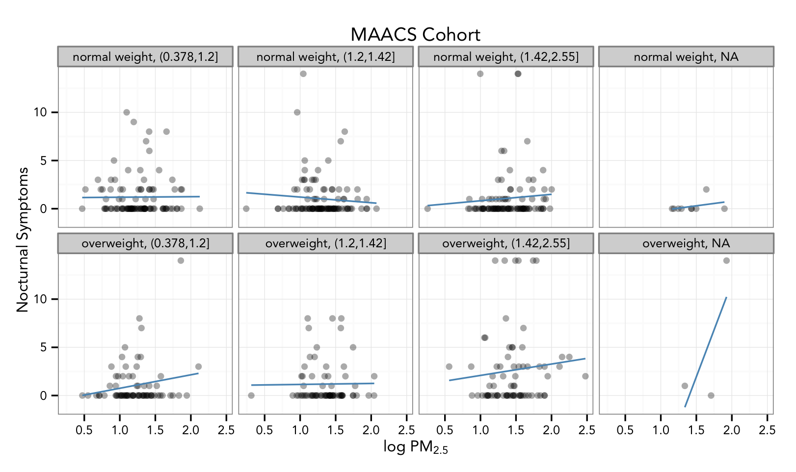
Final Plot
Non-default font
Multiple panels
Transparent points
Smoother
Labels/Title

Slide 43
Code for Final Plot
Add points
## Setup ggplot with data frame
g <- ggplot(maacs, aes(logpm25, NocturnalSympt))
## Add layers
g + geom_point(alpha = 1/3)
+ facet_wrap(bmicat ~ no2dec, nrow = 2, ncol = 4)
+ geom_smooth(method="lm", se=FALSE, col="steelblue")
+ theme_bw(base_family = "Avenir", base_size = 10)
+ labs(x = expression("log " * PM[2.5])
+ labs(y = "Nocturnal Symptoms”)
+ labs(title = "MAACS Cohort”)
Add smoother
Make panels
Change theme
Add labels

Slide 44
Summary
ggplot2 is very powerful and flexible if you learn the “grammar” and the various elements that can be tuned/modified
Many more types of plots can be made; explore and mess around with the package (references mentioned in Part 1 are useful)

