Slide 1
Computational and Policy Tools for Reproducible Research
Roger D. Peng, PhD
Department of Biostatistics
Johns Hopkins Bloomberg School of Public Health
July 2011
Vancouver, BC

Slide 2
Replication
The ultimate standard for strengthening scientific evidence is replication of findings and conducting studies with independent
Investigators
Data
Analytical methods
Laboratories
Instruments
Replication is particularly important in studies that can impact broad policy or regulatory decisions

Slide 3
Why Do We Need Reproducible Research?
Some studies cannot be replicated
No time, opportunistic
No money
Unique
New technologies increasing data collection throughput; data are more complex and extremely high dimensional
Existing databases can be merged into new “megadatabases”
Computing power is greatly increased, allowing more sophisticated analyses
For every field “X” there is a field “Computational X”

Slide 4
How Can We Bridge the Gap?
?
Replicate
Nothing

Slide 5
Research Pipeline
Article
Reader

Slide 6
Research Pipeline
Author
Presentation code
Processing code
Analytic code
Figures
Measured Data
Analytic Data
Computational Results
Tables
Article
Numerical Summaries
Text
Reader

Slide 7
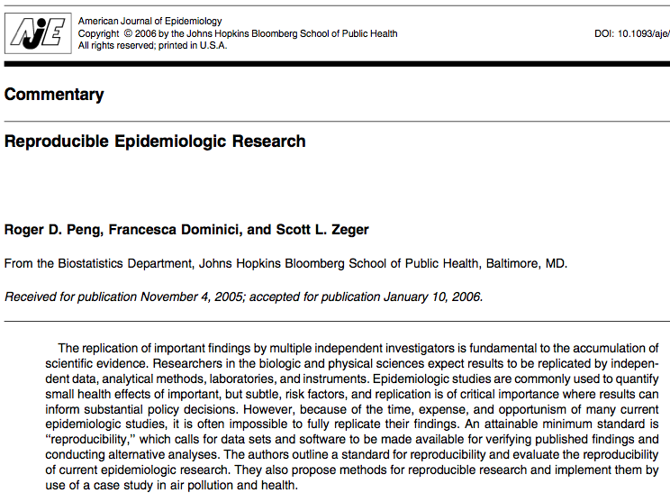

Slide 8
Reproducible Air Pollution and Health Research
Estimating small (but important) health effects in the presence of much stronger signals
Results inform substantial policy decisions, affect many stakeholders
EPA regulations can cost billions of dollars
Complex statistical methods are needed and subjected to intense scrutiny

Slide 9
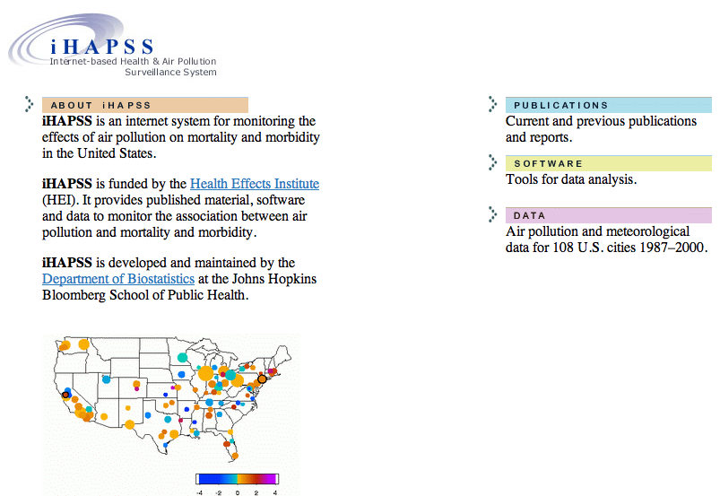
Internet-based Health and Air Pollution Surveillance System (iHAPSS)
http://www.ihapss.jhsph.edu

Slide 10
What is Reproducible Research?
Analytic data are available
Analytic code are available
Documentation of code and data
Standard means of distribution

Slide 11
Who are the Players?
Authors
Want to make their research reproducible
Want tools for RR to make their lives easier (or at least not much harder)
Readers
Want to reproduce (and perhaps expand upon) interesting findings
Want tools for RR to make their lives easier

Slide 12
Challenges
Authors must undertake considerable effort to put data/results on the web (may not have resources like a web server)
Readers must download data/results individually and piece together which data go with which code sections, etc.
Readers may not have the same resources as authors

Slide 13
In Reality…
Authors
Just put stuff on the web
Journal supplementary materials
There are some central databases for various fields (e.g. biology, ICPSR)
Readers
Just download the data and (try to) figure it out
Piece together the software and run it

Slide 14
Literate (Statistical) Programming
An article is a stream of text and code
Analysis code is divided into text and code “chunks”
Each code chunk loads data and computes results
Presentation code formats results (tables, figures, etc.)
Article text explains what is going on
Literate programs can be weaved to produce human-readable documents and tangled to produce machine-readable documents

Slide 15
Literate (Statistical) Programming
Literate programming is a general concept that requires
A documentation language (human readable)
A programming language (machine readable)
Sweave uses L^{A}T_{E}X and R as the documentation and programming languages
Sweave was developed by Friedrich Leisch (member of the R Core) and is maintained by R core
Main web site: http://www.statistik.lmu.de/ ̃leisch/Sweave
Alternatives to LATEX/R exist, suchas HTML/R (package R2HTML) and ODF/R (package odfWeave).

Slide 16
Research Pipeline
Author
Presentation code
Processing code
Analytic code
Figures
Measured Data
Analytic Data
Computational Results
Tables
Article
Numerical Summaries
Text
Reader

Slide 17
Research Pipeline
Author
Presentation code
Processing code
Analytic code
Figures
Measured Data
Analytic Data
Computational Results
Tables
Article
Database
Numerical Summaries
Text
Reader

Slide 18
Caching Computations
LaTeX/R
PDF
Local/Remote
Magnum Opus
Magnum Opus
Cached computations
Figure 1
Code chunk 1
Database 1
Code chunk 2
Database 2
Table 1

Slide 19
The cacher package for R
Add-on package for R
Evaluates code written in files and stores intermediate results in a key-value database
R expressions are given SHA-1 hash values so that changes can be tracked and code reevaluated if necessary
“Cacher packages” can be built for distribution
Others can “clone” an analysis and evaluate subsets of code or inspect data objects
Journal of Statistical Software, 26 (7), 1—24

Slide 20
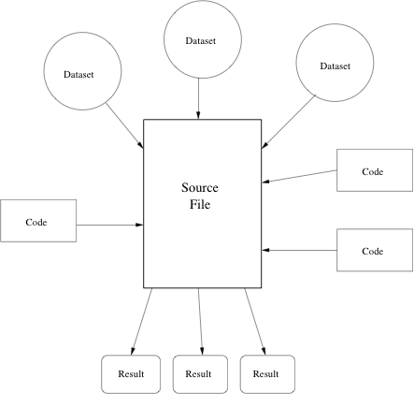
Conceptual Model

Slide 21
Using cacher as an Author
Parse the R source ﬁle; Create the necessary cache directories and subdirectories
Cycle through each expression in the source ﬁle:
If an expression has never been evaluated, evaluate it and store any resulting R objects in the cache database,
If a cached result exists, lazy-load the results from the cache database and move to the next expression,
If an expression does not create any R objects (i.e., there is nothing to cache), add the expression to the list of expressions where evaluation needs to be forced
Write out metadata for this expression to the metadata ﬁle.

Slide 22
Using cacher as an Author
The cachepackage function creates a cacher package storing
Source file
Cached data objects
Metadata
Package file is zipped and can be distributed
Readers can unzip the file and immediately investigate its contents via cacher package

Slide 23
Example: Simple Analysis
library(datasets)
library(stats)
## Load the dataset
data(airquality)
## Fit a linear model
fit <- lm(Ozone ~ Wind + Temp + Solar.R, data = airquality)
summary(fit)
## Plot some diagnostics
par(mfrow = c(2, 2))
plot(fit)
Nothing created (packages attached)
“airquality” object loaded into workspace
“fit” object created in workspace
Side effect (printing to console)
Side effect (plotting to graphics device)

Slide 24
Using cacher as a Reader
A journal article says...
“…the code and data for this analysis can be found in the cacher package 092dcc7dda4b93e42f23e038a60e1d44dbec7b3f.”
> library(cacher)
> clonecache(id = "092dcc7dda4b93e42f23e038a60e1d44dbec7b3f”)
> clonecache(id = “092d”) ## Same as above
created cache directory '.cache'
> showfiles()
[1] "top20.R"
> sourcefile("top20.R")

Slide 25
Cloning an Analysis
Local directories created
Source code files and metadata are downloaded
Data objects are not downloaded by default
References to data objects are loaded and corresponding data can be lazy-loaded on demand

Slide 26
Examining Code
> code()
source file: top20.R
1 cities <- readLines("citylist.txt")
2 classes <- readLines("colClasses.txt")
3 vars <- c("date", "dow", "death",
4 data <- lapply(cities, function(city) {
5 names(data) <- cities
6 estimates <- sapply(data, function(city) {
7 effect <- weighted.mean(estimates[1,
8 stderr <- sqrt(1/sum(1/estimates[2,
> graphcode()

Slide 27
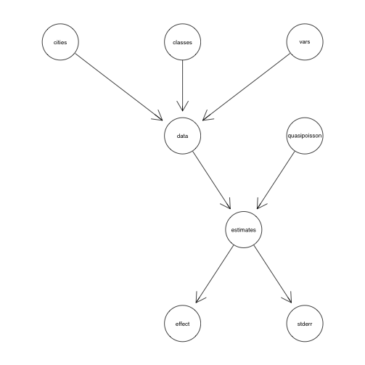
Analysis Code Graphs

Slide 28
Tracing Code Backwards
> objectcode(“data”)
source file: top20.R
1 cities <- readLines("citylist.txt")
2 classes <- readLines("colClasses.txt")
3 vars <- c("date", "dow", "death", "tmpd", "rmtmpd", "dptp",
"rmdptp", "l1pm10tmean")
4 data <- lapply(cities, function(city) {
filename <- file.path("data", paste(city, "csv",
sep = "."))
d0 <- read.csv(filename, colClasses = classes,
nrow = 5200)
d0[, vars]
})
5 names(data) <- cities

Slide 29
Running Code
The runcode function executes code in the source file
By default, expressions that results in an object being created are not run and the resulting objects is lazy-loaded into the workspace
Expressions not resulting in objects are evaluated

Slide 30
Checking Code and Objects
The checkcode function evaluates all expressions from scratch (no lazy-loading)
Results of evaluation are checked against stored results to see if the results are the same as what the author calculated
Setting RNG seeds is critical for this to work
The integrity of data objects can be verified with the checkobjects function to check for possible corruption of data (i.e. in transit)

Slide 31
Inspecting Data Objects
> loadcache()
> ls()
[1] "cities" "classes" "data" "effect"
[5] "estimates" "stderr" "vars"
> cities
/ transferring cache db file b8fd490bcf1d48cd06...
[1] "la" "ny" "chic" "dlft" "hous" "phoe"
[7] "staa" "sand" "miam" "det" "seat" "sanb"
[13] "sanj" "minn" "rive" "phil" "atla" "oakl"
[19] "denv" "clev"

Slide 32
Inspecting Data Objects
> effect
/ transferring cache db file 584115c69e5e2a4ae5...
[1] 0.0002313219
> stderr
/ transferring cache db file 81b6dc23736f3d72c6...
[1] 0.000052457
A 10 unit increase in PM₁₀ is associated with a 0.23% increase in daily mortality

Slide 33
cacher Summary
The cacher package can be used by authors to create cache packages from data analyses for distribution
Readers can use the cacher package to inspect others’ data analyses by examining cached computations
cacher is mindful of readers’ resources and efficiently loads only those data objects that are needed

Slide 34
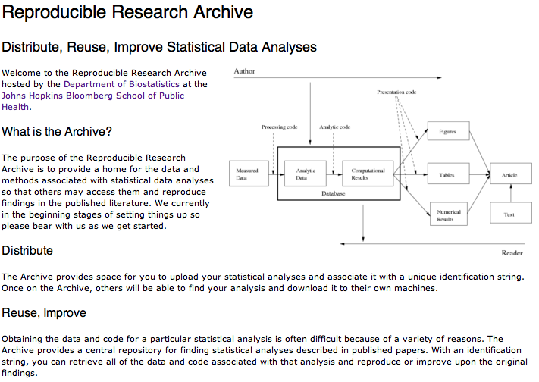
A Central Archive for Reproducible Data Analyses
http://penguin.biostat.jhsph.edu/

Slide 35
Reproducible Research and Journals
What policies can journals implement to make published research reproducible?
Carrot or stick?

Slide 36
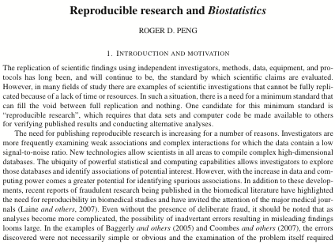
RR Policy at Biostatistics
Biostatistics (2009), 10, 3, pp. 405–408

Slide 37
Dimensions of Reproducibility
Data (“D”): The analytic data from which the principal results were derived are made available on the journal’s Web site. The authors are responsible for ensuring that necessary permissions are obtained before the data are distributed.

Slide 38
Dimensions of Reproducibility
Data (“D”): The analytic data from which the principal results were derived are made available on the journal’s Web site. The authors are responsible for ensuring that necessary permissions are obtained before the data are distributed.
Code (“C”): Any computer code, software, or other computer instructions that were used to compute published results are provided. For software that is widely available from central repositories (e.g. CRAN, Statlib), a reference to where they can be obtained will suffice.

Slide 39
Dimensions of Reproducibility
Data (“D”): The analytic data from which the principal results were derived are made available on the journal’s Web site. The authors are responsible for ensuring that necessary permissions are obtained before the data are distributed.
Code (“C”): Any computer code, software, or other computer instructions that were used to compute published results are provided. For software that is widely available from central repositories (e.g. CRAN, Statlib), a reference to where they can be obtained will suffice.
Reproducible (“R”): An article is designated as reproducible if the AER succeeds in executing the code on the data provided and produces results matching those that the authors claim are reproducible. In reproducing these results, reasonable bounds for numerical tolerance will be considered.

Slide 40


Kite Marking

Slide 41
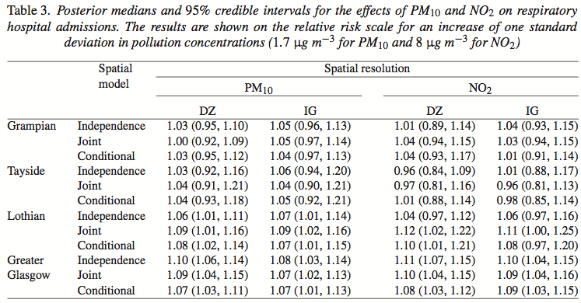
What is Reproducible?
Lee, Ferguson & Mitchell, Biostatistics, 2009

Slide 42
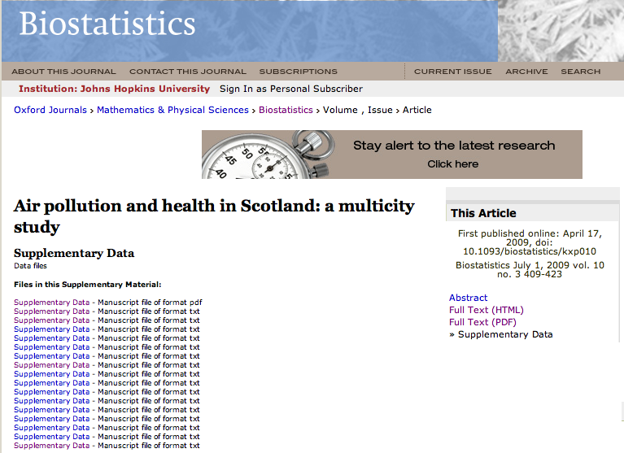
Supplementary Data (not ideal)

Slide 43
Some Sparse Data
Data so far (a little old…)
4 papers have requested and received the “R” kite mark
4 papers received a “C”
2 papers received a “D”
1 paper with “DC”

Slide 44
Further Work
Need a better system at journal for tracking and highlighting papers with kite-marks
Infrastructure for hosting data is limited
Infrastructure for reproducing results is limited
Need better advertising of this policy

Slide 45
Summary
Reproducible research is important as a minimum standard, particularly for studies that are difficult to replicate
Infrastructure is needed for creating and distributing reproducible documents, beyond what is currently available
The cacher package caches intermediate computations for future inspection
Scientific culture needs to evolve to encourage greater sharing of datasets and methods
Journals can play a key role by providing both carrots and sticks to authors

Slide 46
Acknowledgments
Joint work with
Duncan Temple Lang (UC Davis)
Deb Nolan (Berkeley)
Sandy Eckel (USC)
Funded by
National Institute of Environmental Health Science
National Institute on Aging
Johns Hopkins Faculty Innovation Fund
Health Effects Institute

