Slide 1
Reproducible Research: Concepts and Ideas
Reproducible Research
Roger D. Peng, Associate Professor of Biostatistics
Johns Hopkins Bloomberg School of Public Health

Slide 2
Replication
The ultimate standard for strengthening scientific evidence is replication of findings and conducting studies with independent
Investigators
Data
Analytical methods
Laboratories
Instruments
Replication is particularly important in studies that can impact broad policy or regulatory decisions

Slide 3
What’s Wrong with Replication?
Some studies cannot be replicated
No time, opportunistic
No money
Unique
Reproducible Research: Make analytic data and code available so that others may reproduce findings

Slide 4
How Can We Bridge the Gap?
Replication
?
Nothing

Slide 5
How Can We Bridge the Gap?
Replication
Reproduciblity
Nothing

Slide 6
Why Do We Need Reproducible Research?
New technologies increasing data collection throughput; data are more complex and extremely high dimensional
Existing databases can be merged into new “megadatabases”
Computing power is greatly increased, allowing more sophisticated analyses
For every field “X” there is a field “Computational X”

Slide 7
Example: Reproducible Air Pollution and Health Research
Estimating small (but important) health effects in the presence of much stronger signals
Results inform substantial policy decisions, affect many stakeholders
EPA regulations can cost billions of dollars
Complex statistical methods are needed and subjected to intense scrutiny

Slide 8
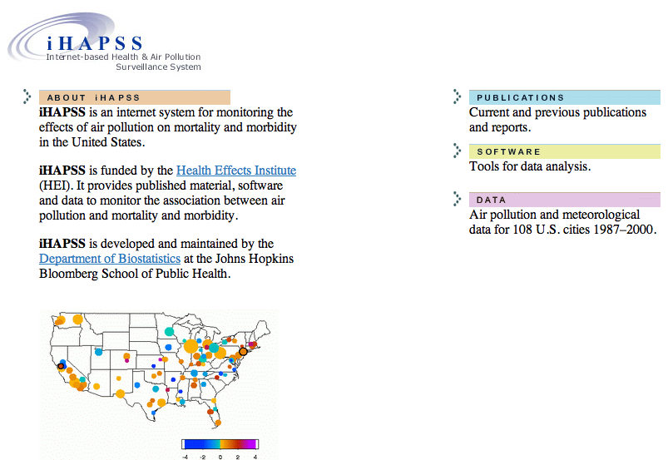
Internet-based Health and Air Pollution Surveillance System (iHAPSS)
http://www.ihapss.jhsph.edu

Slide 9
Research Pipeline
Article
Reader

Slide 10
Research Pipeline
Author
Presentation code
Processing code
Analytic code
Figures
Measured Data
Analytic Data
Computational Results
Tables
Article
Numerical Summaries
Text
Reader

Slide 11

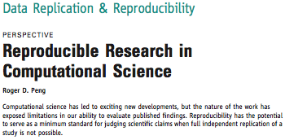
Recent Developments in Reproducible Research

Slide 12

Recent Developments in Reproducible Research
The Duke Saga

Slide 13
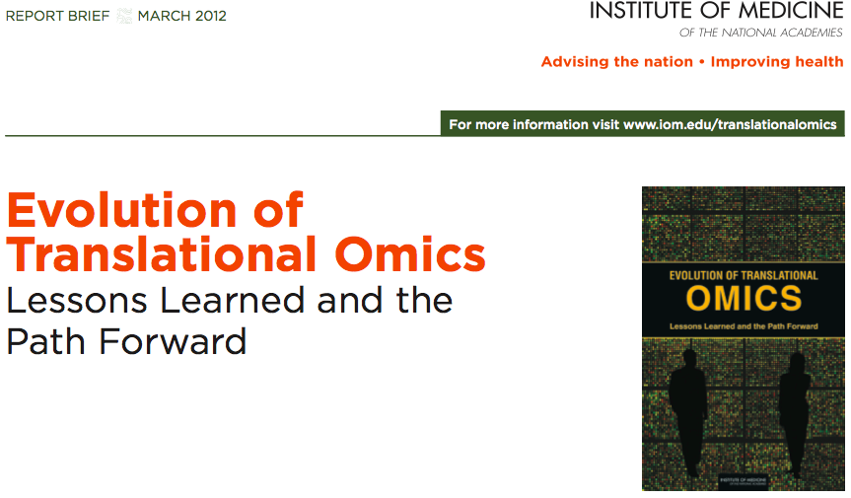
Recent Developments in Reproducible Research

Slide 14
The IOM Report
In the Discovery/Test Validation stage of omics-based tests:
Data/metadata used to develop test should be made publicly available
The computer code and fully specified computational procedures used for development of the candidate omics-based test should be made sustainably available
“Ideally, the computer code that is released will encompass all of the steps of computational analysis, including all data preprocessing steps, that have been described in this chapter. All aspects of the analysis need to be transparently reported.”

Slide 15
What do We Need?
Analytic data are available
Analytic code are available
Documentation of code and data
Standard means of distribution

Slide 16
Who are the Players?
Authors
Want to make their research reproducible
Want tools for RR to make their lives easier (or at least not much harder)
Readers
Want to reproduce (and perhaps expand upon) interesting findings
Want tools for RR to make their lives easier

Slide 17
Challenges
Authors must undertake considerable effort to put data/results on the web (may not have resources like a web server)
Readers must download data/results individually and piece together which data go with which code sections, etc.
Readers may not have the same resources as authors
Few tools to help authors/readers (although toolbox is growing!)

Slide 18
In Reality…
Authors
Just put stuff on the web
(Infamous) Journal supplementary materials
There are some central databases for various fields (e.g. biology, ICPSR)
Readers
Just download the data and (try to) figure it out
Piece together the software and run it

Slide 19
Literate (Statistical) Programming
An article is a stream of text and code
Analysis code is divided into text and code “chunks”
Each code chunk loads data and computes results
Presentation code formats results (tables, figures, etc.)
Article text explains what is going on
Literate programs can be weaved to produce human-readable documents and tangled to produce machine-readable documents

Slide 20
Literate (Statistical) Programming
Literate programming is a general concept that requires
A documentation language (human readable)
A programming language (machine readable)
Sweave uses L^{A}T_{E}X and R as the documentation and programming languages
Sweave was developed by Friedrich Leisch (member of the R Core) and is maintained by R core
Main web site: http://www.statistik.lmu.de/~leisch/Sweave

Slide 21
Sweave Limitations
Sweave has many limitations
Focused primarily on LaTeX, a difficult to learn markup language used only by weirdos
Lacks features like caching, multiple plots per chunk, mixing programming languages and many other technical items
Not frequently updated or very actively developed

Slide 22
Literate (Statistical) Programming
knitr is an alternative (more recent) package
Brings together many features added on to Sweave to address limitations
knitr uses R as the programming language (although others are allowed) and variety of documentation languages
LaTeX, Markdown, HTML
knitr was developed by Yihui Xie (while a graduate student in statistics at Iowa State)
See http://yihui.name/knitr/

Slide 23
Summary
Reproducible research is important as a minimum standard, particularly for studies that are difficult to replicate
Infrastructure is needed for creating and distributing reproducible documents, beyond what is currently available
There is a growing number of tools for creating reproducible documents

