Slide 1
Start Page
Tableau Desktop Workspace
Show Me
Tableau Navigation
Connecting to Excel Files
Data Roles
Blue versus green pills
Data Types
Connecting to Text Files
Connection to Database
Connection to Websites
Connecting to Tableau Server
Notes:
Start Page
Tableau Desktop Workspace
Show Me
Tableau Navigation
Connecting to Excel Files
Connecting to Text Files
Connection to Database
Connection to Websites
Connecting to Tableau Server
Data Relationship
Union
Data Sorting
Replacing Data Source

Slide 2
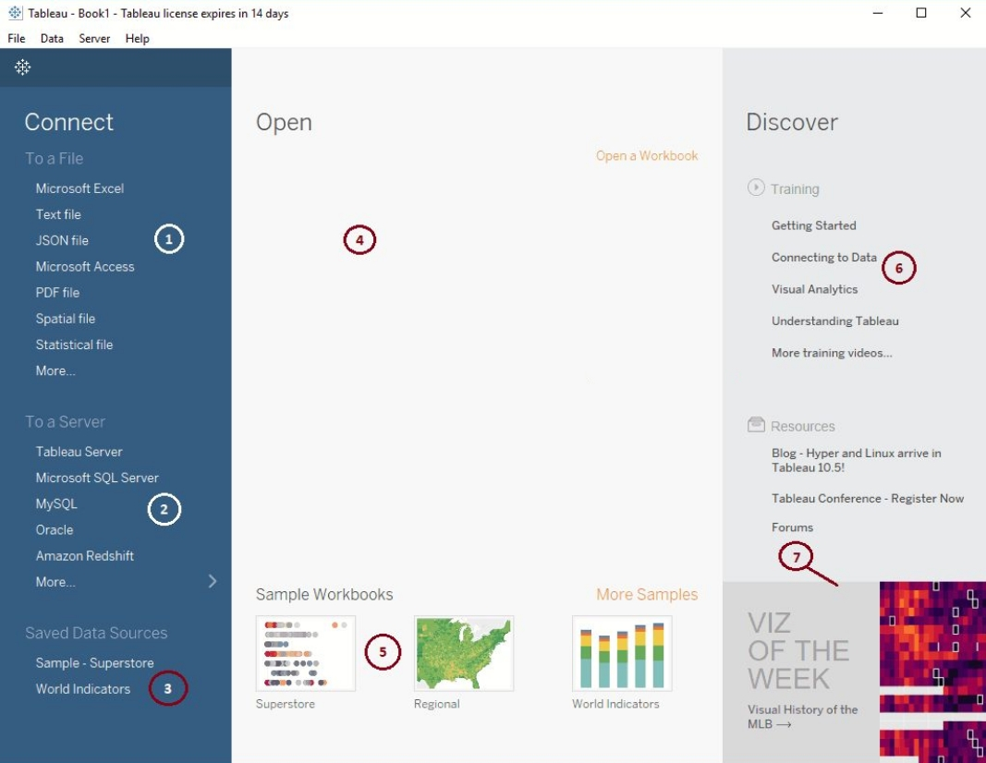
Start Page
Notes:
Connect to a File: This section helps you to connect with Files, or allows you to extract data from files such as Excel, Text Files, PDFs, Spatial Files etc.
Connect To a Server: This section helps you to connect with the Servers, or allows you to extract data from servers such as MySQL, SQL Server, Tableau Server etc.
Saved Data Sources: All the existing or Saved Data Sources will be displayed under this section.
Open: Most recently used Workbooks will be displayed under this section. Currently, we don’t have any used workbooks.
Sample Workbooks: These are sample workbooks that will come with Tableau Desktop installation.
Training and Resources: Links to Useful Blogs and some videos.
Content produced by the tableau Community.

Slide 3
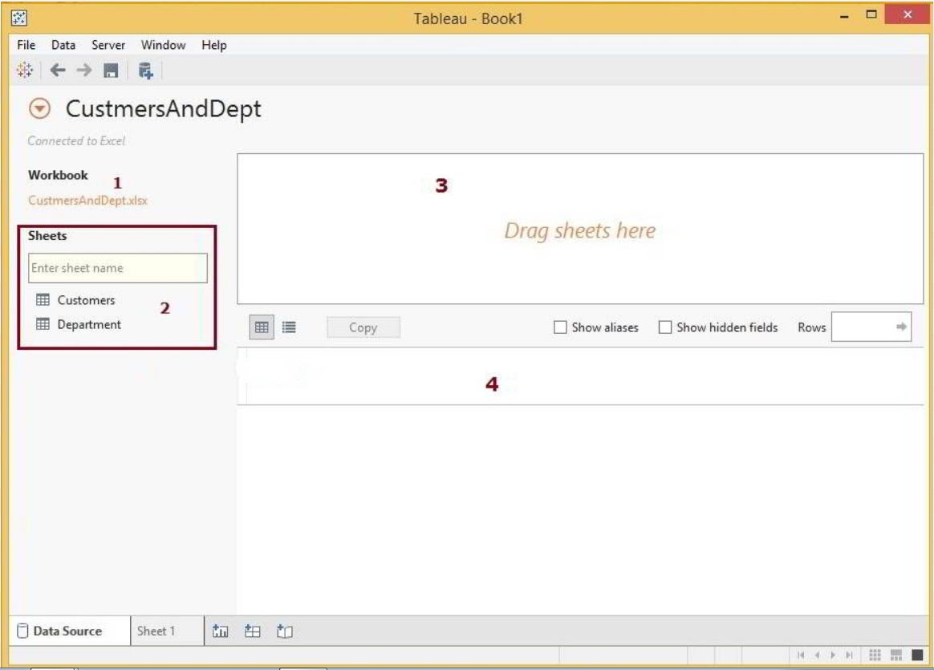
Tableau Desktop Workspace
Notes:
Workbook: Excel File we selected from our file system.
Sheets: This section will display the Sheets or Tables present in the Excel source. We have two tables so, it is displaying those two sheets (Customers and Department). We have the search bar under this section and it is very useful for a large number of sheets. For instance, If you have 30 or 40 sheets then you can use this to search for a specific table
Drag Sheets Here: You have to Drag Table(s) from Sheets to this Section. Tableau will only use the tables present in this area. This is something like Dataset.
This region will show the data present in our Dataset

Slide 4
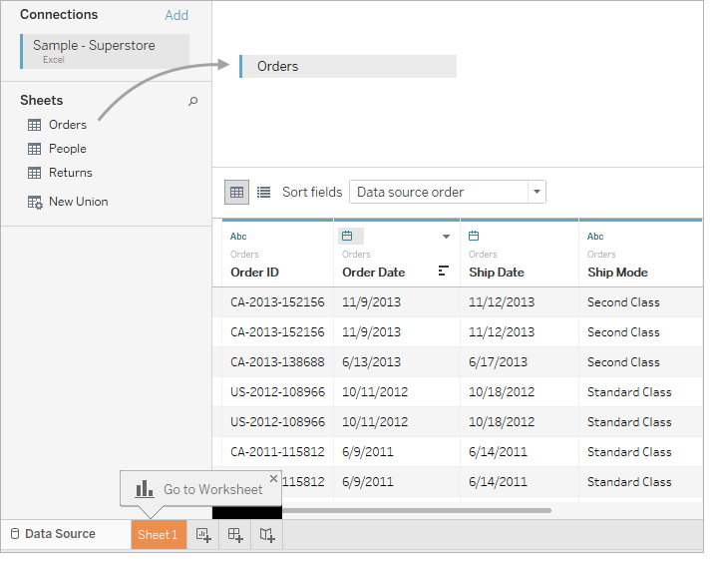
Notes:
Connect to your data
The first step is to connect to the data you want to explore. This example shows how to connect to Sample - Superstore data in Tableau Desktop.
Open Tableau. On the start page, under Connect / Saved Data Sources, click Excel.
In the Open dialog box, navigate to the Sample - Superstore Excel file on your computer. Go to /My Documents/My Tableau Repository/Datasources/version number/[language]. Select Sample - Superstore, and then click Open.
Click the sheet tab to go to the new worksheet and begin your analysis.

Slide 5
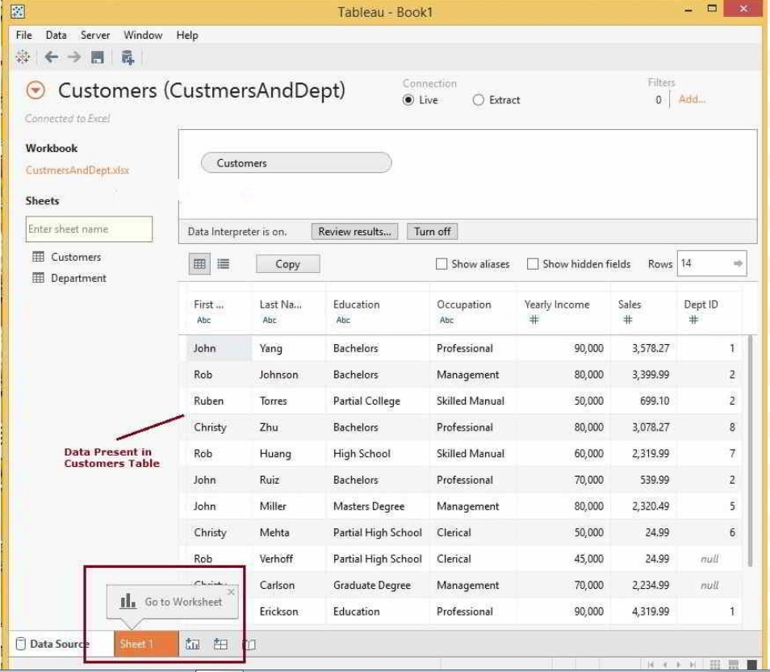
Notes:
We can add the sheets to Region 3 in Multiple Ways: As the Name suggests, Either we can Drag the Customers Table from Sheets region to 3rd region or else simply double-click on the required table will automatically add

Slide 6
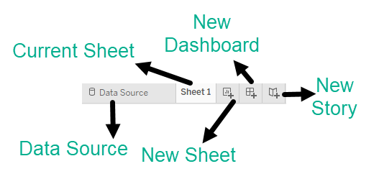
Tableau Navigation
Notes:
Data Source:
The addition of new data source of modification of existing data source can be done using the 'Data Source' tab present at the bottom of the Tableau Desktop Window.
Current Sheet:
Current Sheet can be viewed with the name of the sheet. All the sheets, dashboards and story board present in the workbook can be viewed here.
New Sheet:
The new sheet icon present in the tab can be used to create a new worksheet in the Tableau Workbook.
New Dashboard:
The new dashboard icon present in the tab can be used to create a new dashboard in the Tableau Workbook.
New Storyboard:
The new storyboard icon present in the tab can be used to create new storyboard in the Tableau Workbook.

Slide 7
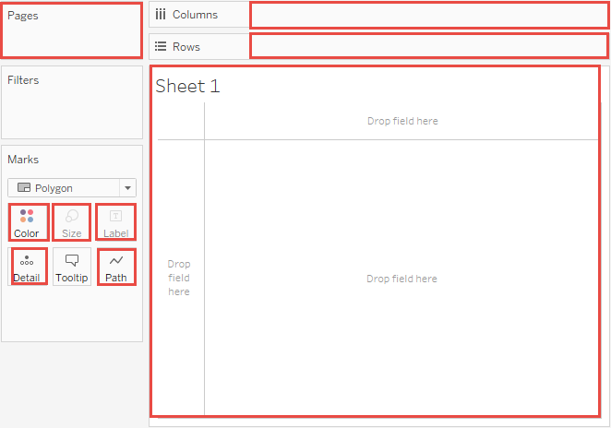

Slide 8
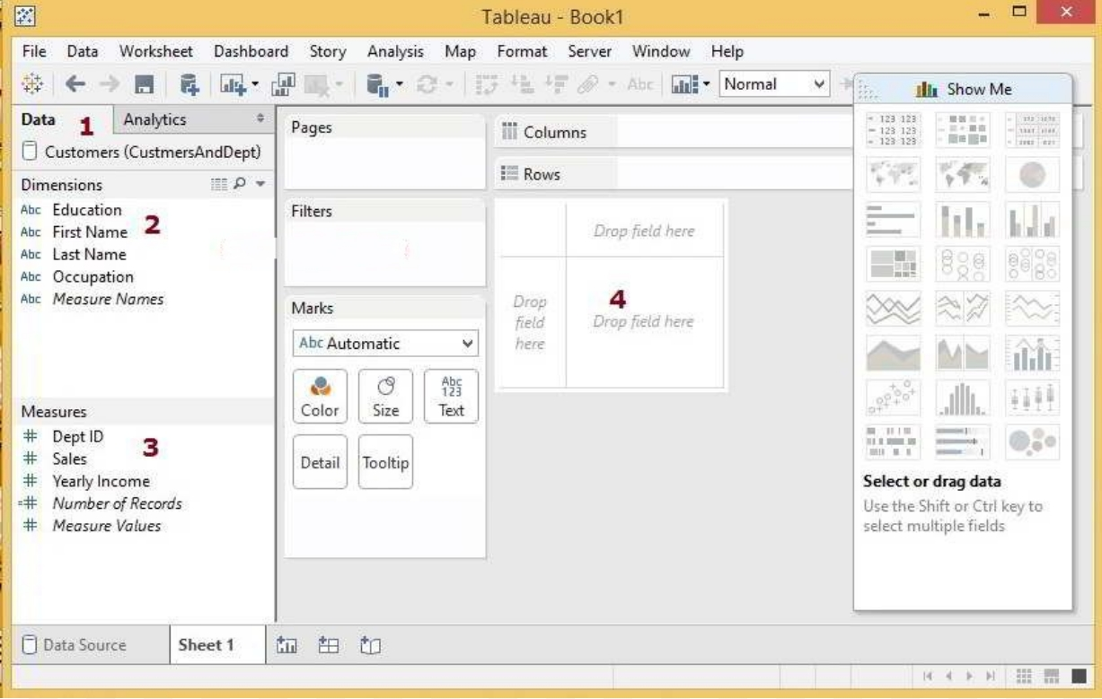
Notes:
Once you are finished, Click on the Sheet 1 tab to design the report.
Data: This will display the list of currently connected data Sources. We have only “One” at this time otherwise, it will display all the data sources available.
Dimensions: Columns with string data will be placed under the Dimensions section
Measures: Columns with Numeric data or Metric values will be placed under the Measures section
This is the region where we design our Tableau reports by dragging Measures and Dimensions

Slide 9
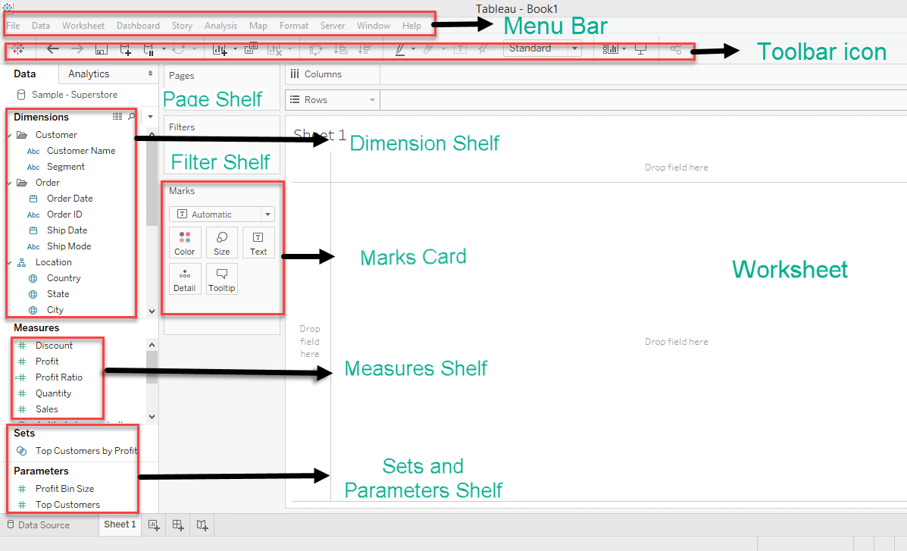
Notes:
Menu Bar:
It consists of menu options such as File, Data, Worksheet, Dashboard, Story, Analysis, Map, Format, Server, and Windows. The options in the menu bar include features such as file saving, data source connection, file export, table calculation options, and design features for creating a worksheet, dashboard, and storyboard.
Toolbar Icon:
Toolbar icon present below the menu bar can be used to edit the workbook using different features such as undo, redo, save, new data source, slideshow and so on.
Dimension Shelf:
The dimensions present in the data source can be viewed in the dimension shelf.
Measure Shelf:
The measures present in the data source can be viewed on the measure shelf.
Sets and Parameters Shelf:
The user-defined sets and parameters can be viewed in the sets and parameter shelf. It can also be used to edit the existing sets and parameters.
Page Shelf:
Page shelf can be used to view the visualization in video format by keeping the relevant filter on the page shelf.
Filter Shelf:
The filters that can control the visualization can be placed on the filter shelf, and the required dimensions or measures can be filtered in.
Marks Card:
Marks card can be used to design the visualization. The data components of the visualization such as color, size, shape, path, label, and tooltip used in the visualizations can be modified in the marks card.
Worksheet:
The worksheet is the place where the actual visualization can be viewed in the workbook. The design and functionalities of the visual can be viewed in the worksheet.

Slide 10
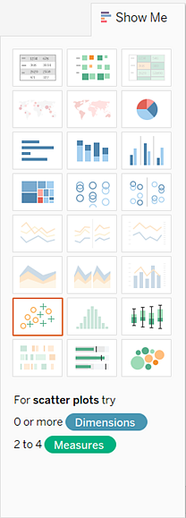
Show me
Notes:
Following are the list of charts that are available in Show me window.
Text Label
Heat Map
Highlight Table
Symbol Maps
Maps
Pie Chart
Horizontal Bars
Stacked Bars
Side-By-Side Bars
Treemap
Circle Views
Side-By-Side Circle Views
Line Chart
Discrete Lines
Dual Lines
Area Chart
Discrete Area Chart
Dual Combination Chart
Scatter Plot
Histograms
Box and Whisker Plots
Gantt Chart
Bullet Graph
Packed Bubbles Chart

Slide 11
Data Roles
A field can be assigned to a Dimension role or a Measure role.
Dimensions contain qualitative values (such as names, dates, or geographical data). You can use dimensions to categorize, segment, and reveal the details in your data. Dimensions affect the level of detail in the view.
Measures contain numeric, quantitative values that you can measure. Measures can be aggregated. When you drag a measure into the view, Tableau applies an aggregation to that measure (by default).
Qualitative fields (Dimensions)
Describes or categorizes data
Tells you what, when, or who
Slices the quantitative data
Quantitative fields (Measures)
Numerical data
Provides the measurement for qualitative category
Can be used in calculations

Slide 12
Blue versus green pills
discrete (blue)
continuous (green)
discrete means "individually separate and distinct."
Discrete values are treated as finite
discrete fields add headers to the view.
Continuous field values are treated as an infinite range.
continuous fields add axes to the view
Continuous means "forming an unbroken whole, without interruption"

Slide 13
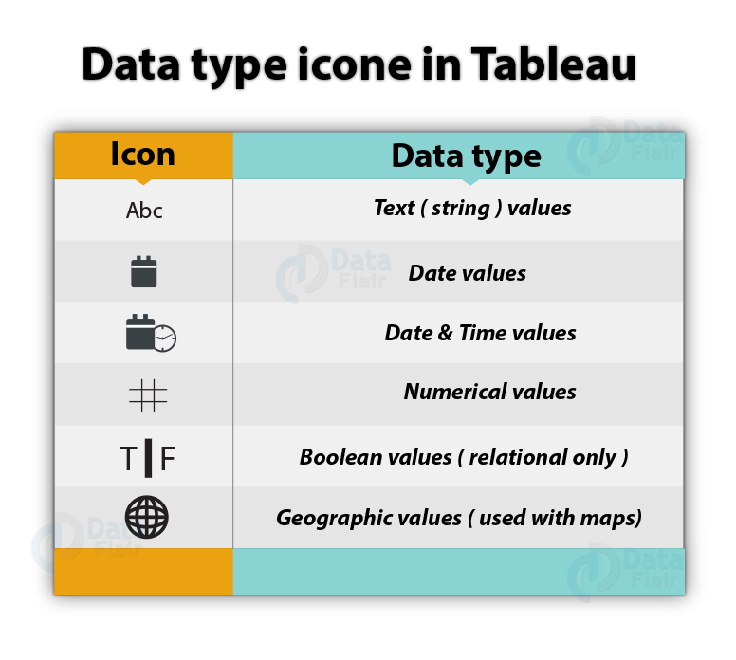
Data Types

Slide 14
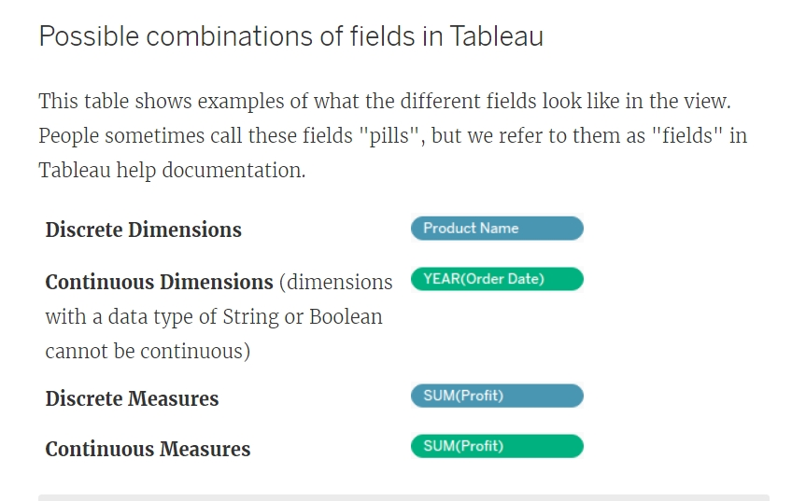

Slide 15
Blue things group your data
Green things count your data
Dimensions split up the view
Measures fill the view

Slide 16
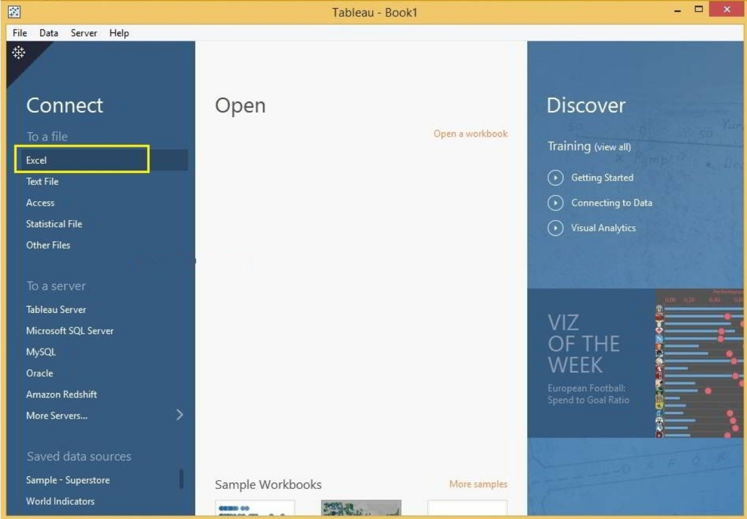
Connecting to Excel Files
Notes:
Once you selected the Excel Option, a new window will be opened to select the Excel file from our file system.

Slide 17
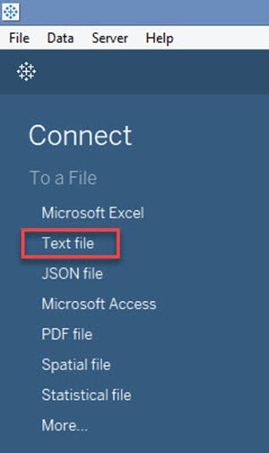
Connecting to Text Files
Notes:
Click on the "Text File" option given in the data tab.
In the next screen, Select the SuperStore.csv

Slide 18
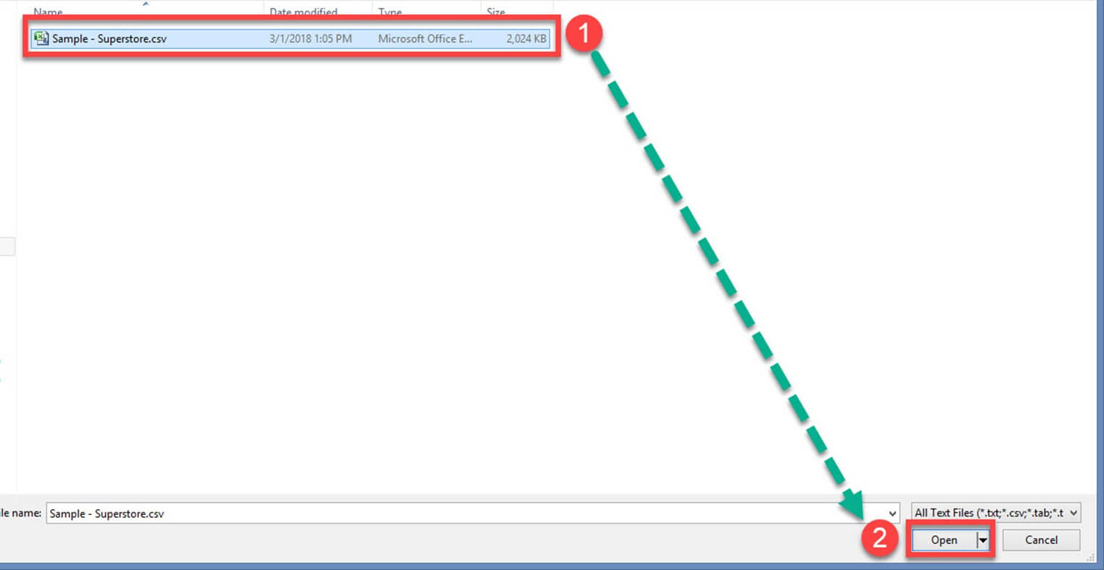
Notes:
Select the SuperStore.csv
Click on "Open" Option. This will connect the text file into Tableau

Slide 19
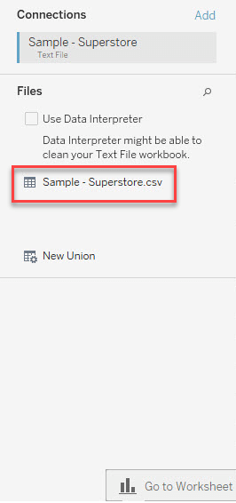
Notes:
In the left pane you will see the CSV file.

Slide 20
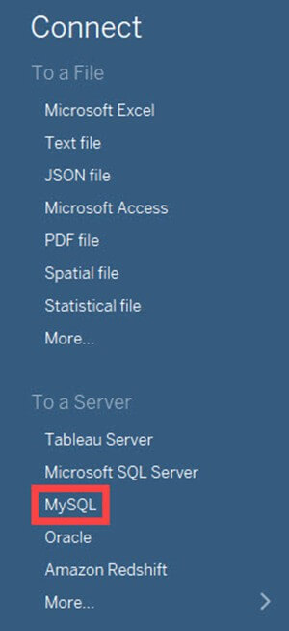
Connection to Database
Notes:
Click on the required database connection given in the data tab. For example, if you want to connect to MySQL database, click on the "MySQL" Option.

Slide 21
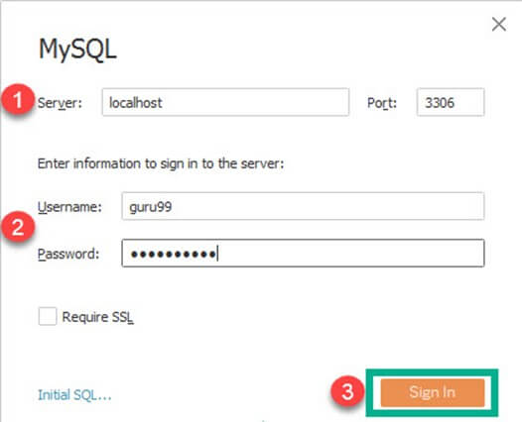
Notes:
You can enter the MySQL server name and edit the "Port" if needed.
Enter the username and password used to connect the database.
Click on the "Sign in" button to connect to the database.

Slide 22
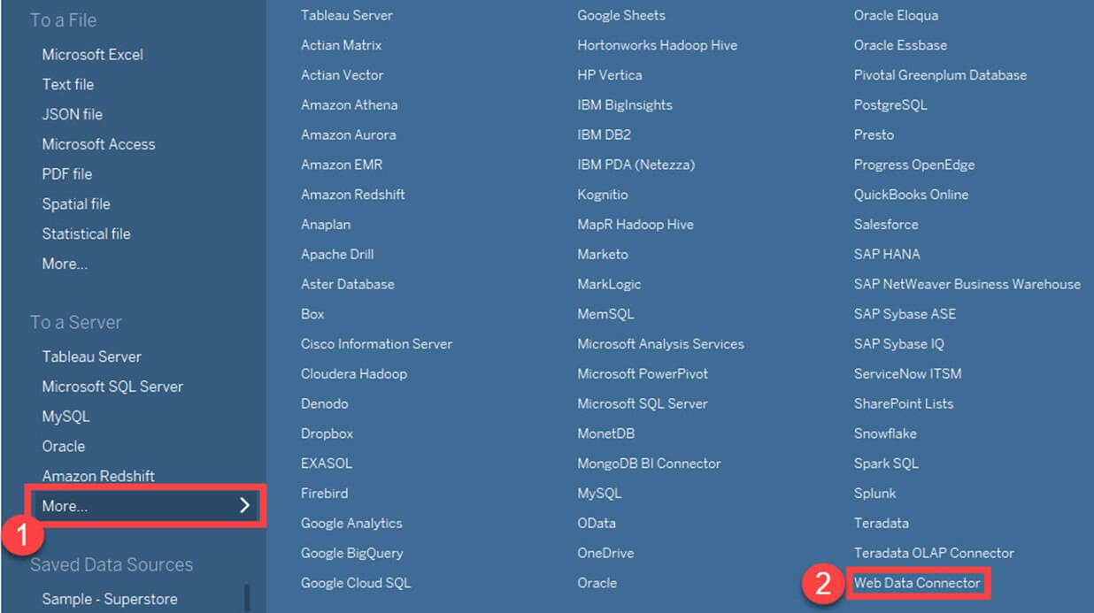
Connection to Websites
Notes:
In this window,
Click on "More" option in the data tab.
Select "Web Data Connector" from the list.

Slide 23
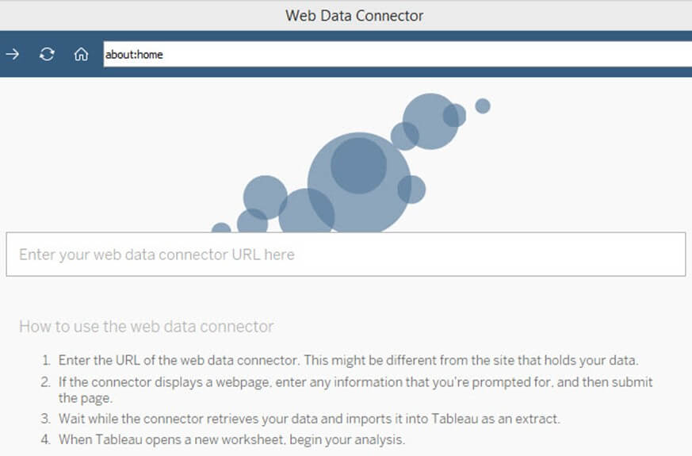
Notes:
This will open a Web Data Connector window where you need to enter the web connector details.

Slide 24
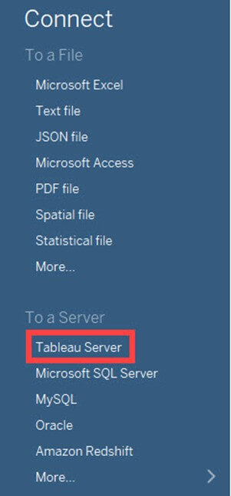
Connecting to Tableau Server
Notes:
Tableau Server can store extracted data sources and database connections. In enterprise level, it is important to keep all the required data connections in Tableau Server. It helps all the users of the enterprise to connect to the data source easily. The data sets in the Tableau Server can connect to Tableau Desktop by following the given procedures.
Select the "Tableau Server" option given in the data tab.

Slide 25
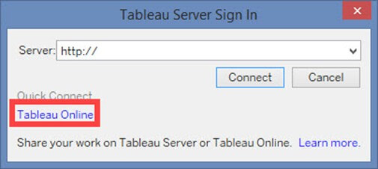
Notes:
This opens the Tableau Server Sign in window. Click on 'Tableau Online' option.

Slide 26
Resources:
https://public.tableau.com/en-us/s/resources

