Slide 1
Calculated Fields & Functions

Slide 2
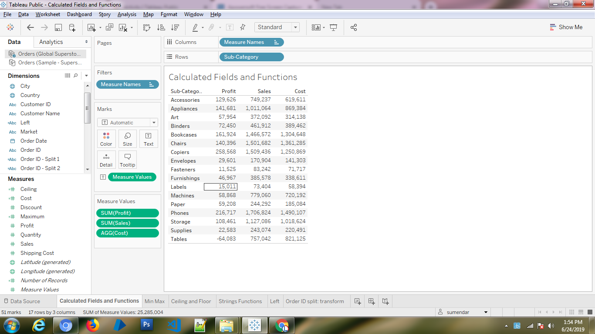

Slide 3
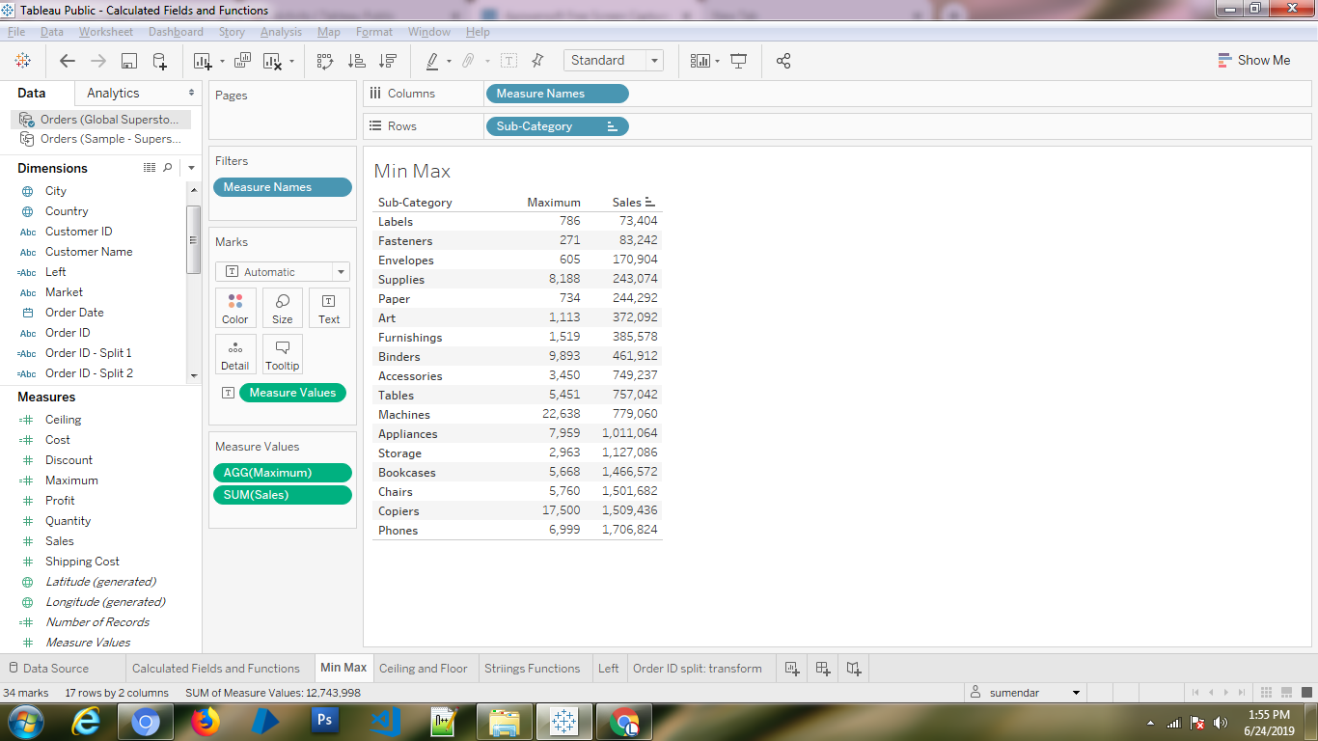

Slide 4
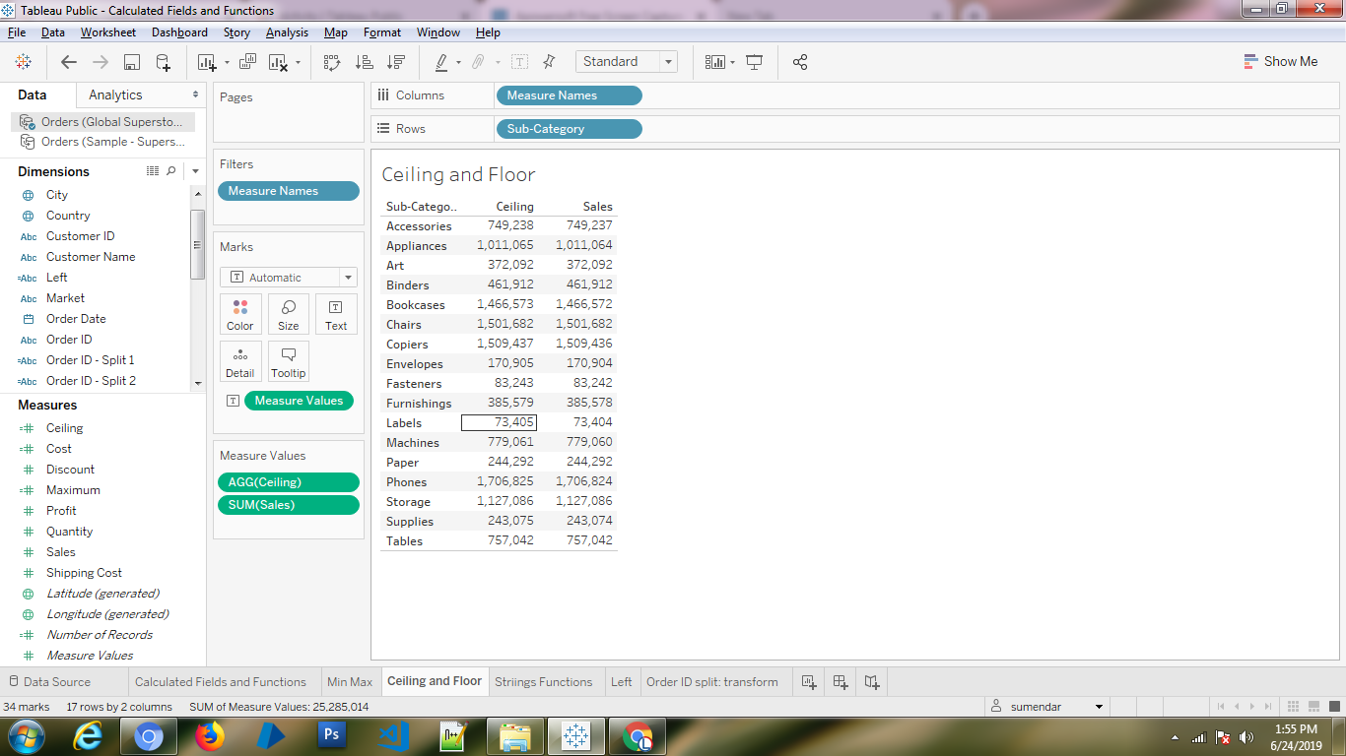

Slide 5
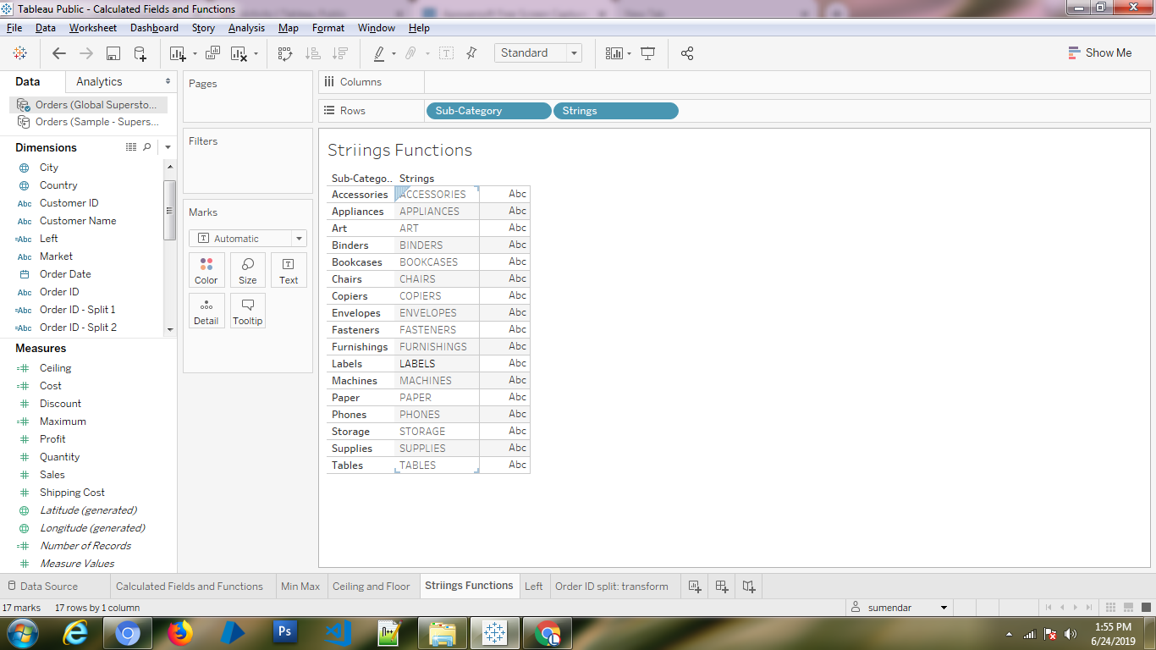

Slide 6
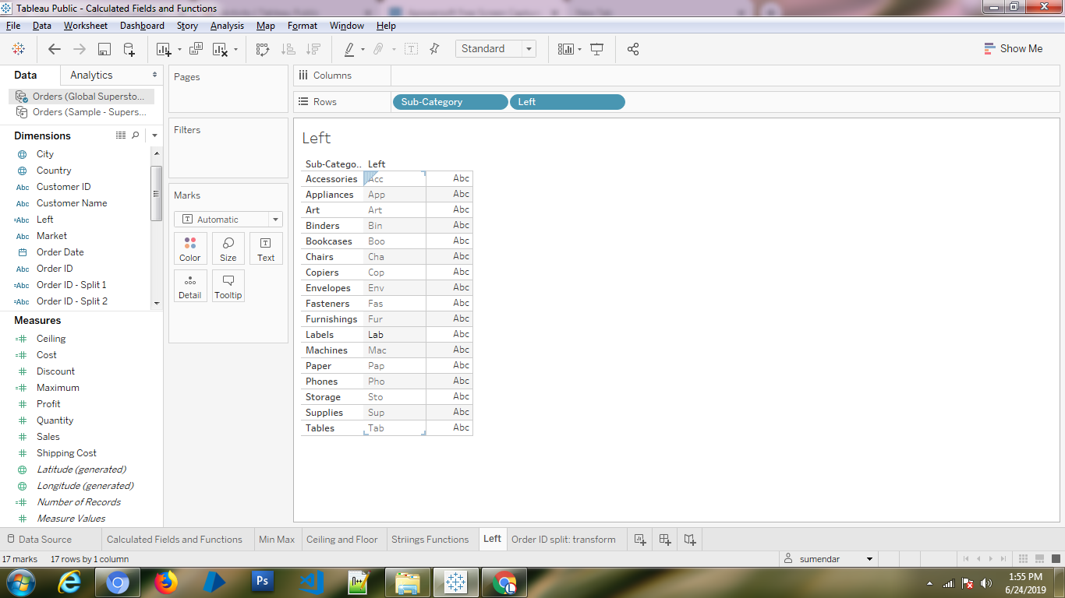

Slide 7
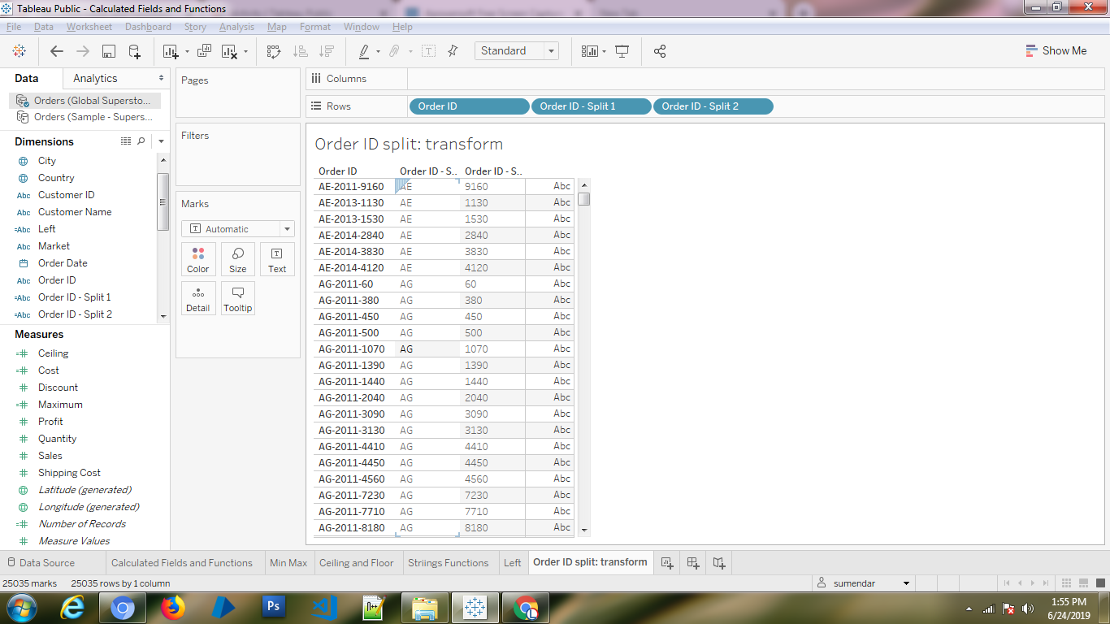
https://help.tableau.com/current/pro/desktop/en-us/calculations_calculatedfields_formulas.htm

