Slide 1
Grouping:
Defining a group (Viewed)
Save Defining a group
Defining a group for “other” values (Viewed)
Save Defining a group for “other” values
Finding members of a group
Save Finding members of a group
Editing and deleting groups
Save Editing and deleting groups
Sets:
Defining a set
Save Defining a set
Creating summaries using sets
Save Creating summaries using sets
Combining sets
Save Combining sets
Editing and deleting sets
Pages:
create Tableau pages
Jump to a specific page
Manually advance through the pages
Automatically advance through page

Slide 2
Grouping
Build groups:
Group is used to combine members present in a field. For example, aggregated values of 'Furniture' and 'Office Supplies' can be obtained by using group. Once the group is built, aggregated value of 'Furniture' and 'Office Supplies' can be shown in the visuals. The procedure to build group is given as follows.
Notes:
Build groups:
Group is used to combine members present in a field. For example, aggregated values of 'Furniture' and 'Office Supplies' can be obtained by using group. Once the group is built, aggregated value of 'Furniture' and 'Office Supplies' can be shown in the visuals. The procedure to build group is given as follows.

Slide 3
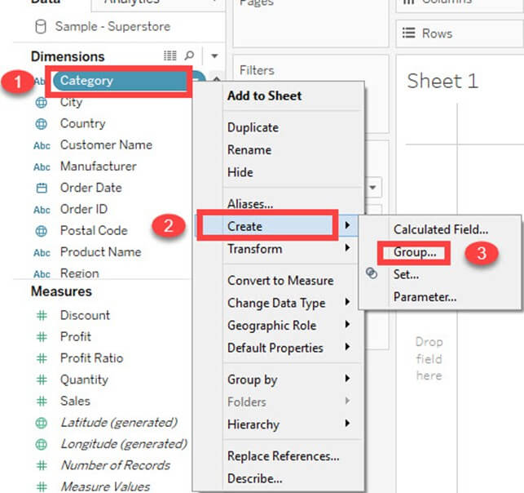
Notes:
Step 1)
Right-click on the dimension 'Category'.
Click on 'Create' option.
Select 'Group' option.

Slide 4
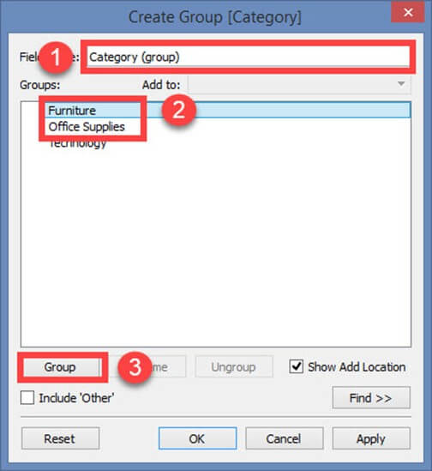
Notes:
Step 2) It opens the 'Create group' window.
Type the name of the group.
Select the members to be grouped.
Click on 'Group 'button.

Slide 5
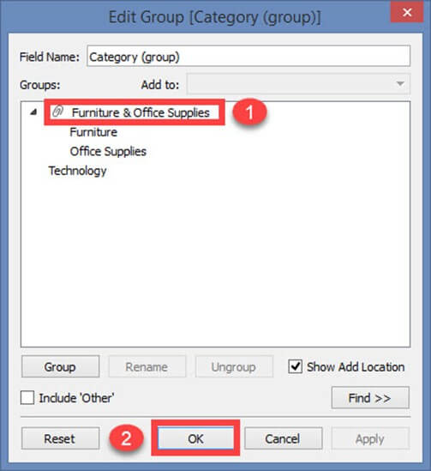
Notes:
Step 3) In Edit Group Window,
1. It creates a group of 'Furniture' and 'Office supplies'.
2. Click on Ok to create the group.

Slide 6
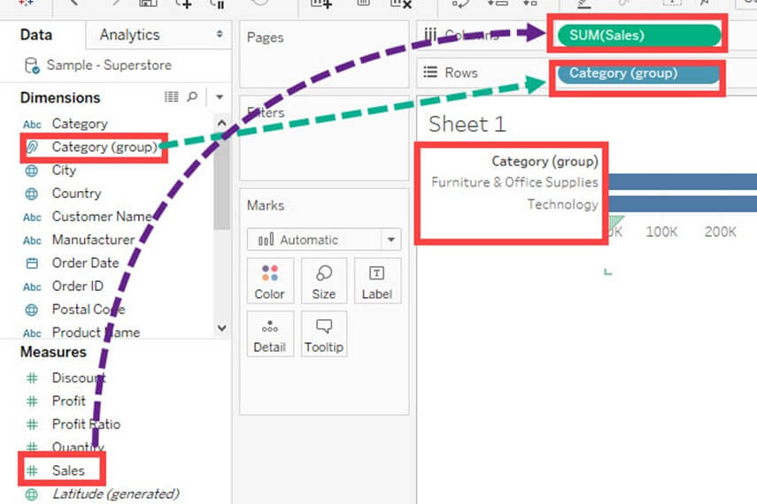
Notes:
It created a group in the name of Category (Group) and added in the dimension list. This can be used for visualizing the group of members present in a field.
The following image explains the functionality. The sum of sales is visualized for both furniture and office supplies.

Slide 7
Sets
Build Sets:
Sets create a set of members out of the field present in a data set. It acts as a separated field or dimension. The procedure to build sets is given as follows.
Notes:
Build Sets:
Sets create a set of members out of the field present in a data set. It acts as a separated field or dimension. The procedure to build sets is given as follows.

Slide 8
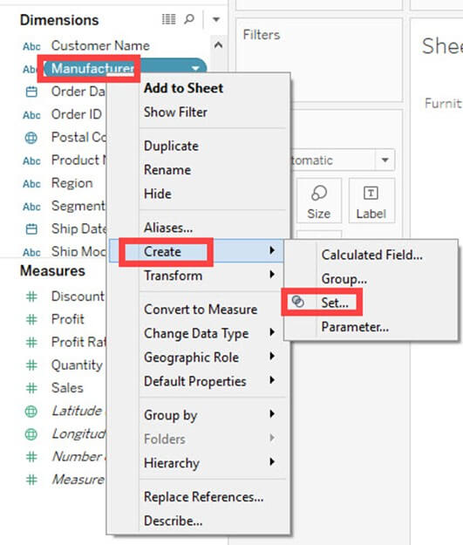
Notes:
Step 1) Go to a Worksheet.
Right-click on a dimension.
Select 'Create' option.
Click on 'Set' option.

Slide 9
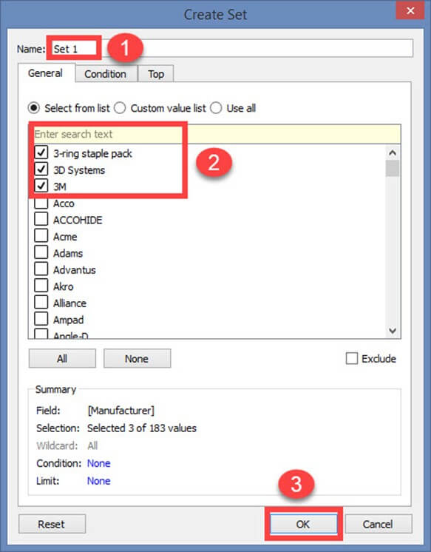
Further reading: https://www.absentdata.com/sets-in-tableau/
Notes:
Step 2) It opens 'Create Set' Window.
Name the set to be created.
Select the members needs to be added in the set.
Click on OK.
Sets can be created to select or exclude one or more members from a field. A set can be added as a separate dimension in Tableau.

Slide 10
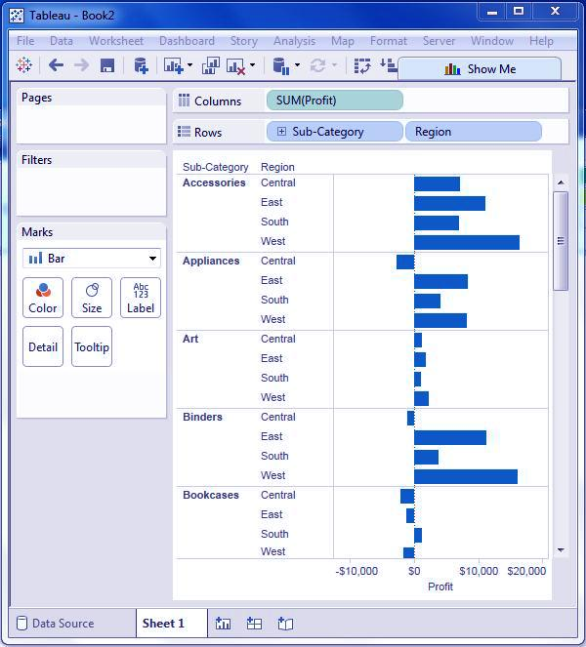
Pages
Notes:
Step 1
A bar outline with two measurements and one measure is made. The measure benefit is dragged to the segments rack and the measurements sub-classification and region are dragged to the columns rack.

Slide 11
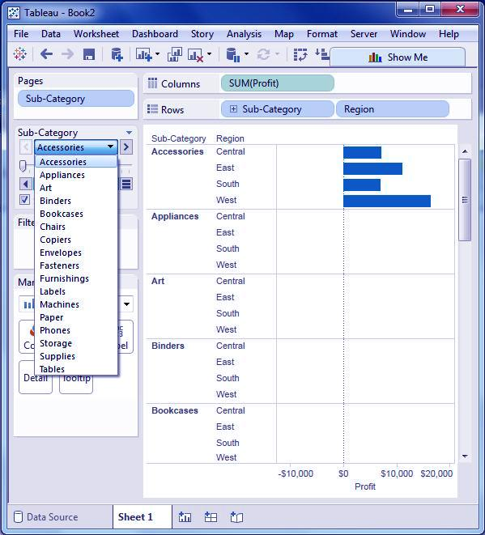
Notes:
Step 2
Drag the SubCategory field again to the page rack. It is watched that a page control is naturally included, just underneath the pages rack. This page control gives the accompanying highlights to explore through the pages in a view:
Jump to a specific page
Manually advance through the pages
Automatically advance through page
We should perceive how to hop to a particular page and how to get the programmed show of pages. To go to a particular page tap on the drop down on the page control and select Accessories. The beneath outline shows up.

Slide 12
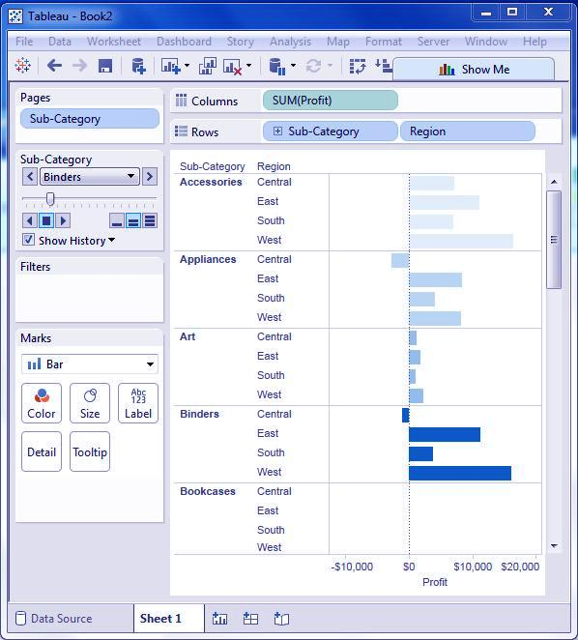
Notes:
Step-3
For a programmed show of pages, keep the show history checkbox ticked and tap the play catch. The programmed play of various pages of subclassifications can be seen. While the present Sub Category esteem has appeared with a dim shading, the past qualities are shaded with light shading. The underneath chart represents this c.

