Slide 1
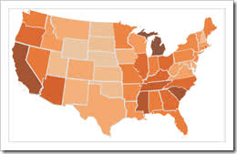
Maps in Tableau

Slide 2
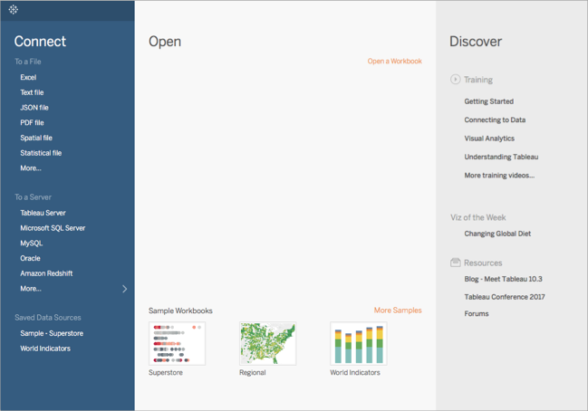

Slide 3
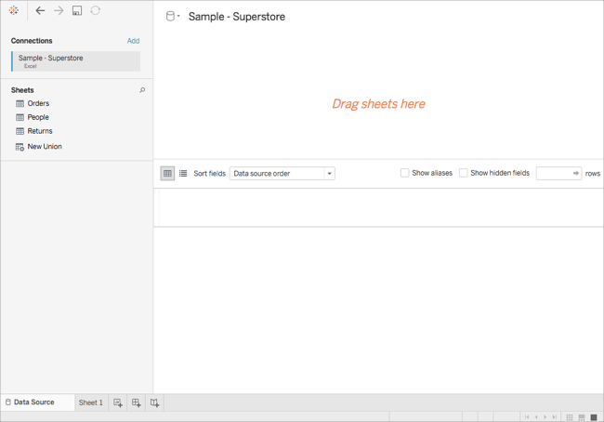

Slide 4
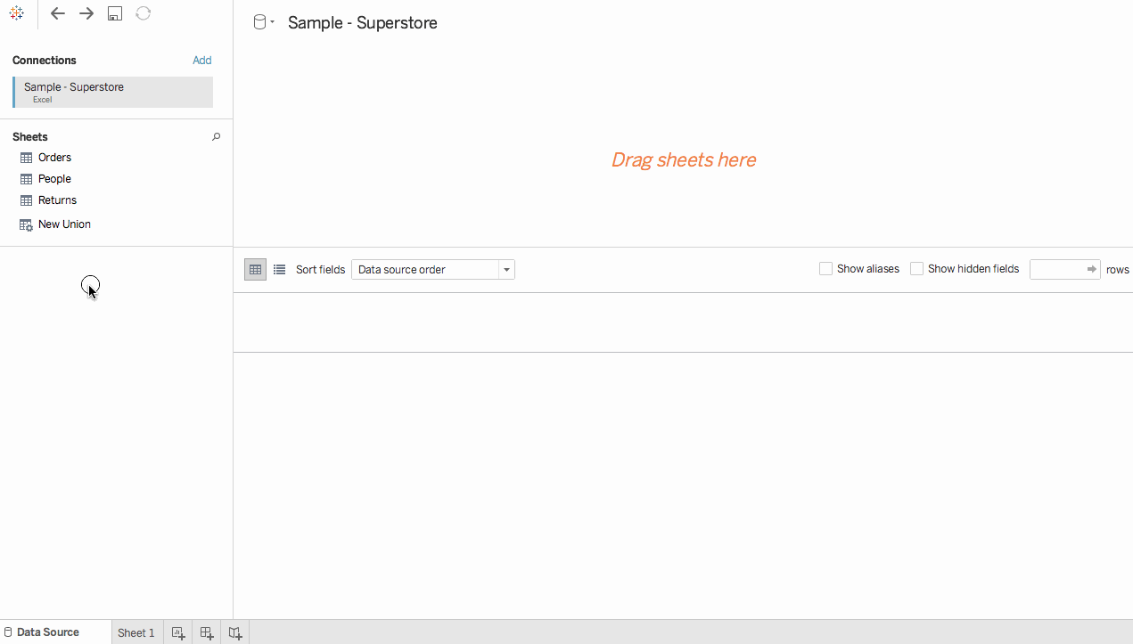

Slide 5
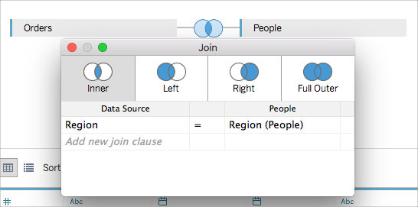

Slide 6
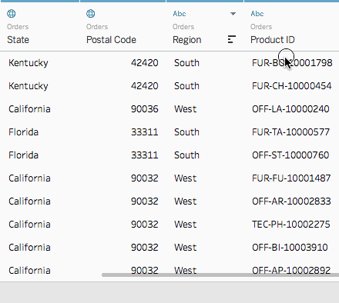

Slide 7
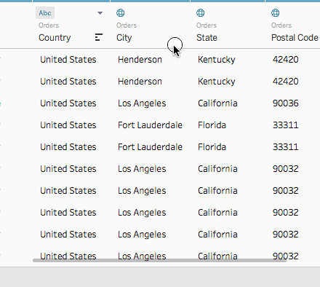

Slide 8
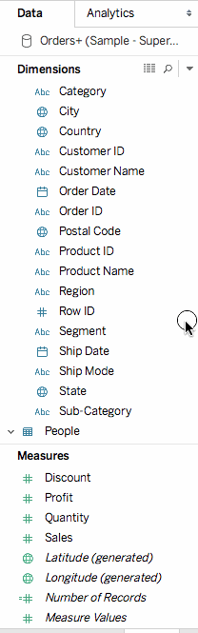

Slide 9
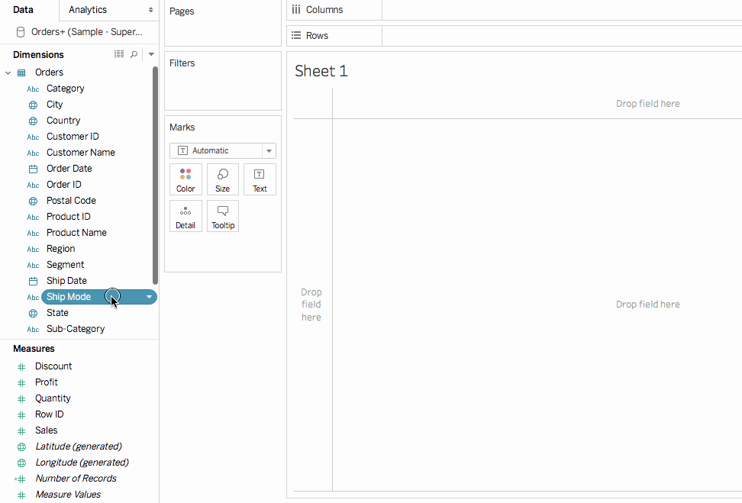

Slide 10
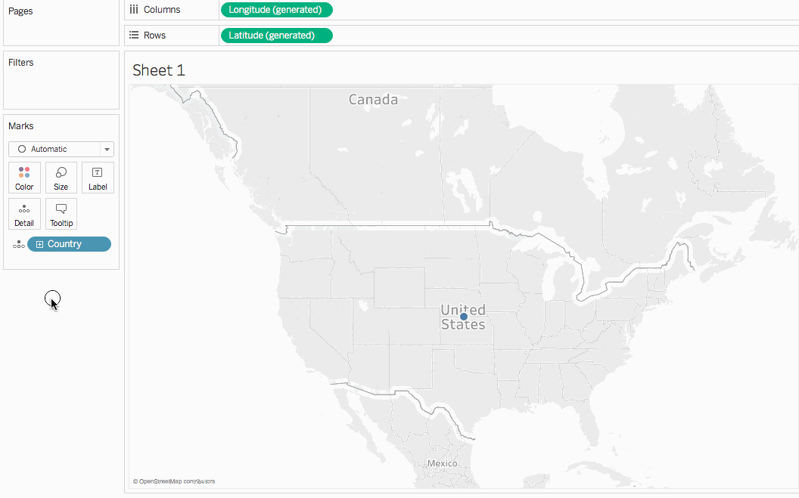

Slide 11
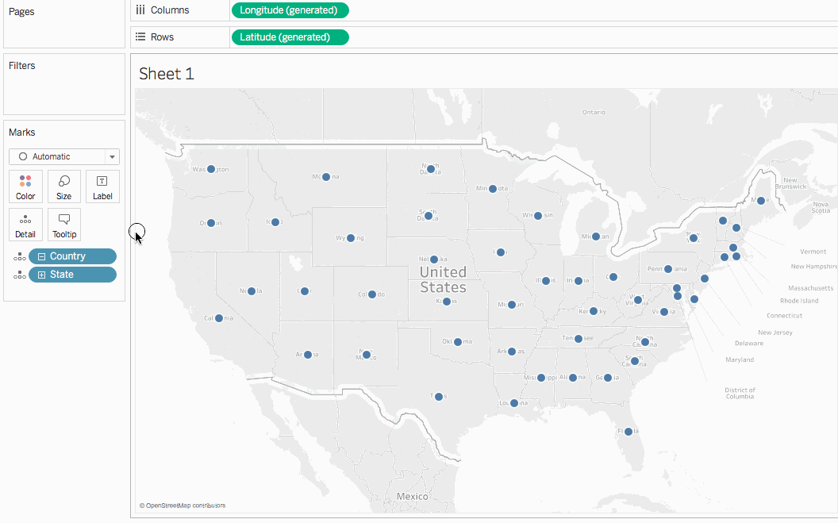

Slide 12
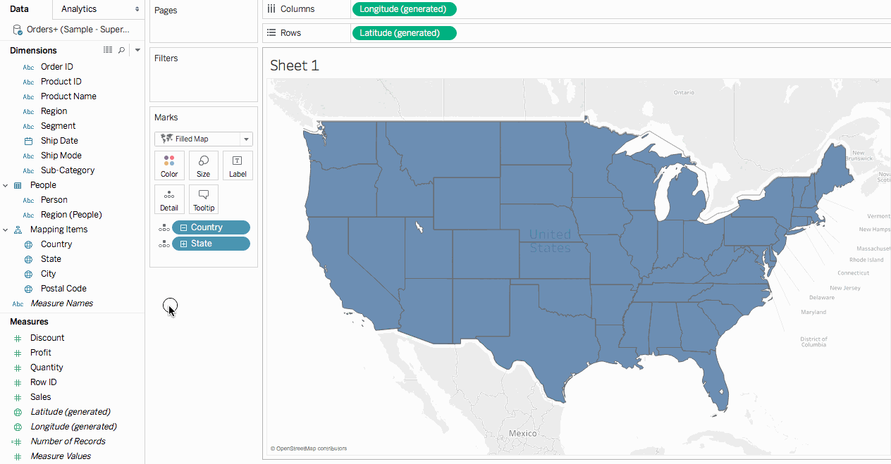

Slide 13
Maps in Tableau
https://help.tableau.com/current/pro/desktop/en-us/buildexamples_maps.htm
https://help.tableau.com/current/pro/desktop/en-us/maps_howto_simple.htm
https://www.tutorialgateway.org/how-to-create-a-map-in-tableau/

