Slide 1

1.1 What is Tableau?
Tableau is a Data Visualisation tool that is widely used for Business Intelligence but is not limited to it. It helps create interactive graphs and charts in the form of dashboards and worksheets to gain business insights. And all of this is made possible with gestures as simple as drag and drop!

Slide 2
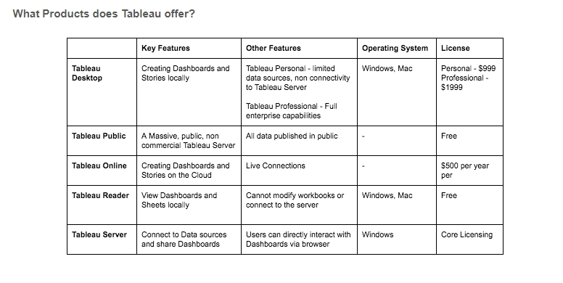
Tableau Products Family

Slide 3
Installation :
Out of the five above mentioned products, Tableau Desktop, Public and Online offer Data Visual Creation.
Tableau Desktop
It is available in the following three formats :
Free trial for 14 days
If you are a student or a teacher, you get free access to the Desktop for a full year.
Purchase Tableau
Tableau Public
Tableau Public is purely free of all costs and does not require any licence. But it comes with a limitation that all of your data and workbooks are made public to all Tableau users.
Tableau Online
Tableau Online is the best option for you, if you wish to make your Workbooks on the Cloud and be able to access them from anywhere

Slide 4
How to Download & Install Tableau Public (Free) & Desktop (Trial)

Slide 5
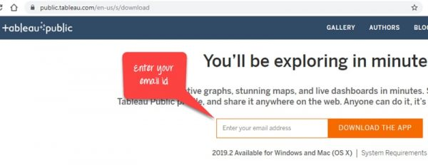
How to Download & Install Tableau Public (Free)
Step 1: Search https://public.tableau.com/en-us/s/download on your browser. Now enter your email id in the specified box and click on the “DOWNLOAD APP” icon.

Slide 6
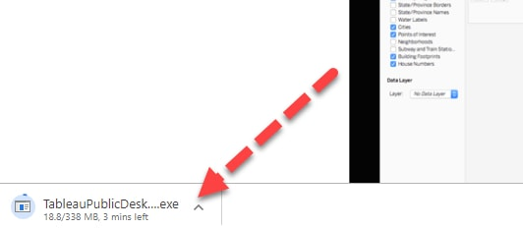
Step 2: It will start downloading you the .exe file in your windows machine by default. You can see the file downloading process on the down left corner of your screen.

Slide 7
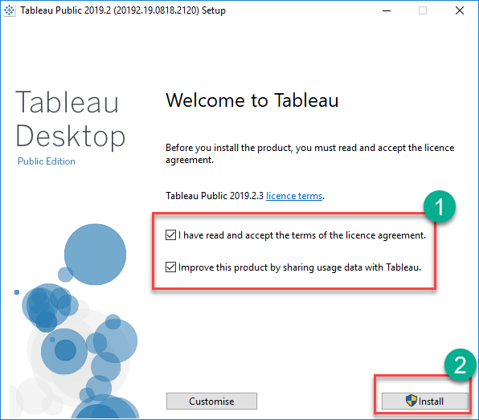
Step 3: Now open the file once it gets downloaded. Accept terms and conditions then click on installation button.

Slide 8
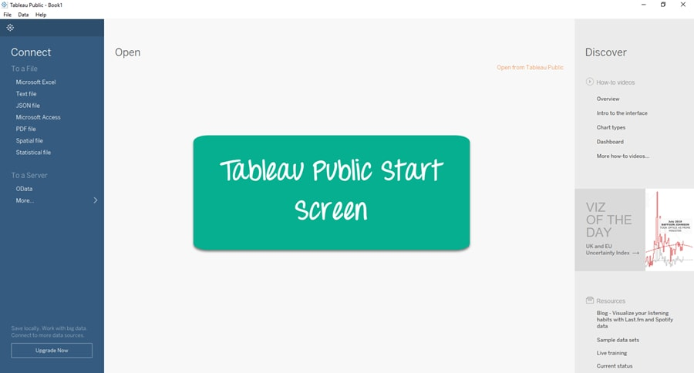
Step 4: once you are done with installation process you will be displayed with a screen like below. Now you can start using it.

Slide 9
How to Download & Install Desktop (Trial)

Slide 10
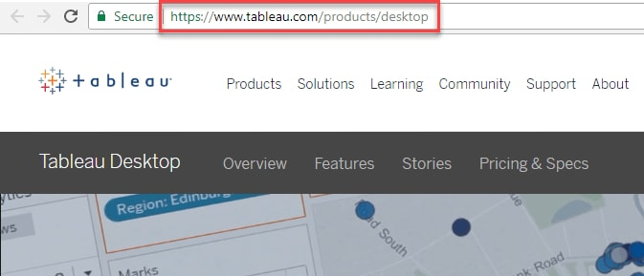
Steps to follow to Download and Install Tableau Desktop
Step 1: Open your browser and go to https://www.tableau.com/products/desktop.

Slide 11

Step 2: Now you will be taken to a screen where you can see three options which are Pricing, Sign in, and TRY NOW. Click on Try now”.

Slide 12
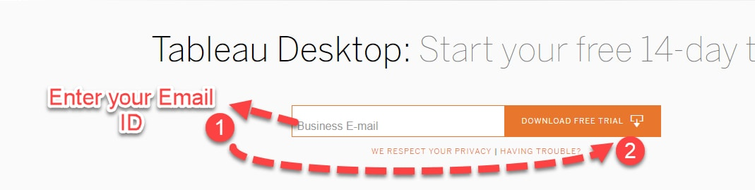
Step 3: Now you will be taken to the page where you are required to enter your Email address and hit the “FREE TRIAL” button.

Slide 13
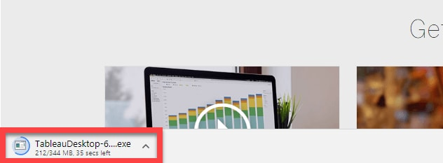
Step 4: Now it will start downloading the latest version of Tableau Desktop .exe file at the left corner of your screen.

Slide 14
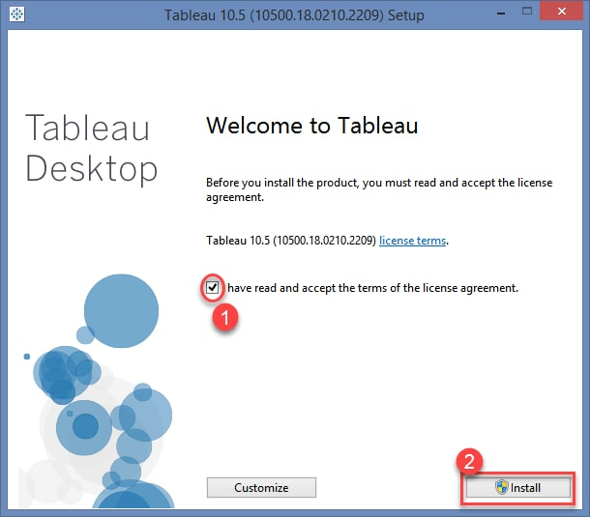
Step 5: Open the downloaded file. Accept the required terms and conditions and hit the “Install” button.

Slide 15
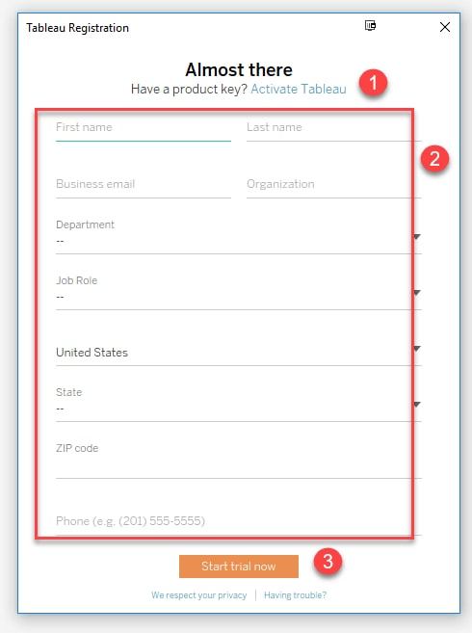
Step 6: you will be shown with the optional pop-up message to get the approval from the administrator to install the software. Click on “Yes” it gets approved. It will start the installation process on your Windows. Once you are done with the installation process, open the Tableau Desktop Software.
Step 7: In this step you will see a registration window, you need to click on Activate,
Enter Your Credentials
Click on Start Trial Now.

Slide 16
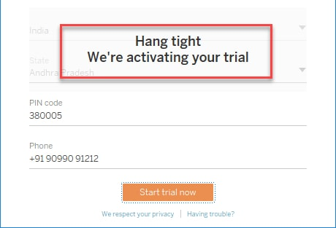
Step 8: wait till the registration process completes.

Slide 17
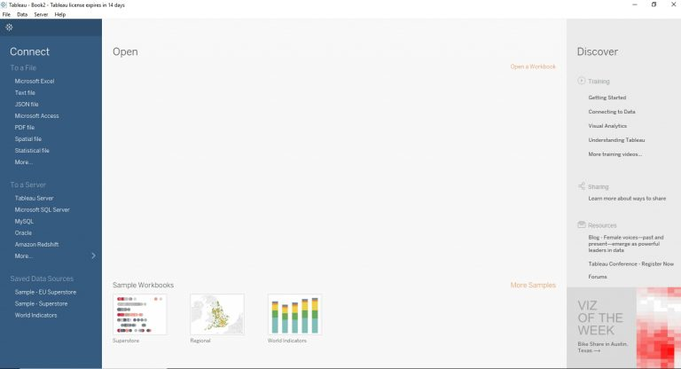
Step 9: you will get a screen like below
Now you are all set to use your Tableau in your windows machine.

