Slide 1

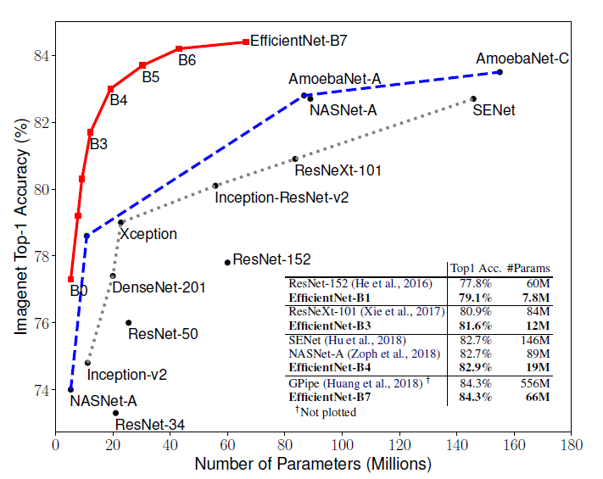
EfficientNet: Rethinking Model Scaling for Convolutional Neural Networks
Pere Gilabert
February 2021

Slide 2
Index
How to scale
Architecture
Results

Slide 3
1. How to scale

Slide 4
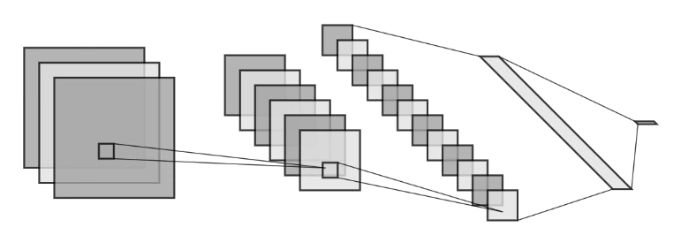
1. How to scale

Slide 5
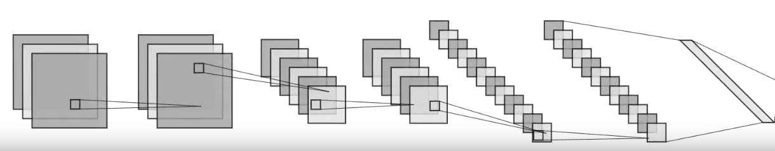
1. How to scale
1. Add new layers

Slide 6
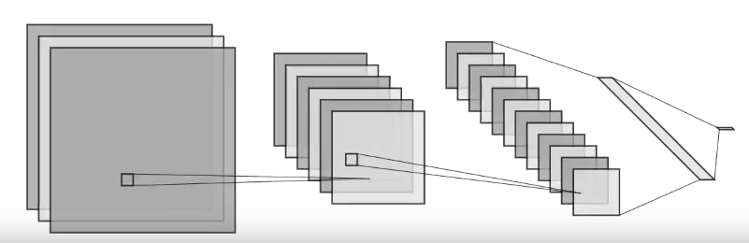
1. How to scale
1. Add new layers
2. Increase height and width

Slide 7
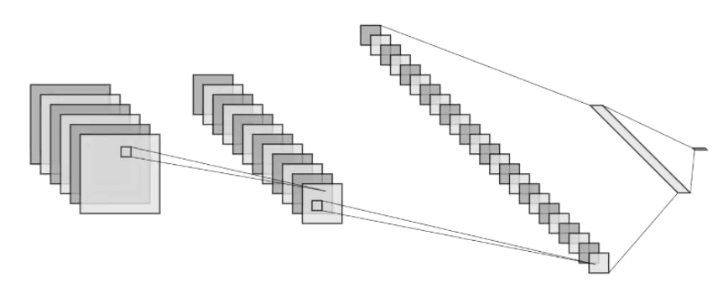
1. How to scale
1. Add new layers
3. Increase the number of channels
2. Increase height and width

Slide 8
1. How to scale
1. Add new layers (d=2)
d
d
d
3. Increase the number of channels (w=2)
2. Increase height and width (r=2)
w
w
w
r
r

Slide 9

1. How to scale
1. Add new layers (d=2)
$$\max_{d,w,r}{Accuracy(Network\left(d, w, r\right))}$$
$$s.t. Hardware requiered<Hardware capabilities$$
$$d≥1, w≥1, r≥1$$
d
d
d
3. Increase the number of channels (w=2)
2. Increase height and width (r=2)
w
w
w
r
r

Slide 10
1. How to scale
Network(1,1,1)
1. Add new layers (d=2)
Network(2,1,1)
$$\max_{d,w,r}{Accuracy(Network\left(d, w, r\right))}$$
$$s.t. Hardware requiered<Hardware capabilities$$
$$d≥1, w≥1, r≥1$$
d
d
d
3. Increase the number of channels (w=2)
2. Increase height and width (r=2)
w
w
w
r
Network(1,1,2)
Network(1,2,1)
r

Slide 11
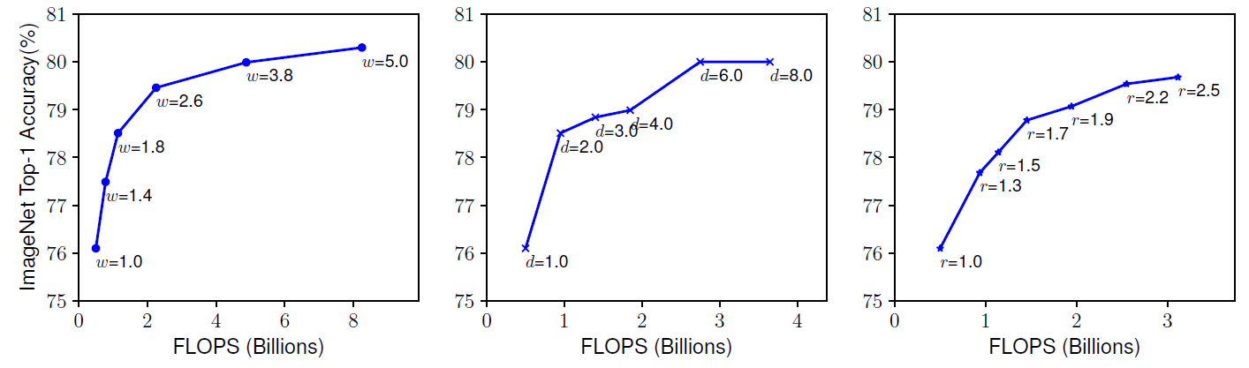
1. How to scale
Network(1, w, 1)
Network(d, 1, 1)
Network(1, 1, r)
FLOPS: Float Operations Per Second

Slide 12




1. How to scale
$$d=α^{φ} \\ w=β^{φ} \\ r=γ^{φ}$$
Hypothesis: Scale d, r, w evenly. We can define $α, β, γ$ s.t.
We can find the best parameters $α, β, γ$ using grid search
$$\max_{d,w,r}{Accuracy(Network\left(d, w, r\right))}$$
$$s.t. Hardware requiered<Hardware capabilities$$
$$d≥1, w≥1, r≥1$$
$$\max_{d,w,r}{Accuracy(Network\left(α, β, γ\right))}$$
$$s.t. Hardware requiered<Hardware capabilities$$
$$α≥1, β≥1, γ≥1$$

Slide 13
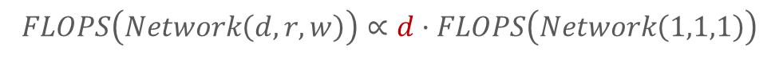
1. How to scale
$$FLOPS\left(Network\left(d, r, w\right)\right)∝d·FLOPS\left(Network\left(1,1,1\right)\right)$$

Slide 14
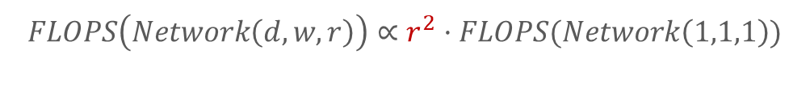
1. How to scale
$$FLOPS\left(Network\left(d, r, w\right)\right)∝d·FLOPS\left(Network\left(1,1,1\right)\right)$$
$$FLOPS\left(Network\left(d, w, r\right)\right)∝r^{2}·FLOPS(Network\left(1,1,1\right))$$

Slide 15
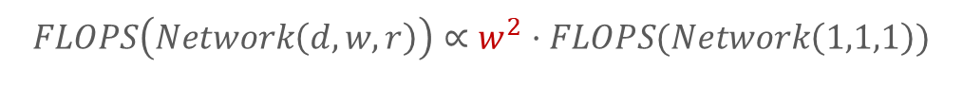

1. How to scale
$$FLOPS\left(Network\left(d, w, r\right)\right)∝d·FLOPS\left(Network\left(1,1,1\right)\right)$$
$$FLOPS\left(Network\left(d, w, r\right)\right)∝r^{2}·FLOPS(Network\left(1,1,1\right))$$
$$FLOPS\left(Network\left(d, w, r\right)\right)∝w^{2}·FLOPS(Network\left(1,1,1\right))$$

Slide 16
1. How to scale
$$FLOPS\left(Network\left(d, w, r\right)\right)∝{dw^{2}r}^{2}·FLOPS\left(Network\left(1,1,1\right)\right)$$

Slide 17
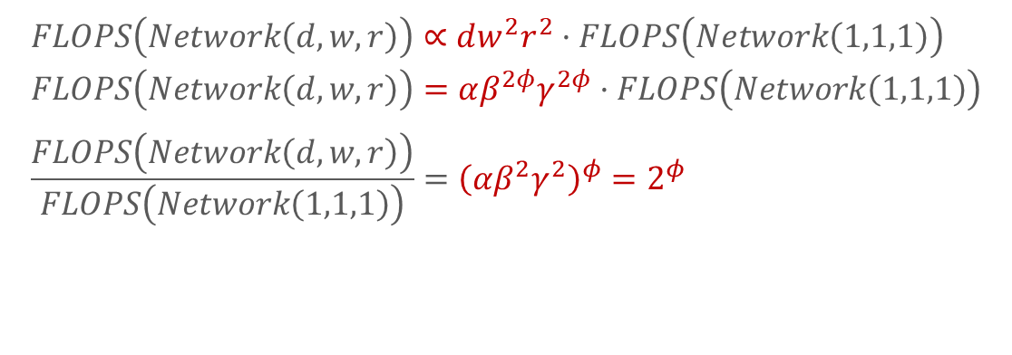
1. How to scale
$$FLOPS\left(Network\left(d, w, r\right)\right)∝{dw^{2}r}^{2}·FLOPS\left(Network\left(1,1,1\right)\right) \\ FLOPS\left(Network\left(d, w, r\right)\right)={αβ^{2φ}γ}^{2φ}·FLOPS\left(Network\left(1,1,1\right)\right) \\ \frac{FLOPS\left(Network\left(d, w, r\right)\right)}{FLOPS\left(Network\left(1,1,1\right)\right)}={\left(αβ^{2}γ^{2}\right)}^{φ}=2^{φ}$$

Slide 18

1. How to scale
$$FLOPS\left(Network\left(d, w, r\right)\right)∝{dw^{2}r}^{2}·FLOPS\left(Network\left(1,1,1\right)\right) \\ FLOPS\left(Network\left(d, w, r\right)\right)={αβ^{2φ}γ}^{2φ}·FLOPS\left(Network\left(1,1,1\right)\right) \\ \frac{FLOPS\left(Network\left(d, w, r\right)\right)}{FLOPS\left(Network\left(1,1,1\right)\right)}={\left(αβ^{2}γ^{2}\right)}^{φ}=2^{φ}$$
$$\max_{d,w,r}{Accuracy(Network\left(α, β, γ\right))}$$
$$αβ^{2}γ^{2}≈2$$
$$α≥1, β≥1, γ≥1$$
Given a network, $φ$ is used to define EfficientNet B0 ($φ$=1), …, B7 ($φ$=8)

Slide 19
2. Architecture

Slide 20
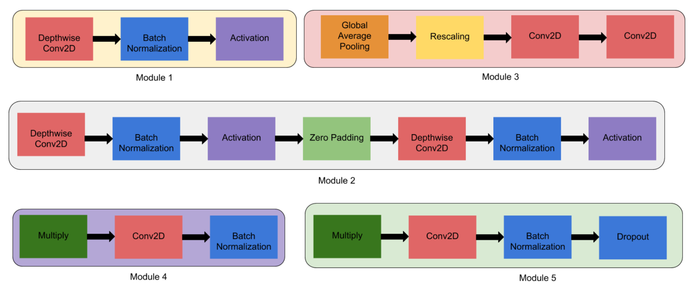
2. Architecture

Slide 21
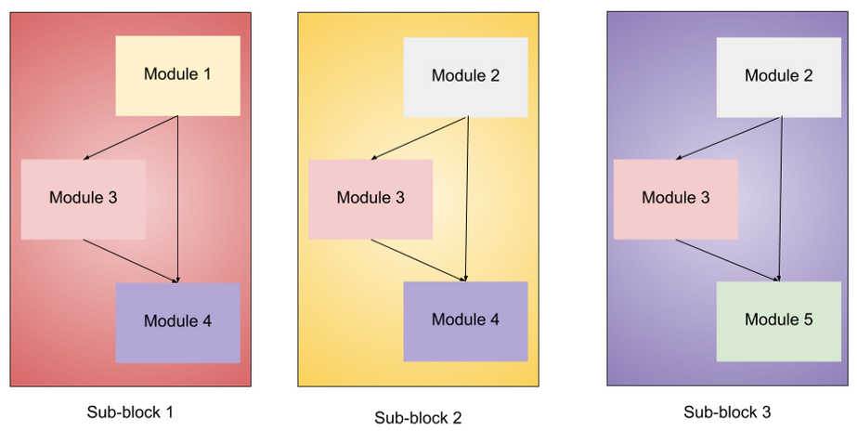
2. Architecture

Slide 22
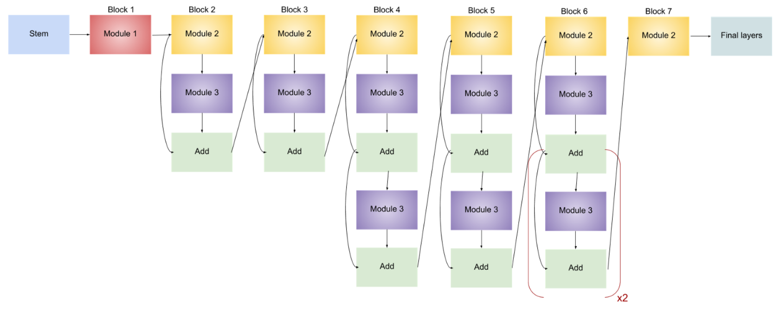
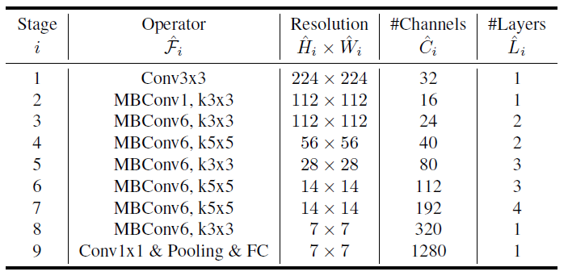
2. Architecture
MBConv: mobile inverted bottleneck (https://arxiv.org/abs/1801.04381v4)

Slide 23
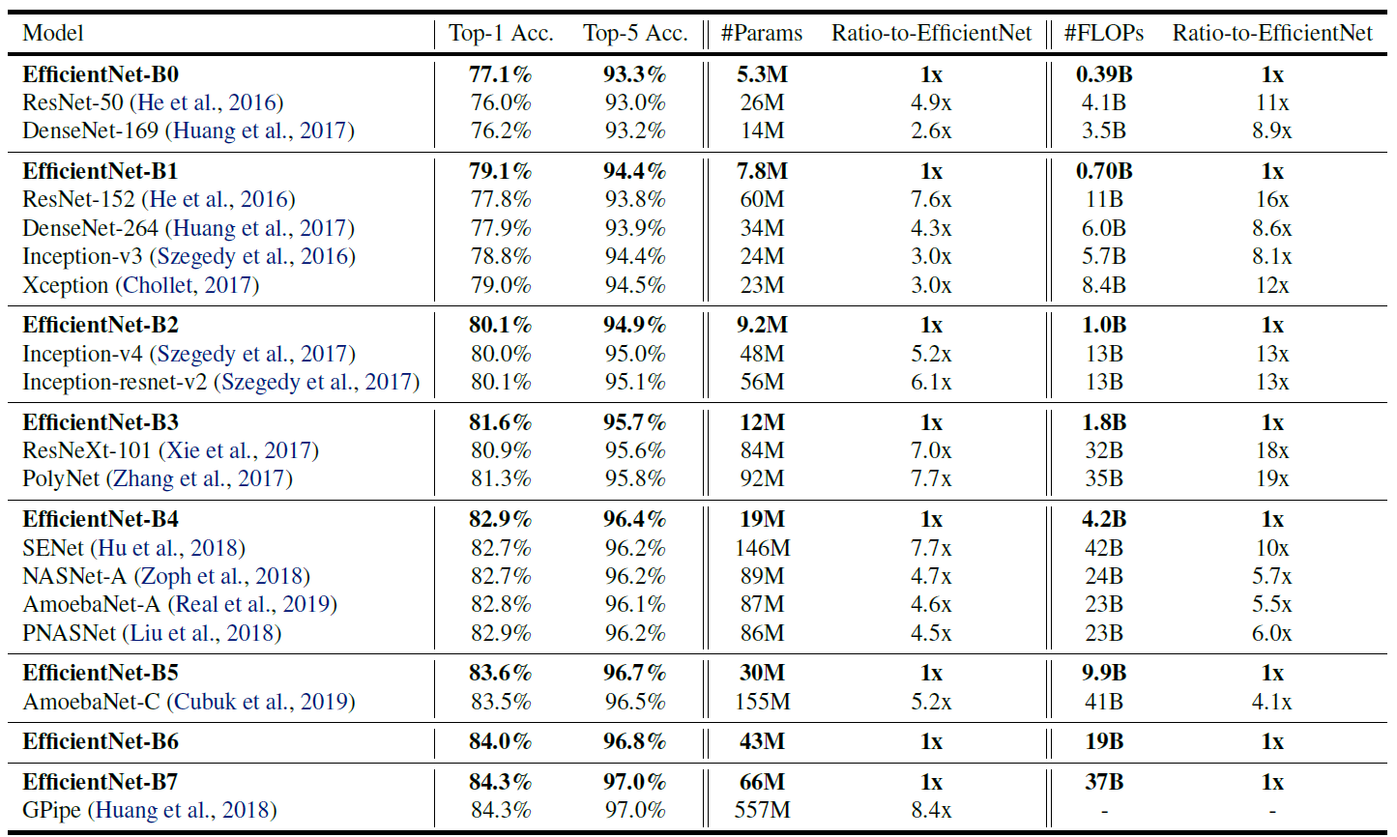
3. Results

Slide 24
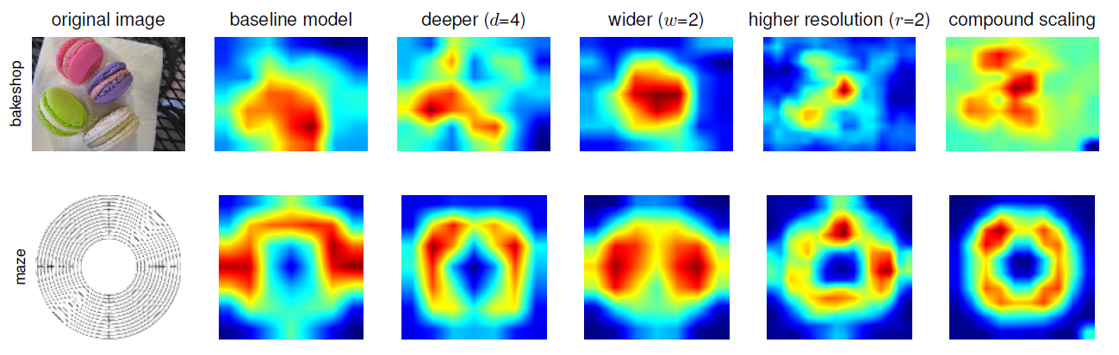
3. Results

Slide 25

Thanks!

