Slide 1
Randomization Tests
STAT 145

Slide 2
Randomization Tests

Slide 3
Today's goals
Set up a test. Recognize when a statistical test is needed, and state null and alternative hypotheses in terms of a parameter.
Model chance with a randomization distribution built under the assumption that the null hypothesis is true.
Find and interpret a $p$-value from that distribution — including one- versus two-tailed tests — as the strength of evidence against the null hypothesis.
Make and state a decision by comparing the $p$-value to a significance level, then conclude in context.
Know what a test can and cannot tell you: Type I and Type II errors, the significance level as the tolerable Type I error rate, and why statistical discernibility is not the same as practical importance.
Motivation: Cereal example

Slide 4

Example 1
Consider the following scenario: A sample of 80 four-to six-year olds participated in a study in which they were asked to taste two cereals, both called “Oat Bits” (in random order). The cereal in each box was exactly the same, but the boxes differed in the fact that one of the boxes had pictures of a star mascot and the other did not.
Figure 1: The two cereal boxes shown to the children. The cereal inside was identical; only one box featured a cartoon star mascot.

Slide 5
If the cartoons make no difference, because after all the cereal is the same in each box, how many of the 80 children do you expect to pick the cartoon box? What sample proportion is this?
. . .
If the cartoons make no difference, each child is equally likely to pick either box.
We expect about half: $40$ of the $80$ children.
As a proportion, $\hat{p}=40/80=0.50$.
Suppose that in this study, 52 of the children chose the box with cartoons. What sample proportion is this? Does this lead you to believe that there was a preference toward the cartoon box, or would you expect this sample proportion to occur by chance even if there was no preference? (We will use StatLens to explore the sampling distribution for the proportion to determine what values are likely to occur.)
. . .
$\hat{p}=52/80=0.65$, which is above the $0.50$ we would expect if there were no preference.
On its own, $0.65$ is not proof: sample proportions vary from sample to sample even when the true proportion is $0.50$.
The real question is whether a value as high as $0.65$ is plausible by chance alone. To answer it, we simulate many samples of $80$ children under “no preference” ($p=0.50$) and see how often chance produces a proportion this large.
Using the simulation from part b), what sample proportions do we expect to see if there is no preference toward the cartoons?
. . .
Under “no preference” ($p=0.50$), the simulated sample proportions cluster around $0.50$.
Almost all fall roughly between $0.39$ and $0.61$ (about $31$ to $49$ of the $80$ children).
The observed $\hat{p}=0.65$ sits beyond that typical range, in the tail — so chance alone is an unlikely explanation. We will make this precise with a $p$-value later in the chapter.

Slide 6
The hypothesis testing framework
Hypothesis testing

Slide 7
Null and alternative hypotheses
The question is about… | Null hypothesis (“no effect”) | Alternative (pick one direction) | A question of this kind
one proportion $p$ | $p=p_{0}$ | $p≠p_{0}, p>p_{0}, p<p_{0}$ | Do more than half of children pick the cartoon box? ($p_{0}=0.5$)
one mean $μ$ | $μ=μ_{0}$ | $μ≠μ_{0}, μ>μ_{0}, μ<μ_{0}$ | Do the bags really average the 16 oz on the label? ($μ_{0}=16$)
a difference in proportions | $p_{1}−p_{2}=0$ | $p_{1}−p_{2}≠0, >0, <0$ | Do two groups differ in who skips the video?
a difference in means | $μ_{1}−μ_{2}=0$ | $μ_{1}−μ_{2}≠0, >0, <0$ | Is average income higher in eastern than western states?
The shape of a hypothesis

Slide 8
Example 2
Class Example 7.1: Defining statistical hypotheses
For each of the following scenarios, state the null and alternative hypotheses with the relevant parameter(s).
We are testing to see if the average income is different in eastern states than western states.
. . .
Parameters: $μ_{E}$ and $μ_{W}$, the mean income in eastern and western states.
$H_{0}:μ_{E}−μ_{W}=0$ (no difference in average income).
$H_{A}:μ_{E}−μ_{W}≠0$ (two-sided — “different” gives no direction).
We are testing to see if the average income is greater in eastern stats than western states.
. . .
Parameters: $μ_{E}$ and $μ_{W}$ as above.
$H_{0}:μ_{E}−μ_{W}=0$.
$H_{A}:μ_{E}−μ_{W}>0$ (one-sided — “greater” points east).
We are testing to see if a particular coin is weighted (i.e., not fair).
. . .
Parameter: $p$, the true proportion of heads for this coin.
$H_{0}:p=0.5$ (the coin is fair).
$H_{A}:p≠0.5$ (two-sided — “not fair” could tip either way).
We are testing to see if the average rent in La Crosse is less than $850.
. . .
Parameter: $μ$, the mean rent in La Crosse.
$H_{0}:μ=850$.
$H_{A}:μ<850$ (one-sided — “less than”).
We are testing to see if children have a preference for the cereal box with cartoons (above).
. . .
Parameter: $p$, the proportion of children who choose the cartoon box.
$H_{0}:p=0.5$ (no preference).
$H_{A}:p>0.5$ (one-sided — a preference for the cartoon box).

Slide 9
Case study: Opportunity cost

Slide 10
Example 3
 | Buy video | Not buy video | Total
Control | 56 | 19 | 75
Treatment | 41 | 34 | 75
Total | 97 | 53 | 150
Class Example 7.2: Opportunity cost
Using the opportunity cost case study, answer the following questions:
Is this an observational study or an experiment? How does the type of study impact what can be inferred from the results?
. . .
It is an experiment: the researchers randomly assigned which version of option (B) each student saw.
Because the treatment was randomly assigned, the two groups are comparable, so a discernible difference can be attributed to the phrasing — we can make a causal claim, not just an association.
State the null and alternative hypotheses for this study.
. . .
Parameters: $p_{T}$ and $p_{C}$, the proportion who do not buy the video in the treatment and control groups.
$H_{0}:p_{T}−p_{C}=0$ (the reminder phrasing has no effect).
$H_{A}:p_{T}−p_{C}>0$ (the reminder increases the proportion who choose not to buy).

Slide 11
Example 4
Class Example 7.3: Opportunity cost, revisited
Compute the difference in the sample proportions of students who choose not to buy the video.
. . .
Control: ${\hat{p}}_{C}=19/75=0.253$.
Treatment: ${\hat{p}}_{T}=34/75=0.453$.
Difference: ${\hat{p}}_{T}−{\hat{p}}_{C}=0.453−0.253=0.20$ (treatment group is 20 percentage points more likely to not buy).

Slide 12
Building a randomization distribution
The card-shuffling metaphor

Slide 13
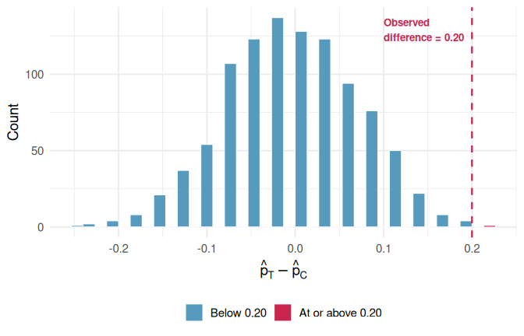
Example 5
Think of the data as 150 cards:
97 red cards (buy video)
53 white cards (not buy video)
In the actual study, 75 cards were dealt to the ‘control’ pile and 75 to the ‘treatment’ pile. Under the null hypothesis, the color of each card (whether to buy the video) has nothing to do with which pile it lands in.
To simulate what the null hypothesis look like, we:
Thoroughly shuffle all 150 cards together.
Deal 75 into a ‘control’ pile and 75 into a ‘treatment’ pile
Count the number of white (not buy video) in each pile and compute the difference in proportions.
This gives us one simulated difference under the null hypothesis, a difference that arose purely from the random shuffle, not from the phrasing.
Many simulations
Figure 2: A histogram of 1,000 simulated differences produced under the null hypothesis. Differences at least as large as the observed 0.20 are highlighted in red.

Slide 14
P-values
Randomization Distributions and p-values

Slide 15
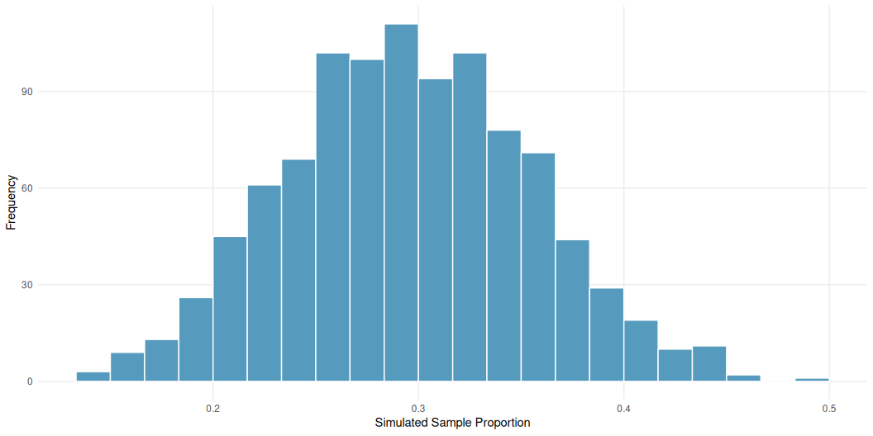
Example 6
Class Example 7.4: Estimating a $p$-value from a randomization distribution
The figure below shows a randomization distribution for testing $H_{0}:p=0.3$ vs $H_{A}:p<0.3$. In each case, use the distribution to decide which value is closer to the $p$-value for the observed sample proportion. There are 1000 randomizations given in the figure below.
Figure 3: Randomization distribution with 1000 randomizations

Slide 16
Why is the distribution centered at 0.3?
. . .
The randomization distribution is built assuming $H_{0}$ is true — that the true proportion is $0.3$.
Each simulated sample proportion is generated with $p=0.3$, so they pile up around $0.3$; the spread shows the sampling variability we get by chance alone.
The $p$-value for $\hat{p}=0.15$ is closest to: 0.04 or 0.40?
. . .
$H_{A}:p<0.3$, so the $p$-value is the lower-tail area — the fraction of simulations at or below $0.15$.
$0.15$ is far into the left tail, where very few simulations land, so the $p$-value is small: closest to 0.04.
Which proportion, $\hat{p}=0.20$ or $\hat{p}=0.10$, provides the strongest evidence to suggest that $H_{0}$ is not true? Explain.
. . .
Smaller $p$-value = stronger evidence against $H_{0}$.
$\hat{p}=0.10$ is farther into the lower tail than $\hat{p}=0.20$, so fewer simulations are that extreme — its $p$-value is smaller.
So $\hat{p}=0.10$ provides the strongest evidence that $H_{0}$ is not true.

Slide 17
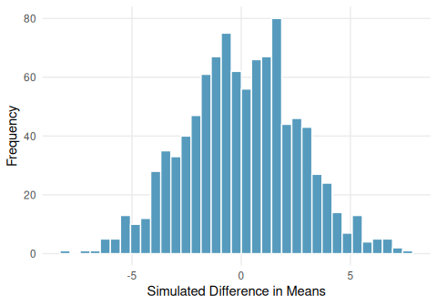
Example 7
Class Example 7.5: Estimating a $p$-value from a randomization distribution…continued
The figure below shows a randomization distribution for testing $H_{0}:μ_{1}−μ_{2}=0$ vs $H_{A}:μ_{1}−μ_{2}≠0$. The statistic used for each sample is $D={\overline{x}}_{1}−{\overline{x}}_{2}$. In each case, use the distribution to decide which value is closer to the $p$-value for the observed sample difference in averages. There are 1000 randomizations given in the figure below.
Figure 4: Randomization distribution with 1000 randomizations

Slide 18
The $p$-value for $D={\overline{x}}_{1}−{\overline{x}}_{2}=−2.9$ is closest to: 0.01 or 0.25?
. . .
$H_{A}:μ_{1}−μ_{2}≠0$ (two-sided), so count simulations at least as far from $0$ as $2.9$ in either tail.
$−2.9$ is only modestly out from the center, so a fair share of simulations are that extreme: closest to 0.25.
The $p$-value for $D={\overline{x}}_{1}−{\overline{x}}_{2}=1.2$ is closest to: 0.30 or 0.60?
. . .
$1.2$ is very close to the center of the distribution, so a large majority of simulations are at least that far from $0$.
The two-sided $p$-value is large: closest to 0.60.
Of the two values of $D$ above, which provides strongest evidence to suggest that $H_{0}$ is not true? Explain.
. . .
$D=−2.9$ has the smaller $p$-value ($≈0.25$ vs. $≈0.60$), so it sits farther in the tail.
So $D=−2.9$ gives the stronger evidence against $H_{0}$ — though with $p≈0.25$ neither result is discernible at $α=0.05$.

Slide 19
Example 8
Class Example 7.6: Migraine Acupuncture Trial
Can acupuncture relieve migraine pain? Allais et al. (2011) conducted a randomized controlled study where 89 individuals who suffered from migraines were randomly assigned to receive either acupuncture (treatment, $n=43$) or placebo acupuncture (control, $n=46$). The placebo acupuncture involved placing needles at non-acupuncture-point locations. Researchers recorded whether each patient was pain-free 24 hours after treatment. The full data are in the data set Migraine Acupuncture Trial on StatLens.
What are the null and alternative hypotheses for this study?
. . .
Parameters: $p_{T}$ and $p_{C}$, the proportion pain-free after acupuncture (treatment) and sham (control).
$H_{0}:p_{T}−p_{C}=0$ (acupuncture is no better than the placebo).
$H_{A}:p_{T}−p_{C}>0$ (acupuncture increases the proportion who are pain-free).
What was the sample statistic for these data?
. . .
Treatment: ${\hat{p}}_{T}=10/43=0.233$. Control: ${\hat{p}}_{C}=2/46=0.043$.
Statistic: ${\hat{p}}_{T}−{\hat{p}}_{C}=0.233−0.043=0.19$ (about 19 percentage points more pain-free in the acupuncture group).
What is the probability that the sample results (or those more extreme) occurred by random chance, assuming that the acupuncture had no effect?
. . .
This probability is the $p$-value. Build the randomization distribution in StatLens by shuffling the 12 pain-free labels among all 89 patients and re-splitting into groups of 43 and 46; record how often the shuffled difference reaches $0.19$ or more.
Very few shuffles reach $0.19$: the one-sided $p$-value is about 0.01. It would be rare to see a gap this large by chance alone.
How would your answer to c) change if the alternative hypothesis was two-sided?
. . .
A two-sided test counts extremes in both tails, so we double the one-sided value: $p≈0.02$.
The evidence is a bit weaker, but $0.02<0.05$, so the conclusion (discernible effect) is unchanged.

Slide 20
Example 9
Class Example 7.7: Calorie Counts
Is the average amount of kilocalories from a major U.S. fast food chain menu item more than 525 kilocalories? Calorie counts for 515 menu items from eight major fast food chains were collected. The full data are in the data set Fast Food Calories on StatLens.
State the null and alternative hypotheses
. . .
Parameter: $μ$, the mean calorie count for fast food menu items.
$H_{0}:μ=525$.
$H_{A}:μ>525$ (one-sided — “more than 525”).
What is the sample statistic?
. . .
The sample mean: $\overline{x}≈531$ kilocalories (from the 515 menu items).
To create the randomization distribution, what do we have to assume?
. . .
We assume $H_{0}$ is true — that the mean really is $525$.
In StatLens we impose this by shifting the data so its mean sits at $525$, then resampling to see how much the sample mean bounces around when $μ=525$. The distribution is therefore centered at $525$.
What is the $p$-value for this study?
. . .
The $p$-value is the fraction of that null distribution at or above the observed $\overline{x}≈531$.
$531$ sits well inside the bulk of the distribution, so the $p$-value is large: about 0.32. The data do not provide discernible evidence that the mean exceeds 525 kcal.

Slide 21
Example 10
Class Example 7.8: Cereal study revisited
Recall the motivating cereal study. We were trying to determine if children had a preference for the cereal in the box with the cartoon. In the study 52 out of 80 children chose the box with cartoons. Use StatLens to find the $p$-value for this scenario.
. . .
$H_{0}:p=0.5$ vs. $H_{A}:p>0.5$; observed $\hat{p}=52/80=0.65$.
In StatLens, simulate many samples of 80 children with $p=0.5$ and find the fraction with $\hat{p}≥0.65$ (52 or more choosing cartoons).
That upper tail is tiny: the $p$-value is about 0.005. Strong evidence that children do prefer the cartoon box.

Slide 22
Statistical discernibility
Decision framework
What “statistically discernible” does and does not mean
How small is small enough?

Slide 23
Example 11
Class Example 7.9: Red wine and weight loss
Resveratrol, an ingredient in red wine and grapes, has been shown to promote weight loss in rodents. A recent study (Science Daily, 2010) investigates whether the same phenomenon holds true in primates. A sample of six lemurs had their resting metabolic rate, body mass gain, food intake, and locomotor activity measured for one week prior to resveratrol supplementation and then the four indicates were measured again after treatment. For each of the following, use the $p$-value to make the appropriate conclusion (reject or do not reject) for the hypothesis tests. Use $α=0.05$ for each of your decisions.
In a test to see if mean resting metabolic rate is higher after treatment ($p$-value of 0.013).
. . .
$p=0.013<0.05=α$, so reject $H_{0}$.
In a test to see if mean body mass gain is lower after treatment ($p$-value of 0.007).
. . .
$p=0.007<0.05=α$, so reject $H_{0}$.
In a test to see if mean locomotor activity is affected by treatment ($p$-value of 0.980).
. . .
$p=0.980≥0.05=α$, so do not reject $H_{0}$.
Interpreting your results

Slide 24
Example 12
Class Example 7.10: Red wine and weight loss revisted
For each of the following, provide an interpretation of the conclusion in the context of the original study.
In a test to see if mean resting metabolic rate is higher after treatment ($p$-value of 0.013).
. . .
At $α=0.05$, we do have discernible evidence that the mean resting metabolic rate is higher after resveratrol treatment.
In a test to see if mean body mass gain is lower after treatment ($p$-value of 0.007).
. . .
At $α=0.05$, we do have discernible evidence that the mean body mass gain is lower after treatment.
In a test to see if mean locomotor activity is affected by treatment ($p$-value of 0.980).
. . .
At $α=0.05$, we do not have discernible evidence that mean locomotor activity is affected by treatment.

Slide 25
Example 13
Class Example 7.11: Migraine Acupuncture Trial revisited
Can acupuncture relieve migraine pain? Using your decision from the Acupunture Trial example, interpret your results in the context of the problem.
. . .
The $p$-value was about $0.01<0.05$, so we reject $H_{0}$.
At $α=0.05$, we have discernible evidence that acupuncture increases the proportion of migraine patients who are pain-free 24 hours after treatment.
Because patients were randomly assigned, this supports a causal conclusion: the acupuncture, not chance, explains the higher pain-free rate.

Slide 26
Example 14
Class Example 7.12: Calorie count revisited
Is the average amount of kilocalories from a major U.S. fast food chain menu item more than 525 kilocalories? Using your decision from the Calorie Count example, interpret your results in the context of the problem.
. . .
The $p$-value was about $0.32≥0.05$, so we do not reject $H_{0}$.
At $α=0.05$, we do not have discernible evidence that the mean calorie count of fast food menu items exceeds 525 kilocalories.
Note this does not prove the mean equals 525 — only that the data are consistent with it.

Slide 27
Example 15
Class Example 7.13: Cereal study revisited
Recall the motivating cereal study. Interpret the results of the study in the context of the problem.
. . .
The $p$-value was about $0.005<0.05$, so we reject $H_{0}$.
At $α=0.05$, we have discernible evidence that more than half of children prefer the cereal box with cartoons.

Slide 28
Type I and Type II errors
 | $H_{0}$ is true | $H_{A}$ is true
Reject $H_{0}$ | Type I error | Correct decision
Fail to reject $H_{0}$ | Correct decision | Type II error
Four possible outcomes of a hypothesis test.

Slide 29
Example 16
Class Example 7.14: Red wine and weight loss revisted
For each of the following, identify which kind of error could have occurred (Type I or Type II) using $α=0.05$.
In a test to see if mean resting metabolic rate is higher after treatment ($p$-value of 0.013).
. . .
$p=0.013<0.05$, so we reject $H_{0}$. When we reject, the only possible error is a Type I error (rejecting a true $H_{0}$).
In a test to see if mean body mass gain is lower after treatment ($p$-value of 0.007).
. . .
$p=0.007<0.05$, so we reject $H_{0}$ → a possible Type I error.
In a test to see if mean locomotor activity is affected by treatment ($p$-value of 0.980).
. . .
$p=0.980≥0.05$, so we do not reject $H_{0}$. When we fail to reject, the only possible error is a Type II error (failing to reject a false $H_{0}$).
What can cause these errors?
Balancing out the errors

Slide 30
Example 17
Class Example 4.15: Errors in a drug study
A pharmaceutical company is researching a new anti-anxiety drug. Marketing a new drug is costly, and the company only makes a profit when the drug is effective for over 80% of patients. A random sample of 60 participants are placed on the drug and the number of participants that respond favorably to the drug will be recorded.
Give the null and alternative hypothesis that you would use for determining if the drug should be marketed.
. . .
Parameter: $p$, the proportion of patients who respond favorably.
$H_{0}:p=0.80$ (the drug works for exactly the break-even 80%).
$H_{A}:p>0.80$ (worth marketing — effective for more than 80%). The burden of proof is on showing the drug clears 80%.
Describe in words what a Type I error would mean in the context of this study.
. . .
A Type I error = rejecting a true $H_{0}$: concluding the drug helps more than 80% of patients (and marketing it) when in truth it does not.
Consequence: the company spends money marketing a drug that will not be profitable.
Describe in words what a Type II error would mean in the context of this study.
. . .
A Type II error = failing to reject a false $H_{0}$: concluding there is not enough evidence to market the drug when it truly does help more than 80%.
Consequence: the company passes on a drug that would have been effective and profitable.
Suppose the significance level is set at a = .05, but the researchers find that this produces a Type II error rate of 0.4 and this is too high for their liking. List two ways they could reduce the Type II error rate.
. . .
Increase the sample size (test more than 60 patients) — the surest way to lower the Type II rate without raising the Type I rate.
Increase the significance level $α$ (say to 0.10) — makes rejecting $H_{0}$ easier, lowering the Type II rate (at the cost of a higher Type I rate).
Given a Type II error rate of 0.4, what is the power of the test?
. . .
Power $=1−P\left(\text{Type II error}\right)=1−0.4=0.6$.

Slide 31
The randomization test procedure: a summary

Slide 32
Summary

