Slide 1
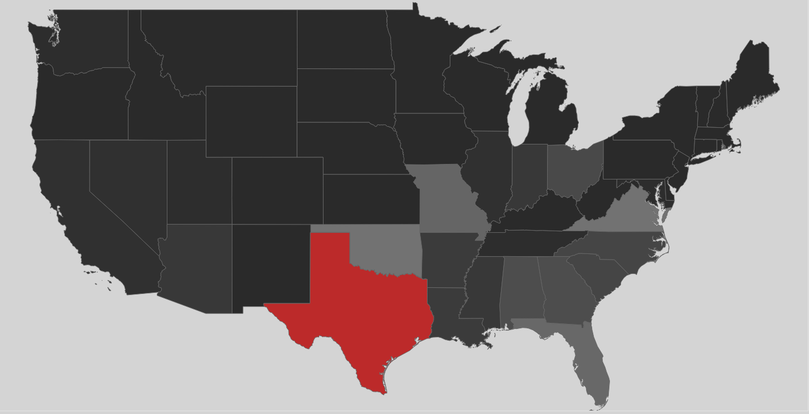

Capital Punishment
National Summary of Capital Punishment
Vladimir Dinolov, Veasna Oum, Stephanie Cruz, Joe Amico
IST 736 Text Mining
Final Project
MS Applied Data Science

Slide 2
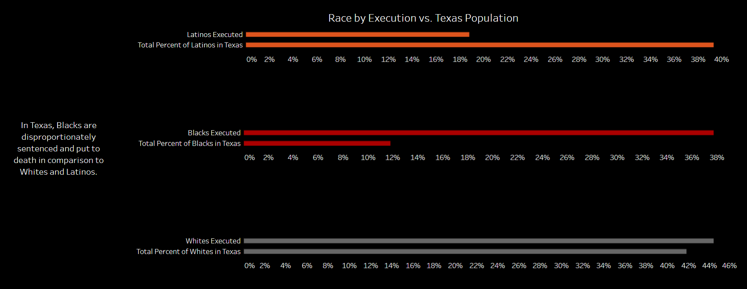
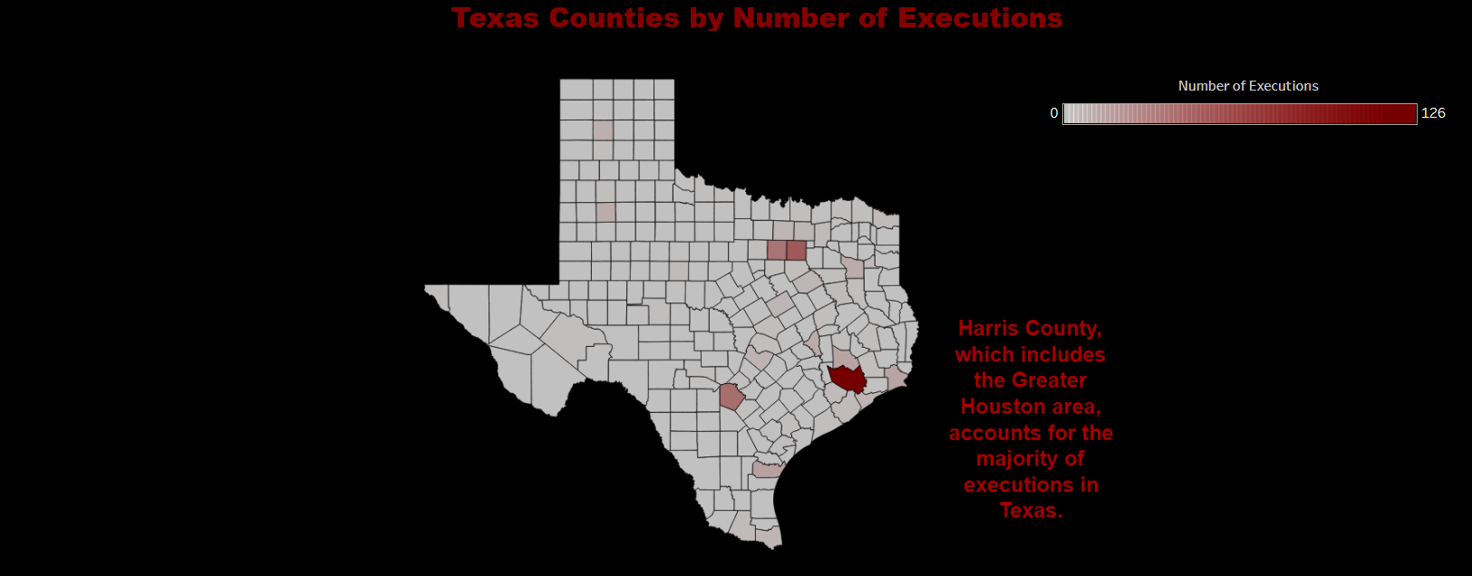

Our Why
Executions by Race in Texas
Texas Counties by Number of Executions

Slide 3
Research Questions
Are there issues of inequity, racial or geographic, in Texas execution rates?
Which words appear the most in final statements of executed prisoners?
Can machine learning algorithms determine if a statement is remorseful or resentful?
What are the final statement topics by U.S. region?
Does location affect the density of remorseful vs. resentful final statements?
Can machine learning be used to predict final statement topics?

Slide 4
Machine Learning Algorithms
K-Means Clusters
Naïve Bayes
SVM
LDA
Decision Tree

Slide 5
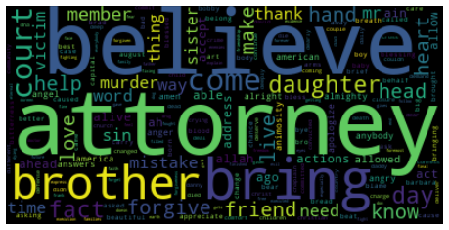
Clusters
Text Sentiment Analysis of “Last Statement”
Visual Exploration
K = 3
Remorseful * Resentment * Other

Slide 6
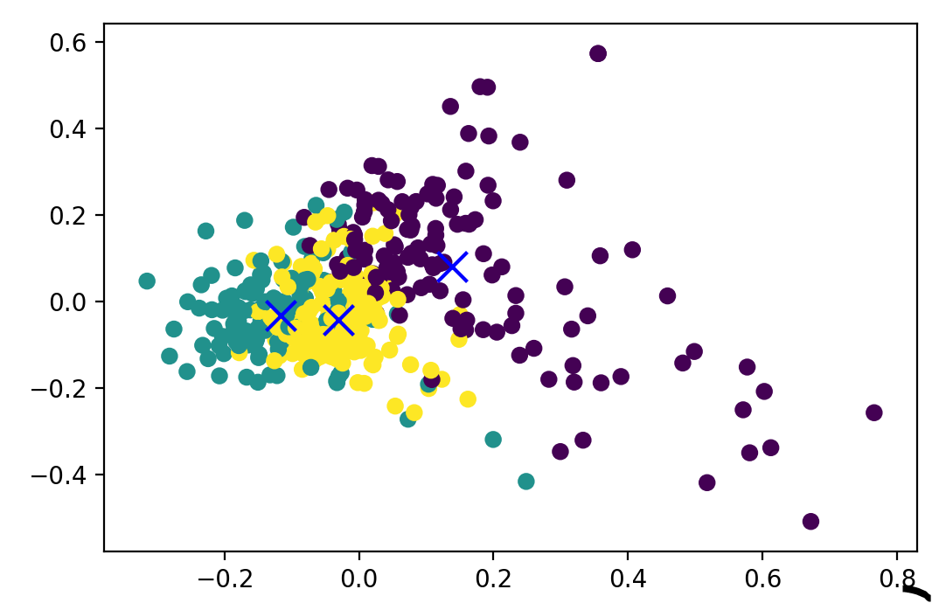

Clusters
Text Sentiment Analysis of “Last Statement”
K = 3
Remorseful * Resentment * Other
Principal Component Analysis (PCA)
Result of separation: 0.124
Overlapping

Slide 7
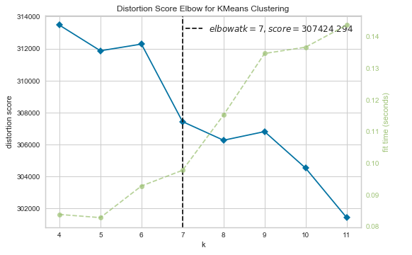
Clusters
Text Sentiment Analysis of “Last Statement”
WSS – Elbow Method
Clusters: 7
Labels
Remorseful
Resentment
Other
Innocent
Religious
Short statement
Appreciative
Mournful

Slide 8
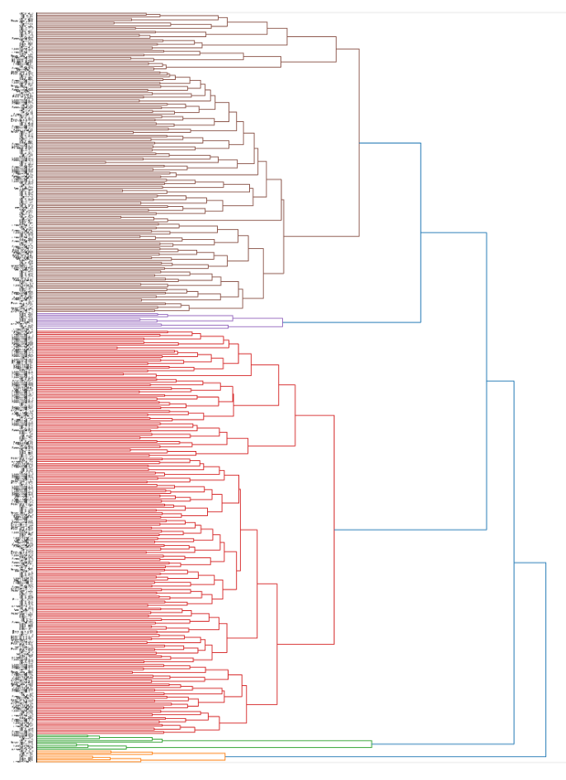
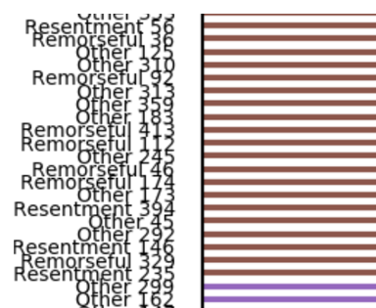
Clusters
Hierarchical Clustering

Slide 9
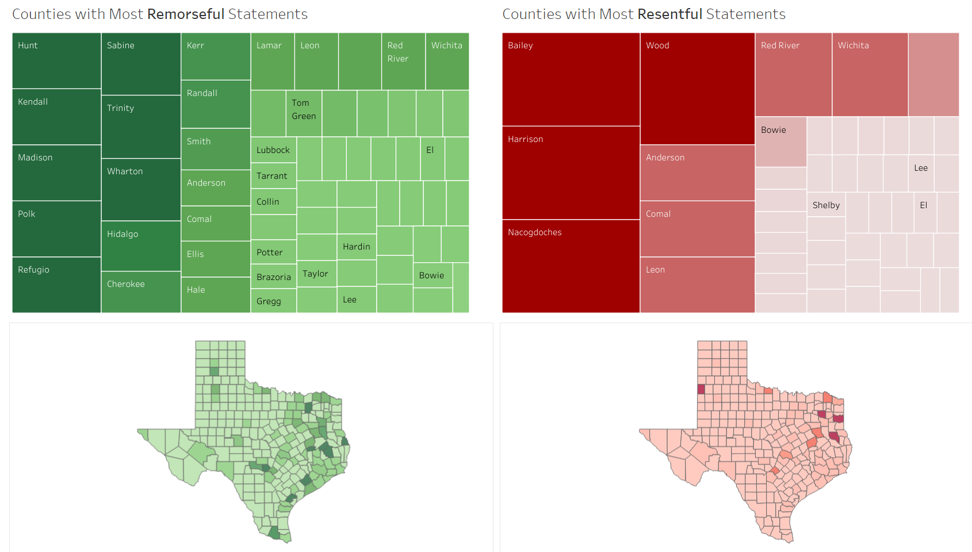
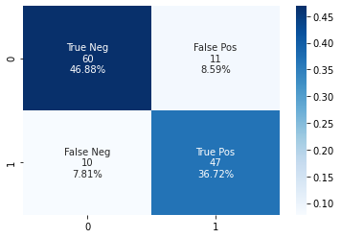
NAÏVE BAYES
Counties by Remorse and Resenment
~84% Accuracy

Slide 10
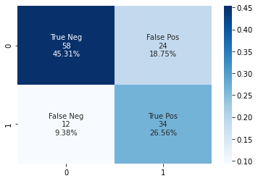
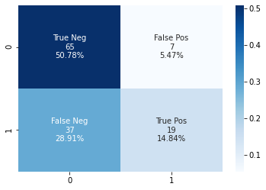
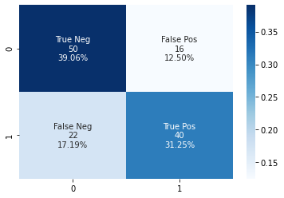
Linear:
C = 10, Max Iterations = 100000
~72% accuracy
SVM
RBF
C = 10000
~70% accuracy
Polynomial
C = 50, Degree = 3
~66% accuracy

Slide 11
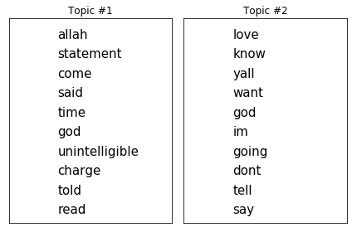
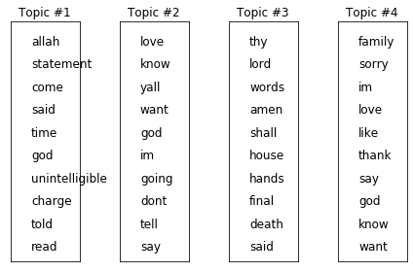
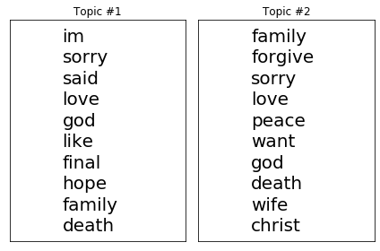
LDA
Count: 55
Count: 750
Count: 99

Slide 12
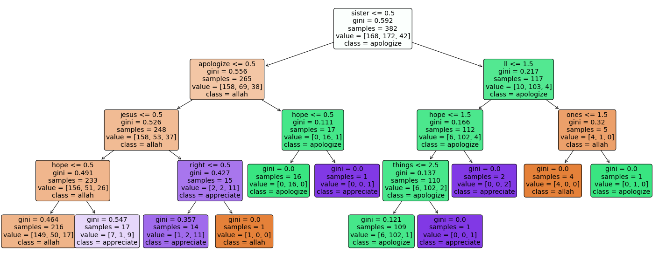
Decision Tree
~40% accuracy

Slide 13
CONCLUSIONS
African Americans/Blacks are disproportionally executed in the state Texas
Harris County, Texas has executed the most inmates in Texas which 126 executions (23%)
The words attorney, brother, and believe appear the most in final statements of executed inmates
Machine learning algorithms CAN determine if statements are remorseful or resentful with high accuracy
The following final statement topics were discovered: showing remorse, religious, very religious, showing appreciation, and talking about family
Final statement topics cannot be predicted with a high level of accuracy

