Slide 1


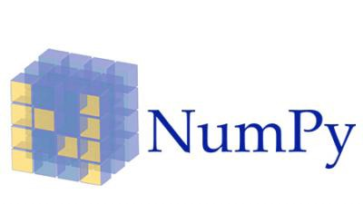

Introduction to Programming, Data Visualization and Model Fitting with Python
April 6, 2018, Cal State Fullerton
Center for Computational and Applied Mathematics
Arjang Fahim, PhD
Department of Biomedical Engineering
University of California, Irvine

Slide 2

Workshop Outline
1:00 PM – 2:45 Overview & Basic of the Python Language
2:45PM – 3:00 Break
3:00PM - 4:00 Python and Data Science – Overview of some simple libraries
4:00PM – 4:15 Break
4:15PM – 5:00 Data visualization tools in python

Slide 3
Basics of Python Language

Slide 4
What this workshop is …
Since this is a four hour workshop it is tough to decide what gets taught and what doesn’t
In that pursuit this course is intended as an introduction to the Python programming language
Focus on the fundamentals of the Python language with the goal of using Python for working data
This course is not intended to teach “how to program”
Assume a basic familiarity with “programmatic” thinking
This does not mean that if you don’t know how to program the workshop will be useless, but it definitely will not make someone a programmer in four hours
The ideal student then has some experience with programming or “programmatic thinking” and may have written codes in other languages (Matlab, C++, R, Java) to analyze data.

Slide 5
What is Python?
Python is an interpreted, object-oriented, high-level programming language with dynamic semantic.
Some of the notable features:
Elegant easy to read syntax
Powerful high level built in data structures combined with dynamic typing, makes it very attractive for Rapid Application Development (RAD).
Rich standard libraries for performing variety of tasks
Runs on any platforms : Mac, Windows, Linux, Unix
100% Free – Thanks to active supporting community

Slide 6
Downloading Python: Different Distribution of the Python
The official distribution of Python can be downloaded from python.org
Additionally, there are many “alternative” distributions
IronPython – Python running on MS .Net (http://ironpython.net)
ActiveState ActivePython (https://www.activestate.com)
Enthought Canopy – Commercial distribution for scientific computing
Anaconda Python – a full Python distribution for data management, analysis and visualization of large data set. (https://www.anaconda.com)

Slide 7
Anaconda Python
Many people often install the Enthought Canopy or Anaconda Python distributions
We’ll be using the Anaconda Python distribution today
About Anaconda:
Free, easy-to-install package manager, environment manager, Python distribution
Collection of over 720 open source package with free community support
Platform-agnostic, can be used on Windows, OS X and Linux

Slide 8
Installing Anaconda
If you haven’t already, go to the following website and follow the instructions to install Anaconda
http://www.continuum.io/downloads
Ensure that you have installed Anaconda for Python 2.7
This process will take a little bit, try to follow along while this is installing

Slide 9
References for Continuing Learning
List of Python Beginners Guides (Non-Programmers)-
https://wiki.python.org/moin/BeginnersGuide/NonProgrammers
List of Python Beginners Guide (Programmers) -
https://wiki.python.org/moin/BeginnersGuide/Programmers
Codecademy
https://www.codecademy.com/learn/python
Udacity
https://www.udacity.com/course/programming-foundations-with-python--ud036

Slide 10
Reference to this workshop
Programming in Python 3: A Complete Introduction to the Python Language
https://www.qtrac.eu/py3book.html
The book focuses on Python 3
Many examples are similar from this book
Python official documentation:
https://docs.python.org/2/

Slide 11
Python Overview - Getting Started

Slide 12

Interfacing with Python – Command Line
There are a few ways to interface with Python
The first and easiest way is directly from the command line in an interactive fashion
Let’s get started …
Open a new terminal ( in Ubuntu or MacOS) and type ipython, hit enter and then type

Slide 13
Interfacing with Python – Command Line
Should have returned something like:
Hello, my name is Arjang
The first line created a variable called myname and assigned a value ‘Arjang’
The second line is composed of two parts:
A print statement
A string ‘Hello, my name is {0}’ modified the method.format() which has been passed the argument myname

Slide 14
Everything is an object
We’re getting a little ahead of ourselves here, but let’s start explaining a bit about what is going on
What is odd about this is the way that we were able to modify the string to include the variable myname
In Python everything is an object
This means that is carries with it special attributes and methods once it has been specified
Throughout today we’ll introduce this type of thinking within Python which allows you to flexibly interact with code
Once it becomes familiar to you it will be second nature
The syntax for this is
Object.attribute # Variables of the object
Object.method() #Functions available to object

Slide 15
Interfacing with Python – Scripts
A more advanced way is to begin to write scripts within text files. Let’s create a file first.
From command line on Linux or Mac
$ cd
$ cd Desktop
$ mkdir py_workshop
$ touch example1.py
From the command prompt on Windows, type
cd %HOMEPATH%
cd Desktop
mkdir py_workshop
Type NUL >> example1.py

Slide 16
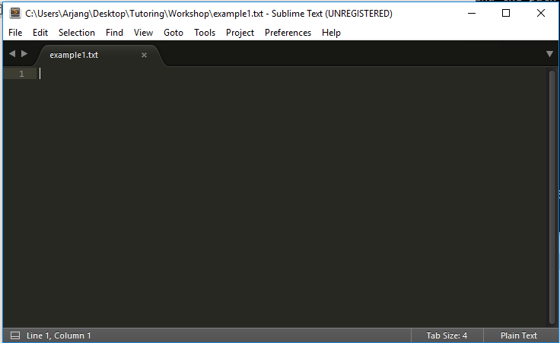
Interfacing with Python – Scripts
From your Desktop open the folder. The file that was created should be there. Now open the file with a text editor.

Slide 17
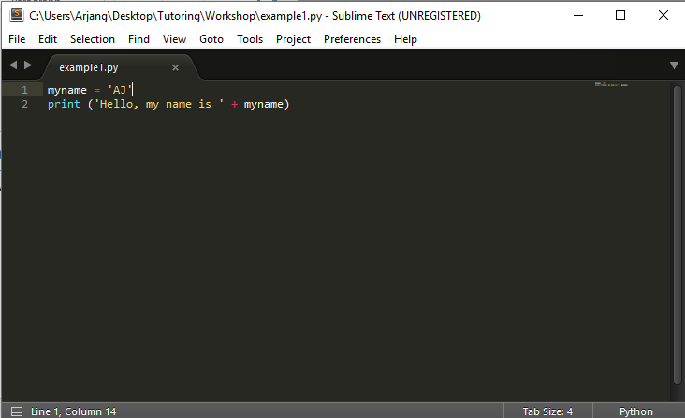
Interfacing with Python – Scripts
Add the code that we used in the interactive mode to the script. It should look as follows:

Slide 18
Interfacing with Python – Scripts
Now let’s run the script …
Open a terminal ( a Command Prompt windows ) and type
On windows
cd Desktop\py_workshop
dir
python example1.py
On Linux and Mac
cd Desktop/py_workshop
ls
python example1.py

Slide 19
How do Python programs work?
The way a Python program is structures provides instructions to the computer as to the order in which to execute code
Each statement encountered in a .py program is executed in the order in which they are arrived at
The Order of commands can be diverted or “controlled” using certain operations and logical operations
Additionally the structure of the spacing provides information to the compiler (interpreter) as to which parts of the code are organized together

Slide 20
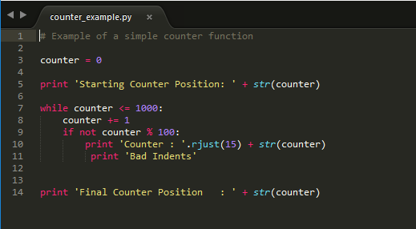
How do Python programs work?

Slide 21
Interfacing with Python – Jupyter Notebooks
Scripts are a simple and straight forward way to create python executable code, but may not be the easiest way to test small bits of code
Additionally, they are not as useful if you’re mainly trying to perform data analysis tasks where you want to consistently view the data different ways
An alternative way to interface with python is with Jupyter notebooks (previously referred as IPython Notebooks)

Slide 22
Interfacing with Python – Jupyter Notebooks
http://jupyterorg/
Open source, interactive data science and scientific computing across over 40 programming languages
The Jupyter Notebook is web application that allows you to create and share documents that contain live code, equations, visualizations and explanatory
Uses include: data cleaning and transformation, numerical simulation, statistical modeling, machine learning and much more.
Installing Jupyter Notebooks is easy! (It was already installed with Anaconda!)

Slide 23
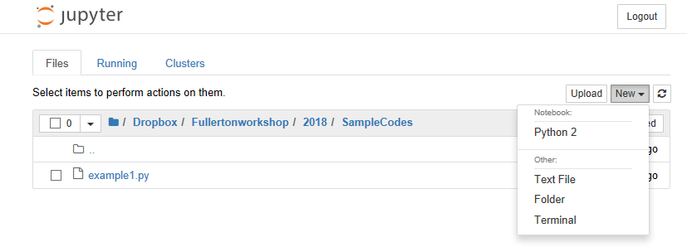
Interfacing with Python – Jupyter Notebooks
Getting a Jupyter notebook started
From command line type
Jupyter notebook
Two things will happen:
First terminal will begin executing some ‘commands’.Basically a local server to run the Jupyter noteback
A web browser will open showing a directory structure
Allows access to files in the directory where the command was execute and all subdirectories of the original directory

Slide 24
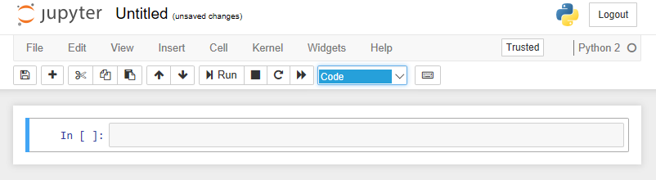
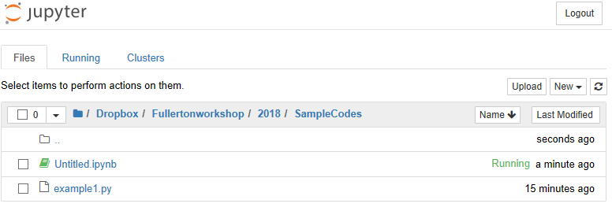
Interfacing with Python – Jupyter Notebooks
This did two things …
Opened a new “Untitled” jupyter notebook in a new tab
Added the new “Untitled” notebook to the direcyory

Slide 25
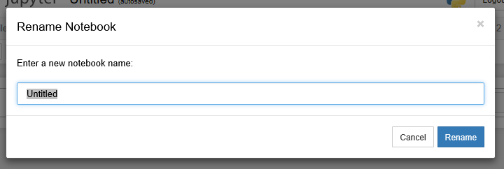
Interfacing with Python – Jupyter Notebooks
Let’s rename the notebook
Click the word “Untitled” next to the logo
Change the name to “pynotebook1”

Slide 26
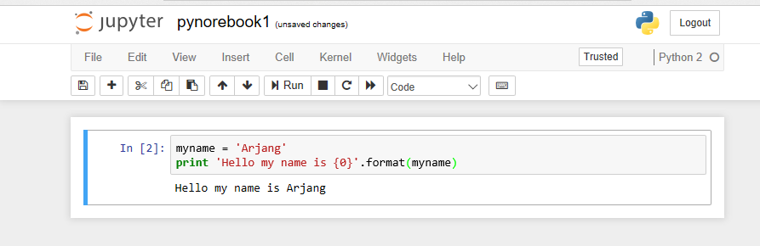
Interfacing with Python – Jupyter Notebooks
In the code box type our simple introductory example
myname = ‘Arjang’
print ‘Hello, my name is {0}’ . Format(myname)
To run the code press: ctl + retuen

Slide 27
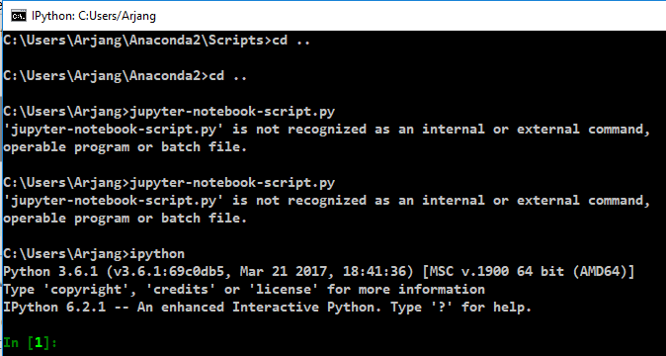
Fundamentals of Jupyter Notebooks
What happens when you press ctrl + return ?
Essentially the norebook copies that block of code and runs it within an ipython consol. (Notice the numbering)
print ‘Hello, my name is {0}’ . Format(myname)
It then return the result below the code block

Slide 28
Fundamentals of Jupyter Notebooks
What happens when you press ctrl + return ?
As with an ipython console all of the variables that you ended are available in subsequent lines
This can be useful if you only want to run blocks of code at a time

Slide 29
Fundamentals of Jupyter Notebooks
Lots of functionality. See (help > Keyboard Shortcut)
Blocks can be of three types, we outline the main two:
Code – This is what a block defers to. Used for entering code which we wish to execute
Markdown – Useful for HTML – like write ups. Additionally supports LaTex commands for mathematical symbols
To change to from a code cell to a markdown cell type esc then m
The active block will indicated by a green border

Slide 30
Fundamentals of Jupyter Notebooks - Useful Keyboard Shortcuts
From within the current cell, to run the current cell
ctrl + enter
From within the current cell, to run the current cell then select the cell below it (or insert a cell below if none exists)
shift + enter
From within the current cell, to adding a cell above the active cell
Esc then b
From within the current cell, to adding a cell above the active cell
esc then a
From within the current cell, to remove (or cut) the active cell from the worksheet
esc then x
From within the current cell, to add a cut cell above the current cell
esc then shift+v
• From within the current cell, to add a cut cell below the active cell
esc then v

Slide 31
Fundamentals of Jupyter Notebooks - Further Reading
To fully utilize the power of Jupyter notebooks for reproducible research it is worth investigating
Jupyter Documentation:
https://jupyter.readthedocs.io/en/latest/index.html
Markdown: Markdown allows you to write using an easy-to-read, easy-to-write plain text format, then convert it to structurally valid XHTML (or HTML).
http://daringfireball.net/projects/markdown/syntax
LaTeX: LaTeX can be used to within the markdown structure of Jupyter notebooks to integrate visually beautiful HTML with mathematical equations

Slide 32
Python Overview – Basics of the Python Language

Slide 33
Primary Topic’s Covered Today
Basic Data Types
Logical Operations
Collection Data Types
Control Flow Structures
Functions
For a more comprehensive overview
https://docs.python.org/2/tutorial/

Slide 34
Basic Data Types

Slide 35
Keywords and Identifiers
Variables in Python are called object reference and the names given to them are called identifiers or plainly names
The first character of an identifier must be a letter
Additionally identifiers are case sensitive
There are also “reserved” keywords which cannot be used as identifiers or variables or objects.
and | continue | except | global | lambda | raise | yield
as | def | exec | if | not | return
assert | del | finally | Import | or | try
break | elif | for | in | pass | while
class | else | from | is | print | with

Slide 36
Keywords and Identifier – Some Examples
Identifiers (Variables) name examples:
myname = “AJ”
todaysweather = ‘sunny’
tomorrowsWeather = ‘Cloudy’
TodayTemp = 77
FAVORITE_color = ‘blue’
The convention or style for variable names should be consistent (Camel Case, or using underscores)
Notice none of these start with numbers

Slide 37
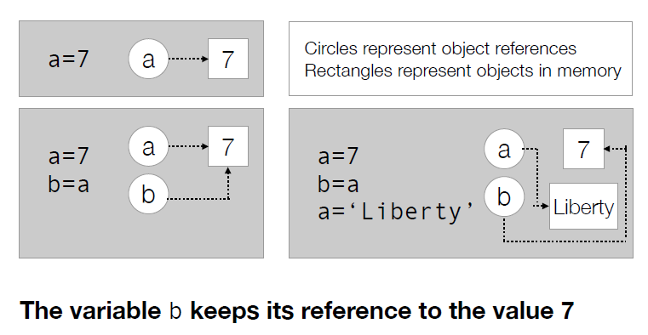
Objects (variables) assignment and reference
From: Programming in Python 3: A complete Introduction to the Python Language. Mark Summerfield

Slide 38
Types of Numbers
There are few major types of numbers that are of basic use in Python
boolean
Integers
floating-point
complex
decimal

Slide 39
Booleans
A Boolean object value is either True or False
Additionally the function bool() attempts to convert objects to a boolean object
With no arguments it returns False
With a Boolean object it returns a copy of the original
Any other object it attempts to convert to a Boolean
Using values 1 and 0 instead of True and False almost always works fine, but the more appropriate syntax is to use Boolean types

Slide 40
Integers
Integers are of the int type and are specified by any numbers without a decimal point
a = 7 # This is an integer
b = 7.0 # This is not
c = 7. # Neither is this
After boolean numbers, integers are the most basic type
To attempt to convert an object to an integer type we have the function int()

Slide 41
Floating Point Numbers
There are a few different versions of floating point numbers in Python
float, complex, Decimal (from the library decimal)
The most often used will be the float and the complex types
The Decimal type can be used for really high precision operations
As with int() and bool(), there is a function float() which can be used to create objects of the float type or convert objects to the float type

Slide 42
Useful Numeric Operations and Functions
Syntax | Description
x + y | Adds number x and number y
x – y | Subtracts y from y
x * y | Multiplies x by y
x / y | Divides x by y
x // y | Floor division of x by y; returns int type
x % y | Modulus operation; remainder of dividing x by y
x ** y | Xx raised to power y
abs (x) | Takes the absolute value of x
round(x, n) | Rounds x to the n digits

Slide 43
A quirk of Integer Division
A feature that almost always trips up those new to Python is the way in which integer division works
Consider a = 1 / 3
We would expect a to return 0.33333333, but instead it return 0
This is because floor division is performed and another variable of type int is return
To correct this one of the values needs to be a floating point
b = 1. / 3 or c = 1 . 0 / 3 or d = 1 / 3. or e = 1 . 0 / 3 . 0

Slide 44
Even numbers are objects
a = 7
type(a) # Returns the type of a - int
dir(a) # Lists the methods and attr
b = 4.0
type(b)
dir(b)
c = True
type(c)
dir(c)

Slide 45
Strings
One of the most versatile data types in Python is the str datatype
Objects can be attempted to be converted to a string using the function str().
Strings hold a sequence of unicode characters
String literals can be created by enclosing a sequence of characters in either single or double quotes
myname = “AJ" or myname = ‘AJ'
but the notation must be consistent

Slide 46
Strings
Additionally, Python provides capability for multi-line strings.
These are useful for using Python to generate flat text files with lots of text without printing line by line.
To create a multi-line string enclose a sequence of characters in triple-quotations
multi_str = """Hello, my name is Brian.
This is a multi-line string."""

Slide 47
Understanding Sequences – Indexes, Sub-sequencing, Slices and Striding …
Python has a syntax for taking subsequences of larger sequences
Python is zero indexed and thus the first index location is 0
Strings are a sequence of characters and are a good place to learn this notation
Consider string a = “My name is AJ”
Using this notation we can access individual characters of string
a[2] is “ “ or a[3] = ‘N’
a[0] | a[1] | a[2] | a[3] | a[4] | a[5] | a[6] | a[7] | a[8] | a[9] | a[10] | a[11]
M | y |  | N | a | m | e |  | is |  | A | J
a[-12] | a[-11] | a[-10] | a[-9] | a[-8] | a[-7] | a[-6] | a[-5] | a[-4] | a[-3] | a[-2] | a[-1]

Slide 48
Understanding Sequences – Indexes, Sub-sequencing, Slices and Striding …
We may want more than one character though
A subsequence of sequence in Python is called slice and has the following notation
seq[start]
seq[start:stop]
seq[start:start:step]
Where start, stop, step must be all integers
This notation will work with any sequence such as a list, string or a tuple

Slide 49
Understanding Sequences – Indexes, Sub-sequencing, Slices and Striding …
Consider the following sequences
s[0 : 4] is ‘Data’
s[4 :] is ‘ Science’
s[-7 :] is ‘Science’
s[: : 2] is ‘Dt cec’
s[ : : -1] is ‘ ecneicS ataD’
S[-7:]
D | a | t | a |  | S | c | i | e | n | c | e
S[0:4]
S[4:0]

Slide 50
Methods available to String object
A major strength of Python is its ability to manipulate strings.
Often the primary reason that I give for learning Python in addition to R
Each str object carries with it a set of methods (or functions), which allow easy manipulation of the string
This with logical operations make manipulating strings in Python fairly straight forward
That is up until you need to learn regular expression …

Slide 51
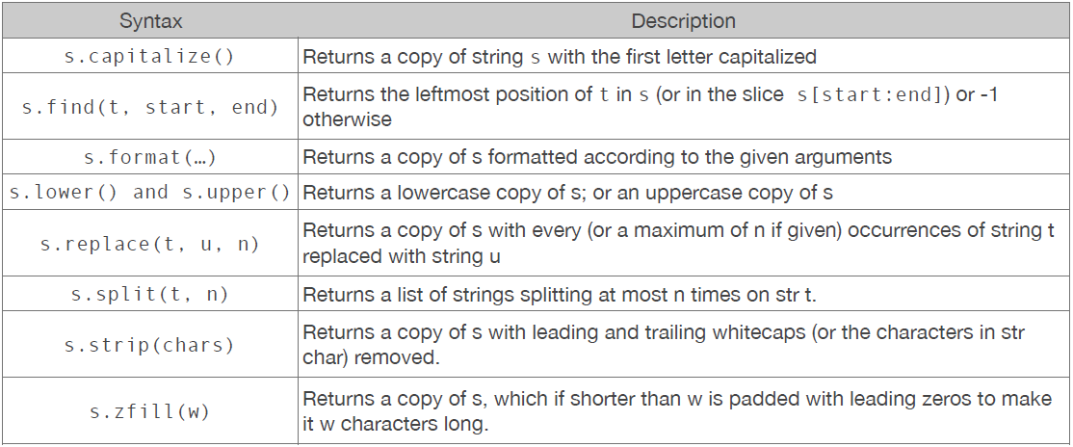
Methods available to String object
Below is an overview of some of the methods available.
As you can see these are very handy when parsing documents and strings

Slide 52
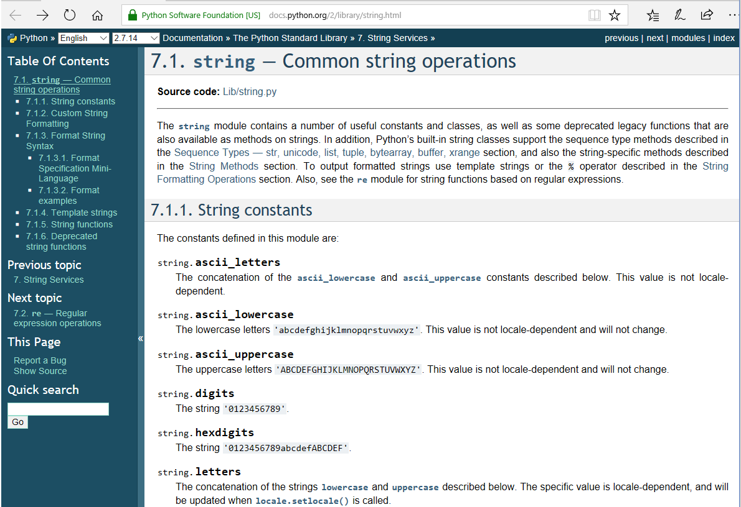
Further Reading – Completely understanding Strings
https://docs.python.org/2/library/string.html

Slide 53
Logical Operations

Slide 54
Logical Operations
A fundamental extension to having data types is comparing them or performing logical operations on them
I’ll provide a brief overview of the three main logical operations you’ll want to concern yourself with
Comparison Operations
Logical Operations
Membership Operations

Slide 55
Comparison Operations
As with most programming languages, Python provides a set of binary comparison operators
< less than, <= less than or equal to
== equal to, != not equal to
> greater than, >= greater than or equal to
Additionally it provides an identity operation, is
This references location in memory ( is this the same object in memory as another), thus want to use == or != to test values

Slide 56
Logical Operations
Additionally Python provides a way to test Boolean statements with and, or, not
Both and and or use short-circuit logic and return the operand which determined the result
This can tricky if you’re not careful
What this means is :
a = True
b = False
a and b return False
a or b return True

Slide 57
Membership Operations
We haven’t talked about collection of data types yet, but we will introduce another type of logical operation
This is the in operation
This operator will return whether an object is within a collection
Additionally can be used with logical operators (not in)
Slow for large ordered collections, but can be very fast on certain data types such as dictionaries and sets

Slide 58
Collection Data Types

Slide 59
Types of Collections
There are three types of collection data types
Sequence Types, Set Types, Mapping Types
Often we will want to collect many of the simple data types that we introduced earlier, or collection collections of variables together!
We deal with collection types all the time working with data

Slide 60
Sequence Types
Collections of the Sequence type support the membership operator in, the size function len(), slices, and are iterable
When iterated, a sequence will provide the items in their order in the sequence
The primary sequence types that are of interest are
list
str : We have already worked with str
tuple

Slide 61
Lists
Lists are one of the most versatile data structures in Python.
A list object is a list of comma separated values (the items of a list) within square brackets.
small_list = [1, 2, 3, 4]
While lists can be constructed of many different data types they are often homogeneous

Slide 62
Lists
Lists support operations like simple concatenation
my_list_1 = [1,2,3]
my_list_2 = my_list_1 + [4,5,6]
Additionally they have many methods available to them as well.
For those familiar with algorithms they can be used a stacks (last-in, first-out)
Or they can be used as a queue (first-in, first-out), but there are more efficient data structures developed for that purpose.
Are used extensively throughout data science and will be a primary data structure used for manipulating data

Slide 63
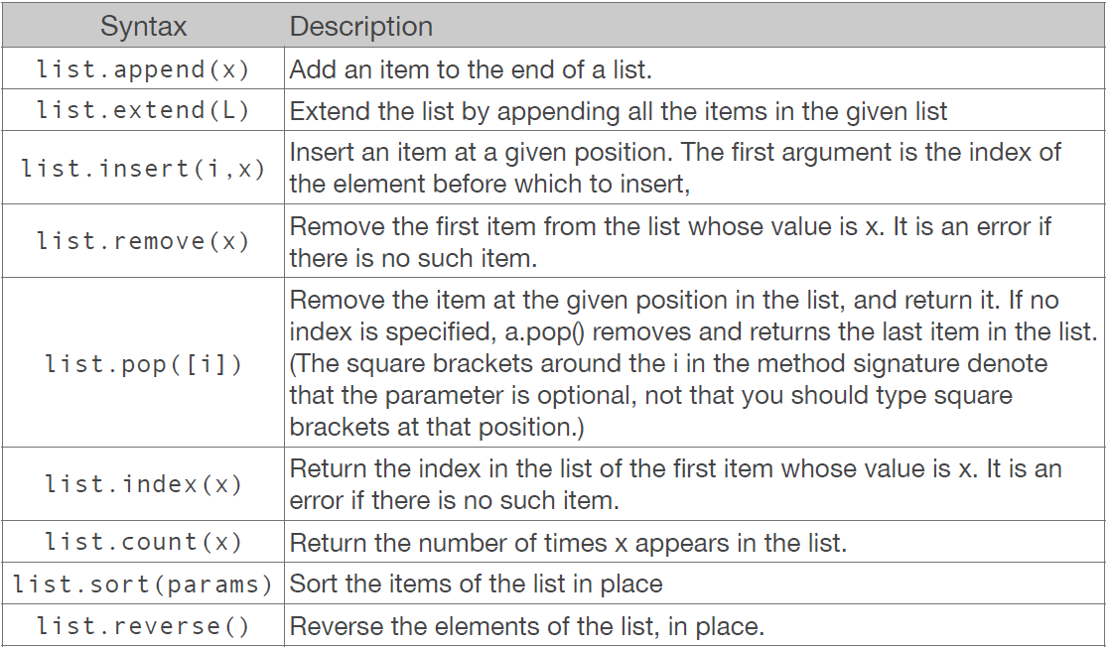
Methods available to lists

Slide 64
Lists of Lists: Multidimensional Lists
Since a list can contain any object, it naturally follows that they can contain lists
Multi_list = [ [ 1, 2, 3], [4, 5, 6]]
We introduce these because it is worth understanding how to use multiple indices
To get to the element 3, use indexing as follows:
Multi_list[0][2]

Slide 65
Lists of Lists: Multidimensional Lists
Why does this work? The object multi_list[0] is itself a list. Namely the list [1, 2, 3]
To get to the element 3, we can use the same convention with list [1, 2, 3] [0] which return 1
This chaining together of indices or methods is very useful throughout the Python language and we’ll make more use of this later

Slide 66
Tuples
A tuple consists of a number of values separated by commas ( and often times contained in parentheses)
my_tuple = ( a, b, c )
my_tuple2 = 4, 1, 5
my_tuple3 = 4, # ugly but it works
Similar to lists, but used in different situations for different purposes
Tuples are immutable (unchangeable), and contain a heterogeneous sequence of elements
my_tuple [0] = d will return an error
Items can accessed via unpacking or indexing
Conversely, lists are mutable, and their elements are usually homogeneous and are accessed by iterating over the list

Slide 67
Lists are mutable … Tuples are immutable …
Consider the following small bit of code
a = [1, 2, 3]
b = (1, 2, 3)
a[0] = 4
b[0] = 4
We see that we are able to edit the value at index zero of the list a.
Conversely when attempting to edit the first index of the tuple we get the following error
TypeError: ‘tuple’ object does not support item assignment

Slide 68
Tuples - Unpacking
Tuple packing/unpacking will be referenced and useful throughout learning Python
Tuples can be packed in the following manner
t = 123.0, ‘hello’ , 4
And similarly unpacked into new variables
a, b, c = t
Here t is unpacked and each item is assigned to the identifiers a, b, c at the beginning of the line

Slide 69
Set Types
A set type is a collection which supports the membership operator in, the size function len(), and iterable
A set is an unordered collection of zero or more object references which refer to objects
Since it is unordered, there is no concept of a slice of stride as with strings and tuples
In the interest of time, we won’t go into the details of sets, but they can be incredibly useful for using set operations such as union, disjoint, intersection

Slide 70
Mapping Types
A mapping object maps hashable values to arbitrary objects
An object is hashable if it has a hash value which never changes during its lifetime and can be compared to other objects
Hashable objects which compare equal must have the same hash value
Currently only one standard mapping type, the dictionary dict() exist

Slide 71
Dictionaries
A dictionary is a set of unsorted key:value pairs where each key is a unique identifier
Keys can be any immutable type; strings and integers can always be used s keys
Tuples can be used as keys if they contain only strings, numbers, or tuples; otherwise it cannot
Dictionaries, lists, and tuples are all arguably the most common data collections that you’ll run into in Python when manipulating data

Slide 72
Dictionaries
Examples of dictionaries
my_dict = { } # empty dictionary
my_dict2 = dict() # empty dictionary
my_dict3 = {1:2, 2:3, 3:4}
my_dict4 = {‘one’ : 1, ‘two’ : 2, ‘three’ : 3 }
To access items in a dictionary the must be accessed via their key names
Dict[key] for example my_dict4[‘three’]

Slide 73
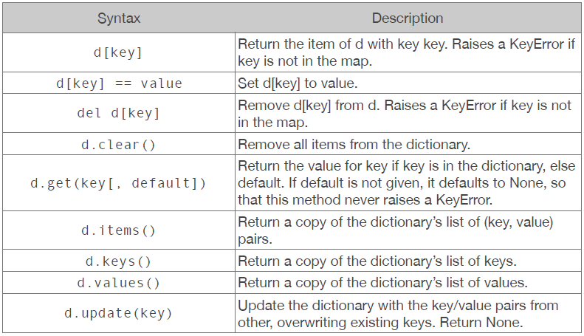
Methods for Dictionaries

Slide 74
An interesting property of object reference of collections
Consider the following example
a = [1, 2, 3]
b = a
a[1] = 4
Print a, b
Let’s investiga…

Slide 75
An interesting property of object reference of collections
What has happened is that Python has created a shallow copy of the variable a
This means that b is only a pointer to the location of the list of a in memory
When a change … b does not retain an original copy of the list and is still bound to the location of that list in memory
While this is done to converse memory it means that you have to be careful when creating object references
One method (though not universal) of correcting this the following
a = [1, 2, 3]
b = list(a)
a[1] = 4
print a, b

Slide 76
Control Flow Statement

Slide 77
Control Flow Statements
Now that we’ve defined basic data types, operations on these data types and finally collections of simple data types… we can start doing more interesting programing tasks
To build on this we want to be able to construct the language so that certain statements tell the program how to “flow” between statements

Slide 78
Conditional Branches
The most simple conditional branches is the if statement
x = 3
if x == 3:
print “x = ” + str(x)
As you can see, it is of the form
if condition:
#code executed if true
This is why we introduced logical operations before understanding flow statements
In the above code nothing happens if the statement evaluate to false

Slide 79
Conditional Branches
If we want something to happen when the if statement fails, we can add an else statement
x = 4
if x == 4:
print “x was ” + str(x)
else:
print “x was not 4”
This allows us to have a condition that will always run when checking a conditional

Slide 80
Conditional Branches
To add multiple conditions to a program we can nest elif statements between the if and else statements
x = 4
if x == 3:
print ‘x was ‘ + str(x)
elif x == 4:
print ‘x was ‘ + str(x)
else:
print ‘x not found in conditions’
The first statement must an if statement and the else statement does not contain a condition to check.
As with all Python code, the conditions are evaluated in order so understand the precedence for certain conditions is imperative

Slide 81
A bit about whitespace and structure
Leading whitespace (spaces and tabs) at the beginning of a logical line is used to compute the indentation level of the line
This is in turn is used to determine the grouping of statements
The total number of spaces preceding the first non-blank character then determines the line’s indentation.
Python’s spacing is what is used to organize the structure of a program.

Slide 82
A bit about whitespace and structure
Organization of blocks of code by whitespaces is actually very useful
We can see to the right that the indentation allows us to clearly see where the while loop begins and where the conditional structure begins on the line below it
Additionally blocks of code are started
by colon
See the while loop and the if statement

Slide 83
A bit about whitespace and structure
Indentations can either be groups of space or tabs so long as they are consistent within the document.
Additionally many text editors can be set
to show these indents for you!

Slide 84
A bit about whitespace and structure
The code to the right highlights a ‘bad indent’
The if block is no longer properly and consistently indented
Attempting to run this code will throw an
IndentationError

Slide 85
Tabs VS. Spaces
So do you use tabs or space?
From the PEP 8 Python Style Guide:
Spaces are the preferred indentation method
Tabs should be used solely to remain consistent with code that is already indented with tabs
https://www.python.org/dev/peps/pep-0008/

Slide 86
Loops
Another thing that is often important when controlling the flow of a program is to iterate or loop over the objects in a collection
The two primary looping statements are the while and for loops
In addition to the for loop, there are functions built into Python which are often used with the for loop. Namely the range() and enumerate() functions

Slide 87
While Loops
A simple description of a while loop is that is used to execute some code zero or more times
The number of times that the code is executed is determined by a Boolean condition
While loops are often useful when the structure of the object is unknown or if we don’t know how many times we will need to do something
Caution: You will create infinite loops at some point …
The simple example is as follows:
x = 0
while x < 10:
x += 1
print x

Slide 88
While Loops
Useful with while statements are the commands break and continue
These commands are often used within conditional branches to change or divert the flow of a loop
x = 0
while True:
if x == 10:
break
x += 1
print x
The above code snip does the same as the previous slide

Slide 89
While Loops
Similarly the continue command can be used to skip certain steps
The following code prints all even numbers to 10:
x = 0
while x <= 10:
x += 1
if x % 2: # 1 is true 0 is false
continue
print x

Slide 90
For Loops
Python’s for loop is used to iterate through the objects of an object which is iterable
An iterable is any object which can be iterated over, including strings
For loops will be used fairly often within data science, because we often had a set of observations with which we want to iterate over.
Similar to the while loop, the break and continue statements are available to the for loop for controlling the flow through the iterable object

Slide 91
For Loops
Reuses the in statement from membership operations
Syntax:
for variable in iterable:
#some code here
Example:
x = [‘one’, ‘two’, ‘three’]
for number in x:
print number

Slide 92
For Loops
Two commands will be very useful in conjunction with for loops: range() and enumerate()
range() create sequence of integer
Syntax range(stop)
range(start, stop[, step])
Example range(10) # Outputs a list of 10 int (0 to 9)
range(0, 10, 2) # Outputs a list of even numbers
This is useful if you know the number of objects and want to create a list of indices to iterate through.
x = [1, 2, 3]
for ind in range(3):
print x[ind]

Slide 93
For Loops
The enumerate() command returns an iterable object that ties each object to its position in the iteration process
To understand hoe this works it is best to see it in action
a, b, c = 15.0, 33.0, 3.14
x = [a, b, c]
for ind, obj in enumerate(x):
print ind, obj
The enumerate() function is useful when the order of two lists is useful and comparable
my_dict = {‘one’:1, ‘two’:2, ‘three’:3}
for ind, obj in enumerate(my_dict):
print ind, obj
Recall that dictionaries have an arbitrary ordering, therefore it may not make sense in
this use case!

Slide 94
Creating Functions

Slide 95
Built-in functions
Python has many, many, many built-in functions already at your disposal
These functions are always available
https://docs.python.org/2/library/functions.html
They don’t encompass everything that could possibly be done with the language and therefore it is useful to know how to create your own functions

Slide 96
Defining Functions
The keyword def introduces a new function definition
It must be followed by the function name and the parenthesized list of formal parameters
The statements that form the body of the function start at the next line, and must be indented,
def function_name(parameters):
pass

Slide 97
Example function
def fib(n): # write Fibonacci series up to n
“”” print a Fibonacci series up to n. “””
a, b = 0, 1
while a <= n:
print a,
a, b = b, a+b
fib(1000) #This line calls the function

Slide 98
Defining Functions – Introducing default values
Functions can be specified with default values, so that the function can take in less arguments than are specified
The default values are then used when specified
def print_names(x =[‘AJ’]):
if len(x) == 1:
print ‘There was one name: ‘ + x[0]
else:
print ‘There were {} name’.format(len(x))
for ind, name in enumerate (x, start = 1 ):
print ‘Name{0}: {1}’.format(ind, name)
print_names()
print_names([‘AJ’, ‘Steve’, ‘Steve’])
print_names (‘AJ’) # Don’t forget strings are iterable

Slide 99
Returning values from a Function
Most of the time you will need to return something from a function.
This can be accomplished with the return statement at the end of the function
def function_name( parameters ):
# Some operation
return object

Slide 100
Returning values from a Function
Example of how to return multiple numbers
def min_max(x)
return min(x), max(x)
Some_numbers = [1, 5. 15, -1, 6, 3.]
print min_max( some_numbers) # a tuple
min_x, max_x = min_max (some_numbers)
The function min_max() returns a tuple containing the minimum and maximum of the object x.
This can be unpacked into multiple variables using the unpacking notation that was described earlier in the workshop!

Slide 101
It’s impossible to teach everything …
Clearly I don’t have enough time to teach everything today, but hopefully I’ve included enough of the fundamentals for you to get started.
Python has many quirks that takes getting used to, but in my opinion it is worth learning to for all the benefits of the language
Consider the output from following code
x = [0] * 10
y = [x] * 4
y[1][2] = 1
print y
At first this will seem unintuitive because this changes ALL rows as opposed to the first row. Understanding object references further would make this behavior clear.
To really understand the language explore the Python documentation

Slide 102
Break for Simple Code Exercises

Slide 103
Libraries in Python - Introducing Numpy, Pandas, Sci-kit Learn, Statemodels

Slide 104
Enhancing Python with Libraries
Out of the box there are many functions available to you in Python.
But you are not limited to the ‘out of the box’ version of Python and there are entire libraries of functions that are available to use within Python
One of the major reasons for installing the Anaconda distribution of Python is that it is a package manager that helps keep all of these libraries (and more) managed
conda update conda

Slide 105
Python Standard Library
Python’s standard library is very extensive
The standard library provide access to system functionality such as file I/O that would otherwise be inaccessible to Python programmers
Additionally it provides standardized solutions to many problems that occur in programming
i.e. Often it Python it’s worth checking to see if someone has done it before you reinvent the wheel.

Slide 106
Common Modules, Packages, Solutions
String Services
String – Common string operations re-Regular expression operations
Data Types
Datetime – Basic date and time types COLLECTIONS – High-performance container datatypes array – Efficient arrays of numeric values
Numeric and Mathematical Modules
Math – Mathematical functions decimal – Decimal fixed point and floating point arithmetic random – generate pseudo-random numbers
File and Directory Access: glob – Unix style pathname pattern expansion
File Formats : csv – CSV File Reading and Writing
Generic Operating System Services: os – Miscellaneous operating system interfaces
Python Runtime Services : sys – System- specific parameters and functions
Many, many, many, more : https://docs.python.org/2/library/

Slide 107
Using external modules and libraries
It’s nice that all of these modules and libraries exist, but it isn’t apparent yet how to interface with them
Python has a syntax for imports, for example
import math
print math.pi
The above makes available the module math. The second line prints the attribute pi from the math module
To see all of the functions available to the math module use tab completion on math.<tab> in the Jupyter notebook

Slide 108
Using external modules and libraries
There is an alternative way of importing modules and packages where we shorten their names
This is especially useful because using the ‘dot’-notation of the python objects can require a lot of typing and programmers want to minimize their typing as much as possible
This motivates the as statement
import math as m
print m.pi
Many packages have specific short hand names that are generally agreed upon in the developer community (for example the package numpy is generally brought in as np)

Slide 109
Importing specific functions
Sometimes we may only want to import specific functions from a module. This is possible too to save resources
As an example suppose we only wanted the value of pi from the math module
from math import pi
print pi
Now we can access the value of pi without typing math first.
We can also use the as statement here, for example
from math import pi as p
Note: that while we can do this such simple variable names as p are unadvised since more verbose code is arguably more readable and there is less of a chance of creating a conflict with specific names

Slide 110
Importing specific functions
If we wanted to be really aggressive we could import all of the functions and attributes from a library with the following notation
from math import *
Generally this is unadvisable! (Don’t do it)
Consider
pi = 5
from math import pi
print pi
We see that pi has been replaced by the value from the math module. We’re getting into the types of programming that makes us dangerous if we’re not careful.

Slide 111
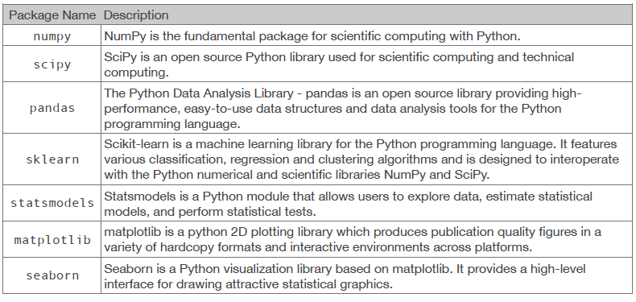
Libraries for Data Science

Slide 112
Getting started with NumPy
NumPy is imported into python as the identifier np
import numpy as np
This is the first package to get familiar with for working with data
Provides data structures for creating arrays and matrices and for manipulating them

Slide 113
NumPy arrays
NumPy arrays are one of the reasons for the packages success
my_array = np.array([1,2,3.])
They can also be used to create multidimensional arrays
matrix_array = np.array([[1,2],[3,4]])
They look awfully familiar to lists…

Slide 114
NumPy arrays VS. Lists
A simple check of the methods available to the two objects shows the major advantages of lists vs. numpy arrays
a = [[1,2], [3,4]]
b = np.array([[1,2], [3,4]])
print dir(a)
print dir(b)

Slide 115
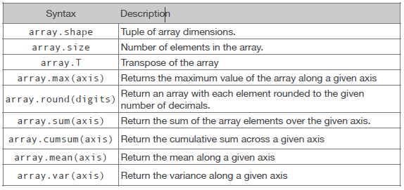
Some Methods and Attributes for Arrays
Here are a sample of some useful methods and attributes of arrays

Slide 116
But numpy has a Matrix Object?
Numpy provides, in addition to np.array(), an additional np.matrix() type that you may see used in some existing code. Which one to use?
Short Answer? Use np.array()
NumPy provides the matrix class for matrix algebra, but you can almost consider it a "subclass" in numpy.
Additionally, arrays are the standard vector/matrix/tensor type of numpy. Many numpy functions return arrays, not matrices.
Any algebra you would want to use on a matrix object is available to an array object

Slide 117
Matrix Operations in numpy
Matrix multiplication can be done using the .dot() method
A = np.array([[1,2], [3,4]])
b = np.array([1, 2])
print np.dot(A,b.T) # Matrix Mult
print np.dot(A,b) # numpy fixes dim
print A.dot(b) # Chained Method
print A * b # Element-wise

Slide 118
Linear Algebra Operation – numpy.linalg
There are other linear algebra functions within
numpy.linalg
A = np.array([[1,2], [3,4]])
b = np.array([1, 2])
A_inv = np.linalg.inv(A) #inverse
A_det = np.linalg.det(A) #determinant
A_svd = np.linalg.svd(A) #sing.val.decomp

Slide 119
Getting Started with Pandas
Pandas builds on the functionality of numpy, but introduces data frames
import pandas as pd
DataFrames are a two-dimensional tabular data structure (very similar to data frames in R)
Here the data is actually composed of a numpy array! Therefore much of what we just learned is still useful
Named columns for easy access
We now have almost everything we had with numpy arrays, but with more added functionality

Slide 120
A few ways to create a DataFrame
fake_data = np.array([[‘AJ', 30],
['Brett', 29],
['Jake', 26],
['Bob', 57]])
data_set = pd.DataFrame(fake_data,
columns=['Name', 'Age'])
print data_set.Name
print data_set.Age

Slide 121
A few ways to create a DataFrame
fake_data = {'Names':[‘AJ', 'Brett',
'Jake', 'Bob'],
'Age':[30, 29, 26, 57]}
data_set = pd.DataFrame(fake_data)
print data_set.Names
print data_set.Age

Slide 122
Reading Files with Pandas is Easy
Another reason for using pandas is the ease with which it brings data into python
pd.read_csv(some_file)
This function can take in many arguments to customize its behavior, but it generally works well without any modifications.

Slide 123
Lets move to the Jupyter Notebooks

Slide 124
Everything is an object in Python
All components of a program can be considered as object .
Variables, data structures, function , …
Object oriented programming is an approach to designing modular reusable software systems
So we define an object as a particular instance of a class where the object is the combination of variables, functions and data structures.
This type of thinking in python allows us to interact with codes easier and more fexible!
The syntax for this
object.attribute # a variable in the object
object.method() # functions available to the object
Example :

Slide 125
Integers
Integers are of the int type and are specified by any numbers without a decimal point
a = 7 # This is an integer
b = 7.0 # This is not
c = 7. # Neither is this
To attempt to convert an object to an integer type function int() is used
The maximum value of an integer in a typical computer (Intel 64 bit) is 2⁶³ - 1
(9,223,372,036,854,775,807)

Slide 126
Python Installation
If you haven’t already, go to the following website and follow the instruction for your operating system to install Python:
https://www.python.org/downloads/
For our workshop python version 2.7+ works fine.
The latest version of Python is 3.6.2

Slide 127
Keywords and Identifier – Some Examples
Identifiers (Variables) name examples:
myname = “AJ”
todaysweather = ‘sunny’
tomorrowsWeather = ‘Cloudy’
TodayTemp = 77
FAVORITE_color = ‘blue’
The convention or style for variable names should be consistent (camel case, or using underscores)
Notice none of these start with numbers
Let’s do some experiment on python command line.

Slide 128
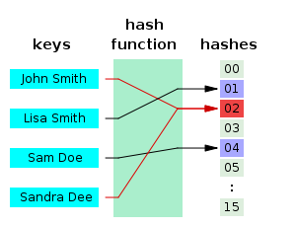
Hash function
A hash function is a mathematical function!
The value returned by a hash function is called hash values, hash codes.
Image source: https://en.wikipedia.org/wiki/Hash_function

