Slide 1
triplets
user
track_id
listening_count
track_metadata
track_id
song_id
title
artist_id
…
tripet_metadata
user
track_id
song_id
title
artist_id
listening_count
…
track_features
id
title
artist_id
audio features
tripet_metadata_features
user
track_id
song_id
title
artist_id
listening_count
audio features
…

Slide 2
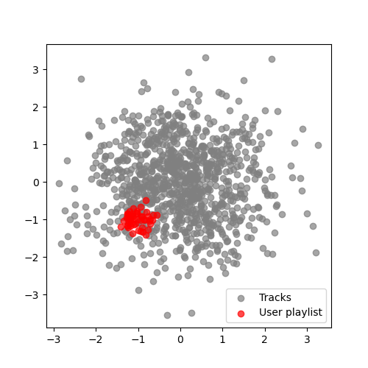
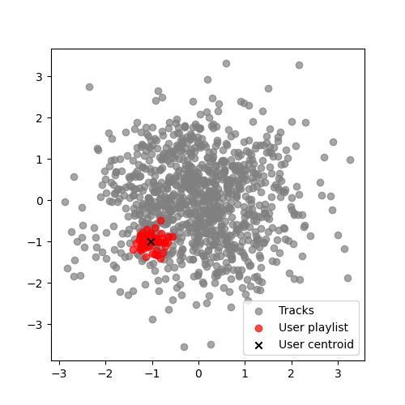
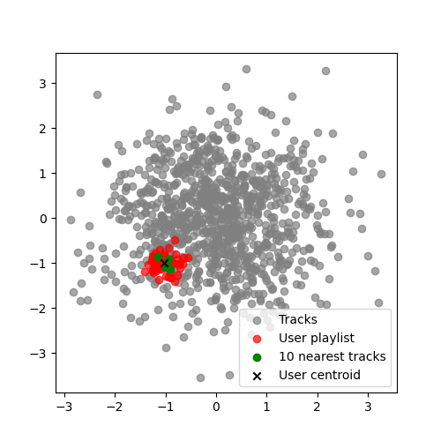
Step1
playlist averaging
Step2
tracks recommendation

Slide 3
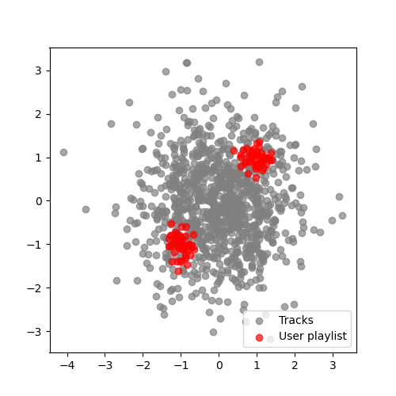
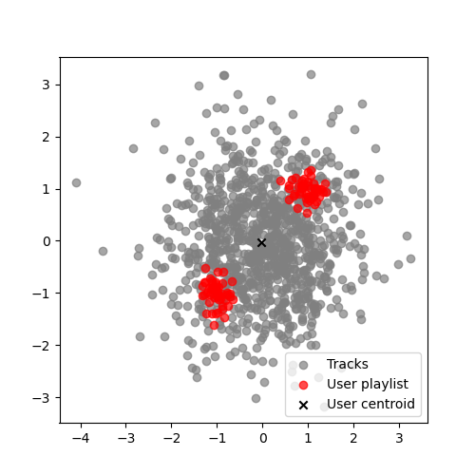
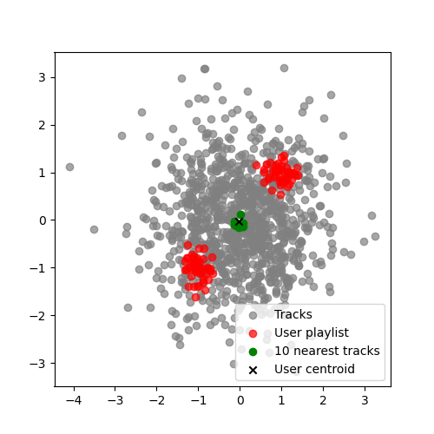
Step1
playlist averaging
Step2
tracks recommendation

Slide 4


Step1
playlist clustering
Step2
tracks recommendation

Slide 5
User playlist
Title | Artist
A
Ranked tracks
Artist A
Ranked and filtered tracks
Title | Artist | Rank
 |  | A
A
Title | Artist | Rank
 |  | A
A
Artist B
Artist C
Artist D
Artist E
Increasing ranks
Increasing ranks
Ranking algorithm
Artist Filtering
Ranks modified according to the number of tracks interpreted by the same artist in the user playlist

