Slide 1

CryptoBot with Binance
OPA
OPA Bootcamp DE Feb 2025

Slide 2












OPA CryptoBot with Binance
Content
Project scope
Architecture
Database structure
API
Streamlit
Data loader (Bionance)
Machine learning
Improvements
OPA Bootcamp DE Feb 2025

Slide 3
OPA CryptoBot with Binance
Project scope
OPA Bootcamp DE Feb 2025

Slide 4
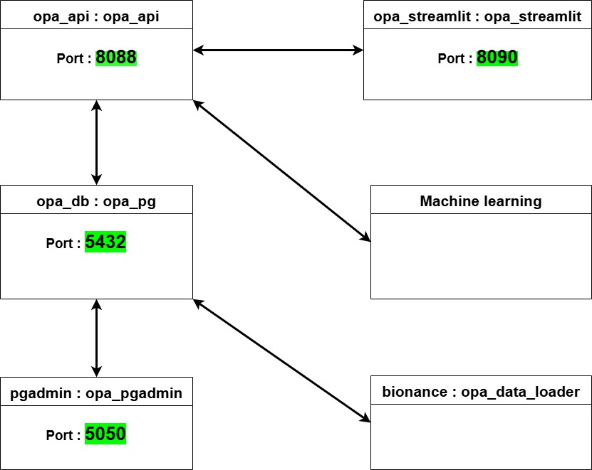
OPA CryptoBot with Binance
Architecture (Docker containers)
OPA Bootcamp DE Feb 2025

Slide 5
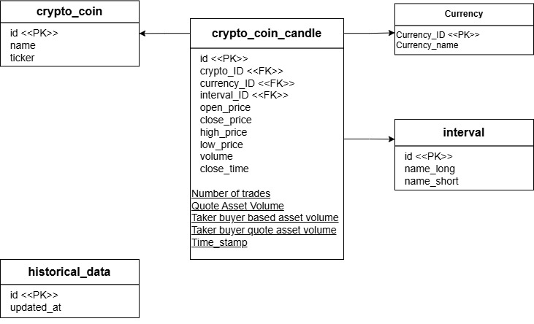
OPA CryptoBot with Binance
Database structure
OPA Bootcamp DE Feb 2025

Slide 6
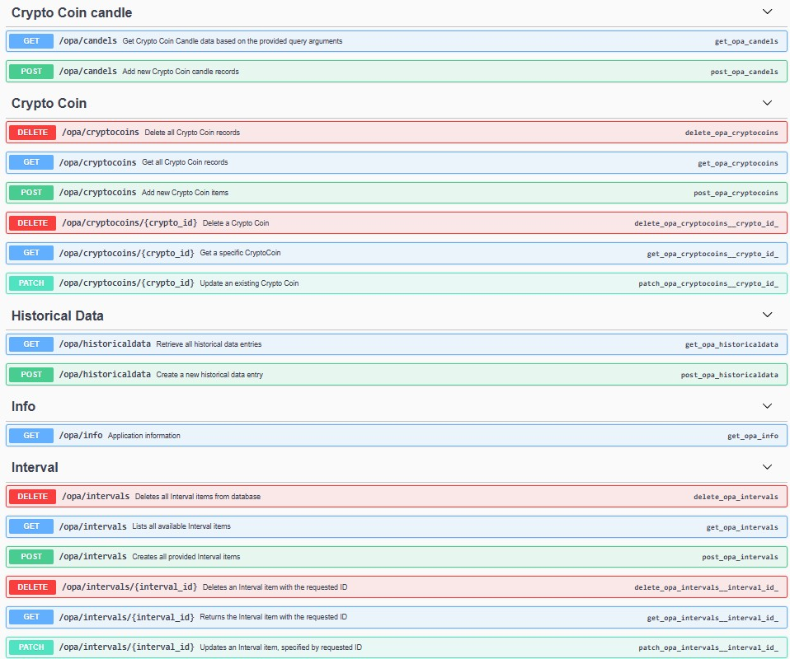
OPA CryptoBot with Binance
API
OPA Bootcamp DE Feb 2025

Slide 7
OPA CryptoBot with Binance
Data loader (Bionance)
OPA Bootcamp DE Feb 2025

Slide 8
OPA CryptoBot with Binance
Machine learning
OPA Bootcamp DE Feb 2025

Slide 9
OPA CryptoBot with Binance
Improvements
API : athentication + authorization + performance
Database : users management, cascading deletion
Streamlit : improve user interface
Logging : adding better logging to API, Streamlit and data loader
Data loader automation: use cron jobs
GitHub actions : code review, pytest
AirFlow Automation : test + deployment
OPA Bootcamp DE Feb 2025

Slide 10

OPA CryptoBot with Binance
Thank you
OPA Bootcamp DE Feb 2025

