Slide 1
CryptoBot with Binance
Data Pipeline & Machine Learning
for Cryptocurrency Trading
Team:
Ayoub Barkaoui
Aniket Kakde
Alex Pajaron
Jennifer Bramadas

Slide 2
AGENDA
01
Introduction
06
API Development
Context, research question & objectives
FastAPI endpoints
02
Overall Architecture
07
GitOps & Flow Orchestration
Data pipeline schema & technology choices
Docker, Github & Cron automation
03
Data Collection
08
Dashboard & Visualisation
Binance API ingestion — batch & streaming
Grafana & Streamlit
04
Data Modeling & Consumption
09
Limitations & Conclusion
MongoDB schema & storage strategy
05
Machine Learning Model
Feature engineering, Logistic Regression vs SVM

Slide 3
01 — Introduction
Research Question
How can an end-to-end system be designed for the collection, storage, modelling and exposure of real-time cryptocurrency trading signals?
📈 Market Worth $3T+
⚡ 24/7 Volatility
Bitcoin exceeds 50% of total crypto market cap (2024)
Daily price swings of 5–15% make manual trading ineffective
🤖 70%+ Algorithmic
🎯 Core Challenge
Most major exchange volumes are driven by automated bots
Reproducible pipeline: ingest → model → expose → visualise
Objectives: Collect BTC data via Binance API (real-time + historical) · Store in MongoDB · Train ML model · Expose via REST API · Visualise signals · Containerise 12 services with Docker

Slide 4
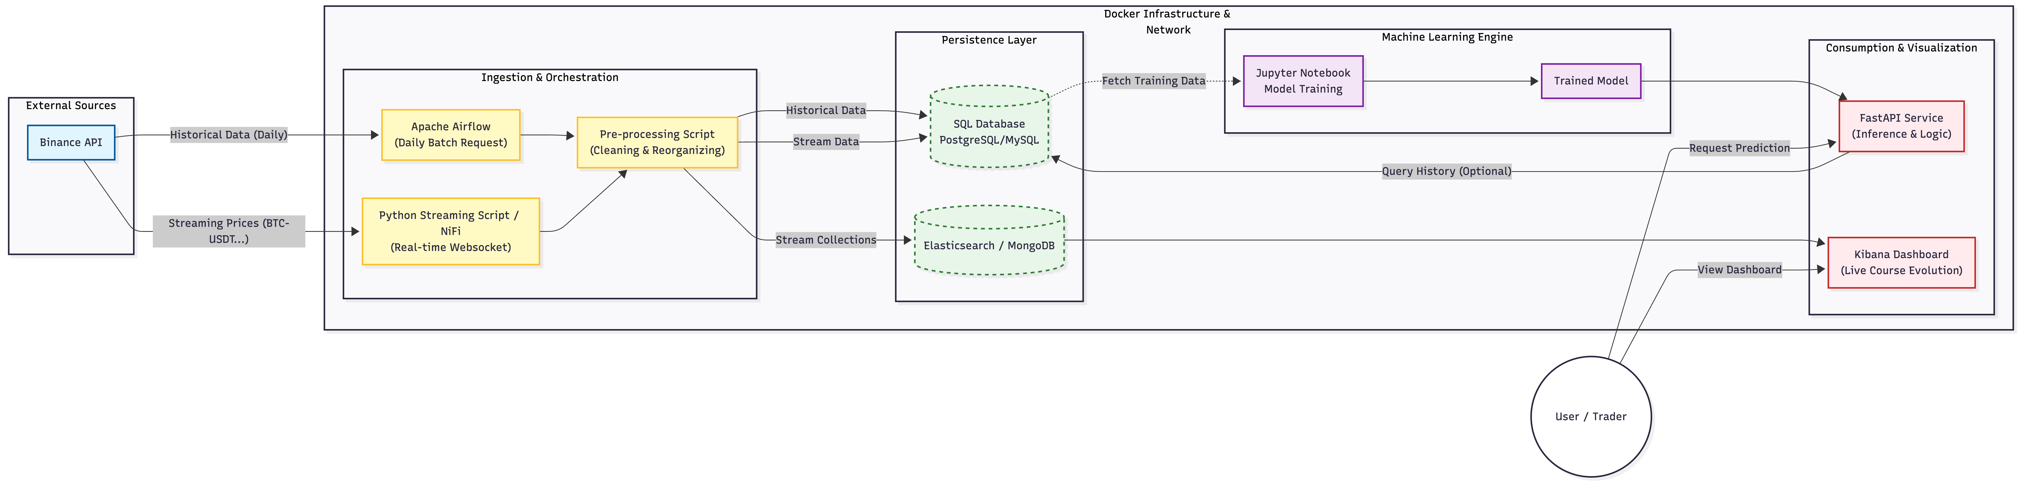
02 — Overall Architecture
Data Source
Message Broker
Storage
ML + API
Dashboards
Batch Path:
Historical data → periodic REST collection → MongoDB klines_historical → ML training
Streaming Path:
WebSocket live stream → Redpanda broker → klines_streaming → real-time prediction API

Slide 5
03 — Data Collection (Binance API)
Batch Collection
Streaming Collection
Service: binance-collector
Services: stream-producer / stream-consumer
Source: Binance REST API for historical candles.
Purpose: Build a complete historical dataset for ML training.
Logic: Detect missing ranges and Fetch only the gaps
Outputs: Raw files, processed files and MongoDB.
Scheduling: One Run at the startup, then hourly via Internal Cron Job.
Automation: Triggers model retraining when new historical data is inserted.
Source: Binance WebSocket for live closed candles.
Purpose: Keep the system fresh for monitoring and recent market views.
Flow: WebSocket -> Redpanda -> Consumer -> MongoDB.
Resilience: If MongoDB is temporarily unavailable, messages stay buffered in Redpanda.
Usage: Grafana reads recent data through the API layer, which uses the streaming collection for freshness.
Data Quality and Reliability
Schema validation and type conversion are applied before storage.
Duplicate prevention is handled through idempotent keys and unique indexes.
Historical and streaming data are stored separately for different use cases.
Result: a reliable collection layer supporting both ML training and live dashboards.
Preprocessing pipeline: type conversion · null handling · deduplication · schema validation

Slide 6
04 — Data Modeling & Consumption
MongoDB — Two Collections
Data Consumption Interfaces
klines_historical (ML Training)
Streamlit Dashboard
Stores validated historical candles collected by the batch pipeline.
Main source for model training and the current prediction workflow.
Idempotent upserts ensured by the unique key: `symbol + interval + open_time_ms`.
Optimized for large historical reads and scheduled retraining.
Business-facing dashboard for ML signals, confidence, and recent predictions
klines_streaming (Real-time Feed)
Grafana
Stores near-real-time candles written by the Redpanda consumer.
Includes streaming-specific time fields such as `event_time` and `timestamp`.
Optimized for continuous writes and recent-candle queries.
Used to provide fresher market views, especially for Grafana.
Monitoring dashboard for market visualization
Reads data through the `main` API, which merges historical and streaming MongoDB data
Why MongoDB? Flexible schema · No migrations · Composite index for fast queries · Async Python driver

Slide 7
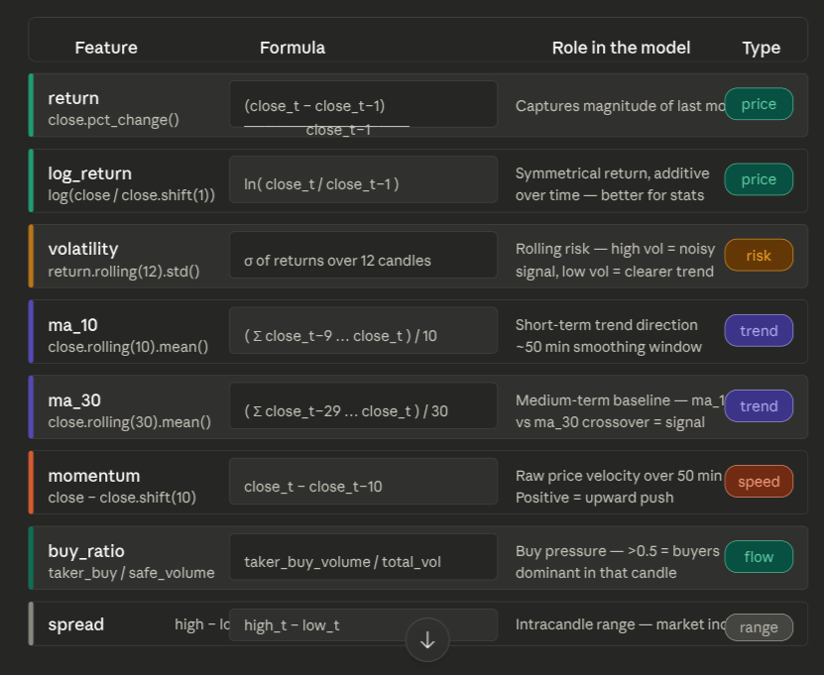
05 — Machine Learning Model
Objective: Binary classification — predict whether BTC price will go UP or DOWN on the next 5-min candle
Feature Engineering
Logistic Regression
SVM (Comparison)
✅ RETAINED MODEL
❌ Not selected
Accuracy: 74.34%
Accuracy: 74.18%
AUC score: 0.8173
AUC score: 0.82
Training time: <1 sec
Training: several minutes (>50min)
Hourly auto-retrain
Not justified for prod
Target: binary price direction
Chronological train/test split to prevent data leakage · StandardScaler normalisation · 232,000+ observations

Slide 8
06 — API Development
Framework: FastAPI · Async engine · Pydantic validation · Auto-docs via Swagger UI · Built-in monitoring
GET
/predict/logistic/{symbol}?limit=N
POST
/predict/logistic/retrain/admin
GET
/status/check

Slide 9
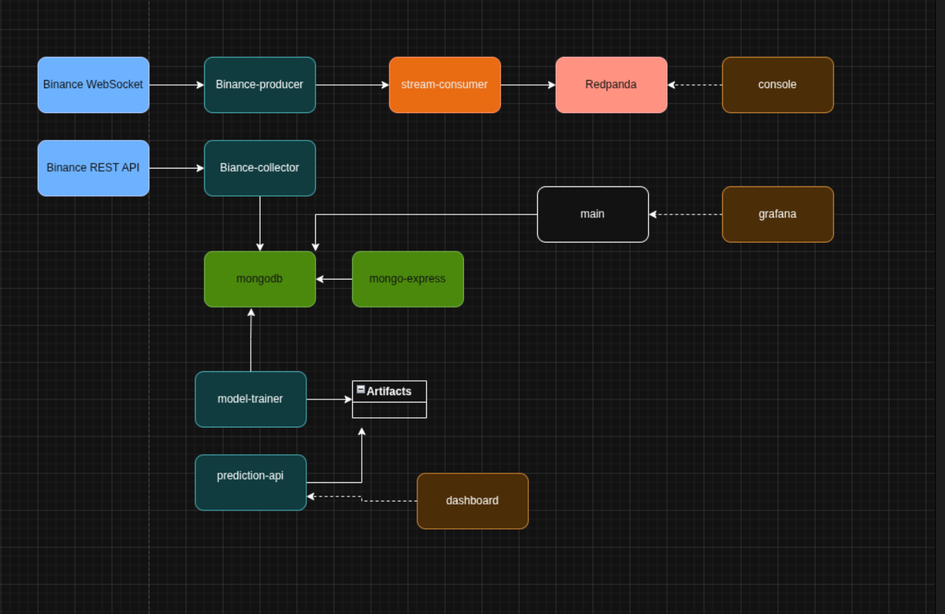
07 — GitOps & Flow Orchestration
Docker Services
Orchestration Highlights
⏱️ Cron Automation
Hourly data collection + Automatic model retraining cycle
🐳 Docker Compose
Single docker-compose.yml orchestrates all services
🐙 GitHub / GitOps
Version control · CI pipeline · docker image generation
🔄 Persistent Volumes
Model weights & data survive container restarts
🚀 Startup Script
docker-up-clean.sh: ordered boot with healthchecks & model init

Slide 10
08 — Dashboard & Visualisation
Streamlit Dashbaord
ML Signal Dashboard — BTC/USDT
KPI cards: signal · confidence · latest price · candle time
Candlestick chart + UP/DOWN signal histogram
Confidence % chart with 50% decision threshold line
Predictions table showing last N candles
Auto-refresh every 30s · adjustable symbol & window
Grafana
Real-time monitoring dashboard
Queries `main` FastAPI via `/grafana/*`
Visualizes merged historical + streaming candles
Good for price, volume, and trade-count monitoring
Provisioned as code for reproducibility

Slide 11
09 — Limitations & Conclusion
⚠️ Limitations
🚀 Future Improvements
Model accuracy ~52% — near-random (noisy market)
LSTM / Transformer deep learning models
No backtesting or Sharpe ratio evaluation
Multi-asset portfolio support
BTC/USDT only — no multi-asset portfolio
Full backtesting framework + Sharpe ratio
No live trade execution (signals only)
Risk management & position sizing
Logistic Regression may miss complex patterns
Kubernetes for production-scale deployment
✅ Complete end-to-end automated pipeline — from Binance raw data to live trading signals
✅ 12-service Docker stack · reproducible · deployable with a single command
✅ Real ML in production · retrained hourly on 232K+ observations
✅ Full skill coverage: Data Engineering · ML · API Dev · DevOps · Orchestration

Slide 12
The end
Questions and Answers ?

