Slide 1
Help Desk Operations
Employee Performance Analytics—using Real World Data
Project Defense | 24 Feb 2026 | DataScientest | Liora | Christian Gebert | Marina Pfeifer
Notes:
[Sources] - Provided by user: documentation.html [/Sources]

Slide 2
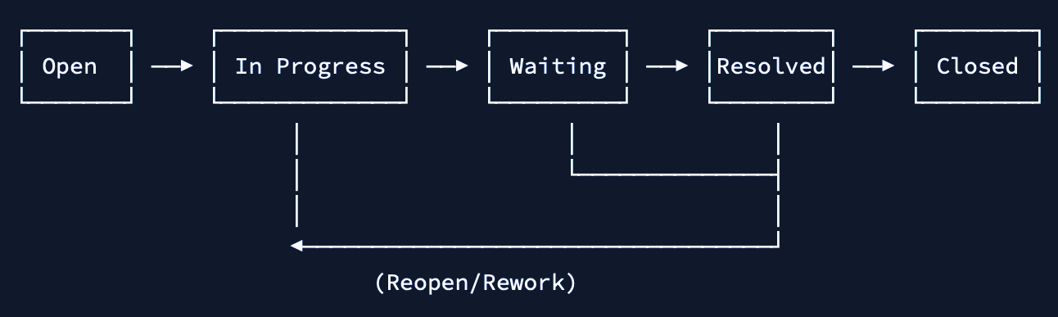
CONTEXT
A help desk is a structured support function where tickets (or issues) are created, triaged, worked on by support employees, and eventually closed. Tickets move through a workflow and can be handed over between employees if needed (so-called turns).
Process flow
Approach:
Using process and internal communication data to quantify turn-level performance and SLA risk, thereby evaluating manager ratings (Q-Scores) with operational and more objective proxies (O-Scores), and performer clusters.
Project Defense | 24 Feb 2026 | DataScientest | Liora | Christian Gebert | Marina Pfeifer
Notes:
[Sources] - Provided by user: documentation.html [/Sources]

Slide 3
PROJECT OVERVIEW
AI-driven system for automated helpdesk performance analysis: compute employee scores, form clusters, and predict manager ratings from real world ticket data (doi: 10.17632/btm76zndnt.2).
90,963
302
2016—2023
Tickets (snapshots)
Employees analyzed
Data from
Reality Ticket demand fluctuates; single tickets often need multiple touches/assignees
Helpdesk success = efficiency (time/cost) + service quality
Goal Score performance per employee/turn using process + communication data
Compare manager ratings vs operational scores; model key drivers (features)
Business Value Identify training/coaching targets and improve service consistency
Enable monitoring/alerts and drive process improvements
Project Defense | 24 Feb 2026 | DataScientest | Liora | Christian Gebert | Marina Pfeifer
Notes:
[Sources] - Provided by user: documentation.html [/Sources]

Slide 4
INPUT DATA
issues
issues_snapshot
issues_snapshot_sample
sample_utterances
sample_change_history
Ticket Level
Turn Level
Labeled Sample
Utterance Level
Event Log
priority,
type,
project,
timestamps,
workflow aggregates (wf_*, wfe_*, wf_total_time)
splits tickets into
assignee turns (started, ended, turn);
allocates workflow time per assignee
manager ratings (Q1/Q2/Q3)
spent hours
steps
comments,
validity flag
notes
communication signals (roles, privacy flags, masked text)
assignee/status changes over time
66,691×58
90,963×60
747×19 (Q1–Q3 labels)
30,104×9
257,508×6
Project Defense | 24 Feb 2026 | DataScientest | Liora | Christian Gebert | Marina Pfeifer
Notes:
[Sources] - Provided by user: documentation.html [/Sources]

Slide 5
PERFORMANCE MEASURES
Q-Score
Manager Ratings (subjective)
Q1 – Quality of Work: Accuracy & precision
Q2 – Quality of Work: Thoroughness & completeness
Q3 – Client Relations: Responsiveness & courteousness
O-Score
Operational Composite Score (objective)
Quality (35%): 0% Reopen Rate (inverted) + 40% Success Rate
Efficiency (25%): 100% Processing Time (percentile, inverted)
Productivity (20%): 60% Ticket Volume + 40% Processing Steps (inverted)
Communication (20%): 50% First-Touch Rate + 50% Comment Deviation
Performer Cluster
K-Means Clustering
Agglomerative
DBSCAN
Project Defense | 24 Feb 2026 | DataScientest | Liora | Christian Gebert | Marina Pfeifer
Notes:
[Sources] - Provided by user: documentation.html [/Sources]

Slide 6
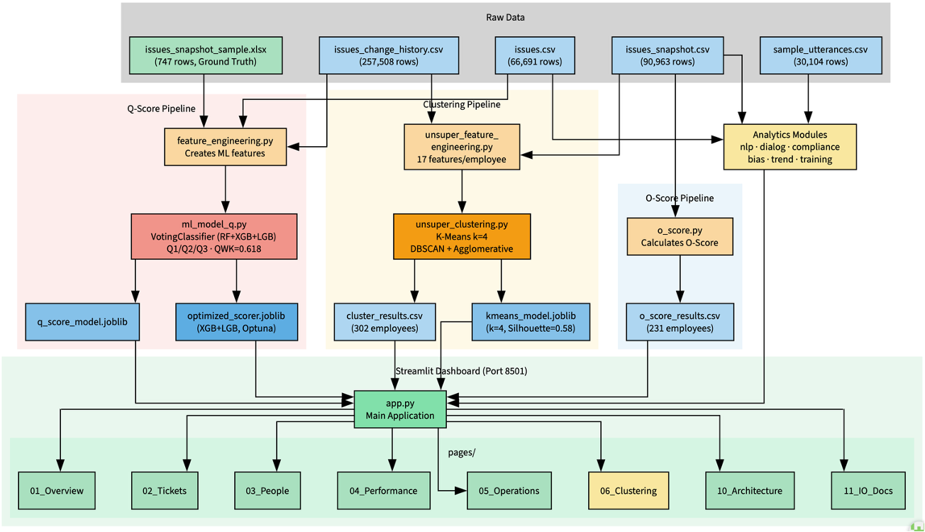
DATA FLOW DIAGRAM
Project Defense | 24 Feb 2026 | DataScientest | Liora | Christian Gebert | Marina Pfeifer
Notes:
[Sources] - Provided by user: documentation.html [/Sources]

Slide 7
STREAMLIT APPLICATION
Overview High-level overview of ticket load and workforce status
Tickets Live ticket monitoring (status/priority) and detailed ticket view
People Performance and risk monitoring, trends, employee drill-down, training recommendations
Performance Scores Score validity (Q vs O, bias), model results, and forecasting
Operations Communication quality (sentiment/dialog acts) and process compliance
Employee Clustering Unsupervised performance clusters
Project Architecture
I/O Documentation
Export
Settings
Project Defense | 24 Feb 2026 | DataScientest | Liora | Christian Gebert | Marina Pfeifer
Notes:
[Sources] - Provided by user: documentation.html [/Sources]

