Slide 1
Help Desk Operations
Employee Performance Analytics with Real World Data

Slide 2
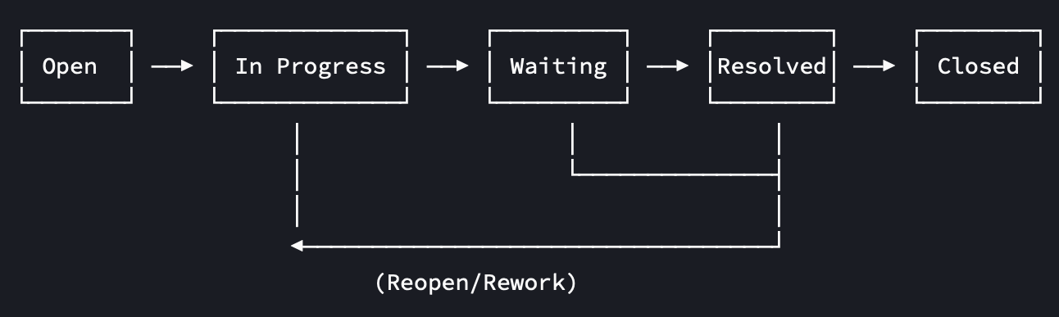
CONTEXT
A help desk is a structured support function where tickets (or issues) are created, triaged, worked on by support employees, and eventually closed. Tickets move through a workflow and can be handed over between employees if needed (so-called turns).
Approach:
Using process and internal communication data to quantify turn-level performance and SLA risk, thereby evaluating manager ratings (Q-Scores) with operational and more objective proxies (O-Scores).

Slide 3
RELEVANCE
Reality:
Ticket queues fluctuate (peaks, outages, recurring incidents).
A single ticket can require multiple interactions and multiple assignees.
Customer experience depends on speed, clarity, and correctness.
Help desks are measured by efficiency (time/cost) and service quality.
Goal:
Evaluate performance using employee/turn using ticket process & communication data
Compare performance scores (manager-ratings & operational scores)
Predict performance scores through key drivers (features)
Business value:
Identify training needs and highlight coaching targets
Improve service consistency and customer experience
Enable monitoring/alerts and process improvements

Slide 4
DATA
real world data (doi: 10.17632/btm76zndnt.2)
International help desk software company
Jan 2016 – Mar 2023
issues.csv
(ticket level):
priority,
type,
project,
timestamps,
workflow aggregate (wf_*, wfe_*, wf_total_time)
issues_snapshot.csv (turn level):
splits tickets into
assignee turns
(started, ended, turn)
and allocates workflow time per assignee
issues_snapshot_ sample.xlsx (labeled sample):
manager ratings (Q1/Q2/Q3)
spent hours
steps
comments,
validity flag
notes
sample_utterances.csv
(utterance level):
communication signals (roles, privacy flags, masked text)
issues_change_history.csv (event log):
assignee/status changes over time

Slide 5
PERFORMANCE SCORES
Q-SCORES:
Q1 – Quality of Work: Accuracy & precision
Q2 – Quality of Work: Thoroughness & completeness
Q3 – Client Relations: Responsiveness & courteousness
Manager Ratings (subjective)
O-SCORES:
Quality (35%): reopen rate, success rate
Efficiency (25%): processing time
Productivity (20%): ticket volume, processing steps
Communication (20%): first-touch rate, comment activity
→ Operational Score (objective)

