Slide 1
Intelligent Classifier
Ideation
Presented by:
- Ranjith N
- Rajesh Kumar K
- Vignesh M

Slide 2
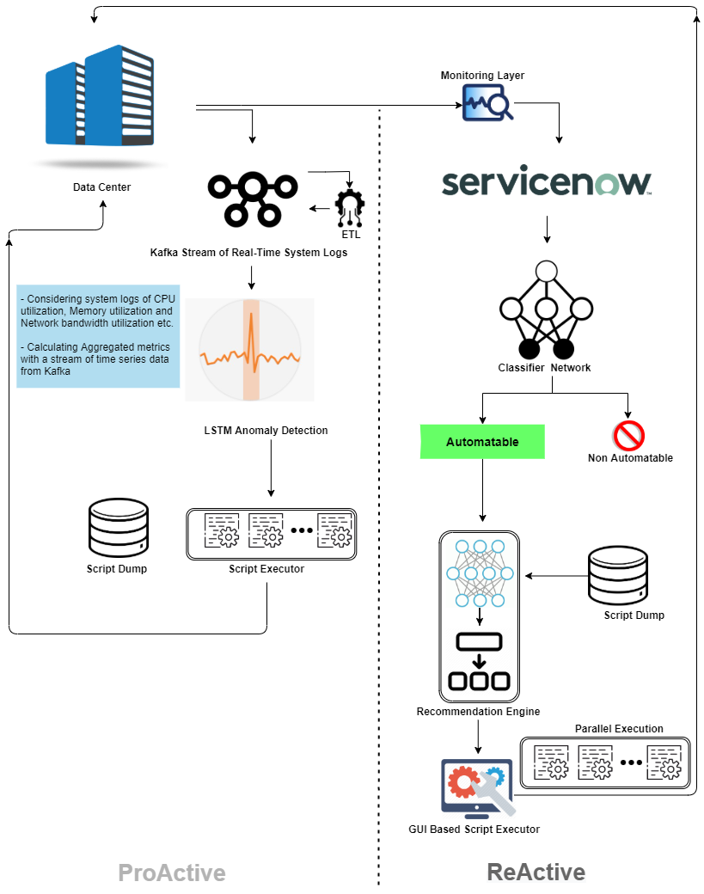

Our Confident of Automation in H&M Environment over the past 6 Months of Sample Incident Data.
Domain Wise Analysis done by using 2L Semantic Analysis & Indexing Technique.

Slide 3
Top 10 Automatable Use Cases
Domain | Use Cases
Database | Accounts SAP Access
Database | AD group creation
Network | Citrix Profile Reset Request
Network | CPU Utilization is too high
SD & Datacenter | Increase VDI disk space
SD & Datacenter | Install Microsoft Access for Office 365
Wintel | Not able to access SAP
Wintel | Morning Health checks for VDI environment
Wintel | Move folder from old server to new sever
Unix & Linux | Store Services (or/and applications inside) is not working

Slide 4

2L Semantic Analysis & Indexing
Analyzing Relationship Between Set of Documents
03
The Process
Through this Analysis We have Identified over 22% of Automatable solutions under different Domains.
2L Semantic Analysis & Indexing
Latent Semantic Analysis and Latent Indexing is an NLP Technique That Identifies Relationship between Documents using SVD (Singular Value Decomposition) Algorithm.
2L Analysis
01
Automation Production Dump
02
Nearly 6,000 + Tickets
Our Production Dump having 20,000 +
Solutions over different Domains Including Orchestrator Workflows and
Auto Ticketing Solutions.
H&M Incident Dump
H&M Incident Dump having 6,000 + Ticket Over the Past 6 Months with Possible Automatable Tickets occurring over and over Again.
Nearly 20,000 +
Solutions

Slide 5





Revenue Generation by Automation
$38,466
$461,593
Monthly in Man Hours
Yearly in Man Hours
Nearly 2000 + scripts per day
Dedicated Team
24/7 Technical Support
Nearly 2000 + scripts per day
Dedicated Team
24/7 Technical Support
As Used by

