Slide 1

Guided By:
Yogita Chhabra
Team Members:
Harshdeep Rana
Ishaan Bhattacharya
Ishita Tyagi

Slide 2
PREDICTION OF FOREST FIRES

Slide 3
Introduction
Wildfires are one of the biggest catastrophes faced by our society today causing irrevocable damages.
These forest fires can be man-made or caused by mother nature by different weather conditions, torrential winds.
These fires cause damages not only to the environment they also destroy vast homes and property.
Hence we devised a panacea “Fire Analysis and Prediction System” to fight this disaster and help our planet.

Slide 4
Abstract
Wildfires are an uncontrollable disaster which cause damages to the society as well as endanger the nature.
Forest Fire Prediction System is built to detect the forest fires and then performs prediction of the area of the spread fire.
With the help of machine learning algorithms we intend to build a tool which serves an aid to the society and thus prepare the area for evacuation.

Slide 5
Technologies Used
Python
Python is an interpreted, high-level, general-purpose programming language. Its language constructs and object-oriented approach aim to help programmers write clear, logical code for small and large-scale projects.
Scikit Learn
Scikit-learn provides a range of supervised and unsupervised learning algorithms. The library is built upon the SciPy (Scientific Python) that must be installed before you can use scikit-learn

Slide 6
CSV
A comma-separated values file is a delimited text file that uses a comma to separate values. Each line of the file is a data record. Each record consists of one or more fields, separated by commas. The use of the comma as a field separator is the source of the name for this file format.
Matplotlib
Matplotlib is a plotting library for the Python programming language and its numerical mathematics extension NumPy. It provides an object-oriented API for embedding plots into applications.

Slide 7
Pandas
Pandas is the most popular python library that is used for data analysis. It provides highly optimized performance with back-end source code is purely written in Python

Slide 8
Implementation and Methodology

Slide 9
This work will consider ten different regression models to predict the size of the forest fires from the attributes in the dataset. The regression models are:
Linear Regression : It is a linear approach to modeling the relationship between a scalar response and one or more explanatory variables.
Ridge Regression : is a technique for analyzing multiple regression data that suffer from multicollinearity. When multicollinearity occurs, least squares estimates are unbiased, but their variances are large so they may be far from the true value

Slide 10
Lasso Regression : is a type of linear regression that uses shrinkage. Shrinkage is where data values are shrunk towards a central point, like the mean.
ElasticNet Regression: merged as a result of critique on lasso, whose variable selection can be too dependent on data and thus unstable. The solution is to combine the penalties of ridge regression and lasso to get the best of both worlds.
Baggging Regression : is an ensemble meta-estimator that fits base regressors each on random subsets of the original dataset and then aggregate their individual predictions (either by voting or by averaging) to form a final prediction.

Slide 11
RandomForest Regression :A random forest is a meta estimator that fits a number of classifying decision trees on various sub-samples of the dataset and uses averaging to improve the predictive accuracy and control over-fitting.
ExtraTrees Regression : It implements a meta estimator that fits a number of randomized decision trees (a.k.a. extra-trees) on various sub-samples of the dataset and uses averaging to improve the predictive accuracy and control over-fitting.
KNeighbours Regression: The target is predicted by local interpolation of the targets associated of the nearest neighbors in the training set.

Slide 12
DecisionTree Regression: It is used to fit a sine curve with addition noisy observation. As a result, it learns local linear regressions approximating the sine curve.
SupportVector Regression: It is a supervised machine learning algorithm which is used for regression challenges

Slide 13
Dataset Description
Attribute | Description
X | X Axis coordinate
Y | Y Axis coordinate
Month | Month of the Year
Day | Day of the Week
FFMC | FFMC code
DMC | DMC code
DC | DC code
ISI | ISI code
Temperature | Outside Temperature(Celsius scale)
Relative Humidity | Outside Relative Humidity (in %)
Wind Speed | Outside Wind Speed (in km/h)
Outside Rain | Outside Rain (in mm/m²⁾
Area Burned | Total burned area (in ha)

Slide 14
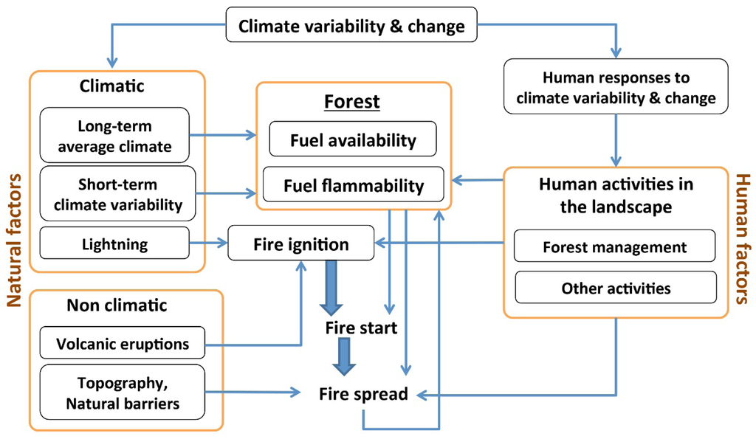

Slide 15
Functional Requirements:
Data in relation over time-:
The number of fires Example: Number of fires per region.
Data in relation to the place-:
To analyze the relations between the place of ignition (area, province, community).
The number of fires Example: Number of fires per region.
Burned surface. Example: Total, maximum, and average burned surfaces by fire and by region
Evolution over time of the fire number and burned surfaces. Example: Number of fires and total, maximum, and average burned surfaces by fire, area, year.
Fire causes. Example: Fire causes by area.

Slide 16
Data Entry
The recorded data must also be checked, for example, in one of the following ways: − Make a double data entry by two operators and to compare the two files; − Print data and compare them with the original forms. − In the case of a detected error or missing data, additional information is requested from the operator.

Slide 17
Non Functional Requirements
Performance Requirements-
The system must be interactive and the delays involved must
be less .So in every action-response of the system, there are
no immediate delays.
Safety Requirements-
Information transmission should be securely received from
the server without any changes in information.
Security Requirements-
The data should be taken from a trusted Government website for the authentication, in order to stay clear of the spam or false data

Slide 18
Reliability-
As the system provide the right tools for discussion, problem solving it must be made sure that the system is reliable in its operations and for securing the sensitive details.
Usability-
As the system is easy to handle and navigates in the most expected way with no delays. In that case the system program reacts accordingly and transverses quickly between its states.

Slide 19
DIAGRAMS RELATED WITH FOREST FIRES-

Slide 20
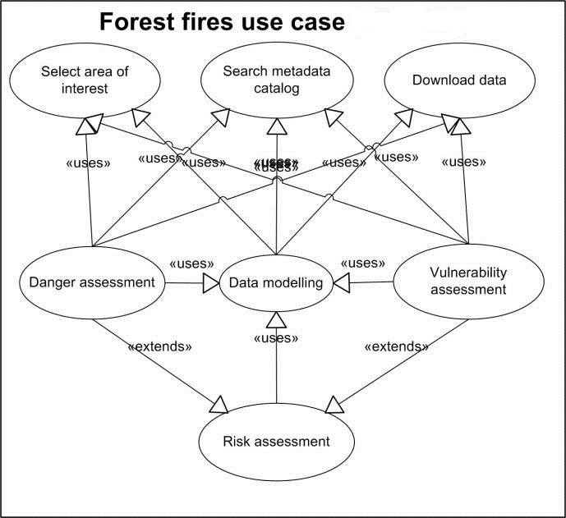
USE CASE DIAGRAM-fig(1)

Slide 21
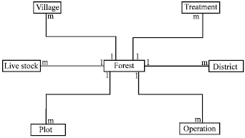
ER DIAGRAM-fig(2)

Slide 22
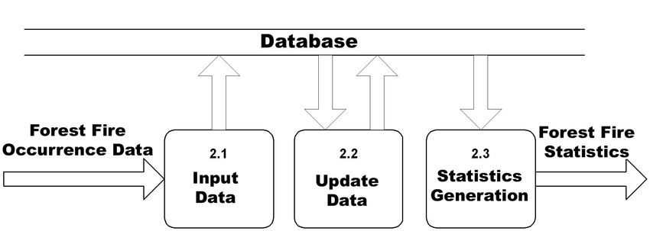
DATA FLOW DIAGRAM-fig(3)

Slide 23
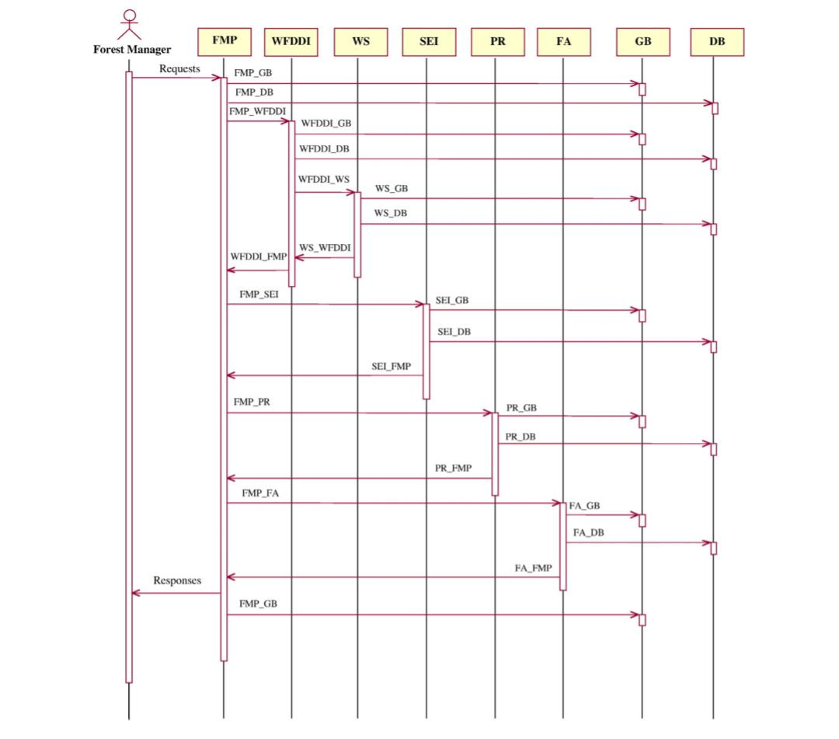
SEQUENCE DIAGRAM-fig(4)

Slide 24
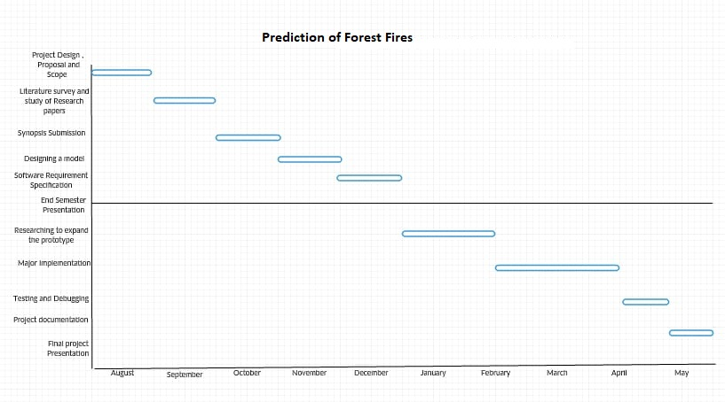
GANTT CHART-fig(5)

Slide 25
Purpose of Project
Several experiments are carried out by considering Data Mining algorithms and then they are fed into normalization. Then the output ‘area’ is first transformed with a ln(x+1) function. Then experiments are conducted using a 10-fold (cross-validation) x 30 runs.

Slide 26
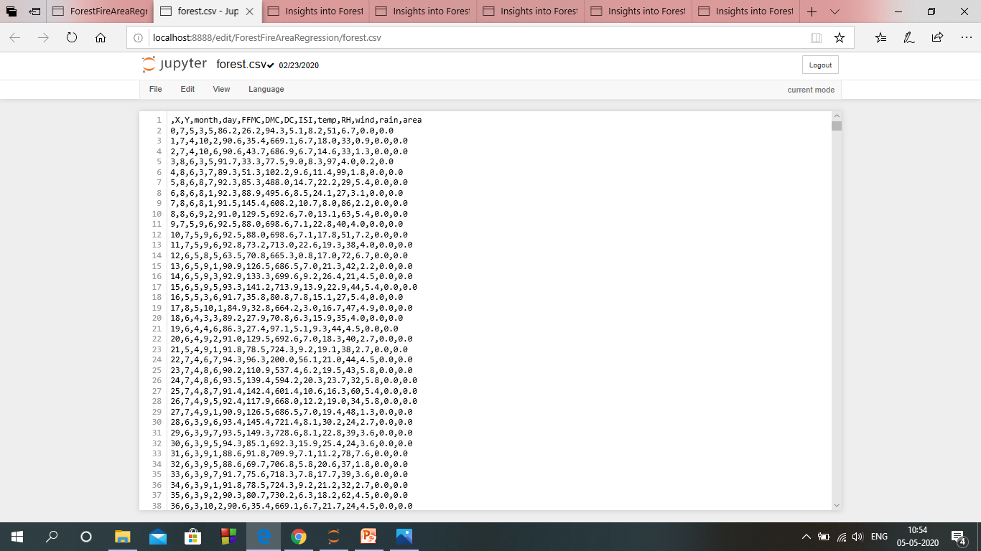
DATA SET

Slide 27
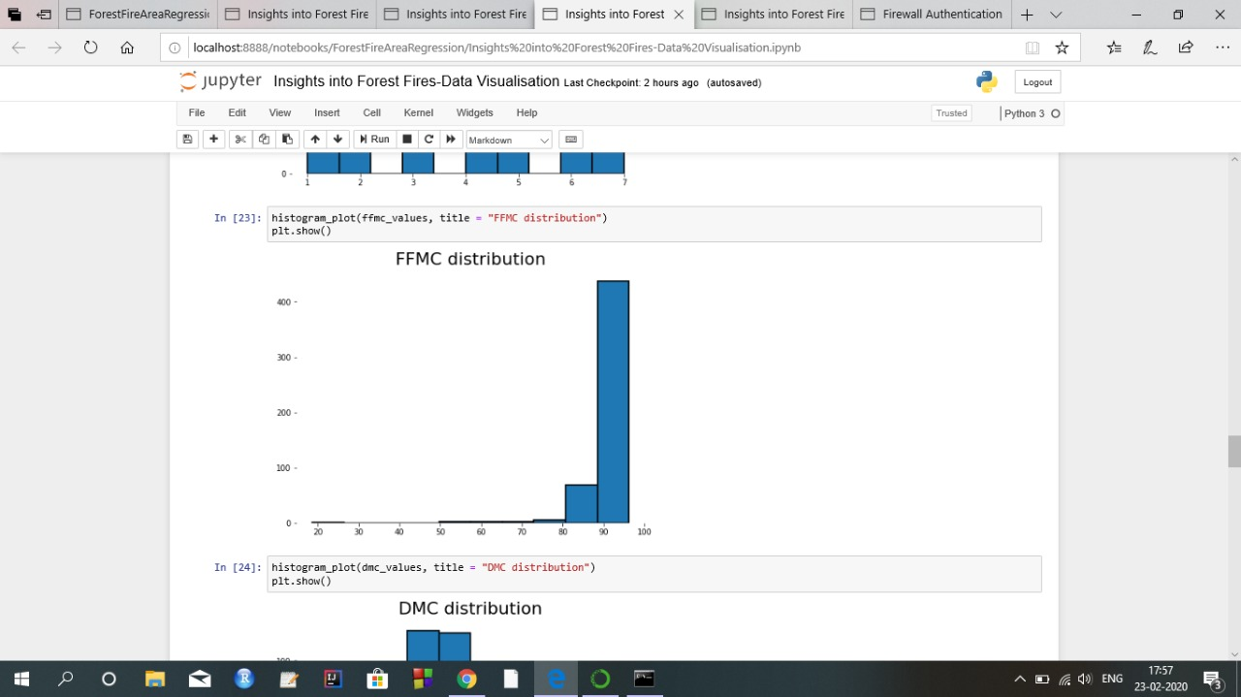
FFMC DISTRIBUTION

Slide 28
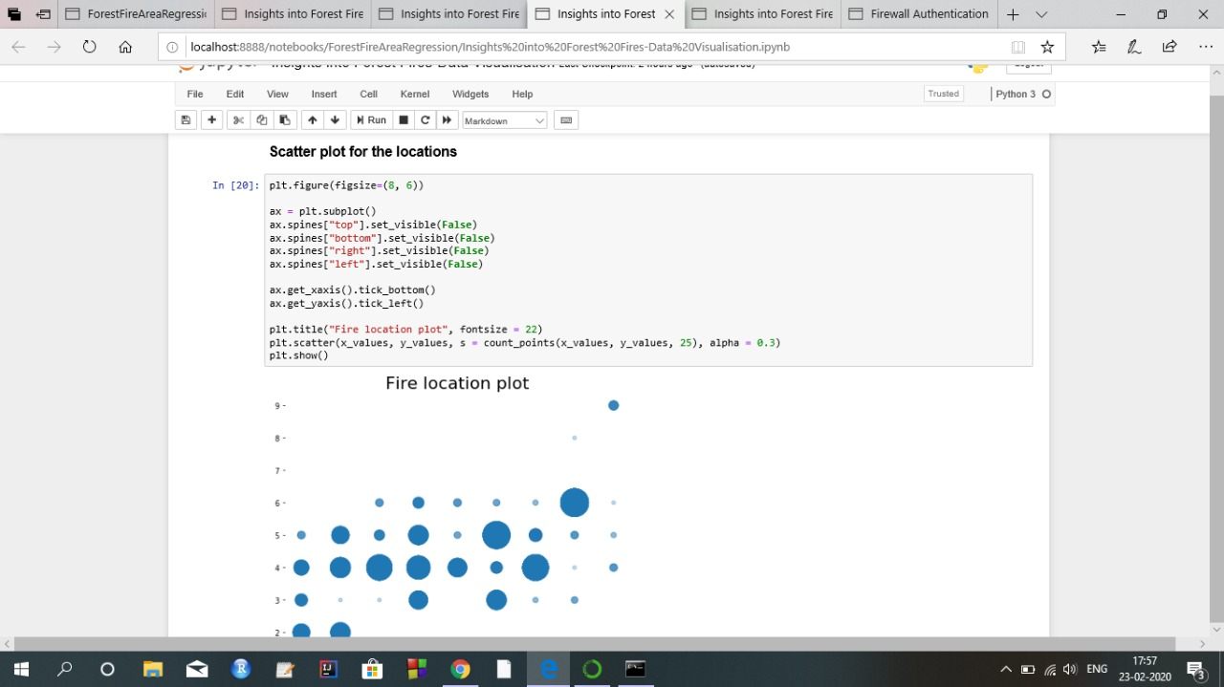
FIRE LOCATION PLOT

Slide 29
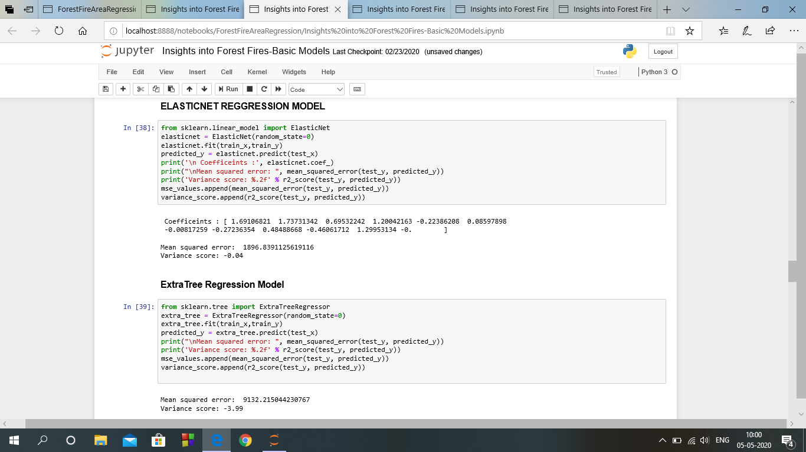
BASIC MODELS

Slide 30
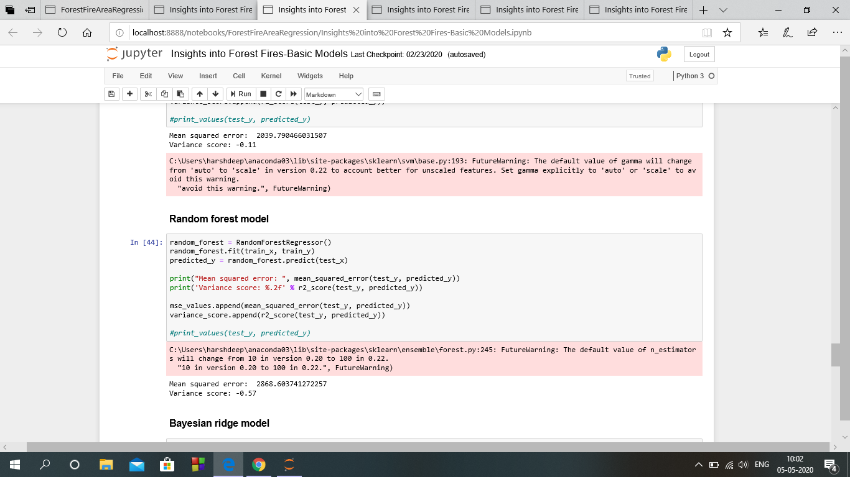
BASIC MODELS

Slide 31
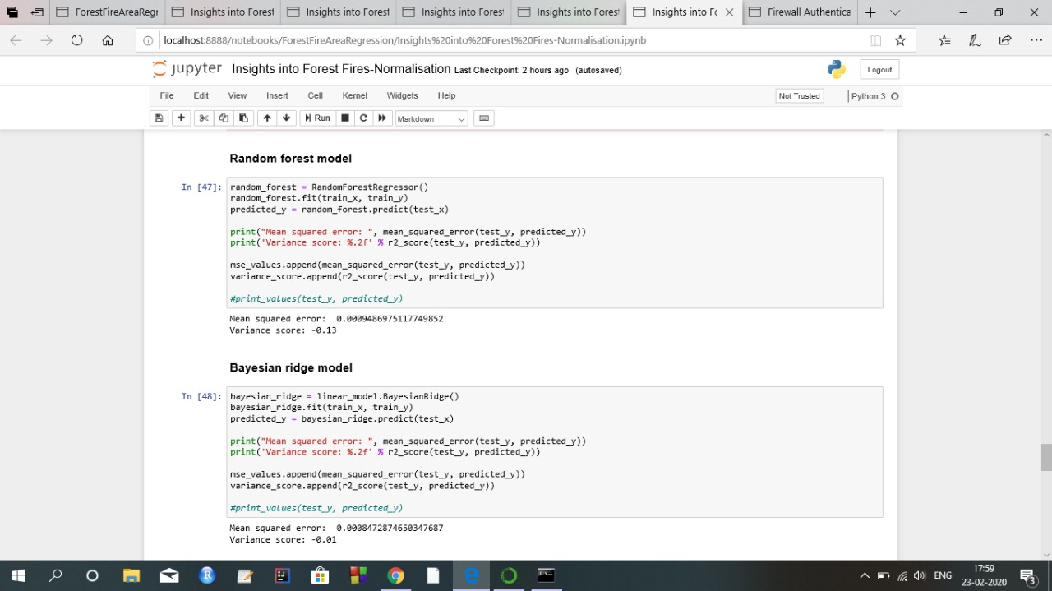
Normalisation

Slide 32
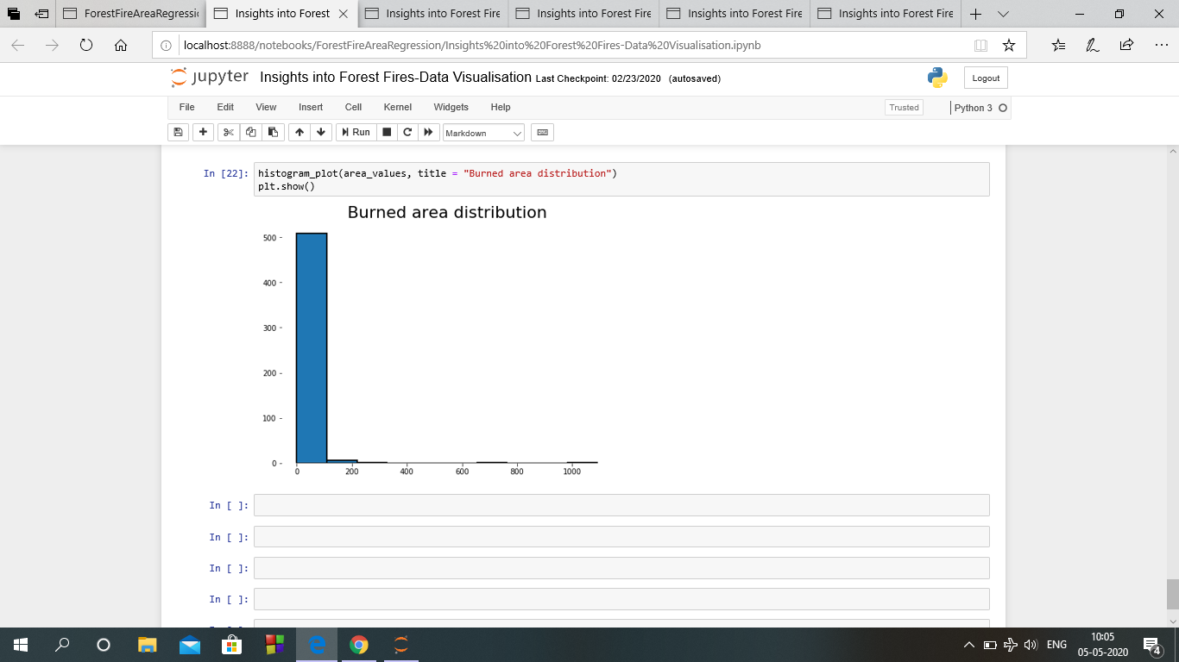
BURNED AREA DISTRIBUTION

Slide 33
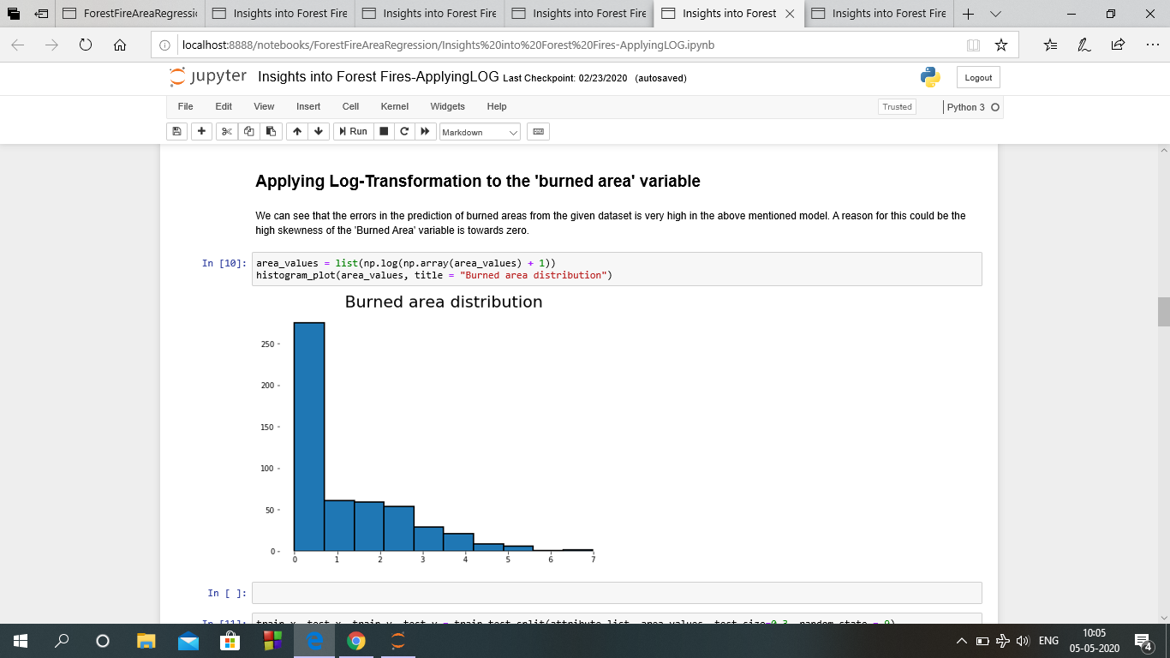
LOG TRANSFORMATION

Slide 34
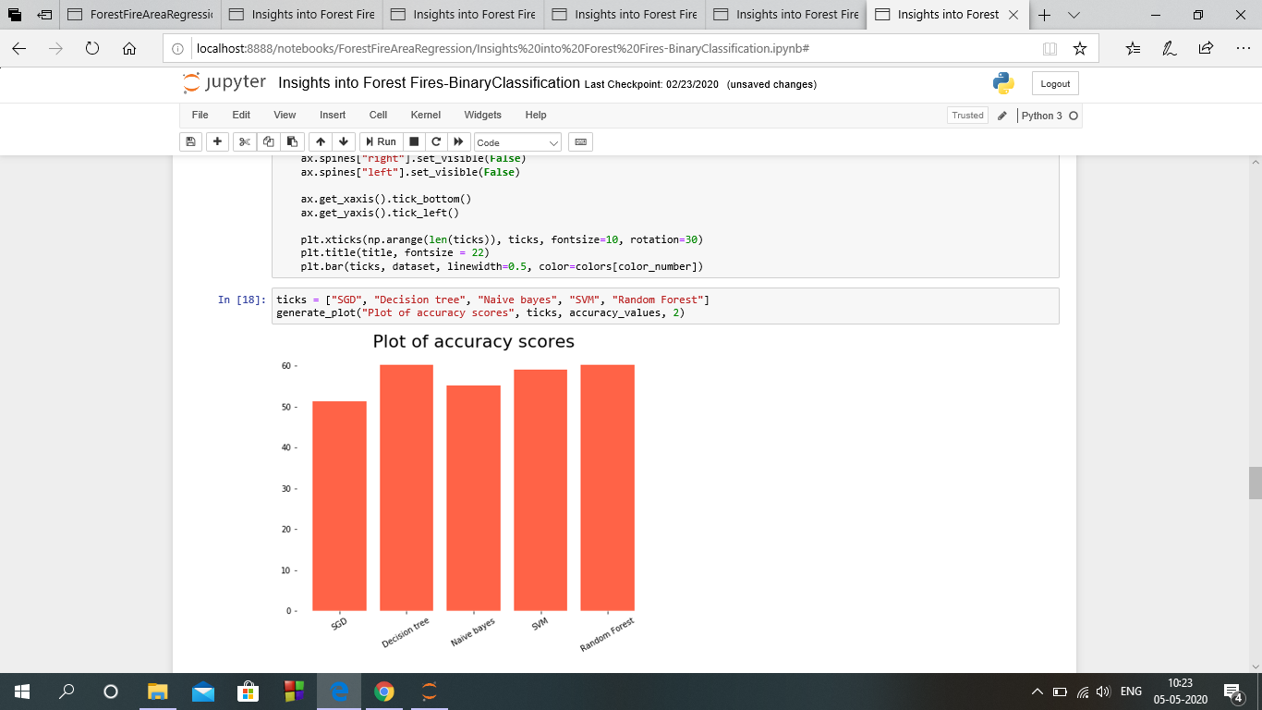
BINARY CLASSIFICATION

Slide 35
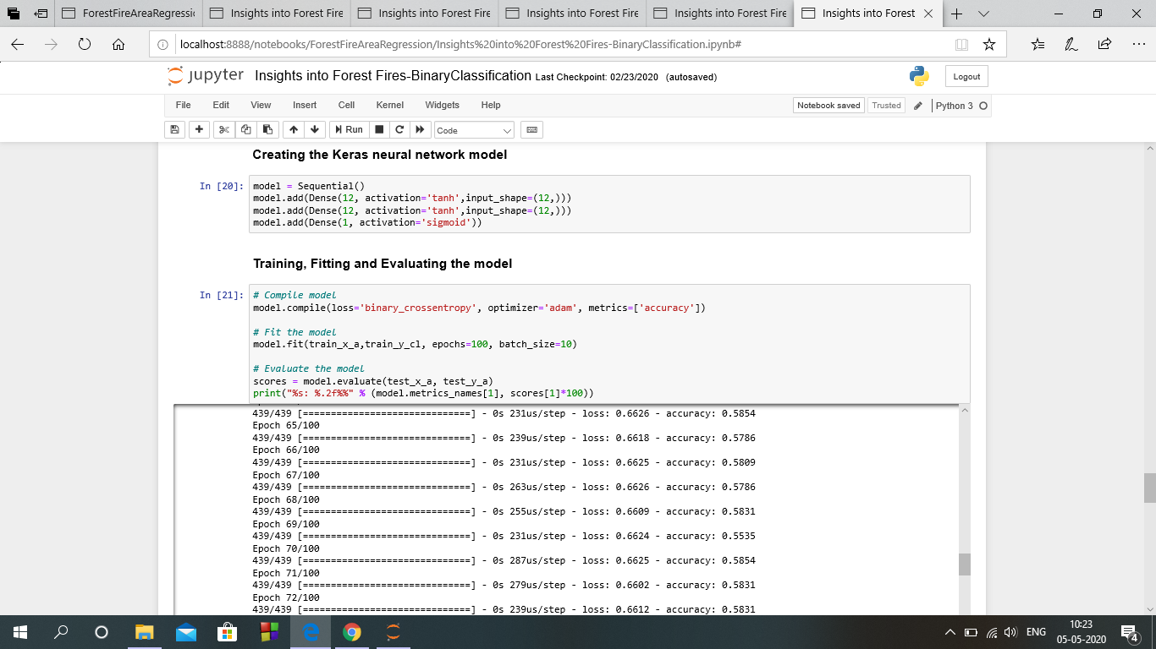
NEURAL NETWROKS IMPLEMENTATION

Slide 36
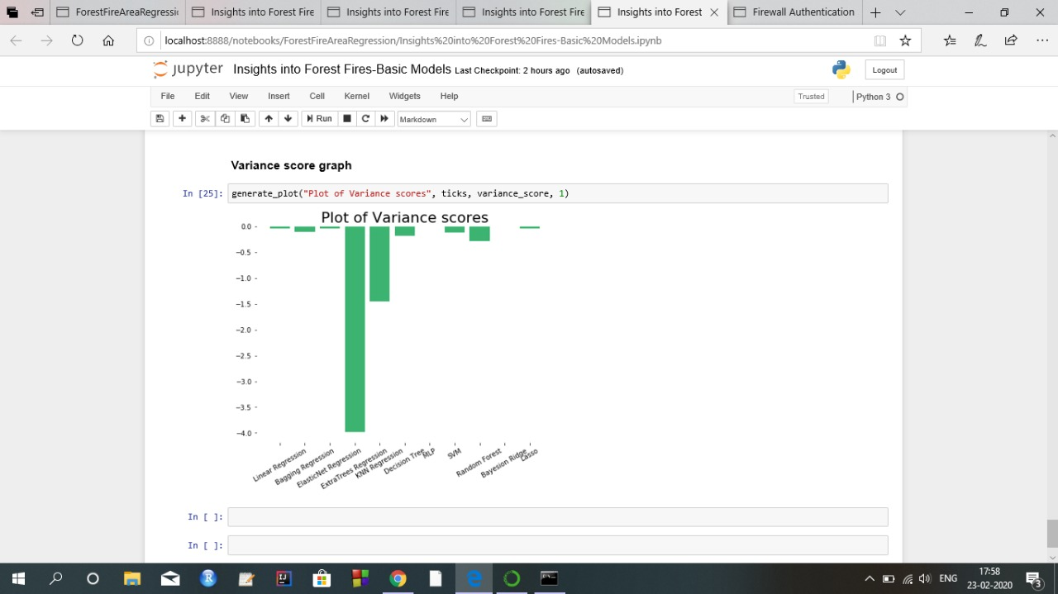
VARIANCE SCORE GRAPH(Basic Models)

Slide 37
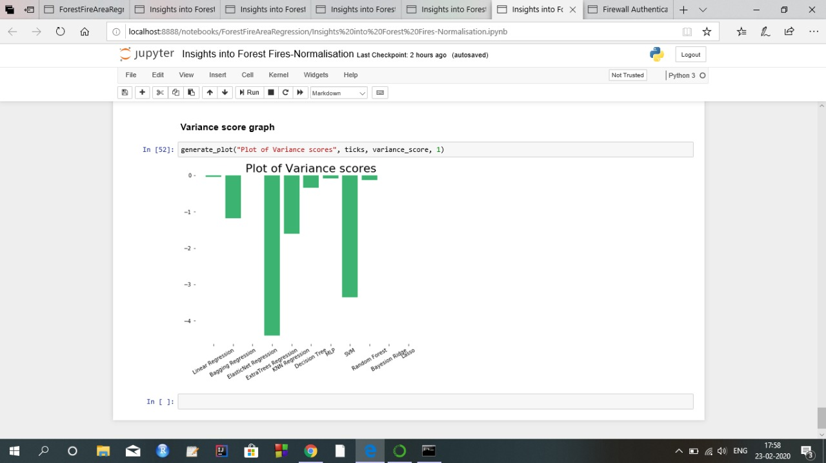
VARIANCE SCORE GRAPH(Normalisation)

Slide 38
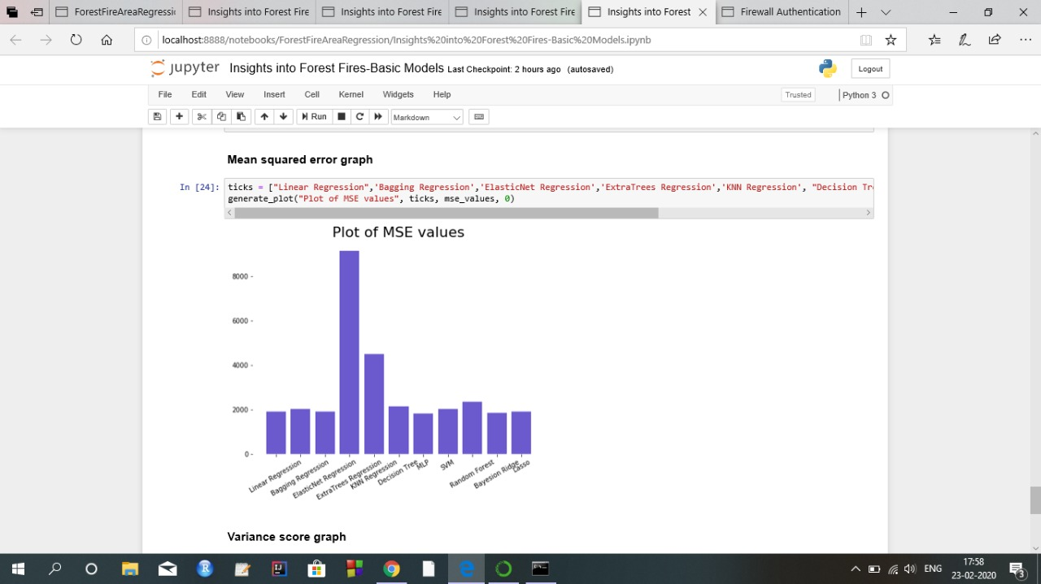
MSE GRAPH(Basic Models)

Slide 39
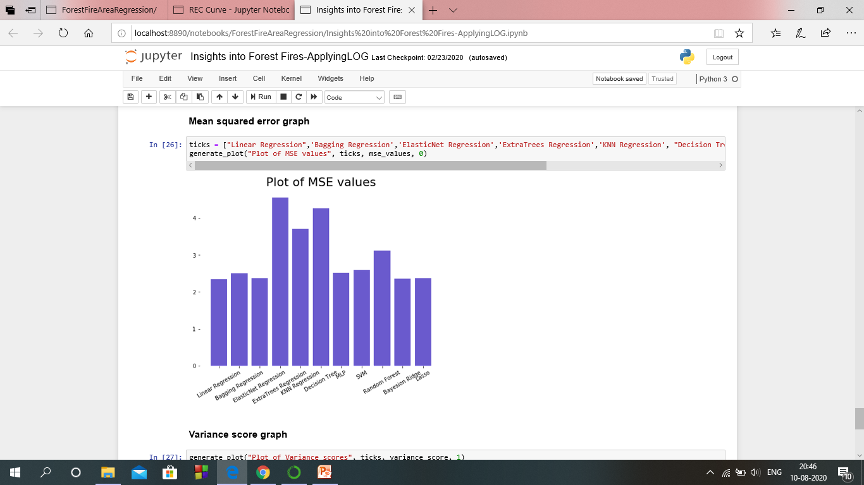
MSE GRAPH(Log Transformation)

Slide 40
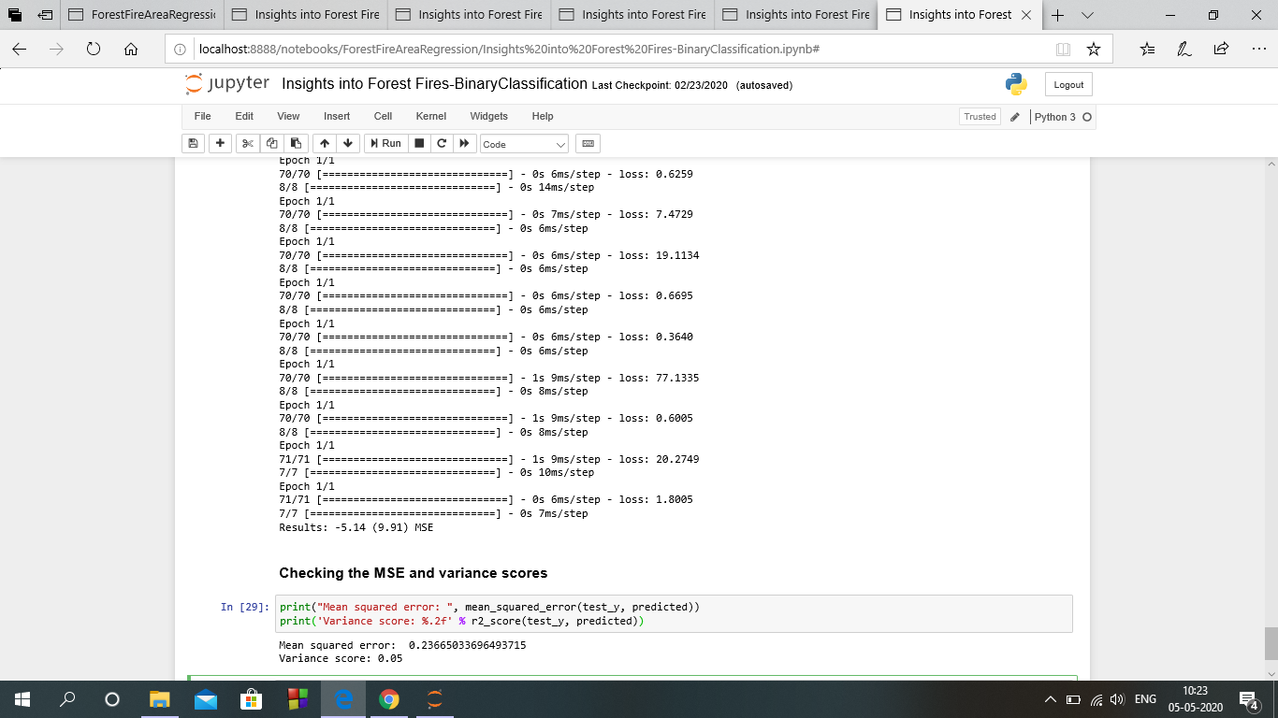
NEURAL NETWORK (MSE and VARIANCE Scores)

Slide 41
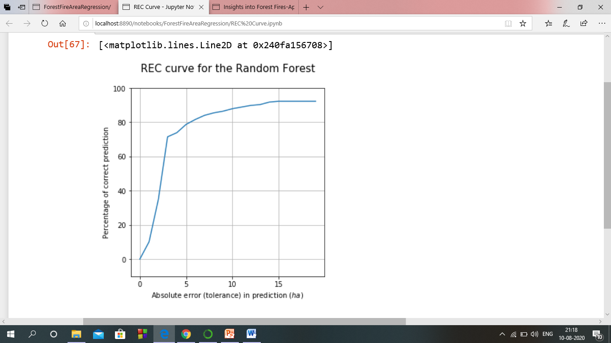
REC CURVE (Random Forest)

Slide 42
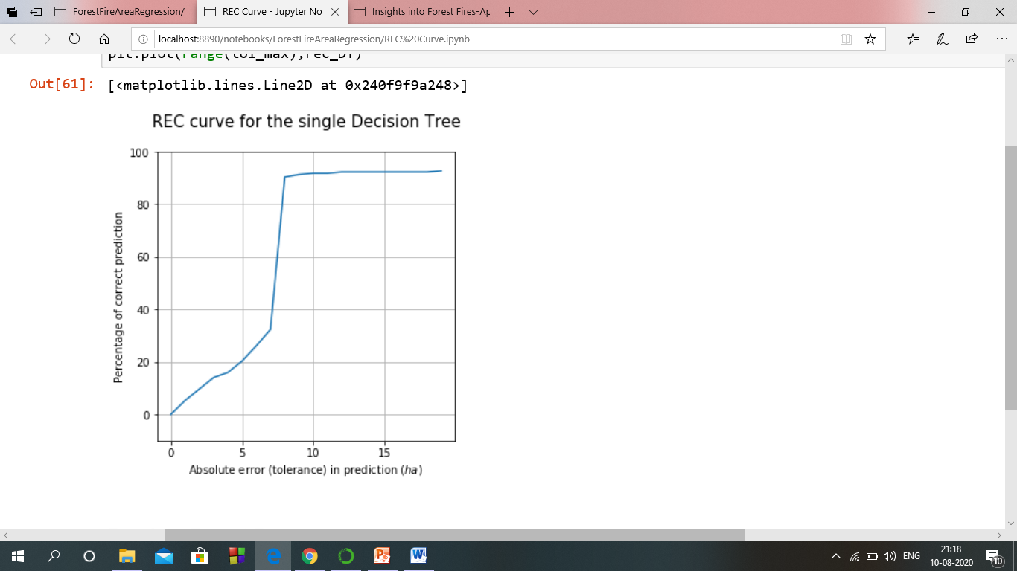
REC CURVE (Decision Tree)

Slide 43
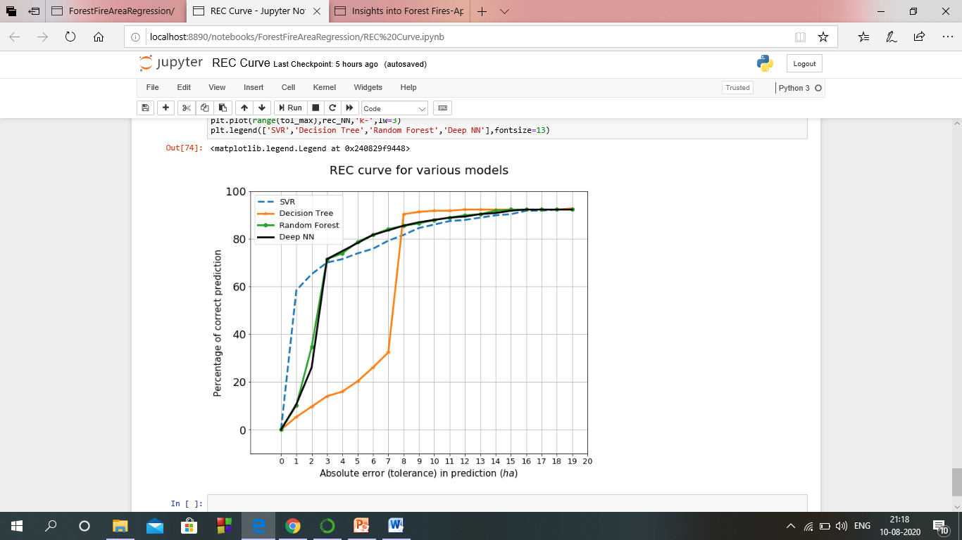
RELATIVE PERFORMANCE OF VARIOUS MODELS (REC CURVE)

Slide 44
Result
The best RMSE was attained by the Neural Networks. An analysis to the Regression Error Curve (REC) shows that the SVR model predicts more examples within a lower admitted error. In effect, the SVR model predicts better small fires, which are the majority.
The models and future forecasts are based on existing policy across several domains, and an important assumption of the forecasts is that the future develops without change to the policy setting.

Slide 45
THANK YOU

