Slide 1


AI product studio
Making data science and machine learning have a real impact on organisations

Slide 2
Python Workshop

Slide 3
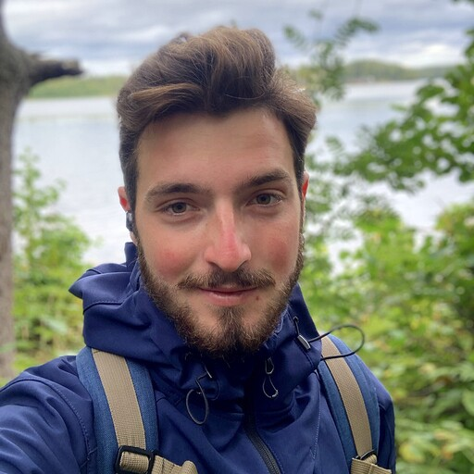
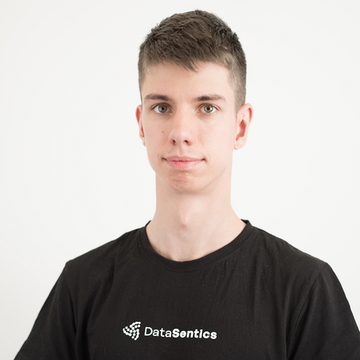
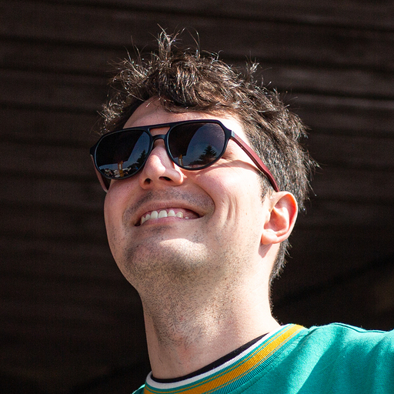
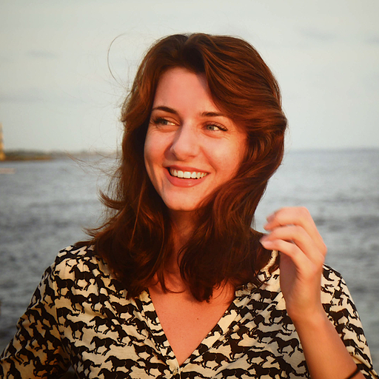
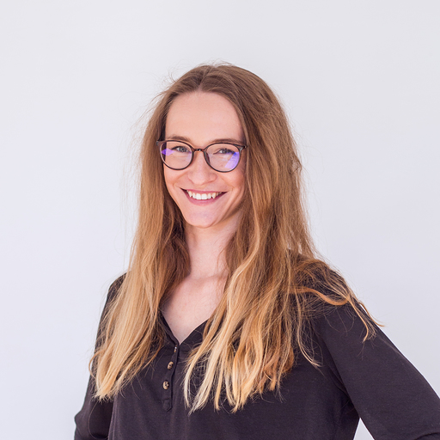
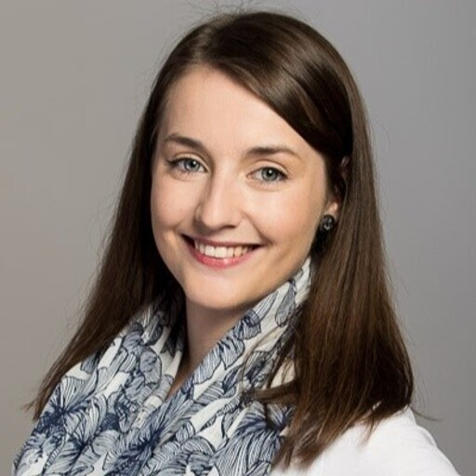
Who are we?
Ondra Lošťák
Tomáš Bouma - Tošo
Lukáš Langr
Adriána Furdová - Ád
Aneta Albrechtová
Lucie Koulová

Slide 4
Workshops outline
List of workshops
Python workshop
Introduction to Databricks
Data Engineering with Databricks
Git
Data Science with Databricks
Each workshop:
2-3 Hour introduction
Self-paced work
1 Hour walkthrough of the self-paced work

Slide 5
Python workshop outline
3 Hour workshop - Today
Kahoot game
Quick introduction to Databricks
Data analysis in Pandas
Machine learning showcase
Decorators
Self-paced exercise for 2 to 4 hours - In the incoming days
1 Hour walkthrough through the exercise - In the incoming days

