Slide 1
Learn How Zomato Recommends Restaurants
Sarveshwaran R
Duration : 60 mins

Slide 2

01
02
03
04
05
Introduction to Data Science
Understanding Recommendation Systems
Data Collection & Preprocessing
Building a Recommendation System
Code Walkthrough

Slide 3

Introduction to Data Science & The Future of Data Science
Exploratory Data Analysis (EDA)
Machine Learning & AI
Building predictive models.
Identifying patterns and trends.
03
04
Data Preprocessing
Data Visualization
Cleaning and transforming data for analysis.
Communicating insights effectively.
02
Data Science
05
Data Collection
Data Science is the field that combines statistics, programming, and domain expertise to extract meaningful insights from data.
Gathering structured and unstructured data.
01
06

Slide 4





Key Applications of Data Science
Healthcare – Predicting diseases, personalized treatments.
Retail & E-commerce – Personalized recommendations, demand forecasting.
Key Applications
Food & Hospitality – Customer sentiment analysis, restaurant recommendations (like Zomato!)
Finance – Fraud detection, risk assessment.

Slide 5
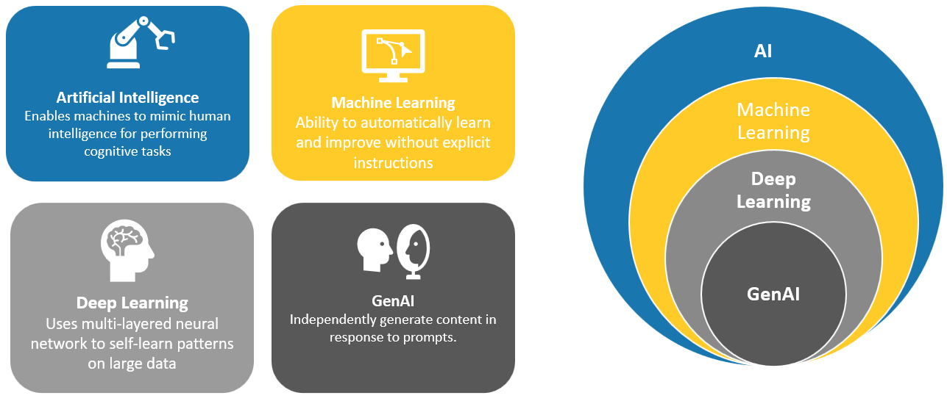
Traditional ML Methods vs Data Science

Slide 6


Image Placeholder
Recommendation System
A Recommendation System is a tool used to predict and suggest items (e.g., products, services, or content) that a user might like based on their preferences, behaviors, or other factors.
These systems are widely used in e-commerce, social media, streaming services, and food tech (like Zomato), to personalize the user experience and enhance engagement.
Notes:
Duration: 5 minutes
Highlights:
Start with an icebreaker activity or poll.
Ensure the poll is created on Zoom before the session. Introduce the poll and options.
Lead the discussion based on the responses.
Key Takeaways: Share the poll results (percentage or count). In general, discuss how people are inclined to different options or the most popular opinion.

Slide 7
Recommendation System Types
Content-Based Filtering
Recommends items similar to what the user has liked in the past, based on attributes (e.g., restaurant cuisine, food type, or restaurant rating).
Example: If a user likes Italian food, the system recommends other Italian restaurants based on their descriptions and tags.
Collaborative Filtering
Recommends items based on the behavior of similar users.
User-based
Item-based
Example: If User A and User B have liked the same set of restaurants, the system might recommend additional restaurants that User A likes but User B hasn't tried yet.
Hybrid Recommendation Systems
Combines content-based and collaborative filtering to make more accurate recommendations.
Example: A system might recommend a new Italian restaurant based on content features but also consider similar users’ preferences.
Notes:
Definitions

Slide 8

Impact of Recommendation Systems in Zomato’s Business
Increased Engagement: Personalized suggestions drive more orders, keeping users engaged with the platform.
Better User Experience: Tailored recommendations help users find what they want quickly, making their experience smoother and more enjoyable.
Revenue Growth: By suggesting popular, well-rated restaurants, Zomato can increase sales and customer satisfaction.
Notes:
Summary

