Slide 1
Debugging In Python
Notes:
Hello everyone, in this video we will talk about debugging in python. First lets us understand what is debugging.
Debugging is the process of finding and fixing errors in your code. These errors can cause your program to crash, or produce incorrect results. Debugging helps us identify and resolve these issues.
There are three common types of error that you might encounter.
"syntax error".
"runtime error". Some of the examples are Name error, Type error or Value error.
The last one is "semantic error". It means the code executed properly but does not produce the expected output.
Now we will what are the various ways through which you can debug the code.
The most commons ways are "print statement", "Exception handling", and the assert statements.

Slide 2
Introduction
Debugging in Python refers to the process of identifying and resolving errors or issues in your Python code.
Notes:
Hello everyone, in this video we will talk about debugging in python. First lets us understand what is debugging.
Debugging is the process of finding and fixing errors in your code. These errors can cause your program to crash, or produce incorrect results. Debugging helps us identify and resolve these issues.
There are three common types of error that you might encounter.
"syntax error".
"runtime error". Some of the examples are Name error, Type error or Value error.
The last one is "semantic error". It means the code executed properly but does not produce the expected output.
Now we will what are the various ways through which you can debug the code.
The most commons ways are "print statement", "Exception handling", and the assert statements.

Slide 3
Common Types of Error
Syntax error
Runtime error (Examples: NameError, TypeError, ValueError)
Semantic Errors (when the code executes without errors but doesn't produce the expected output)
Notes:
Hello everyone, in this video we will talk about debugging in python. First lets us understand what is debugging.
Debugging is the process of finding and fixing errors in your code. These errors can cause your program to crash, or produce incorrect results. Debugging helps us identify and resolve these issues.
There are three common types of error that you might encounter.
"syntax error".
"runtime error". Some of the examples are Name error, Type error or Value error.
The last one is "semantic error". It means the code executed properly but does not produce the expected output.
Now we will what are the various ways through which you can debug the code.
The most commons ways are "print statement", "Exception handling", and the assert statements.

Slide 4
Basic Debugging Techniques
print statements
Exception Handling
assert statements
Notes:
Hello everyone, in this video we will talk about debugging in python. First lets us understand what is debugging.
Debugging is the process of finding and fixing errors in your code. These errors can cause your program to crash, or produce incorrect results. Debugging helps us identify and resolve these issues.
There are three common types of error that you might encounter.
"syntax error".
"runtime error". Some of the examples are Name error, Type error or Value error.
The last one is "semantic error". It means the code executed properly but does not produce the expected output.
Now we will what are the various ways through which you can debug the code.
The most commons ways are "print statement", "Exception handling", and the assert statements.

Slide 5
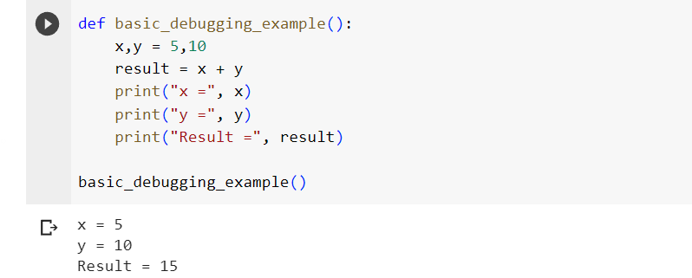
print statements

Slide 6
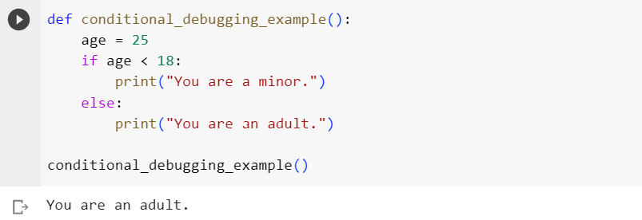

Slide 7
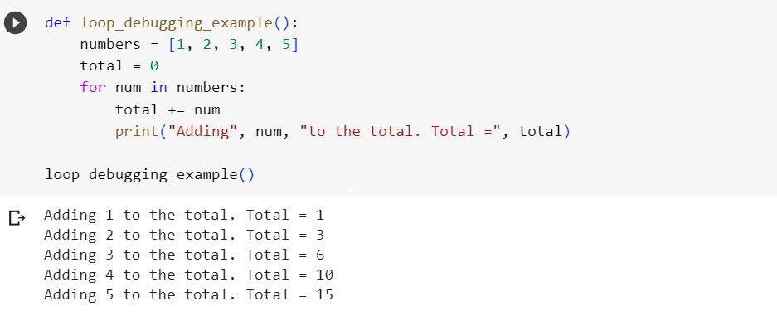

Slide 8
Exception Handling
It plays a significant role in debugging by providing mechanisms to identify, report, and gracefully handle errors in code.
Various ways exception handling helps in debugging.
Error Identification
Error Reporting
Error Traceback

Slide 9
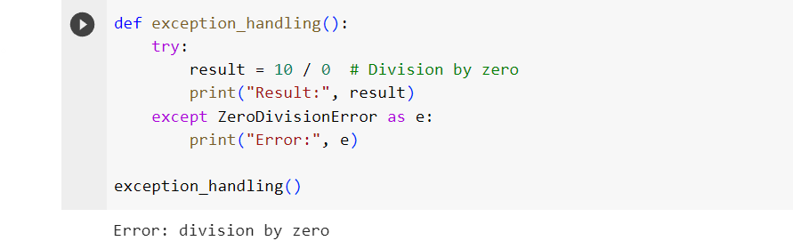

Slide 10
assert statements
The assert statement in Python is used to test whether a given condition is True.
If the condition is True, the program continues executing normally. If the condition is False, an AssertionError exception is raised, and the program terminates.

Slide 11
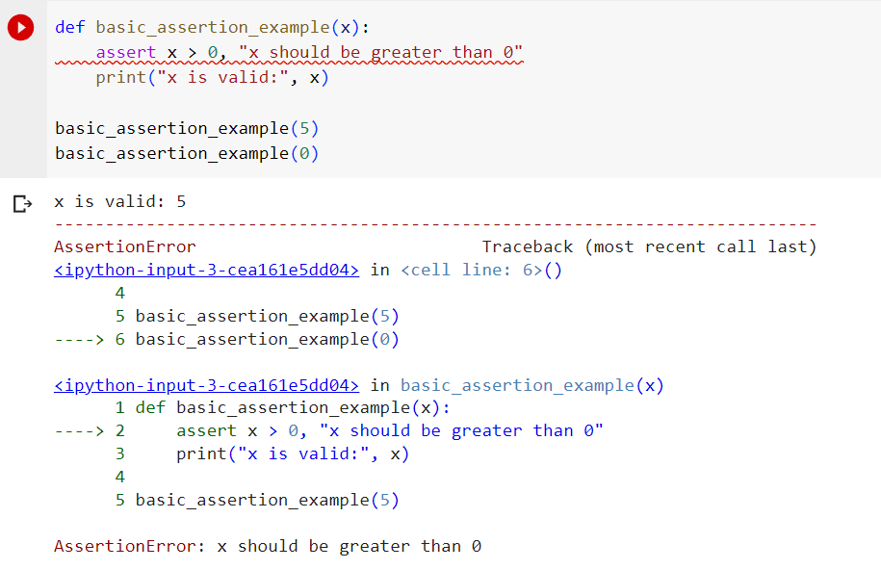

Slide 12
Advance debugging methods

Slide 13
PDB for debugging
It is a debugging tool in python.
It allows developers to interactively debug their Python code, set breakpoints, inspect variables, and step through code execution to identify and fix issues.

Slide 14
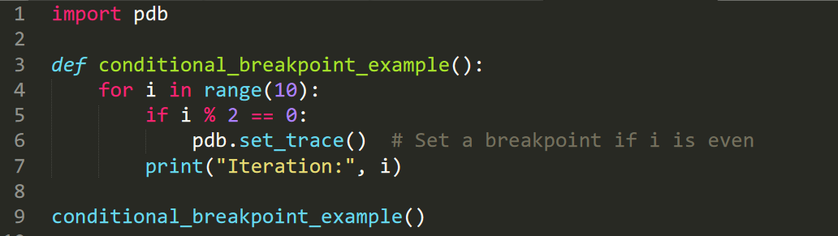

Slide 15
