Slide 1
Logging in Python
Notes:
In today's video, we're diving into one of the fundamental techniques every Python developer should master: "Logging".
Logging is all about recording information during the execution of your Python programs.
Python provides five standard log levels that you can use to categorize your log messages. These are "Debug", "Info", "Warning", "Error", and "Critical".
DEBUG level is used for detailed information, typically used for debugging purposes.
INFO level is for general information about the program's execution.
WARNING level indicates that something unexpected happened or a potential problem.
ERROR level is used for more serious issues that may cause the program to behave unexpectedly.
CRITICAL level represents a critical error that could lead to the program's termination.
Let's see an example of how to use all of them

Slide 2
Introduction
Logging in Python is a fundamental technique for recording information, debugging, and monitoring the execution of your Python programs.
Notes:
In today's video, we're diving into one of the fundamental techniques every Python developer should master: "Logging".
Logging is all about recording information during the execution of your Python programs.
Python provides five standard log levels that you can use to categorize your log messages. These are "Debug", "Info", "Warning", "Error", and "Critical".
DEBUG level is used for detailed information, typically used for debugging purposes.
INFO level is for general information about the program's execution.
WARNING level indicates that something unexpected happened or a potential problem.
ERROR level is used for more serious issues that may cause the program to behave unexpectedly.
CRITICAL level represents a critical error that could lead to the program's termination.
Let's see an example of how to use all of them

Slide 3
✅ DEBUG: Detailed information, typically used for debugging.
Notes:
In today's video, we're diving into one of the fundamental techniques every Python developer should master: "Logging".
Logging is all about recording information during the execution of your Python programs.
Python provides five standard log levels that you can use to categorize your log messages. These are "Debug", "Info", "Warning", "Error", and "Critical".
DEBUG level is used for detailed information, typically used for debugging purposes.
INFO level is for general information about the program's execution.
WARNING level indicates that something unexpected happened or a potential problem.
ERROR level is used for more serious issues that may cause the program to behave unexpectedly.
CRITICAL level represents a critical error that could lead to the program's termination.
Let's see an example of how to use all of them

Slide 4
✅ INFO: General information about the program's execution.
Notes:
In today's video, we're diving into one of the fundamental techniques every Python developer should master: "Logging".
Logging is all about recording information during the execution of your Python programs.
Python provides five standard log levels that you can use to categorize your log messages. These are "Debug", "Info", "Warning", "Error", and "Critical".
DEBUG level is used for detailed information, typically used for debugging purposes.
INFO level is for general information about the program's execution.
WARNING level indicates that something unexpected happened or a potential problem.
ERROR level is used for more serious issues that may cause the program to behave unexpectedly.
CRITICAL level represents a critical error that could lead to the program's termination.
Let's see an example of how to use all of them

Slide 5
✅ ERROR: A more serious issue that may cause the program to behave unexpectedly.
Notes:
In today's video, we're diving into one of the fundamental techniques every Python developer should master: "Logging".
Logging is all about recording information during the execution of your Python programs.
Python provides five standard log levels that you can use to categorize your log messages. These are "Debug", "Info", "Warning", "Error", and "Critical".
DEBUG level is used for detailed information, typically used for debugging purposes.
INFO level is for general information about the program's execution.
WARNING level indicates that something unexpected happened or a potential problem.
ERROR level is used for more serious issues that may cause the program to behave unexpectedly.
CRITICAL level represents a critical error that could lead to the program's termination.
Let's see an example of how to use all of them

Slide 6
✅ CRITICAL: A critical error that could lead to the program's termination.
Notes:
In today's video, we're diving into one of the fundamental techniques every Python developer should master: "Logging".
Logging is all about recording information during the execution of your Python programs.
Python provides five standard log levels that you can use to categorize your log messages. These are "Debug", "Info", "Warning", "Error", and "Critical".
DEBUG level is used for detailed information, typically used for debugging purposes.
INFO level is for general information about the program's execution.
WARNING level indicates that something unexpected happened or a potential problem.
ERROR level is used for more serious issues that may cause the program to behave unexpectedly.
CRITICAL level represents a critical error that could lead to the program's termination.
Let's see an example of how to use all of them

Slide 7
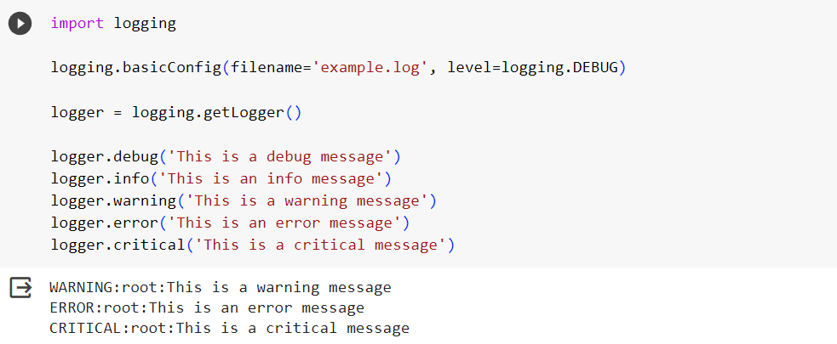
Notes:
In today's video, we're diving into one of the fundamental techniques every Python developer should master: "Logging".
Logging is all about recording information during the execution of your Python programs.
Python provides five standard log levels that you can use to categorize your log messages. These are "Debug", "Info", "Warning", "Error", and "Critical".
DEBUG level is used for detailed information, typically used for debugging purposes.
INFO level is for general information about the program's execution.
WARNING level indicates that something unexpected happened or a potential problem.
ERROR level is used for more serious issues that may cause the program to behave unexpectedly.
CRITICAL level represents a critical error that could lead to the program's termination.
Let's see an example of how to use all of them

