Slide 1
Testing in Python
Notes:
In this video, we will learn about testing in python.
Testing is crucial to ensure your code works as expected and to catch bugs early. There are various ways through which you can test your code. These are "Assertion","unittest", "doctest", and "pytest".
Lets us learn about each one of them.
First of all, we will talk about assertion.
Assertions are the assumption that a programmer alaways wants to be true and hence puts them in code so that failure of these doesn’t allow the code to execute further.
In the given code example assertion is used to check where 3 is present in the given list or not. Similarly in the second example it is used to check whether "foxs" and "dog" present in sentence or not.
In this case it is not present, that's why it throws an assertion error.
Next, we will talk about unittest module.
This module helps us to write test cases in a structured way.
In the given code, a rectangle class is created for calculating its area, changing its width, and changing its height. It also includes a unit test using the unittest framework to ensure that the get area method returns the correct area for a given rectangle.
To run this code, the following commands have been used.
python -m unittest tests dot py
Next, we will talk about doctest module.
This module allows you to write tests as part of your docstrings. It extracts test cases from docstrings and runs them.
In the given code add function is used for adding two numbers. When executed as the main script, it uses doctest to automatically test the function using embedded docstring examples.
To run this code, the following commands have been used.
python -m doctest wert dot py
The last one is pyttest module. It is a popular third-party testing framework for Python. In the given code first of all pyttest library is installed. Then three function are defined which are add, test addition, test subtraction.
To run this code, the following commands have been used.
pyttest script name dot py
From the output we can see that it successfully passed two test case.

Slide 2
Introduction
Testing in Python is a crucial part of software development to ensure that your code works as expected and continues to work correctly as you make changes.
Notes:
Testing is crucial to ensure your code works as expected and to catch bugs early. There are various ways through which you can test your code. These are "Assertion","unittest", "doctest", and "pytest".
Lets us learn about each one of them.
First of all, we will talk about assertion.
Assertions are the assumption that a programmer alaways wants to be true and hence puts them in code so that failure of these doesn’t allow the code to execute further.
In the given code example assertion is used to check where 3 is present in the given list or not. Similarly in the second example it is used to check whether "foxs" and "dog" present in sentence or not.
In this case it is not present, that's why it throws an assertion error.
Next, we will talk about unittest module.
This module helps us to write test cases in a structured way.
In the given code, a rectangle class is created for calculating its area, changing its width, and changing its height. It also includes a unit test using the unittest framework to ensure that the get area method returns the correct area for a given rectangle.
To run this code, the following commands have been used.
python -m unittest tests dot py
Next, we will talk about doctest module.
This module allows you to write tests as part of your docstrings. It extracts test cases from docstrings and runs them.
In the given code add function is used for adding two numbers. When executed as the main script, it uses doctest to automatically test the function using embedded docstring examples.
To run this code, the following commands have been used.
python -m doctest wert dot py
The last one is pyttest module. It is a popular third-party testing framework for Python. In the given code first of all pyttest library is installed. Then three function are defined which are add, test addition, test subtraction.
To run this code, the following commands have been used.
pyttest script name dot py
From the output we can see that it successfully passed two test case.

Slide 3
Ways for testing
Assertions
unittest Module
doctest Module
pytest
Notes:
In this video, we will learn about testing in python.
Testing is crucial to ensure your code works as expected and to catch bugs early. There are various ways through which you can test your code. These are "Assertion","unittest", "doctest", and "pytest".
Lets us learn about each one of them.
First of all, we will talk about assertion.
Assertions are the assumption that a programmer alaways wants to be true and hence puts them in code so that failure of these doesn’t allow the code to execute further.
In the given code example assertion is used to check where 3 is present in the given list or not. Similarly in the second example it is used to check whether "foxs" and "dog" present in sentence or not.
In this case it is not present, that's why it throws an assertion error.
Next, we will talk about unittest module.
This module helps us to write test cases in a structured way.
In the given code, a rectangle class is created for calculating its area, changing its width, and changing its height. It also includes a unit test using the unittest framework to ensure that the get area method returns the correct area for a given rectangle.
To run this code, the following commands have been used.
python -m unittest tests dot py
Next, we will talk about doctest module.
This module allows you to write tests as part of your docstrings. It extracts test cases from docstrings and runs them.
In the given code add function is used for adding two numbers. When executed as the main script, it uses doctest to automatically test the function using embedded docstring examples.
To run this code, the following commands have been used.
python -m doctest wert dot py
The last one is pyttest module. It is a popular third-party testing framework for Python. In the given code first of all pyttest library is installed. Then three function are defined which are add, test addition, test subtraction.
To run this code, the following commands have been used.
pyttest script name dot py
From the output we can see that it successfully passed two test case.

Slide 4
Assertions
Assertions are mainly assumptions that a programmer always wants to be true and hence puts them in code so that failure of these doesn’t allow the code to execute further.
Notes:
Assertions are the assumption that a programmer alaways wants to be true and hence puts them in code so that failure of these doesn’t allow the code to execute further.
In the given code example assertion is used to check where 3 is present in the given list or not. Similarly in the second example it is used to check whether "foxs" and "dog" present in sentence or not.
In this case it is not present, that's why it throws an assertion error.
Next, we will talk about unittest module.
This module helps us to write test cases in a structured way.
In the given code, a rectangle class is created for calculating its area, changing its width, and changing its height. It also includes a unit test using the unittest framework to ensure that the get area method returns the correct area for a given rectangle.
To run this code, the following commands have been used.
python -m unittest tests dot py
Next, we will talk about doctest module.
This module allows you to write tests as part of your docstrings. It extracts test cases from docstrings and runs them.
In the given code add function is used for adding two numbers. When executed as the main script, it uses doctest to automatically test the function using embedded docstring examples.
To run this code, the following commands have been used.
python -m doctest wert dot py
The last one is pyttest module. It is a popular third-party testing framework for Python. In the given code first of all pyttest library is installed. Then three function are defined which are add, test addition, test subtraction.
To run this code, the following commands have been used.
pyttest script name dot py
From the output we can see that it successfully passed two test case.

Slide 5
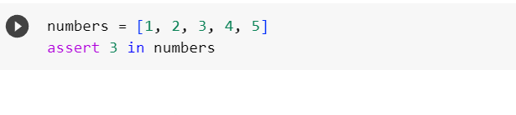
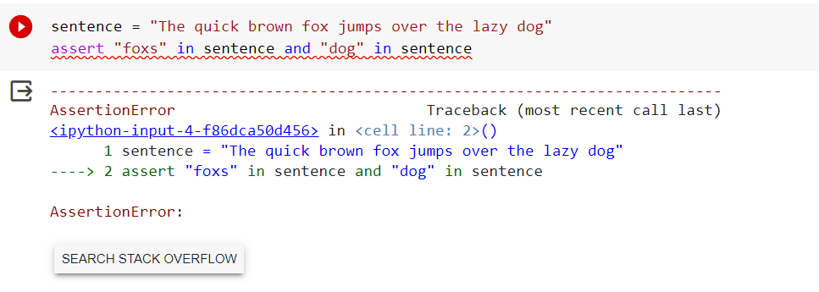

Slide 6
unittest Module
It provides a more structured way to write and organize test cases.
It allows you to create test classes with individual test methods.
Notes:
Next, we will talk about unittest module.
This module helps us to write test cases in a structured way.
In the given code, a rectangle class is created for calculating its area, changing its width, and changing its height. It also includes a unit test using the unittest framework to ensure that the get area method returns the correct area for a given rectangle.
To run this code, the following commands have been used.
python -m unittest tests dot py
Next, we will talk about doctest module.
This module allows you to write tests as part of your docstrings. It extracts test cases from docstrings and runs them.
In the given code add function is used for adding two numbers. When executed as the main script, it uses doctest to automatically test the function using embedded docstring examples.
To run this code, the following commands have been used.
python -m doctest wert dot py
The last one is pyttest module. It is a popular third-party testing framework for Python. In the given code first of all pyttest library is installed. Then three function are defined which are add, test addition, test subtraction.
To run this code, the following commands have been used.
pyttest script name dot py
From the output we can see that it successfully passed two test case.

Slide 7
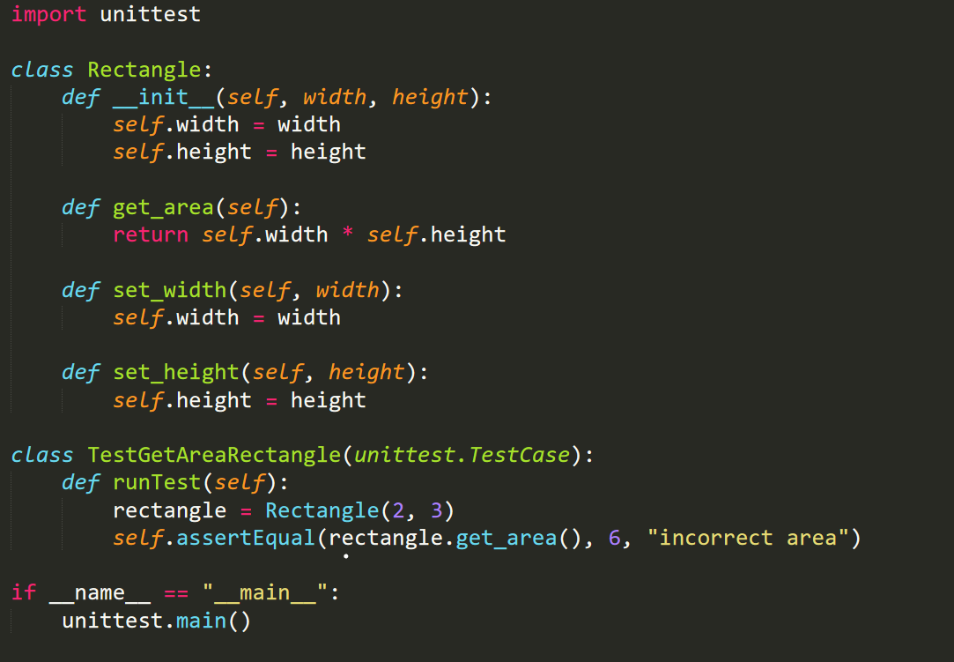

Slide 8
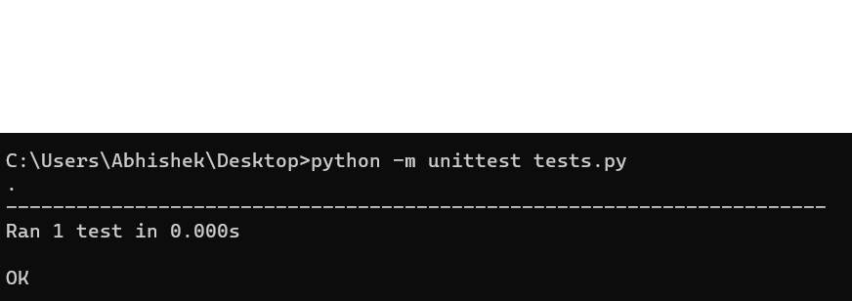

Slide 9
doctest Module
Python's doctest module allows you to write tests as part of your docstrings. It extracts test cases from docstrings and runs them.
Notes:
Next, we will talk about doctest module.
This module allows you to write tests as part of your docstrings. It extracts test cases from docstrings and runs them.
In the given code add function is used for adding two numbers. When executed as the main script, it uses doctest to automatically test the function using embedded docstring examples.
To run this code, the following commands have been used.
python -m doctest wert dot py
The last one is pyttest module. It is a popular third-party testing framework for Python. In the given code first of all pyttest library is installed. Then three function are defined which are add, test addition, test subtraction.
To run this code, the following commands have been used.
pyttest script name dot py
From the output we can see that it successfully passed two test case.

Slide 10
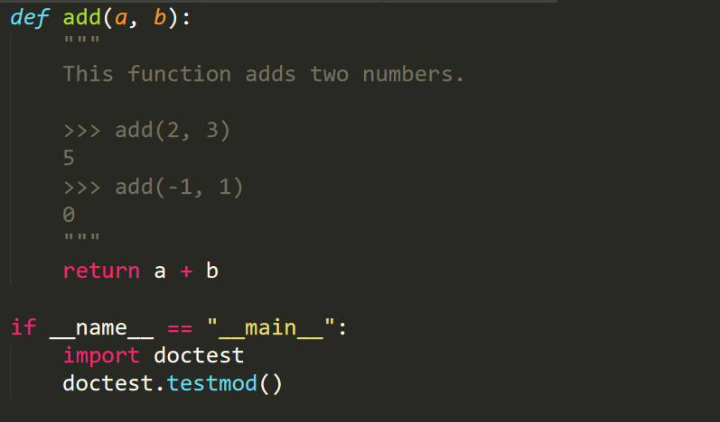

Slide 11
Pytest
pytest is a popular third-party testing framework for Python. It simplifies writing and running tests and offers advanced features like fixtures, parameterized testing, and plugins.
Notes:
The last one is pyttest module. It is a popular third-party testing framework for Python. In the given code first of all pyttest library is installed. Then three function are defined which are add, test addition, test subtraction.
To run this code, the following commands have been used.
pyttest script name dot py
From the output we can see that it successfully passed two test case.

Slide 12
