Slide 1
Transformer

Slide 2
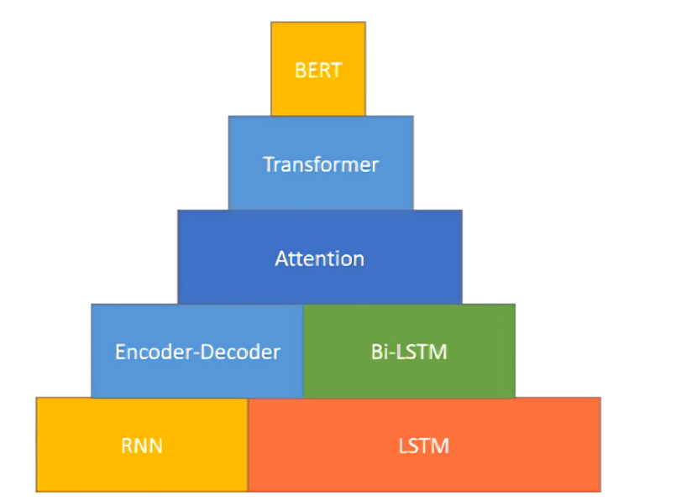

Slide 3
RNN
the clouds are in the sky

Slide 4
RNN
the clouds are in the sky
Relevant
word
Predicted
word

Slide 5
Problems with RNN
I grew up in France… I speak fluent French.
Relevant
word
Predicted
word

Slide 6
LSTM
It is capable of learning long-term dependencies
It uses memory gates to remember long senteneces

Slide 7
Bi-LSTM
I grew up in France… I speak fluent French.

Slide 8

Encoder-Decoder

Slide 9
Attention
I am going to the market

Slide 10
History of Transformer
Launched by Google Brain in 2017
The first research paper https://arxiv.org/pdf/1706.03762

Slide 11
Transformer
It is a Seq2Seq model.

Slide 12
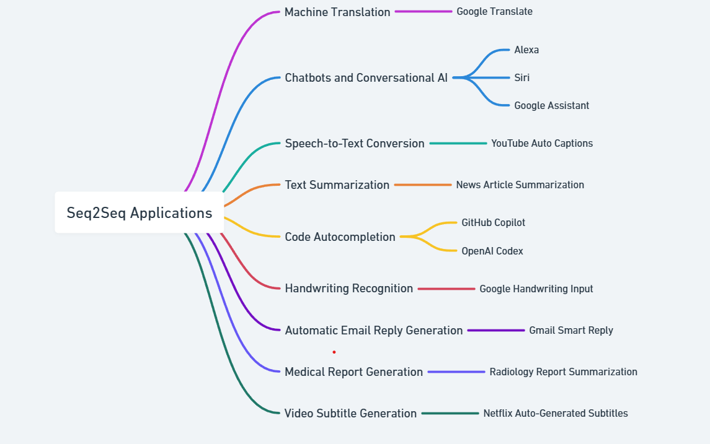

Slide 13
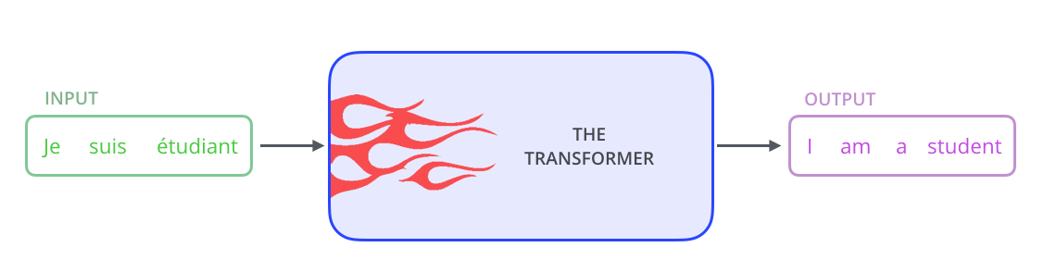
Transformer Architecture Explained

Slide 14
Transformer Architecture Explained

Slide 15

Transformer Architecture Explained

Slide 16
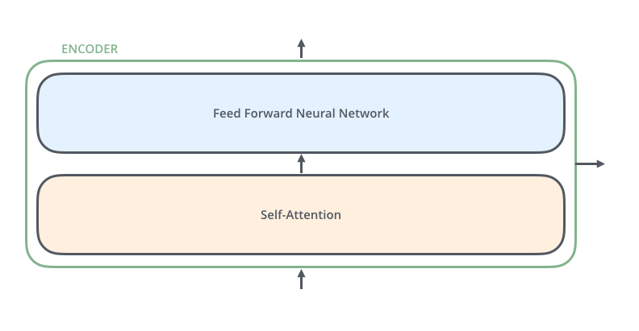
Transformer Architecture Explained

Slide 17
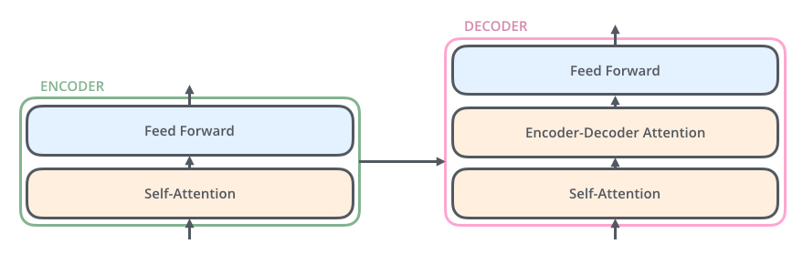
Transformer Architecture Explained

Slide 18

Transformer Architecture Explained
Each word is embedded into a vector of size 512. We'll represent those vectors with these simple boxes.

Slide 19
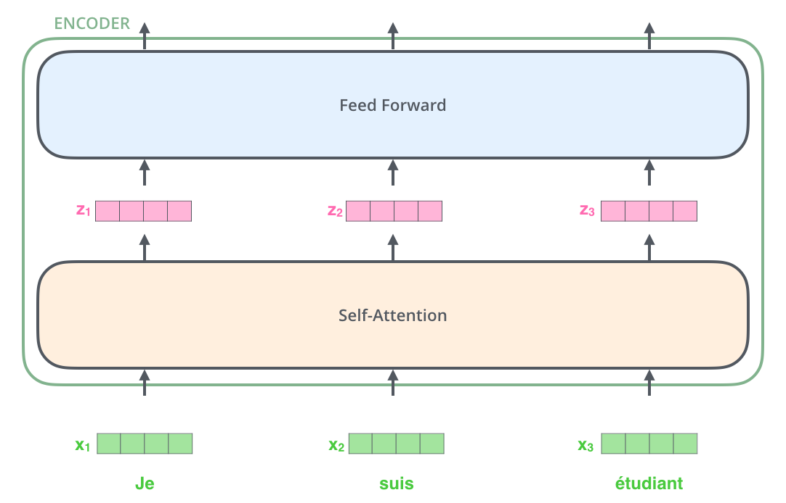
Transformer Architecture Explained

Slide 20
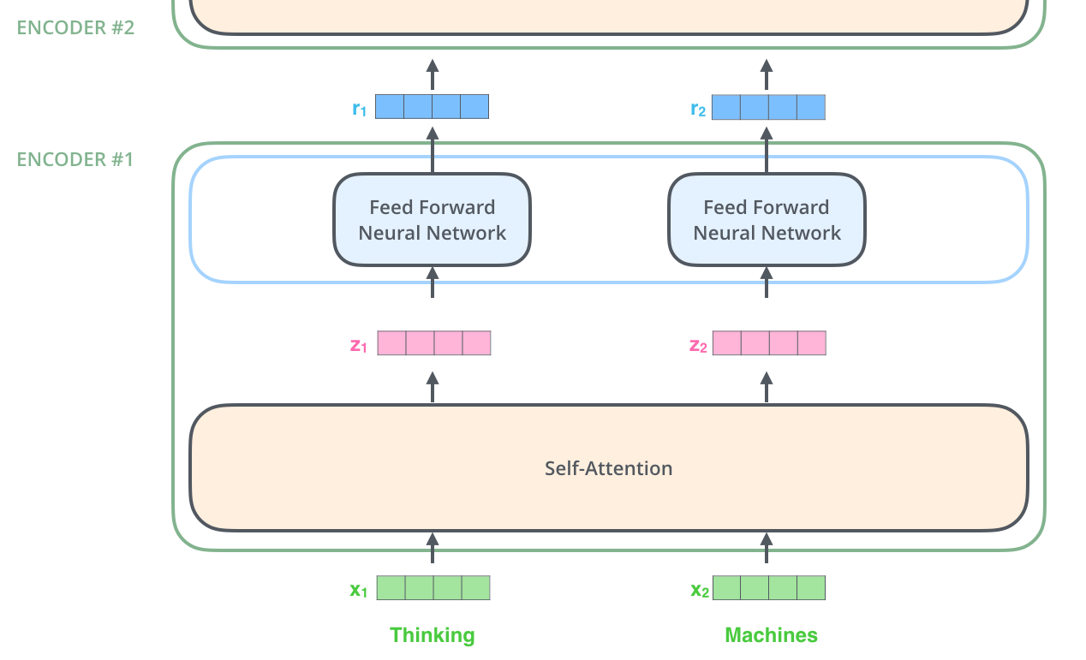
Transformer Architecture Explained

Slide 21
Self-Attention at a High Level
”The animal didn't cross the street because it was too tired”.
What does “it” in this sentence refer to? Is it referring to the street or to the animal?
When the model is processing the word “it”, self-attention allows it to associate “it” with “animal”.
As the model processes each word (each position in the input sequence), self attention allows it to look at other positions in the input sequence for clues that can help lead to a better encoding for this word.

Slide 22
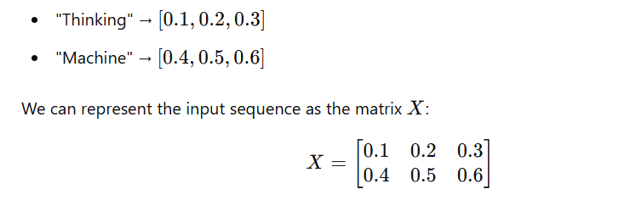
Step 1: Input Sequence and Word Embeddings
Imagine we have a sequence of 2 words: “Thinking Machine".

Slide 23
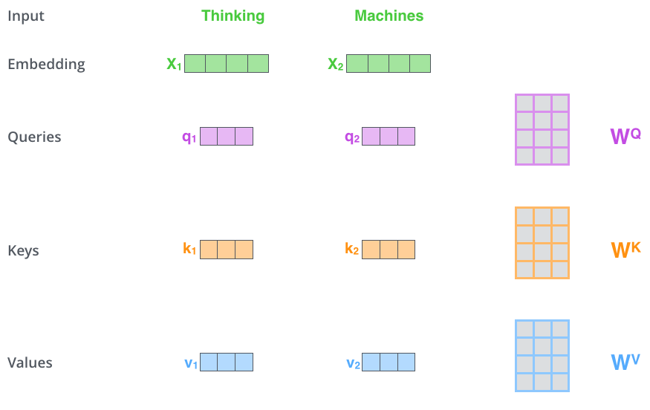
Self-Attention at a High Level (Math)
So, for each word, we create a Query vector, a Key vector, and a Value vector.

Slide 24
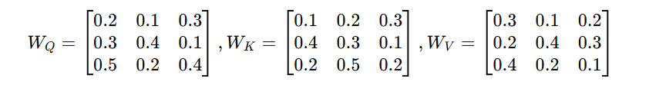
Let’s assume the following weight matrices for simplicity:

Slide 25
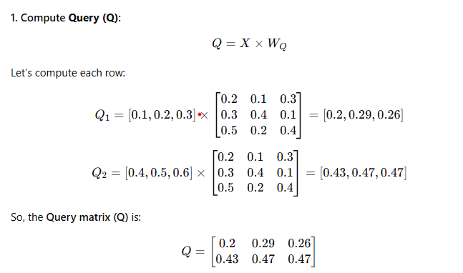
Step 2- Calculate Query (Q), Key (K), and Value (V)
We multiply the input matrix X by these weight matrices to obtain the Query (Q), Key (K), and Value (V) matrices.

Slide 26
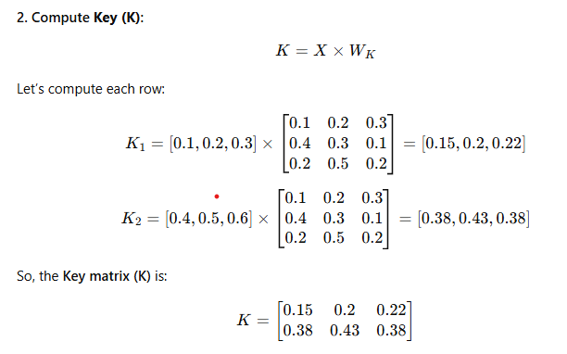

Slide 27
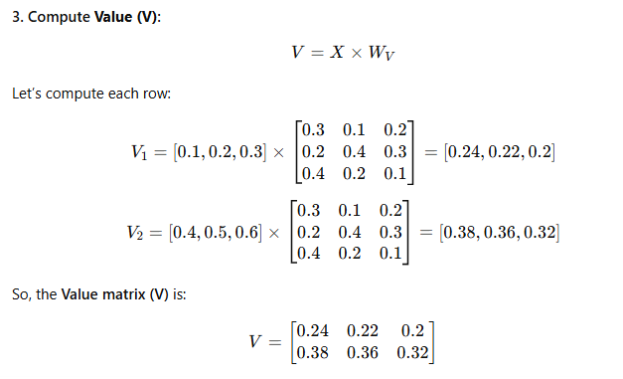

Slide 28
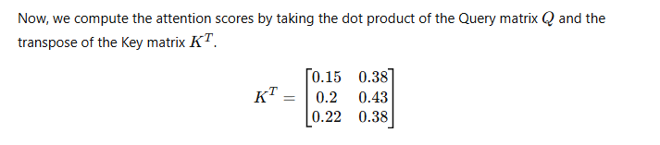
Step 3: Compute Attention Scores

Slide 29
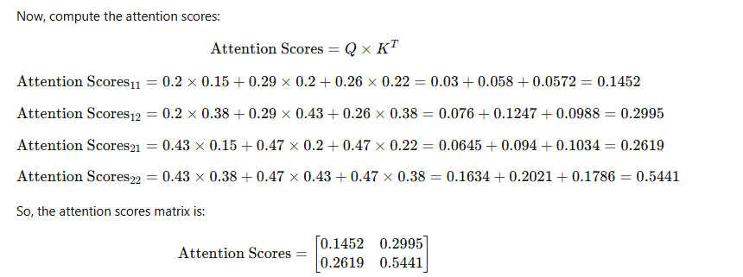
Step 3: Compute Attention Scores

Slide 30
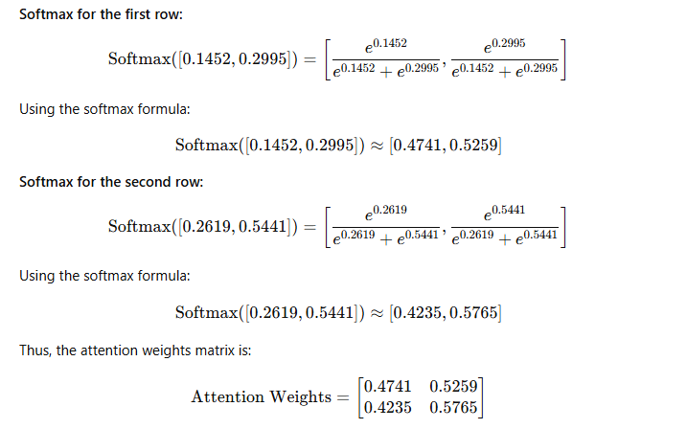
Step 4: Apply SoftMax to Get Attention Weights

Slide 31
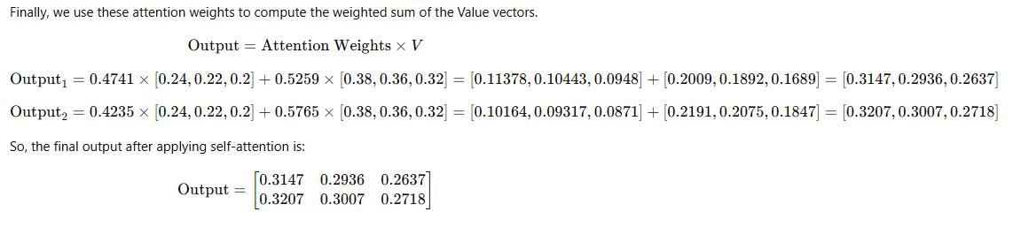
Step 5: Compute Weighted Sum of Values

Slide 32

The Beast With Many Heads
Multihead Attention
Imagine you have several pairs of glasses (attention heads) that let you look at a sentence in different ways.
Each pair of glasses helps you focus on different parts of the sentence, so you understand it better.
Multi-headed attention means the model uses several of these "glasses" to get a more complete understanding of the sentence!

Slide 33
Representation Subspaces
Now, when you use those multiple pairs of glasses (or attention heads), you're looking at the sentence through different lenses. Each lens gives you a different "view" of the words. So, each attention head will help the model understand the sentence from a different "subspace" or perspective.
So, when we talk about representation subspaces, think of it like the different ways or dimensions in which the model tries to understand the sentence. Each attention head works in one of these subspaces, which gives the model more ways to focus on different parts of the sentence.

Slide 34
Positional Encoding
Transformers don't process words in order like older models. So, they add positional encoding to each word, which tells the model the order of the words. This helps the model understand that "I" comes before "love" in the sentence.

Slide 35
Add and Norm
Residual connections (Add) are added between the input and output of each sub-layer (like attention and feed-forward layers).
Residual connection-----When you're walking through a maze (the neural network layers), instead of only following the path in front of you (just the output of the current layer),
you can also go back a few steps to where you started (the input). This helps you not lose any important information and makes it easier to find your way out (i.e., to make better predictions).

Slide 36
Norm
Layer normalization is applied after adding the residual connection. It normalizes the output of each sub-layer so that the values across each layer have a mean of 0 and a variance of 1.

Slide 37
SoftMax
Red (0.1)
Green (0.6)
Blue (0.3)

Slide 38
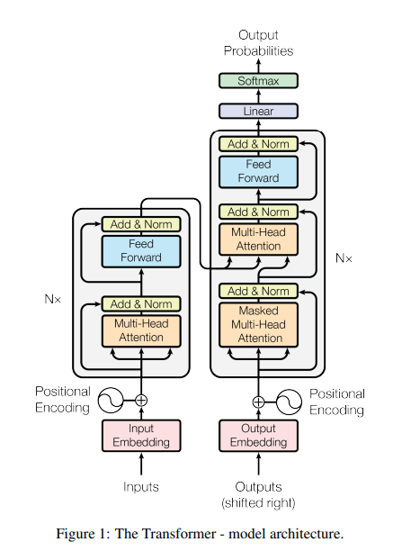

Slide 39
Encoder (Bert)
Language Translation
Sentiment Analysis
Named Entity recognition
Question Answering

Slide 40
References
https://chatgpt.com/share/67a1d1ab-00b4-8008-847f-beba9019be7a

