Slide 1
The Data Stewardship Wizard
Advancements for 2018

Slide 2
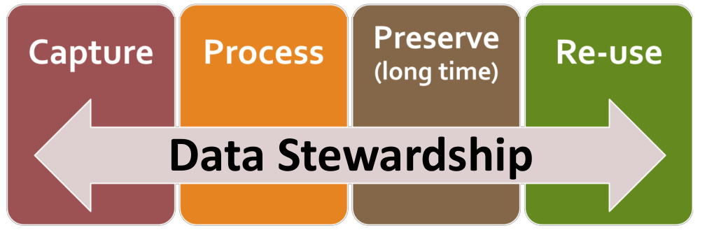
Towards Data Stewardship in ELIXIR: Training and Portal ELIXIR Implementation study
Data Stewardship: Responsible planning and executing of all actions on digital data before, during and after a research project, with the aim of optimizing the usability, reusability and reproducibility of the resulting data
Challenges:
For researchers: Crucial for research but not everyday practice (yet) and very demanding
For Data Stewards: In high demand, Upskilling needed, Skills profile currently being defined
Aim of Implementation Study:
Bundle and effectively expose existing expertise on DM/DS in ELIXIR
Formulate, build and implement first solutions for good DM/DS in ELIXIR

Slide 3
Towards Data Stewardship in ELIXIR: Training and Portal
Task 1: ELIXIR Data Management and Data Stewardship (DM/DS) Training Needs and Activities
Inventory of the ELIXIR DM/DS training landscape
Scoping, training needs and gap analysis
Development of ELIXIR DM/DS training
Run ELIXIR DM/DS courses
Task 2: A Data Stewardship Portal
Deploying an ELIXIR Data Stewardship Wizard (done)
Filling in the Data Stewardship Wizard Knowledge Model (KM) + implement FAIR metrics evaluation + interoperate with TeSS and FAIRsharing
Training Workshops for Service Providers
Increase Usability: Editor (done), DMP Reports (WIP), Containers
Nodes involved: NL, CZ, LUX, SI (and others with 0 PMs) -------->
In close connection with ELIXIR DMP Working Group
Duration: Jan 2018 + 18 month
ELIXIR-NL | Celia van Gelder, Rob Hooft
ELIXIR-CZ | Robert Pergl, Marek Suchánek, Jiri Vondrasek
ELIXIR-LUX | Wei GU, Roland Krause
ELIXIR-CH | Heinz Stockinger, Patricia Palagi
ELIXIR-SI | Brane Leskošek
ELIXIR-UK | Teresa Attwood, Gabriella Rustici
ELIXIR-EE | Hedi Peterson
ELIXIR-PT | Pedro Fernandes
ELIXIR-FR | Victoria Dominguez
ELIXIR-NO | Ståle Nygård
ELIXIR-EBI | Sarah Morgan
ELIXIR-SE | Niclas Jareborg
ELIXIR-BE | Frederik Coppens, Alexander Botzki

Slide 4
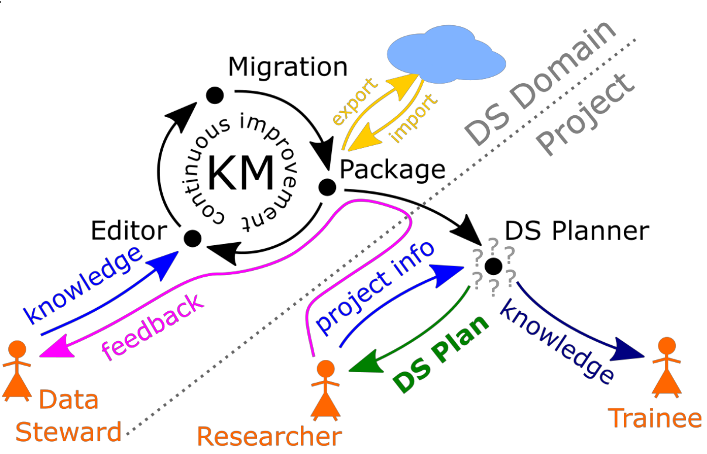
The Data Stewardship Wizard Philosophy:
FAIR KM
FAIR and machine-operable DMPs
not completely there yet, but foundations laid

Slide 5
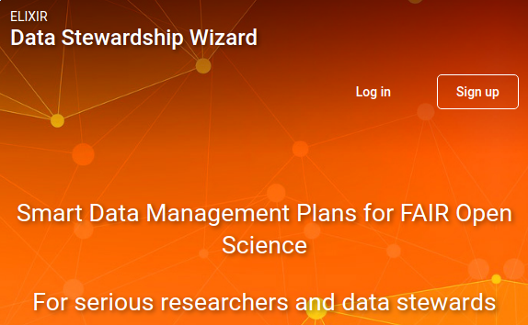
How? Get involved!
https://dsw.fairdata.solutions
Sign up in the DSW and play around
ECCB 2018 Athens Sep 11, 2018
workshop: hands-on/live demo
NETTAB 2018 Oct 22, 2018
"A FAIR approach to Research Data Stewardship and Data Stewardship Planning" by Rob Hooft
workshop/hackaton on DSW contents
2 specialised workshops (to be announced):
Training workshop for power users and contributors
Training workshop for service providers
hands-on for those who want to deploy their local instance of Wizard
Track the progress:
https://github.com/orgs/DataStewardshipWizard
https://github.com/orgs/DataStewardshipWizard/projects

Slide 6
Thank you!
https://dws.fairdata.solutions
Contacts:
Robert Pergl <perglr@fit.cvut.cz>
Rob Hooft <rob.hooft@dtls.nl>
Marek Suchánek <suchama4@fit.cvut.cz>
Celia van Gelder <celia.van.gelder@dtls.nl>

