Slide 1


Theory of Change Validation Conference & Workshop
Understanding Phase 3

Slide 2
What is CLA?
Collaborating, Learning, Adapting
But what does this mean?
Share your data
Look at your data
It’s ok to be wrong
BI

Slide 3
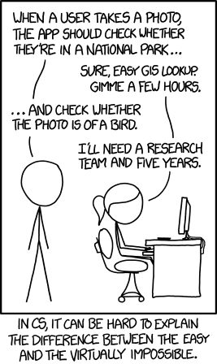
How to match BI with ToC Validation
Technical challenge
Data MGMT a skill
Answers don’t just find themselves!

Slide 4
Matching requests to requirements
If we want answers from our data, what do we need to do?
Customer Requirements vs Engineering Metrics Matrix:

Slide 5
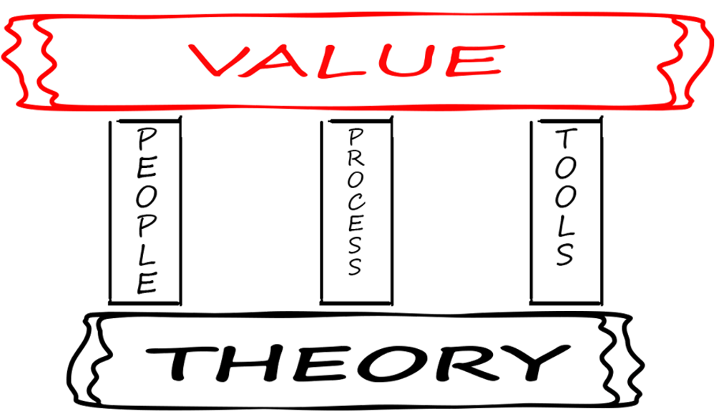
So what do we M&E people need?

Slide 6
Minimum Requirements
All about time!
Paper & Pencil, people

Slide 7
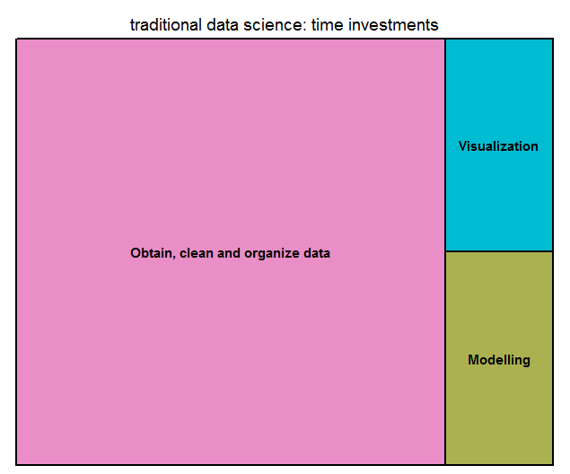
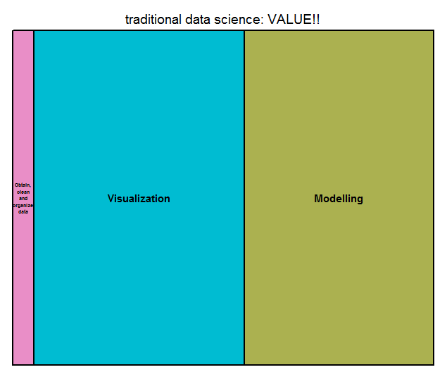
Data Science – Time allocation

Slide 8
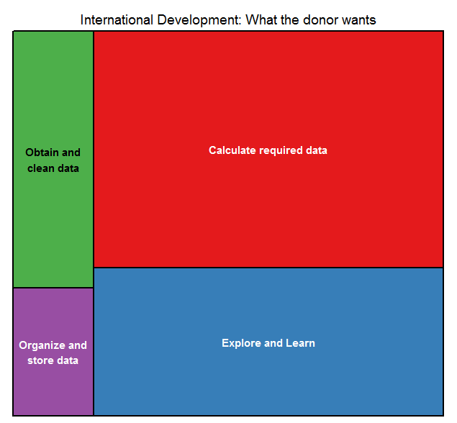
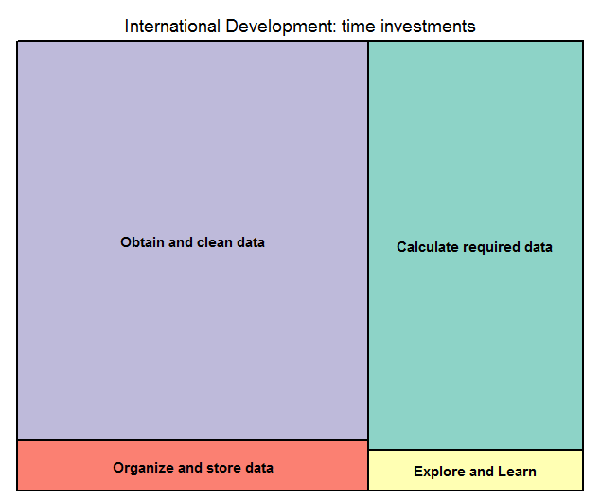
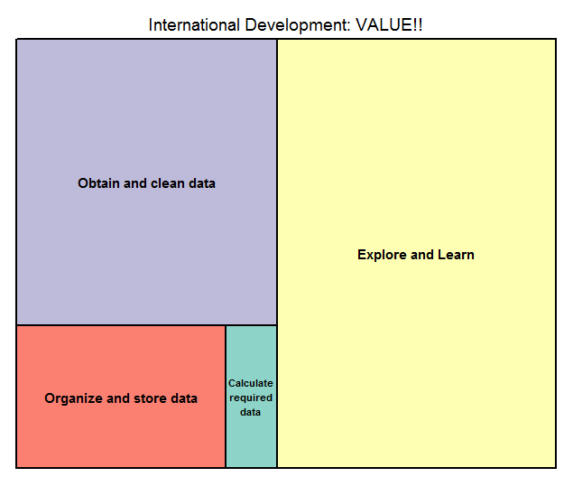
International Development – Time allocation

Slide 9
Summarizing Problems
Data quality is really hard and important and time-consuming
  … but is invisible
Calculating indicators doesn’t necessarily lead to CLA
  … but it’s what we will be evaluated on
We don’t have time to do the fun analysis
  … but we are expected to, also it is MOST important

Slide 10
But not all is lost!
What we need is a change of how we invest our time:

Slide 11
How do we get there?
Not Reports!
  Data silo
  Not interesting
  Not timely
… we need something interactive
DASHBOARDS!

Slide 12
INFORMATION (DATA) IS LIKE A SYPHON…
HARD TO GET GOING
BUT SELF-SUSTAINING

Slide 13
Now some homework…

Slide 14
Raw Data vs Aggregated data
Raw data contains all the information about the beneficiaries and the activities they did, or their statuses
  Adequate for detailed analysis (SLOW, DIFFICULT, EXPENSIVE)
Aggregate data contains summaries
  Adequate for reports (FAST, EASY, CHEAP)
BUT YOU CAN NEVER DISAGGREGATE DATA YOU DON’T HAVE

Slide 15
WITH NO RAW DATA MANAGEMENT SYSTEM ☹
I theorize that
A ➔ B. Let me check
Indicators
PIRS
PMELP
ToC
Etc…
Oh well, at least I respected my PMELP
FAIL
WITH A WELL FUNCTIONING RAW DATA MANAGEMENT SYSTEM ☺
FRESH
LOOK
I theorize that
A ➔ B. Let me check
Huh… that’s interesting. I wonder if…
Indicators
PIRS
PMELP
ToC
Etc…
FAIL
THE ACTUAL DATA
ANALYSIS
data is not a reporting obligation, it’s an opportunity
WINS +
LEARNING!!

Slide 16
Relational structure
Database != Excel
Prevents double-counting
Improves data quality through validations
  … but doesn’t work if data is gathered outside system
Combines information automatically !!$$!!
No problems to scale

Slide 17
Lastly, we need the stuctures…
You can’t analyze data you don’t have
Startup process must include:
  Data structures to collect indicators
  Data structures to capture Theory of Change / Learning Questions
If we want actionable information on Theory of Change Validation, we need to collect data for it, and have the protocol established.

Slide 18
OK,
NOW
THE
FUN
PART
BEGINS!

Slide 19
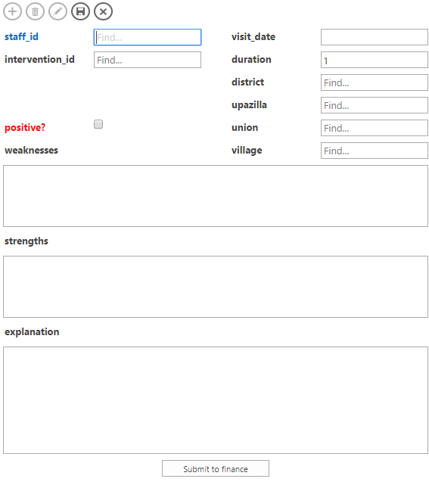
How to gather data frequently…
Force employees to give their impressions (both quant & qual) after every field visit.
Gather info while it’s fresh!
Ensure a constant data stream

Slide 20
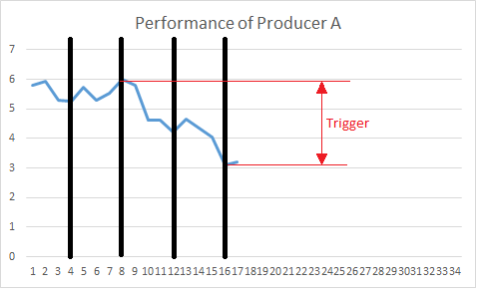
Actionable data points
Gather quantitative information from every producer
Pre-establish conditions that require attention, and link these to an action – Like emailing senior management
Run constant checks against the data, confident that actions will be taken when appropriate.

Slide 21
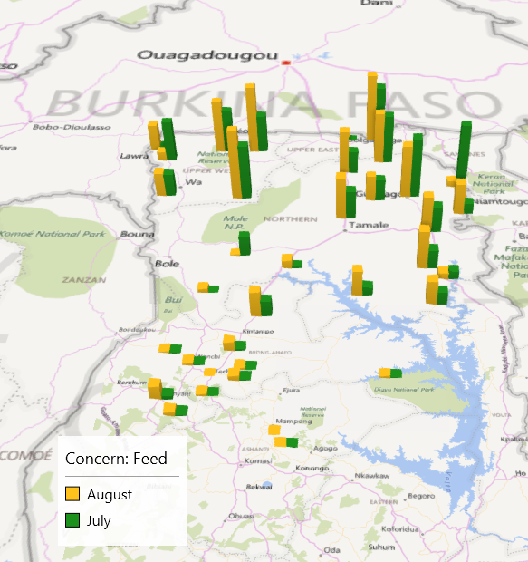
How to do adaptive management
Analyze information regionally and address regionally relevant interventions
In this way, we don’t follow our plan, we respond to the field

Slide 22
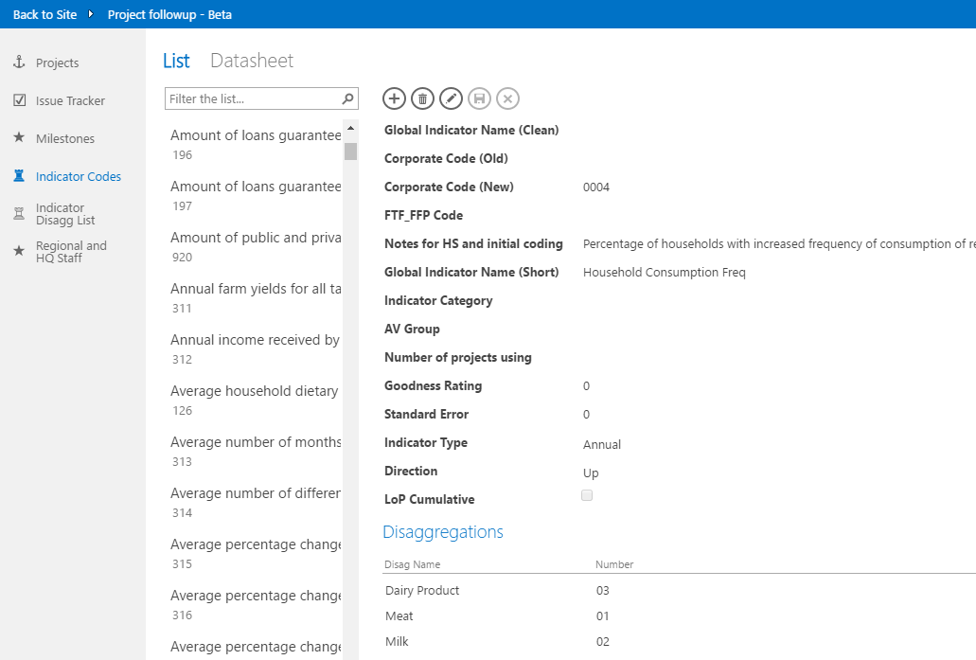
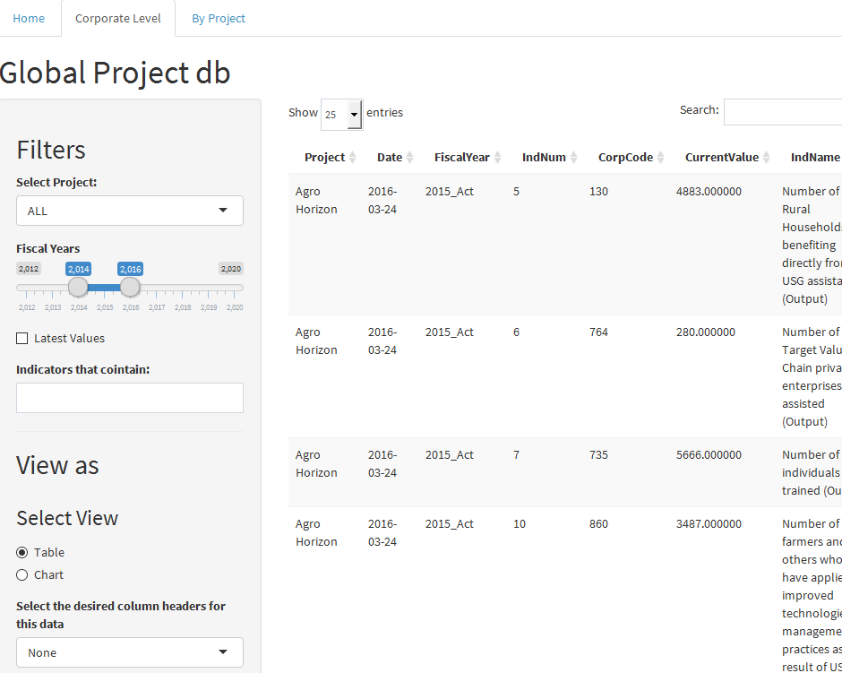

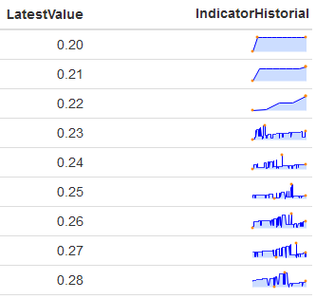
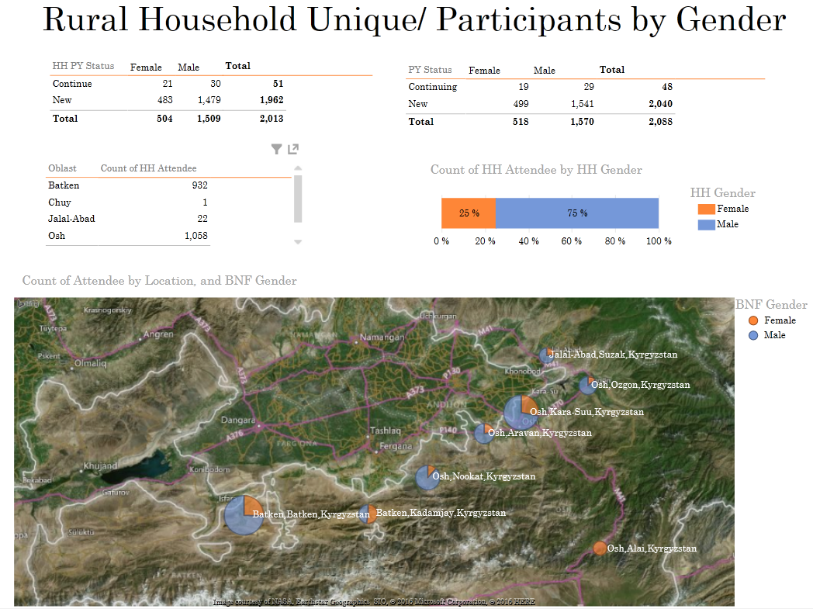
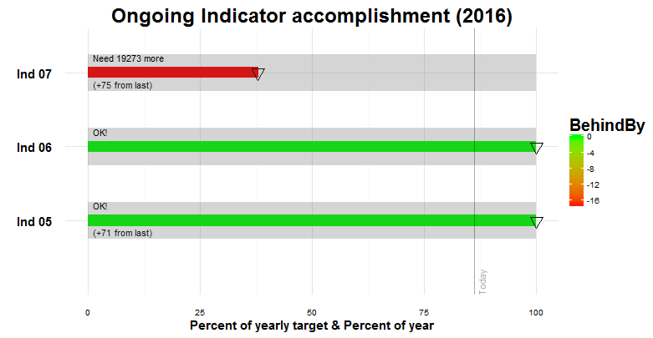
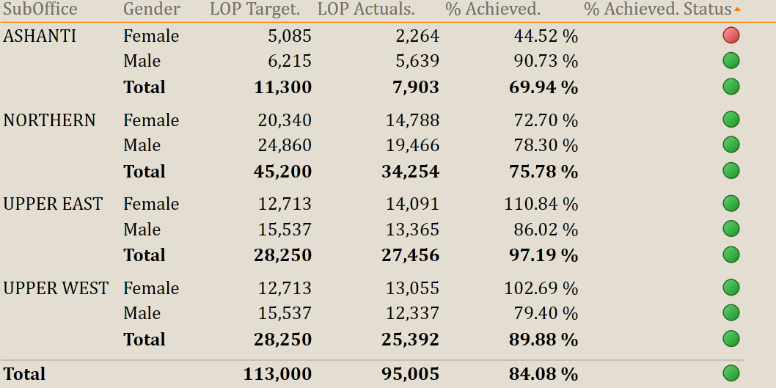
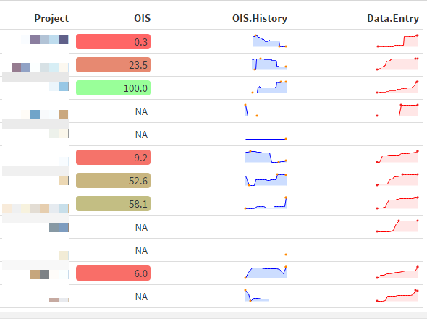
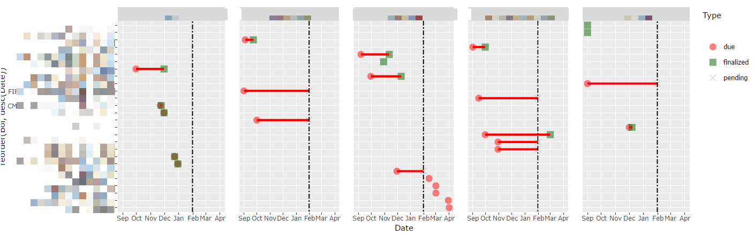
FULL
DETAILS
FAST &
EASY
RESPONSIBLE: PROJECT STAFF
checks
RESPONSIBLE: REGIONAL STAFF

Slide 23
Learning, Evaluation & Analysis Platform (LEAP)
FACILITATES PROJECT MANAGEMENT
  Standardized project management checks, facilitates adaptive management
AUTOMATES REPORTING REQUIREMENTS
  Automatically generated IPTT
EXPOSES DIGESTED DATA
  Adaptive management / data-driven leadership
EXPOSES RAW DATA
  Corporate and cross-Project analysis & project cross-pollination
PROVIDES STANDARDIZED ASSET MANAGEMENT
  Facilitates support, ensures audit compliance, insures against
  staff turnover

Slide 24
Summary
Data management plan for Indicators & ToC including hypotheses
Develop a raw data relational structure
Develop human potential on data entry AND data analysis
Test hypotheses with concrete data continuously
React to the Short term, modify workplan for the longterm

Slide 25
Image sources
https://xkcd.com/1425
https://itsalocke.com/sqlsaturday-portugal/

Slide 26
www.acdivoca.org
Since 1963 and in 146 countries, ACDI/VOCA has empowered people to succeed in the global economy.

