Slide 1

Data Cleaning Session

Slide 2
Anna Karenina principle
Happy families are all alike;
every unhappy family is unhappy in its own way.
- Leo Tolstoy

Slide 3
Queries
Query 1 – Spot-check Tacker
Query 2 – Spot-check Value
Query 3 – Same-Same finder
Notes:
Add a picture! ;)

Slide 4
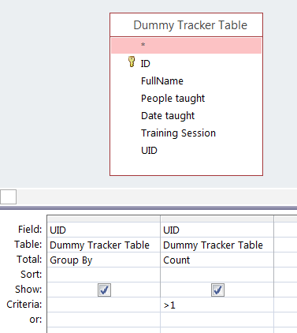
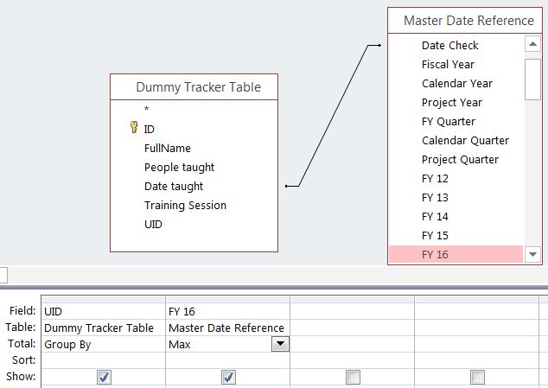
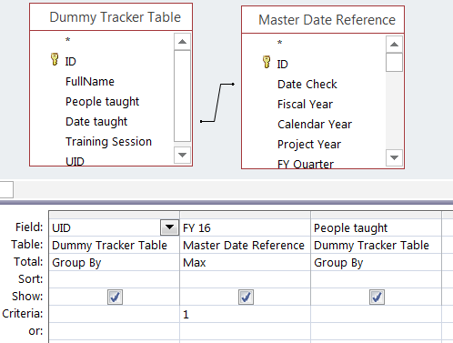
Query 1
Query 2
Query 3

Slide 5
Connect UID-less data to Ben Reg
Create ad hoc semi-UIDs
Ex. If FullName/Phone/Village -> FN|Ph|V; FN|Ph;FN|V
For each sUID make Same-same query connecting BAD table to GOOD table (start from strictest!
Identify matches and bring BenID into BAD
ONLY IF MATCH = 1
If match >1, Actually contact beneficiaries
Notes:
Add a picture! ;)

Slide 6
When duplicate beneficiaries in BenReg
Ensure actually duplicates!
DON’T DELETE!
Consolidate Trackers into one record in Ben Reg manually
Finally delete duplicate
Notes:
Add a picture! ;)

Slide 7
Spot Checks
10% Rule
Data Truths
Informal audits!
Notes:
Add a picture! ;)

Slide 8
Thanks!

