Slide 1


Theory of Change Validation Conference & Workshop
Data Collection Tools

Slide 2
Summary
Technology:
  Smart Cards
  Biometric
  3rd party mobile apps
  Custom apps
  Online data entry
Other considerations
Exercise
Data collection summary

Slide 3
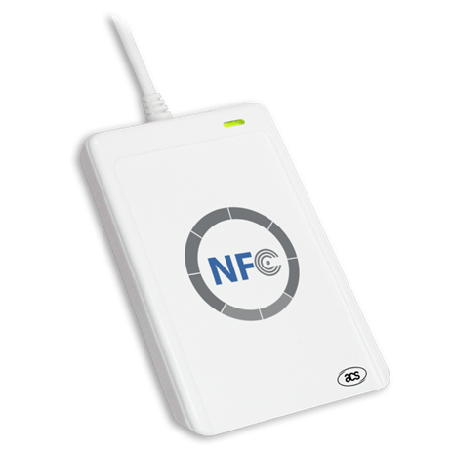
Advantages
Timeliness: Data available immediately for decision-making and adaptive management
Implementation: managers have access to real-time data for decisions; field staff spend less time on paperwork and more time on technical aspects
Beneficiary pride: Beneficiaries see their cards as sense of belonging to a large cause
Accountability: Ensure certain beneficiaries are reached

Slide 4
Why introduce Smart Cards?
Challenge: Field staff spend lots of time collecting data on paper, then entering into the database
Solution: Eliminate paper, provide beneficiaries with smart cards to capture data electronically directly at field level

Slide 5
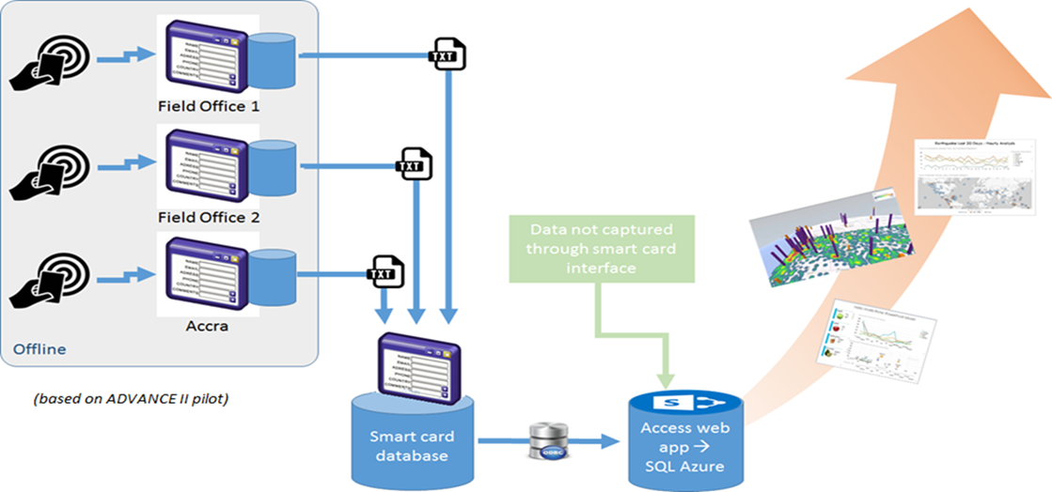
How Beneficiary Smart Cards Work
1. Each beneficiary provided a card
2. Field staff carry card scanners to record participation
3. Data from field machines validated every Tuesday
4. Validated data pushed to LEAP DB every Thursday
5. Managers access data quickly to visualize and monitor progress

Slide 6
If interested, consider the following
Relevance: focus on data-capture requirements that are high-volume and high-frequency
Staffing: more complex than running a standard Database; a higher-qualified MIS Manager is needed
Development: a hardware-software integration consultant is needed; plan for RFP, selection and procurement
Budget: bigger up-front investment for development and equipment, but costs may be offset by higher future efficiency

Slide 7
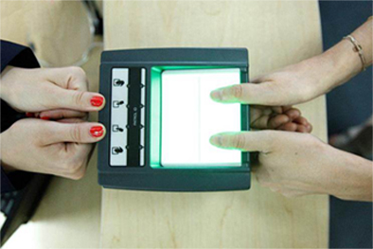
Biometric
Similar to Smart Cards…
PROS:
  No cost for cards!
  No chance of losing card
  100% traceability at individuals level
CONS:
  Fingerprints sensitive in some cultures

Slide 8




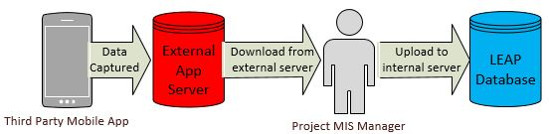
Third-party mobile software
DEMO

Slide 9
Mobile data solution considerations
Sync db → Phone
Gather Info
Push to db
Validate?
 |  | Location
 |  | Main Office | Field
Frequency | Periodic | Category 1 – normal db | Category 2 - 3rd party mobile app
 | Daily | Category 3 - normal db | Category 4 - Custom app or program

Slide 10
Remote Daily Electronic Data Collection (RDEDC)
Effective RDEDC Example | Ineffective RDEDC Example
Project has 100,000 beneficiaries from 77,000 households and each individual will attend an average of 4 activities (RDEDC use for registration and attendance tracking) Project will distribute food rations to 50,000 households on a monthly basis; each distribution point needs to be able to register individuals; confirm identity/distribution; and capture medical check-up information | Project needs to capture sales data from 15 firms, each of whom will report once per quarter (i.e. 60 rows of data/year) Project works with 100 communities on developing action plans, completion of each needs to be recorded (i.e., 100 rows of data for life of project)

Slide 11

For routine collection:
Need custom-built interface!
ACDI/VOCA currently has 6 pilots
2 using smart cards
4 using mobile data collection
Free Mobile apps offer:
1000-2000 rows of data
Max 2 relational tables (or none at all)
No ODBC connection
Good for:
Annual surveys
  <1000 rows of data
  1 table
  one-time collection
Bad for:
Routine collection
  300,000 rows of data
  6+ tables
  Routine collection – Needs an ODBC connection
ALWAYS START
FROM THE
UNIQUE ID

Slide 12
Online data entry
Example showing:
  Validation & Duplicate detection
  Interconnectedness
  Data entry simplicity

Slide 13
Names: English or Local language?
Should names and other local content be entered in English or in Local language?
Consider that anglicizing names isn’t perfect…
UNIQUE ID?

Slide 14
Discussion Session
In your table, discuss your data input strategy within the context of technology.
Generate 2 lessons learned as a group.
Any opportunities for improvement?

Slide 15
Best Practices (draft)
Finalize form design in Word (including validations). Get approvals
Hire contractor. Pay 30%
Finalize form design in tablet. Get approvals
Train contractor/enumerators/staff
Pilot enumerator’s understanding on project staff
Prepopulate survey with Beneficiary names and Beneficiary IDs from db
Pilot survey on 10 beneficiaries
Construct analysis pipeline and verify that survey answers ind. questions
Conduct survey
Address laggard questions
Pay contractor 70%
Write “Lessons Learnt” document -> Upload to corporate M&E folder
BL vs Ann S
Time
Cost

Slide 16
www.acdivoca.org
Since 1963 and in 146 countries, ACDI/VOCA has empowered people to succeed in the global economy.

