Slide 1
Distributed SmartML
Knowledgebase

Slide 2
Knowledge Base Creation
73 Datasets
For each dataset we have 9 records, record per classifier.
We have labeled each record as Good or Bad based (after testing the algorithm against the dataset and measure its metrics.
Features
Label
Dataset Statistics and characteristics | Classifier | Good/Bad

Slide 3
Determine Good or Bad Algorithm
9 Algorithms Accuracy:
33%
39%
45%
50%
59%
60%
81%
85%
91%
10 | 20 | 30 | 40 | 50 | 60 | 70 | 80 | 90 | 100
1 Std. Dev
20.93%
Average
Best Accuracy
60.33%
Y1: the Algorithm with the best Accuracy and all Algorithms within 1 Standard Deviation rang will be marked as Good, other than that will be marked as bad
Y2: the top 3 Algorithm with the highest Accuracy will be marked as Good, other than that will be marked as bad
Y3: Mix between Y1 & Y2 ( maximum three algorithms within one Std. Dev from the highest Accuracy)

Slide 4
Select Best Algorithm to Predict Dataset Good Classifiers
I have tried 9 algorithms against our Knowledge base
I have divided the KB as 80% training & 20% Testing
I have measured (Accuracy, Precision, Recall & F-Score)
I have repeated the process for each label Y1, Y2 & Y3

Slide 5
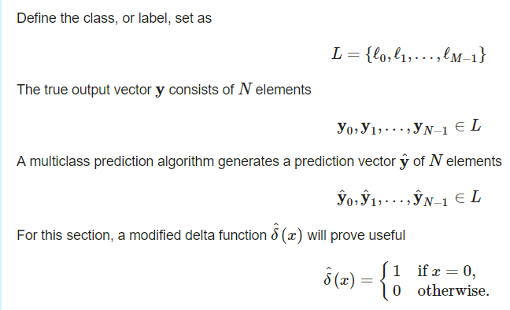
Best Algorithm Metrics (1)

Slide 6
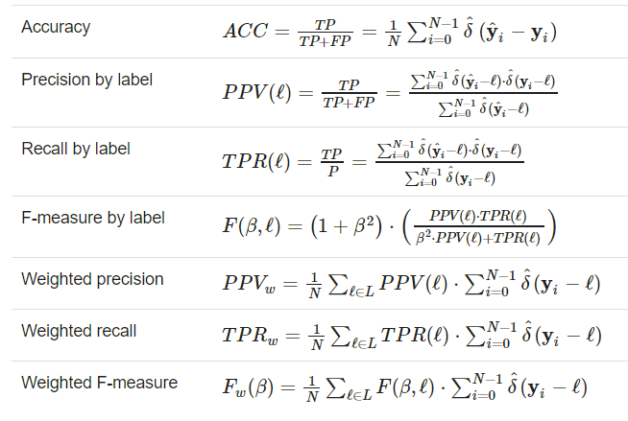
Best Algorithm Metrics (2)

Slide 7
Best Algorithm to Predict Dataset Good Classifiers Result (Using Spark ML)
Best Algorithm (Y1)
Best Algorithm Accuracy | RandomForestClassifier | Accuracy = 0.7716535433070866
Best Algorithm Precision | RandomForestClassifier | Precision = 0.773168795077086
Best Algorithm Recall | RandomForestClassifier | Recall = 0.7716535433070866
Best Algorithm F-Score | RandomForestClassifier | F-Score = 0.7723614446735694
Random Forest
Best Algorithm (Y2)
Best Algorithm Accuracy | DecisionTreeClassifier | Accuracy = 0.7241379310344828
Best Algorithm Precision | DecisionTreeClassifier | Precision = 0.7215176606225763
Best Algorithm Recall | DecisionTreeClassifier | Recall = 0.7241379310344827
Best Algorithm F-Score | DecisionTreeClassifier | F-Score = 0.7226863372437494
Decision Tree
Best Algorithm (Y3)
Best Algorithm Accuracy | DecisionTreeClassifier | Accuracy = 0.762589928057554
Best Algorithm Precision | DecisionTreeClassifier | Precision = 0.7526872619551419
Best Algorithm Recall | DecisionTreeClassifier | Recall = 0.762589928057554
Best Algorithm F-Score | DecisionTreeClassifier | F-Score = 0.7540304643278981
Decision Tree

Slide 8
Best Algorithm to Predict Dataset Good Classifiers Result (Using AutoSKLearn)
Best Algorithm (Y1)
Best Algorithm Accuracy | Extra Trees | Accuracy = 0.7835820895522388
Best Algorithm Precision | Extra Trees | Precision = 0.8513513513513513
Best Algorithm Recall | Extra Trees | Recall = 0.7777777777777778
Best Algorithm F-Score | Extra Trees | F-Score = 0.8129032258064517
Extra Trees
Best Algorithm (Y2)
Best Algorithm Accuracy | DecisionTreeClassifier | Accuracy = 0.7681159420289855
Best Algorithm Precision | DecisionTreeClassifier | Precision = 0.5510204081632653
Best Algorithm Recall | DecisionTreeClassifier | Recall = 0.7297297297297297
Best Algorithm F-Score | DecisionTreeClassifier | F-Score = 0.6279069767441859
Extra Trees
Best Algorithm (Y3)
Best Algorithm Accuracy | DecisionTreeClassifier | Accuracy = 0.8409090909090909
Best Algorithm Precision | DecisionTreeClassifier | Precision = 0.6923076923076923
Best Algorithm Recall | DecisionTreeClassifier | Recall = 0.75
Best Algorithm F-Score | DecisionTreeClassifier | F-Score = 0.7199999999999999
AdaBoost

