Slide 1

DEVELOPING GO
An introduction to setting up and using a development environment for the Go continuous delivery platform

Slide 2
JOB OF GO

Slide 3




Flow
Pipeline 1
Pipeline 1
Pipeline 2
Pipeline 2
MDU
SCHEDULER
WORK ASSIGNER
Notes:
There are many flows of data within the system. Let’s consider one of the main flows:
Setup: There is a repository. There is an instance of Go running which has a pipeline configured to watch the repository. Pipeline has 2 stage. First stage has 2 jobs while Second stage has 1. There is 1 agent available.
(TRANSITION) A person commits to the repository.
(TRANSITION) The pipeline will be triggered i.e. First stage of the pipeline is in “Yellow” / “scheduled” state. Which means, all jobs of that stage (2) will be in “scheduled” state.
(TRANSITION) Go tries to find agents (which are idle) and assigns a job to an agent (if resource & environment criteria match). Eventually all jobs will go through “scheduled” - “assigned” - “building” - “completing” - “completed” / “failed” states.
(TRANSITION) After a while, the stage of pipeline will either pass or fail, that is, go green or red based on state of jobs in the stage. If the First stage goes green then the Second stage will be “scheduled” and the cycle continues.
Lets zoom into every stage individually.

Slide 4
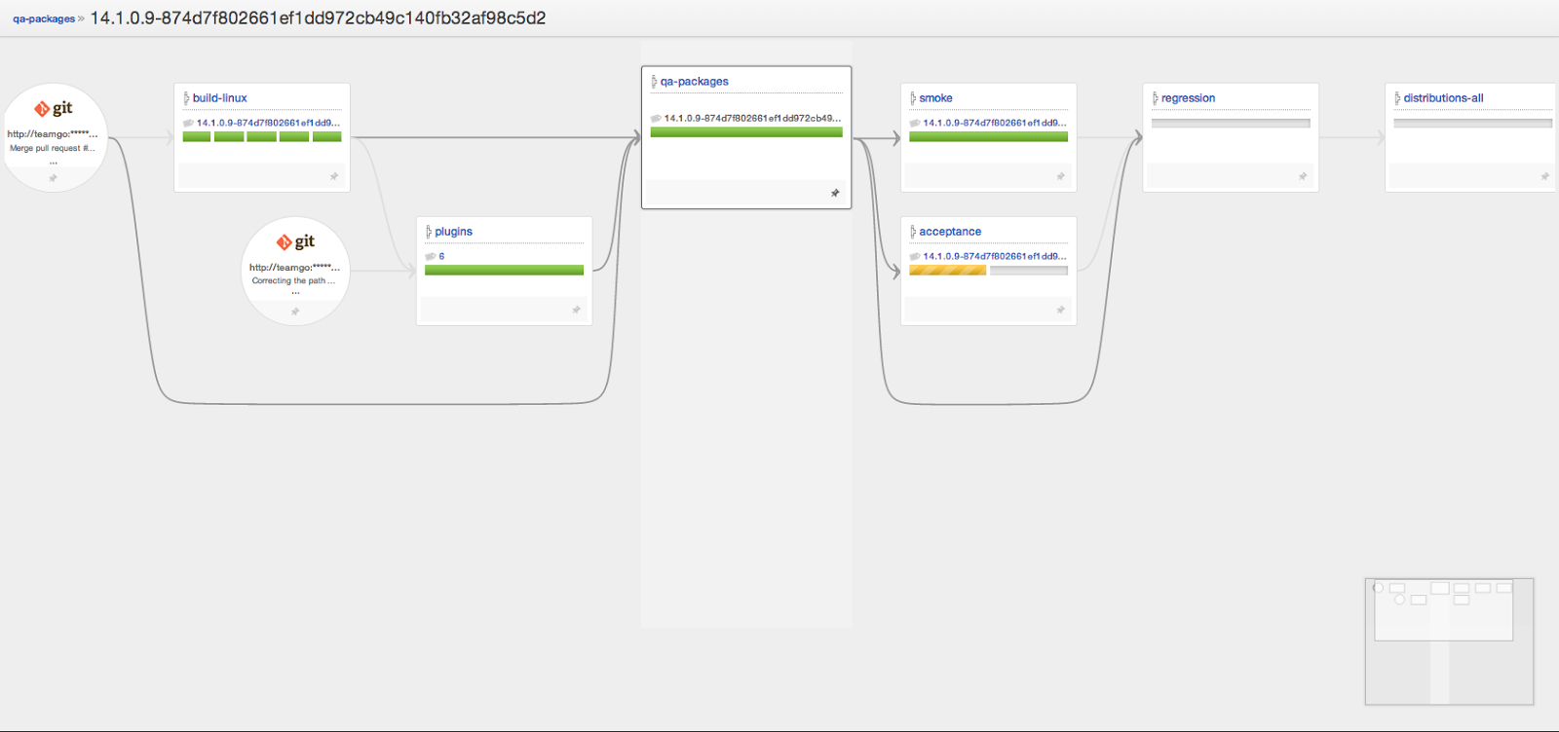
Value Stream Map
Notes:
Even though pipelines look like they’re unrelated to each other, the true power of Go becomes apparent when you chain pipelines together and use multiple different materials (typically, source code from different or the same repositories). Here, you can see a part of the set of Go pipelines used to build Go itself.
As you can see, a change made in a commit flows through different pipelines, each of which has multiple serial stages, each of which has multiple parallel jobs, each of which has mutliple tasks. There lies the power of Go, complex modeling and traceability. You can trace a commit all the way to production.
Here, we build code, run some tests, then build some plugins, package everything (build installers) and run acceptance and regression tests on the installers.

Slide 5
ARCHITECTURE

Slide 6
SUBSYSTEMS

Slide 7

Queues
Material Poller:
Materials to poll Pick and poll for changes
Build Creator:
Auto-schedule Pipelines Pick and check if it can be scheduled
Pipeline Scheduler:
Pipelines to schedule Pick and check if it can be scheduled
Work Assigner:
Scheduled Jobs Pick jobs and assign them to agents

Slide 8

Polls for a new commit
MODULE 1
MDU
Polls for a new commit
WEBAPP
Material Database Updater
DATABASE
(Insert modifications)
Polls for a new commit
DEP SCRIPTS
Notes:
Let’s start with the MDU (Material Database Updater). Bad name. Has history.
(TRANSITION). It runs off of a timer. (TRANSITION) Assuming you have some repositories (I’ll call them “Materials” from now on) setup, Go looks at the config and periodically, polls them
(3 TRANSITIONS). As a bit of an implementation detail, they’re not polled individually but in batches (usually of 10 materials at a time). If there is no new commit since the last time it was polled, nothing happens.
(TRANSITION) If there are new commits however, details about these new commits are put into the database. These details are called “Modifications”.
At the level that we want to go into this today, that’s the main job of the MDU sub-system: to see new commits, and put modification details into the database.
For a new repo - “Latest” modification after that - Modification “since x”

Slide 9
SCM Poller - Core
public interface SCMMaterial {
public String getFingerprint();
public Modification latestModification();
public List<Modification> modificationsSince(Revision revision);
public ValidationBean checkConnection();
public void updateTo(Revision revision);
}

Slide 10
Package Repository Poller - Plugin
public interface PackageMaterialConfiguration {
RepositoryConfiguration getRepositoryConfiguration();
PackageConfiguration getPackageConfiguration();
}
--
public interface PackageMaterialPoller {
PackageRevision getLatestRevision(PackageConfiguration packageConfiguration, RepositoryConfiguration repositoryConfiguration);
PackageRevision latestModificationSince(PackageConfiguration packageConfiguration, RepositoryConfiguration repositoryConfiguration, PackageRevision packageRevision);
Result checkConnectionToRepository(RepositoryConfiguration repositoryConfiguration);
Result checkConnectionToPackage(PackageConfiguration packageConfiguration, RepositoryConfiguration repositoryConfiguration);
}

Slide 11
SCHEDULER
MODIFICATIONS FROM MDU
Pipeline1
Pipeline1
Pipeline 2
Pipeline2
DATABASE
JOBS FOR THE STAGE
Notes:
Next up is the “Scheduler”. The database used by the MDU sub-system is used by the scheduler as well. Along with that, the scheduler looks at the current configuration of the pipelines and materials.
(TRANSITION) The scheduler’s job is to look at the modifications found by the MDU and the configuration (TRANSITION) and figure out which pipelines need to be triggered. Suppose these (orange Git icons) are materials 1, 2 and 3. If a commit to material 1 is found, Go needs to run “Pipeline 1” with that modification. If a commit to material 3 is found, Go needs to run “Pipeline 2” with that modification. If a commit to material 2, the one in the middle, is found, then Go needs to run both pipelines “Pipeline 1” and “Pipeline 2”. Once it figures out what pipelines need to be triggered and with what modifications
(TRANSITION) it creates the jobs for the first stage of those pipelines. These jobs are put into the database.
(TRANSITION) The pipelines are now said to be “Scheduled” and they become yellow on the dashboard.

Slide 12



WORK ASSIGNMENT
Work Assigner
Jobs from scheduler
Notes:
As in the previous sub-systems, the work assignment sub-system uses the jobs that the scheduler put into the database. Consider a few agents which are associated with this Go server.
(TRANSITION) The agents constantly ping the Go server, asking it whether there is any “work” they need to do.
(TRANSITION) When they get that from the agents, the work assigner goes to the database and sees if there are any jobs that are scheduled. (TRANSITION) It takes those jobs, sees if the environment and resources allow the job to be handed over to the agent which asked for work
(TRANSITION) if they are compatible assigns the job to the agent. (TRANSITION).
Sometimes, the answer might be “NO WORK”, in which case the agent stays idle and then, pings again for work a few seconds later.

Slide 13
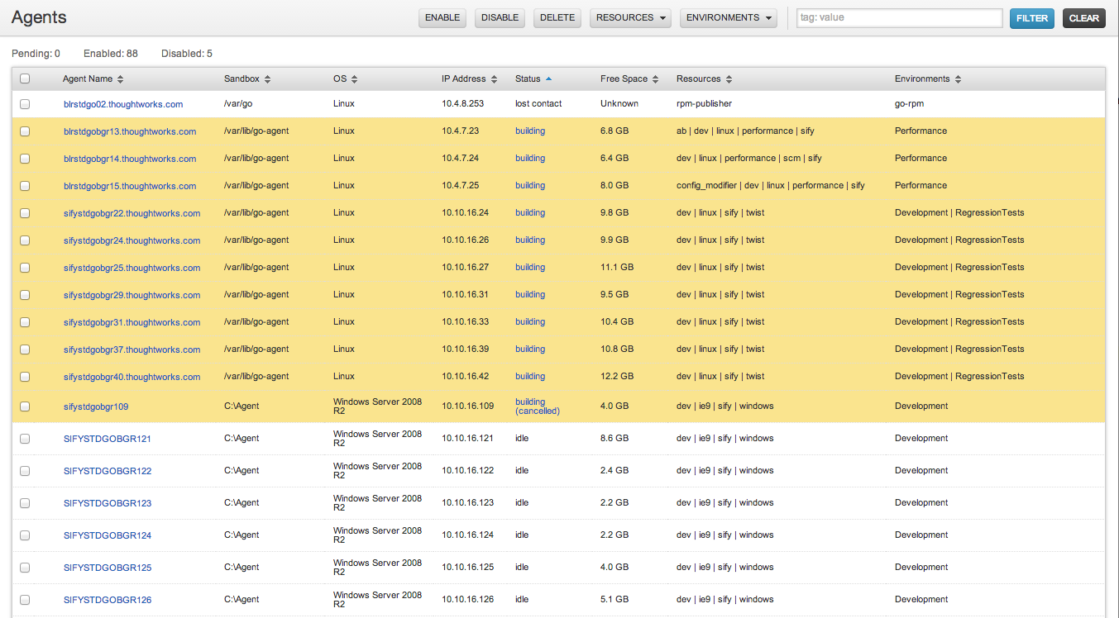
AGENTS, RESOURCES AND ENVIRONMENTS
Notes:
I’d mentioned “agents” earlier. Essentially, they are the workers of the whole system. This is where all the tasks mentioned earlier run. The agents can be put into different environments (TRANSITION). You can have some agents which are used only for deployment, some which are available on your development environments, etc. Also, the agents can be tagged with different “resources” (TRANSITION) and only jobs which correspond to those resources can run of the agents.

Slide 14



CONFIGURATION MANAGEMENT
Edit config xml
or
Use Admin GUI
Serialize/Deserialize
Notes:
1. This is the first system user interacts with Go.
2. Allows users to configure pipeline/material/stage/job etc.
3. Configuration saved as xml.
4. Can view/edit configuration through Admin GUI or raw Config xml.
5. Uses git to maintain config revisions. Every change is checked-in to git repo.
6. Handle concurrent modification {uses git merge}.

Slide 15
AGENTS
Agent has 3 components:
Bootstrapper
Launcher
Agent
Agent Bootstrapper:
The bootstrapper is the only component of a Go agent that requires a manual upgrade.
If at any point the launcher process is killed, the bootstrapper re-launches it as long as the bootstrapper process is still running.
Agent Launcher:
Creates a lockfile. The purpose of the lockfile is to prevent multiple instances of the bootstrapper from being launched.
Downloads new agent-launcher.jar if available & dies.
Downloads new agent.jar from if available & launches it.
Downloads plugins.zip if available.

Slide 16
AGENTS
Agent:
Ping Thread - runs every 5 seconds, to inform the server that the agent is alive. It also informs the server of the agents runtime information.
Loop/Worker Thread - The first time an agent comes up, the loop thread, which runs every 10 seconds, registers it with the server. Once this is done, it checks for agent upgrade and also retrieves work from the server.
Instruction Execution Thread - which runs every 10 seconds to check if the server has issued a job cancel instruction. A separate thread is maintained as a job cancel instruction is an asynchronous action, it might occur at any time and hence, it has to be monitored constantly.
States:
Pending, Idle, Preparing, Building, Lost Contact, Missing, Disabled

Slide 17
Task - Core + Plugin
public interface Task {
TaskConfig config();
TaskExecutor executor();
TaskView view();
ValidationResult validate(TaskConfig taskConfig);
}
--
public interface TaskExecutor {
ExecutionResult execute(TaskConfig taskConfig, TaskExecutionContext taskExecutionContext);
}

Slide 18
PLUGINS
Available Endpoints:
Package Repository Poller
Yum, Debian, Maven (Nexus & Artifactory), Nuget, Puppet Forge, NPM
Task
XUnit Converter
Ideas for next Endpoints:
SCM poller
Project Management Integration
Authentication
Notification
Agent Management
Better Support for tests - reports, analyzer, parallel executor etc.
More Info: http://www.go.cd/community/plugins.html

Slide 19
TECH STACK

Slide 20
TECH STACK
Java
Jetty
Angular.js
Sass
Spring MVC
Spring
H2
JUnit
Maven
jQuery
CSS
JRuby on Rails
Hibernate
Hamcrest
Buildr
d3
iBatis
Mockito
Prototype
Felix
RSec
EhCache
JsUnit
Twist
Gson
XML
Notes:
Presentation Layer : Jquery, Spring MVC, Jruby, D3, Prototype, Angular.js {used for plugin UI}
Plugins : Felix , OSGI, Angular.js
Data access layer: iBatis, Hibernate
Unit Testing : Hamcrest, Mockito, Junit
Functional Testing : Twist
Build : maven and build {packing in buildr, rest in maven }

Slide 21






TECH STACK
Notes:
The flow of data when a web request is made. Browser to Jetty (the web server) - to Spring (Spring Web MVC) - Rails (optional) - to services written in Java.
They can access the configuration and database as needed, to do whatever they need to do.

Slide 22
HANDS-ON WITH
GO CODEBASE

Slide 23
Hands-on Go Codebase
Inside the VM:
Initialize a git repo
$ mkdir /home/vagrant/test-repo
$ cd /home/vagrant/test-repo
$ git init
$ echo test > test
$ git add .
$ git commit -m “first commit”
Start Development Server (DevelopmentServerNewJRuby)
Start Development Agent
Open http://localhost:8153 on your browser

Slide 24
Hands-on Go Codebase
To Do:
Add “modified by” information to “config change” pop-up.

Slide 25
Hands-on Go Codebase
Browsing code:
URL:
http://<server>/go/config_change/between/<revision 1>/and/<revision 2>?ms=<timestamp>
routes.rb:
map.config_change "config_change/between/:later_md5/and/:earlier_md5", :controller => :stages, :action => :config_change, :conditions => {:method => :get}
stages_controller.rb : config_change
@changes = go_config_service.configChangesFor(params[:later_md5], params[:earlier_md5], result = HttpLocalizedOperationResult.new)
go_config_service.configChangesFor()
configRepository.configChangesFor(laterMd5, earlierMd5);
configRepository.configChangesFor(laterMd5, earlierMd5);
findDiffBetweenTwoRevisions() <- our backend target
config_change.html.erb
css_class = 'line-info' if trimmed_line.start_with?('@@') <- our view target
Notes:
Please use “rails.new” folder for writing all UI code. “rails” & “velocity” are deprecated & will be removed soon.

Slide 26
Hands-on Go Codebase
Making Changes:
findDiffBetweenTwoRevisions() - last line in try block
output = "Modified By: " + laterCommit.getAuthorIdent().getName() + output;
after css_class = 'line-info' if trimmed_line.start_with?('@@')
css_class = 'line-info' if trimmed_line.start_with?('Modified')

Slide 27
Hands-on Go Codebase
Writing Tests:
ConfigRepositoryTest.shouldShowDiffBetweenTwoConsecutiveGitRevisions() - after configRepo.findDiffBetweenTwoRevisions()
assertThat(actual.startsWith("Modified By:user-2"), is(true));
“should tag each line of config changes with appropriate css class”
assigns[:changes] = "Modified By:user\n@@ -23,9 +23,10 @@\n <stage name='up42_stage'>\n <jobs>\n- <job name='up42_job'>\n+ <job name='job'>"
with_tag("tr.line-info td pre", "Modified By:user")

Slide 28
Hands-on Go Codebase
Build/Compile
$ cd <code_dir>
$ ./b clean cruise:prepare SKIP_WAR=Y
Run rspec test
$ cd <code_dir>
$./tools/bin/go.jruby -S rake --rakefile server/run_rspec_tests_use_new_rails.rake spec
To run one file:
$./tools/bin/go.jruby -S rake --rakefile run_rspec_tests_use_new_rails.rake spec_file[$FilePath$]

Slide 29
Hands-on Go Application
Build installers (zip)
$ ./b clean cruise:prepare dist
Start Go server
$ cd target/go-server-<version>
$ chmod +x server.sh
$ ./server.sh
Start Go Agent
$ cd target/go-agent-<version>
$ chmod +x agent.sh
$ ./agent.sh
Open http://localhost:8153

Slide 30

THANK YOU
For more information please visit http://www.go.cd/
For commercial support on Go, please visit http://www.thoughtworks.com/

