Slide 1
Business Analytics Case Study
Bank Marketing Dataset: Predicting Term Deposit Subscription
Prepared by Sumaiya Aslam

Slide 2
Problem Statement
Why do some customers subscribe to term deposits while others don't?
Bank marketing teams contact a broad customer base by phone with limited targeting
Only a fraction of calls convert — campaigns are costly and time-consuming
Goal: identify which customer groups are most likely to subscribe, so campaigns can be targeted more efficiently

Slide 3
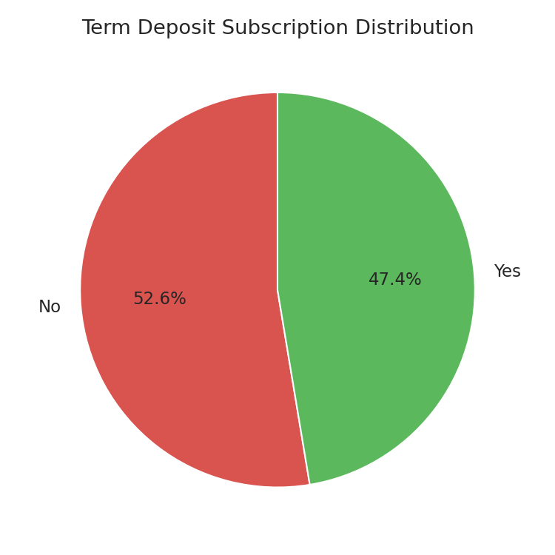
Dataset Overview
Metric | Value
Records | 11,162 customers
Columns | 17 (demographic, financial, campaign attributes)
Target variable | deposit (yes / no)
Missing data | 0 nulls (some 'unknown' category placeholders)
Class balance | 52.6% No / 47.4% Yes

Slide 4
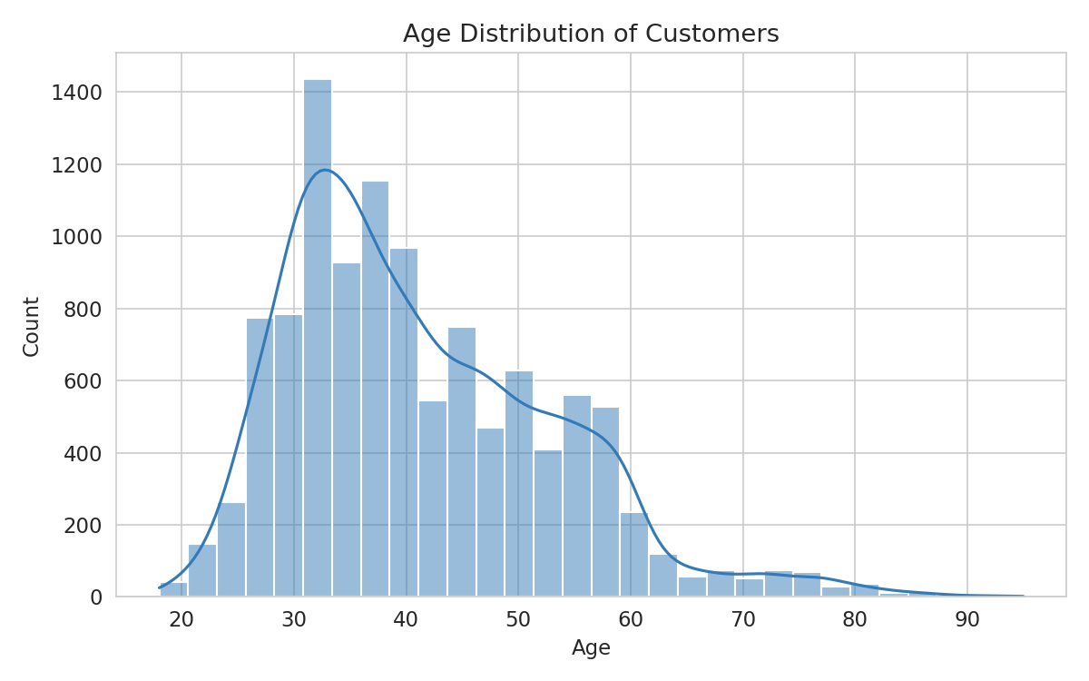
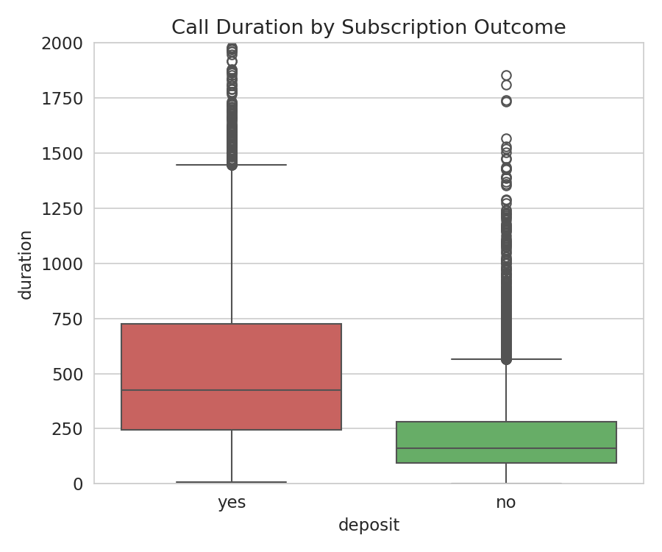
Customer Distributions
Age skews toward working-age adults; most balances are modest

Slide 5
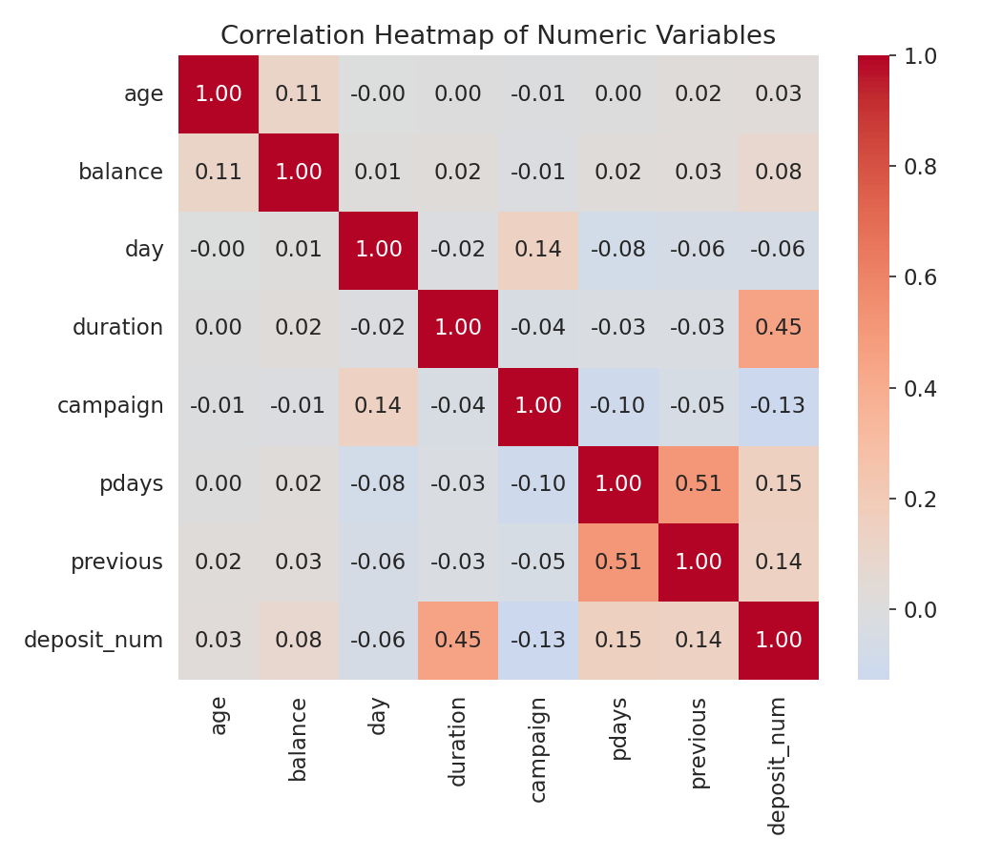
Key Numeric Drivers
Call duration has by far the strongest relationship with subscription (r = 0.45)

Slide 6
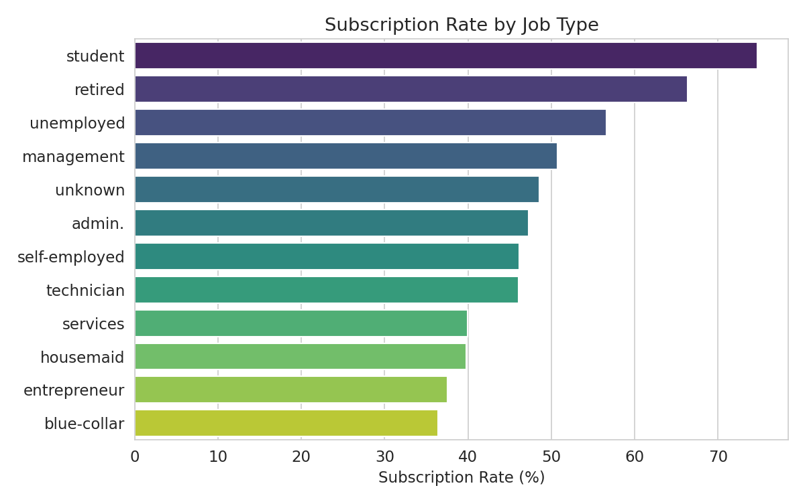
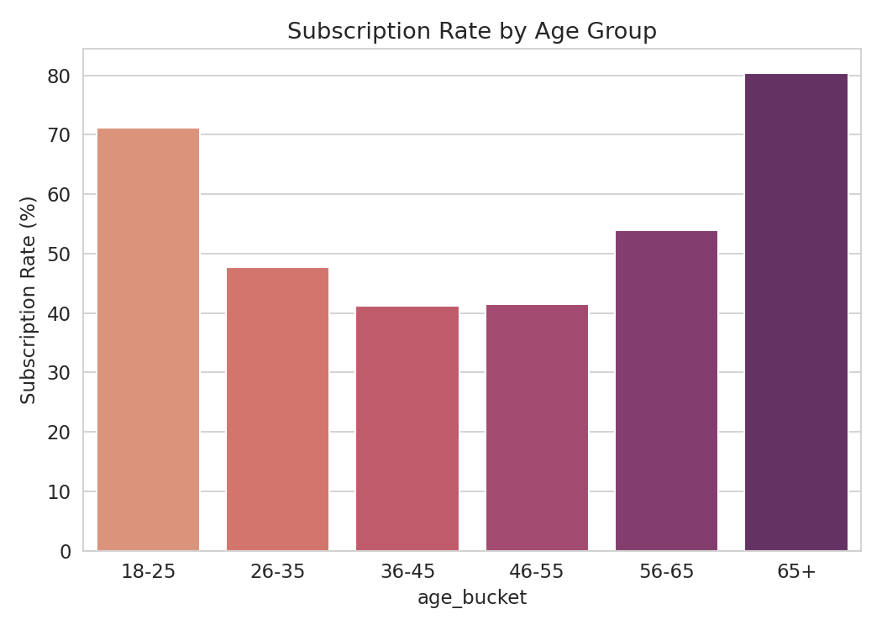
Who Subscribes? Job & Age
Students, retirees, and older/younger customers convert best

Slide 7
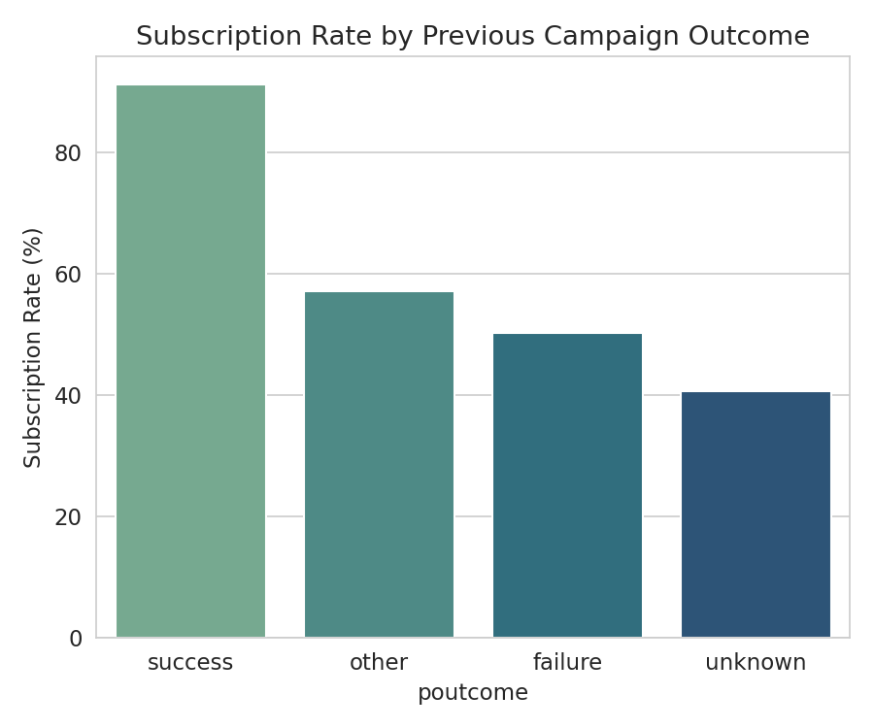
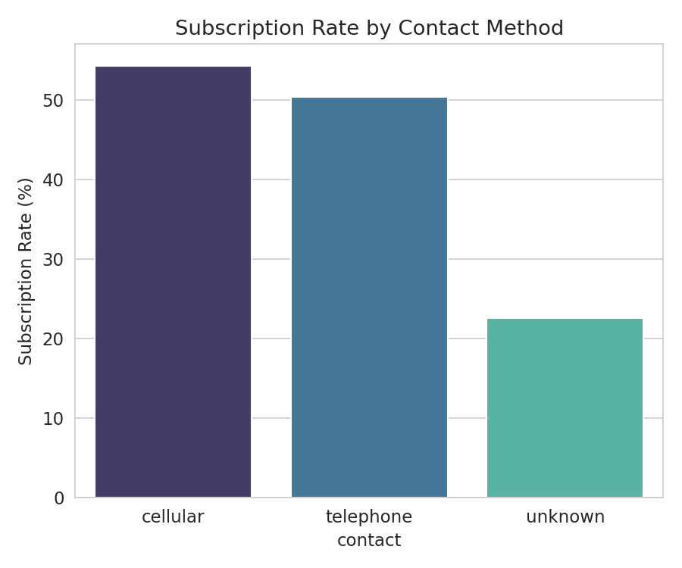
Campaign History & Contact Method
Warm leads and cellular contact convert far better

Slide 8
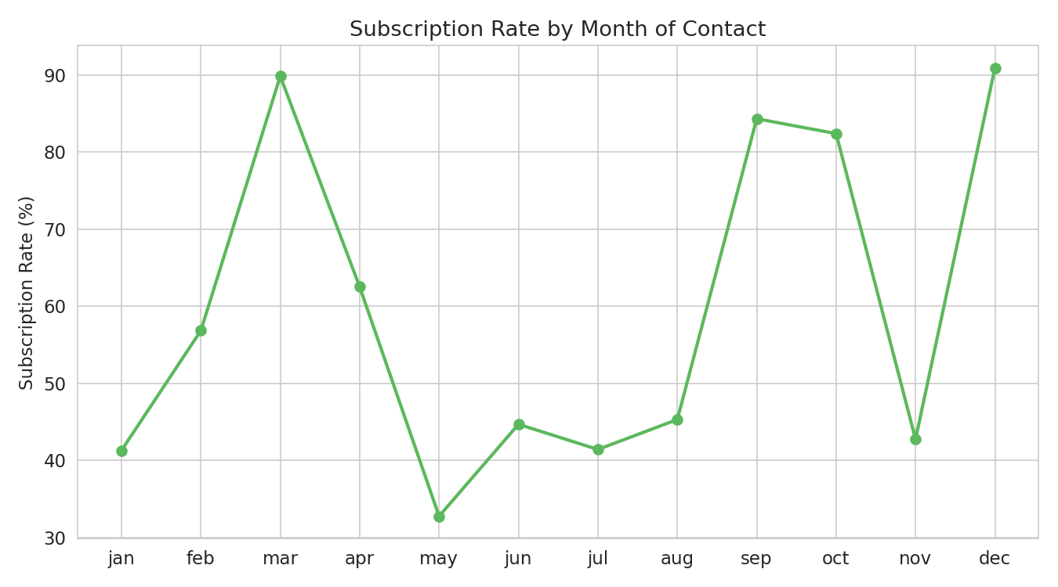
Seasonality of Conversion
May carries the highest call volume but the lowest conversion rate

Slide 9
Major Findings
Call duration is the strongest predictor of subscription (537s avg for 'yes' vs 223s for 'no')
Prior campaign success drives a 91.3% conversion rate vs 40.7% baseline for new contacts
Students (74.7%) and retirees (66.3%) convert far above average; blue-collar (36.4%) lags
Customers without housing/personal loans and with higher balances convert notably better
May is the highest-volume, lowest-converting month (32.8%) — a clear efficiency gap

Slide 10
Recommendations
1. Prioritize outreach to customers with a previous campaign success or positive outcome
2. Shift calling effort away from low-converting May toward Dec/Mar/Sep/Oct
3. Build targeted offers for students & retirees; redesign approach for blue-collar/entrepreneur segments
4. Train reps to extend engagement quality, not just call volume, since duration drives conversion
5. Favor cellular contact and prioritize debt-free, higher-balance customers

Slide 11
Conclusion
Term deposit subscription is highly predictable from call engagement, campaign history, life stage, and financial standing. Shifting from broad, volume-driven outreach to a targeted, data-driven strategy can meaningfully raise conversion while cutting wasted effort.
Thank You

